Slide 1
Презентация по английскому языку
Сочинение
«Биография знаменитого актера
Robert Downey»
Работа Маркалева Анатолия
Ученика 6 класса ГБОУ «Школа №106»
Учитель
Шайдурова В.Ф
Санкт-Петербург
2015

Slide 2
Robert Downey

Slide 3
Marvel is an American movie studio.
An Iron Man was produced there.

Slide 4
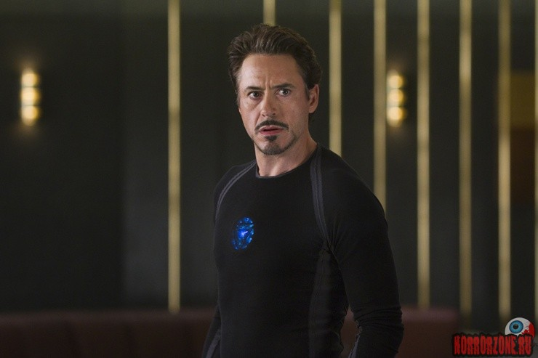
The main character is Tony Starker.
Robert Downey played the star role.

Slide 5
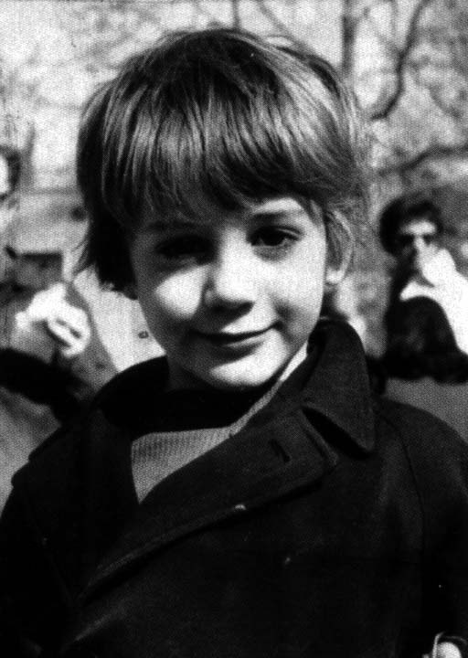
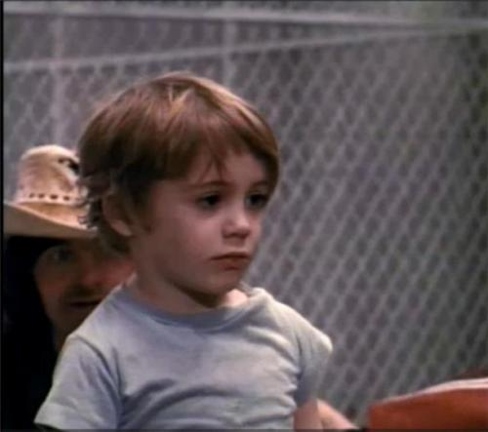
Robert Downey was born in 1965 in New York , the USA

Slide 6
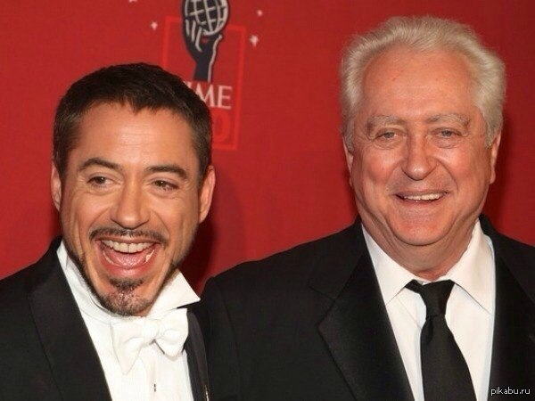
His father was a producer.
Robert started his career as an actor when he was a school boy.

Slide 7
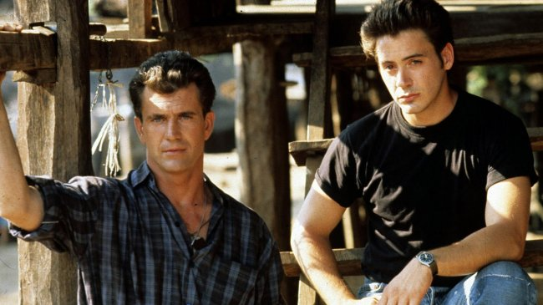
We know nothing about his school years , about his education.
But we know that after the movie «Air America»
he became famous in America.

Slide 8
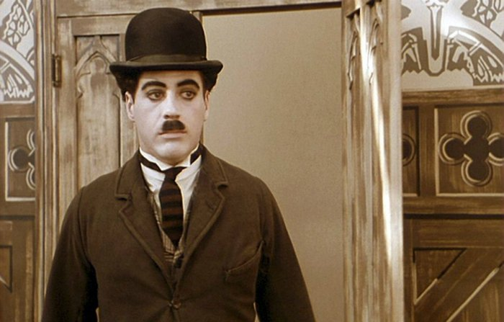
His role of Charlie Chaplin brought him the first prize of the American Academy Award «Oscar»

Slide 9
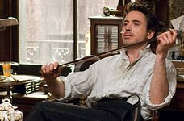
Over the next years Robert won same more Awards for such films as an Iron Man , Sherlock Holmes and others.

Slide 10
Nowdays Robert is famous not only as an actor but as a producer and a musician.

Slide 11
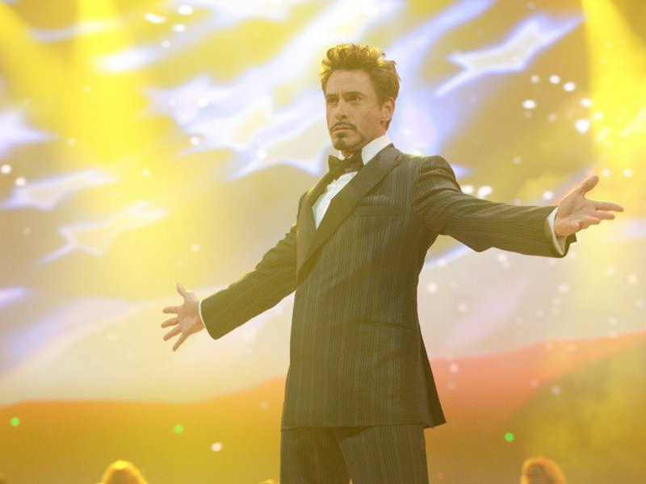
Thank you for your attention!

