Slide 1
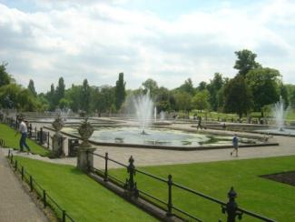
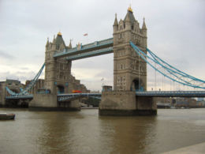
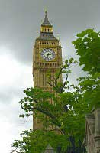
London is the mysterious capital of Foggy Albion

Slide 2
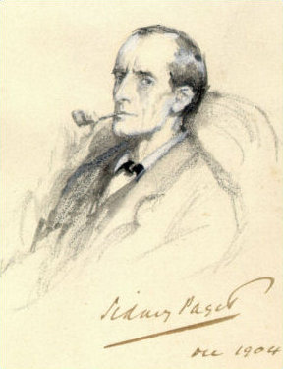
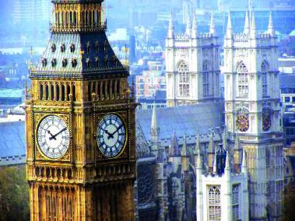
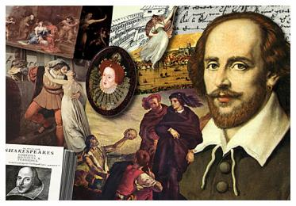
London is worth seeing because it’s the mysterious capital
of Foggy Albion,
the city of Shakespeare, ancient kings …
and Sherlock Holmes!
London is the capital of Great Britain and one of the largest industrial and cultural centers in Europe
We are glad to suggest you to visit this city. We’ll be responsible for accommodation, cultural program and your good mood in this wonderful city.

Slide 3
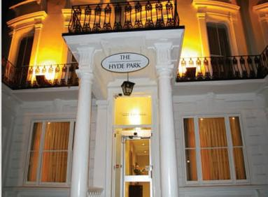
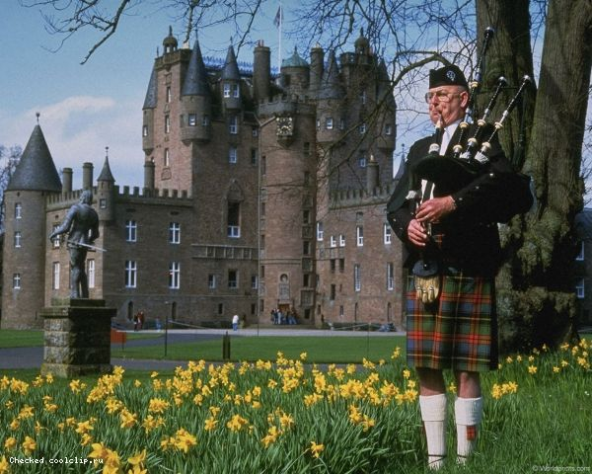
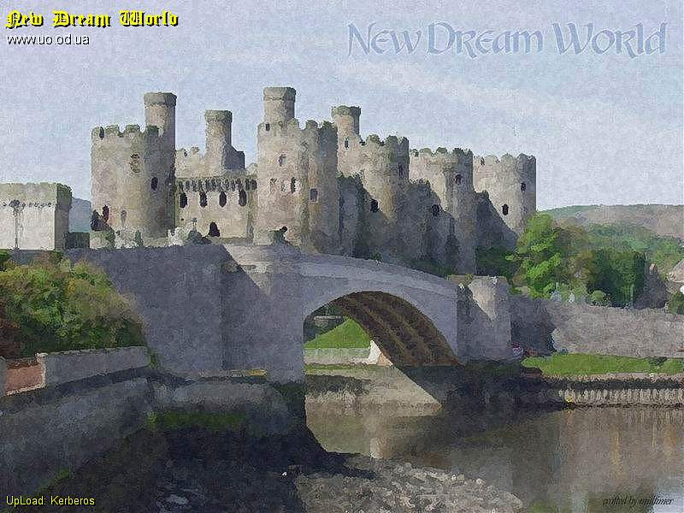
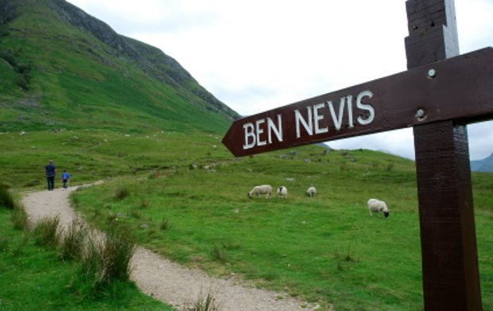
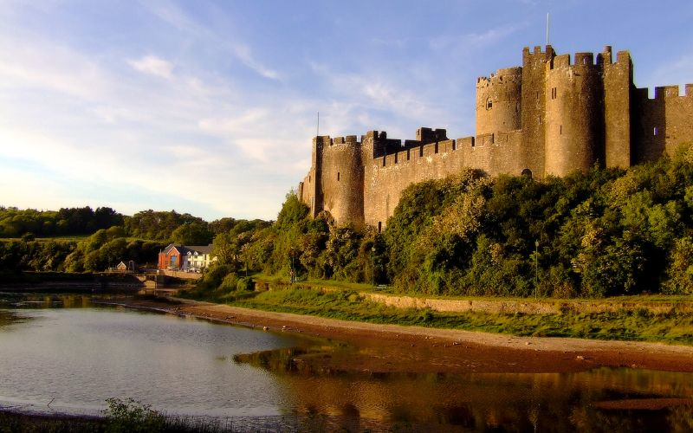
Plan of our tour about the country
Day 1
Day 7
Day 2
Day 6
Day 3
Day 5
Day 4

Slide 4
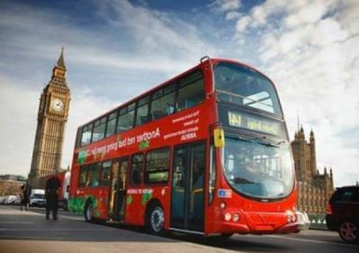
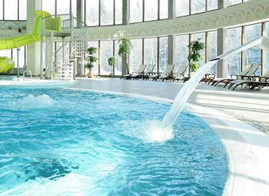
Day 1
On this day you’ll arrive in London.
We’ll meet you at the airport and drive to one of the beautiful hotel by comfortable double-decker bus. In the hotel you should register yourselves and get keys from your apartments.
After that you’ll have time for resting in your rooms and will swim in the swimming pool. Also in our hotel you will have dinner and supper every day.

Slide 5
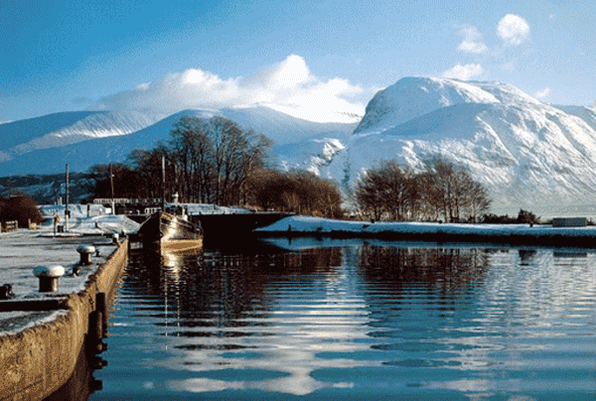
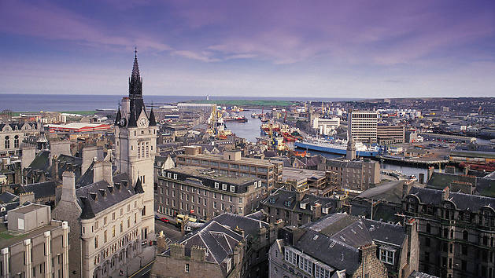
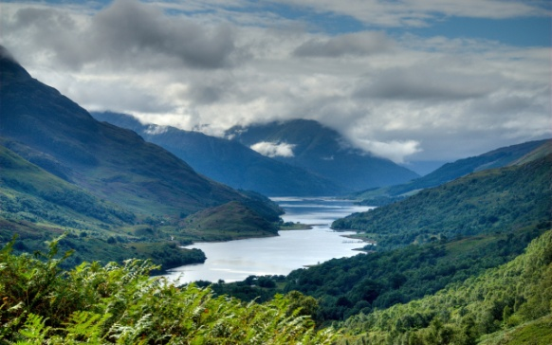
Day 2
On this day well visit the city of Aberdeen. It’s situated in the North-East of Scotland and it’s often called as a Silver Town for the special colour of the granite, which many buildings are built of. As well as Edinburgh, Aberdeen is famous for its festivals. The city is also famous for parks, botanical gardens and exhibits of flowers, all year round.

Slide 6
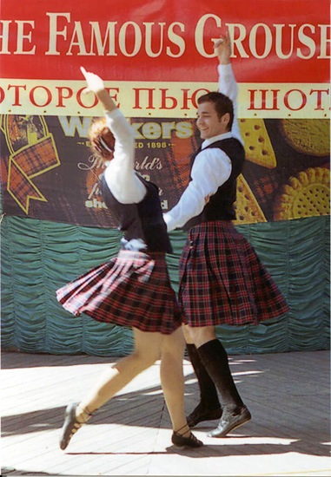
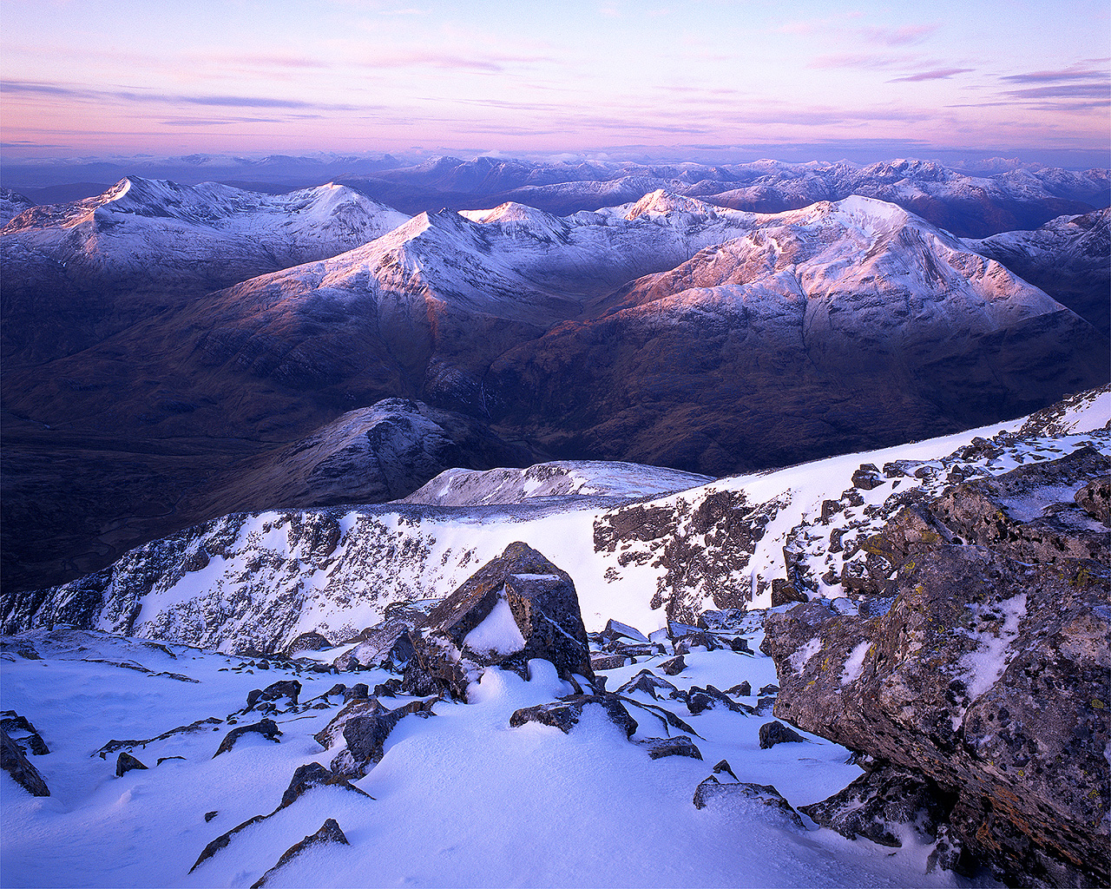
Day 3
On the third day there will be two trips. If you real music lover, you`ll get a good opportunity to visit a festival. There you`ll be able to listen to bagpipes. Also we’ll invite you to enjoy mountain climbing and go to Ben Nevis.

Slide 7
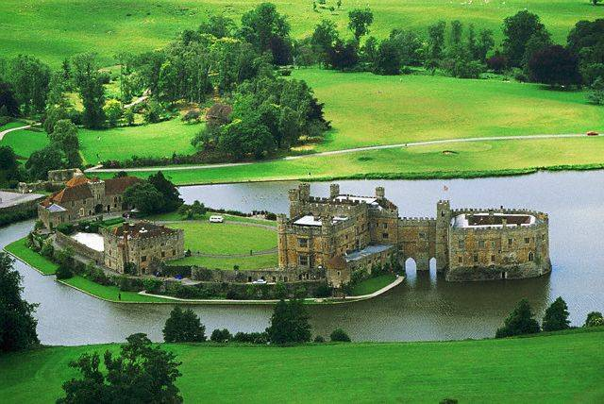
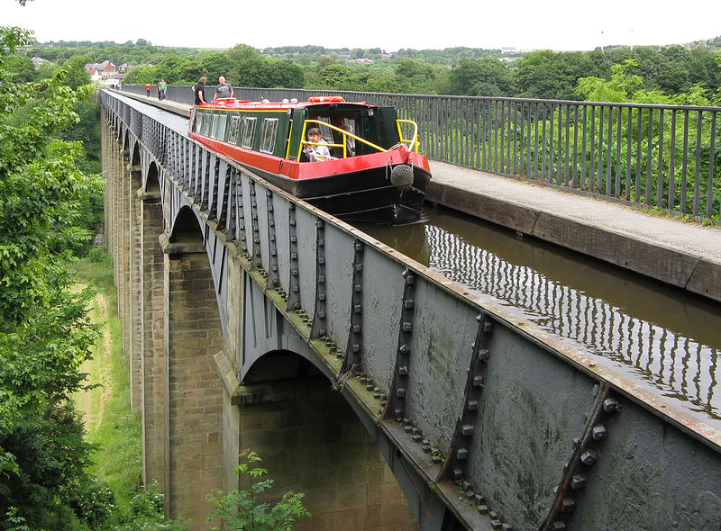
Day 4
On this day we suggest you a bus trip to Wales.
Wales is a land of beautiful landscapes and magnificent medieval castles. About one fifth of the territory of Wales is a National Park: rocky peaks and clean water of lakes, sandy coves and bays. It’ll be an unforgettable trip to the Snowdon mountain railway, and at the bottom of the mountains of Snowdonia you’ll find Bryn Bras Castle, you’ll see a park with waterfalls.

Slide 8
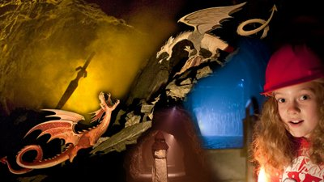
Day 5
An Underground Adventure...
Found deep beneath the mountains of Southern Snowdonia in the village of Corris, King Arthur's Labyrinth is one of the most mysterious visitor attractions in Mid Wales. Join your hooded Dark Age boatman and sail underground, through a waterfall and back across a thousand years. Submersed in the darkest of the Dark Ages, enjoy tales of King Arthur and other ancient Welsh legends as you explore the dramatic underground caverns and winding tunnels of the Labyrinth.

Slide 9
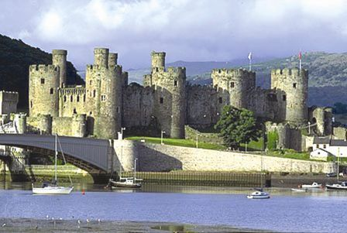
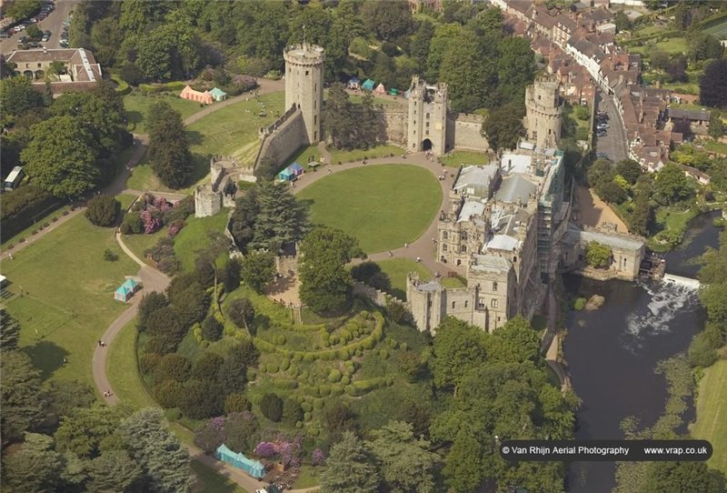
Day 6
On this day you’ll have a walking tour of the ancient city of Chester with its famous black-and-white houses and a two-level shopping gallery "Rose.“ On the way you’ll see the medieval town of Conwy and explore the city Karnarfon which was the ancient capital of Wales, on the coast of the Irish Sea, and you’ll visit the castle Karnarfon

Slide 10
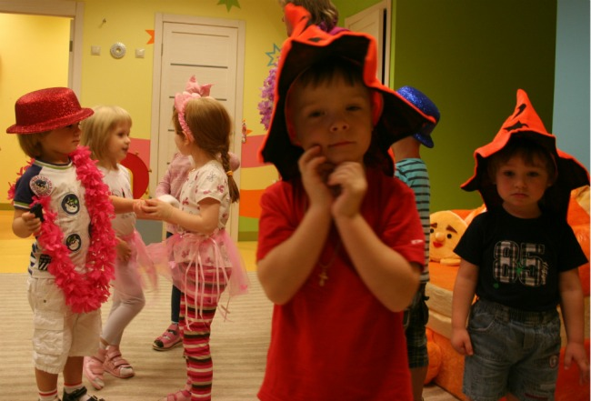
Day 7
You will have a costume party at our hotel. It’ll be the last day of our trip. In the morning you’ll go to airport. We hope that you will come to us again.
Thanks for your attention

