Slide 1
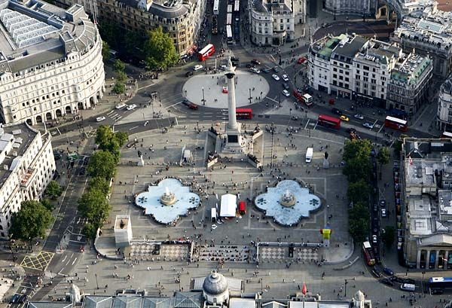
The history of Trafalgar Square

Slide 2
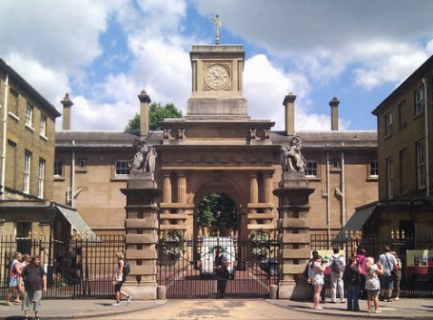
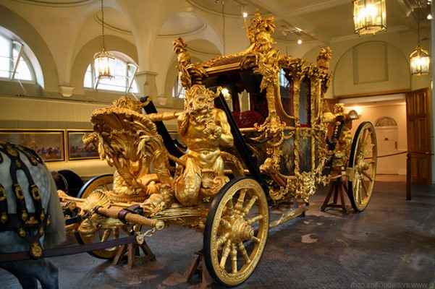
Before the XIX century, this is the place where the royal stables are situated. King Edward I decided to make out the stables and build on this site square, which originally bore his name.

Slide 3
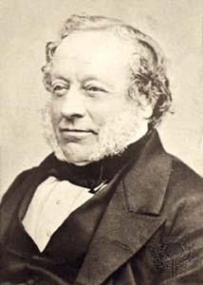
Architect Charles Berry drafted area, its theme was dedicated to the victory of the British fleet in 1805 in the battle off Cape Trafalgar.

Slide 4
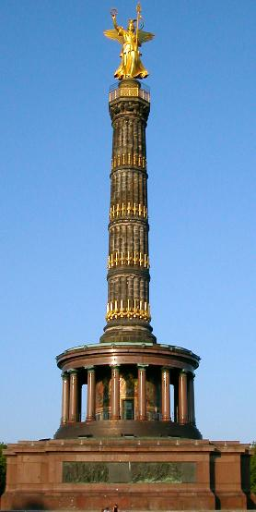
Nelson's Column
In the center of the square there is a monument to the legendary Admiral - a column topped by a five-meter figure of Horatio Nelson. Installed a 44-meter column was in 1842, it made the sculptor William Railton of dark gray granite.

Slide 5
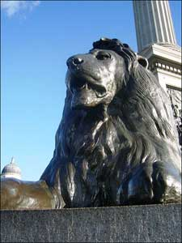
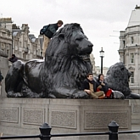
After a quarter century, the colony were four six-meter work Lendsira lion. The height of each lion reaches 6.5 meters.

Slide 6
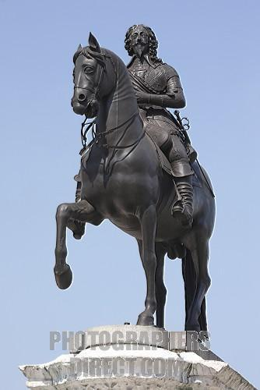
Monument to Charles I
In the southern part of the square is a bronze monument to Charles I, who was sitting on a horse. During the Civil War, after the execution of the king, Cromwell ordered the destruction of the statue, but the Cavaliers kept monument, and in 1675, during the reign of Charles II was restored to the original location. Every year on January 30 the day of execution of King lay a wreath at the monument.
It is the starting point of all London distances.

Slide 7
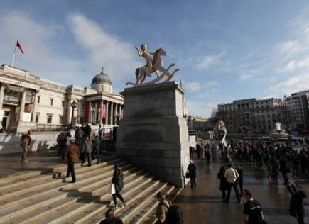
Sculpture Trafalgar Square
Today, the four corners of the square are four pedestal, which were installed in 1841. Three of them are top of the monument: King George IV, General Charles James Napier and General Henry Havelock. All of these sites are created and installed by popular demand of citizens.

