Slide 1
Great Britain
Исполнители: Волкова Алена,
Зырянова Анастасия,
Мустафина Лиана
Руководитель: Ваторопина Елена Васильевна.

Slide 2
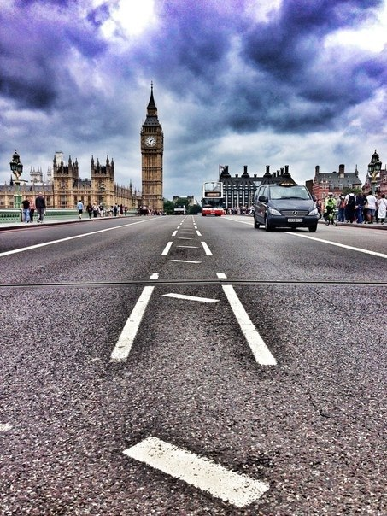
The name's origin: England called England after the Angles, the most numerous Germanic tribe who had settled in England in the V and VI centuries BC. e. Some believe that it was the descendants of the tribe of natives who lived on the peninsula of Angeln, land, which is now part of Denmark and northern Germany. Further interpretation of the name are uncertain and unreliable.
The first mention of England was in a work entitled "Germany", written in 98 BC. e. historian Tacitus.
According to the Oxford English Dictionary, the first known use of "England", relating to the southern part of the island of Great Britain, it was in the year 897.

Slide 3
The United Kingdom of Great Britain and Northern Ireland is one of the smallest countries in the world.
It occupies the British Isles, which lie off the north-west coast of Europe.
The total area of the country is 244 thousand sq km.

Slide 4
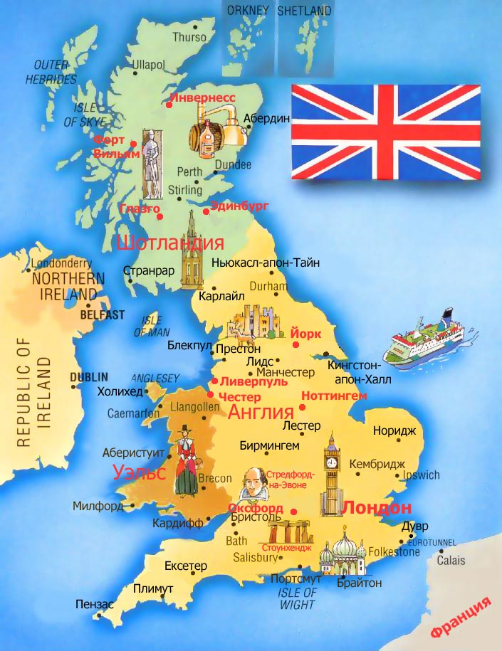
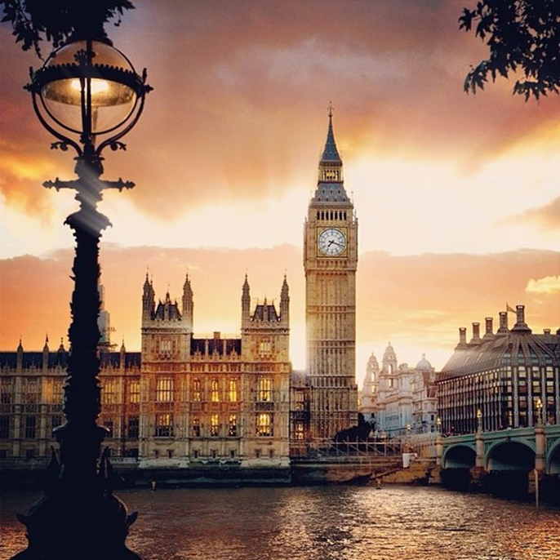

Slide 5
It borders Ireland and by sea, France, the Netherlands, Belgium and the Scandinavian countries.
The United Kingdom of Great Britain and Northern Ireland is made up of four historical parts.
They are: England, Scotland, Wales and Northen Ireland.

Slide 6
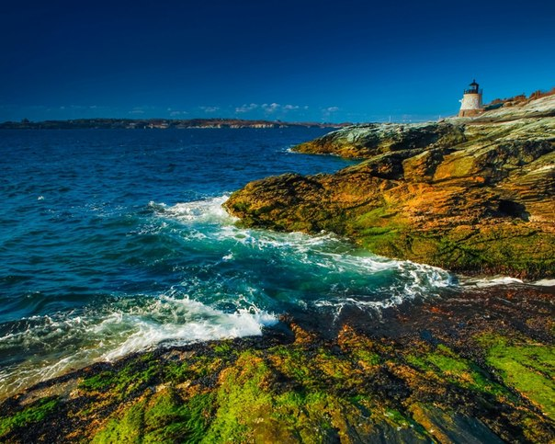
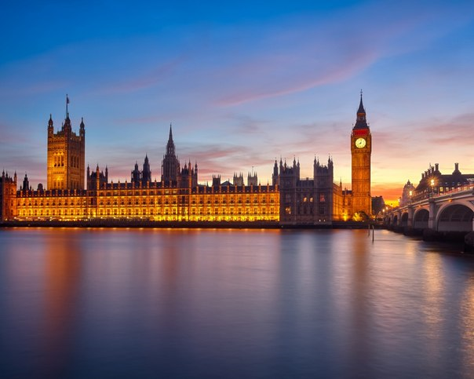
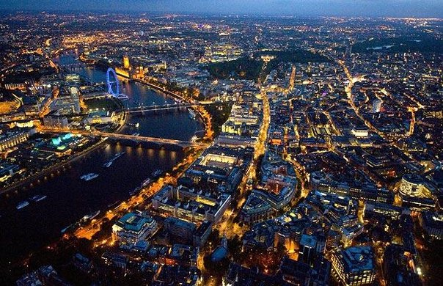
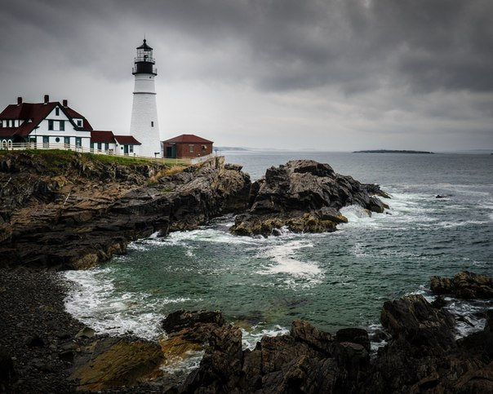
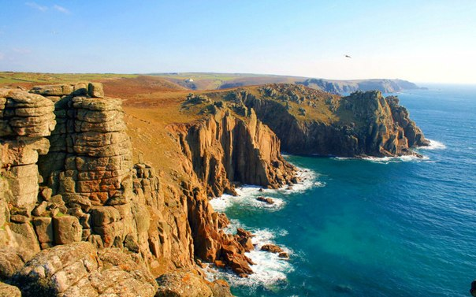
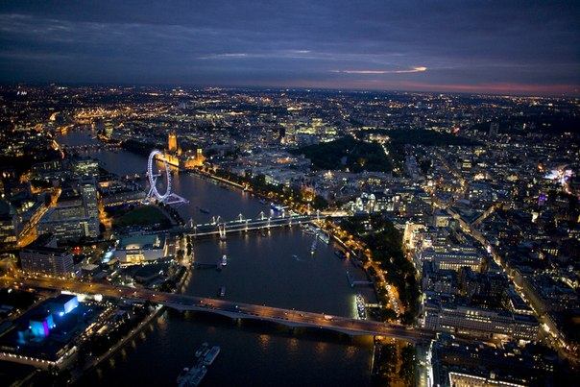

Slide 7
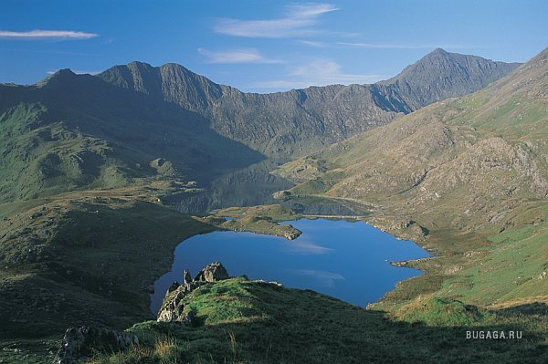
The capital of the country is London.
The largest cities are: Birmingham, Glasgow, Liverpool, Manchester, Leeds, Edinburgh, Sheeffield, Belfast, Newcasle, Cardiff.
If we look at the map, we can see the lowlands and the highlands. The lowlands are in the southern part of country. The higlads are in the northern part of the country.
The highest peak is Ben Nevis.It is located in the Scottish Highland.

Slide 8
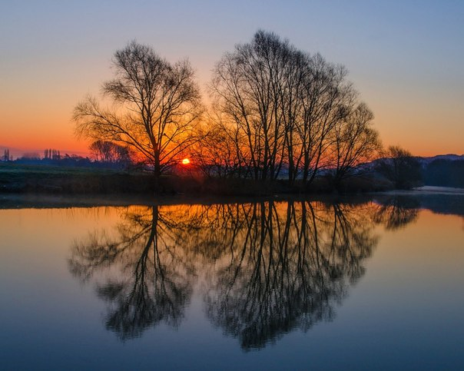
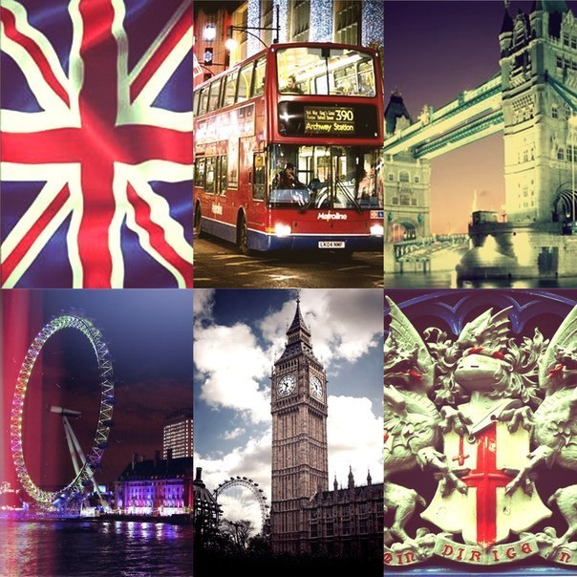
The highest peak is Ben Nevis.It is located in the Scottish Highland.
The longest river is the Severn.
The largest lake is lough Neagh.

Slide 9
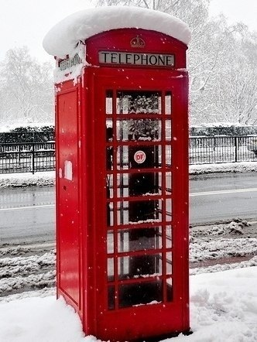
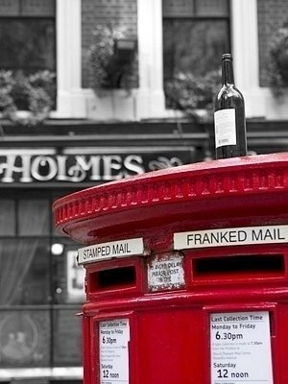
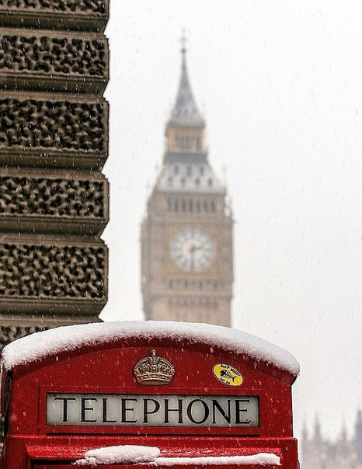
Photo

Slide 10
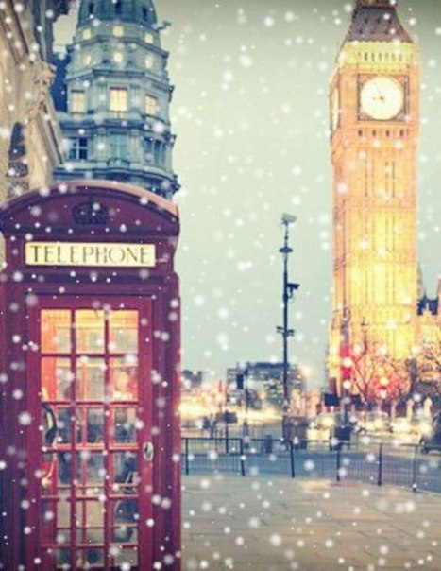
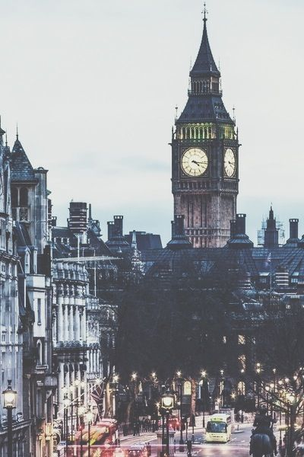
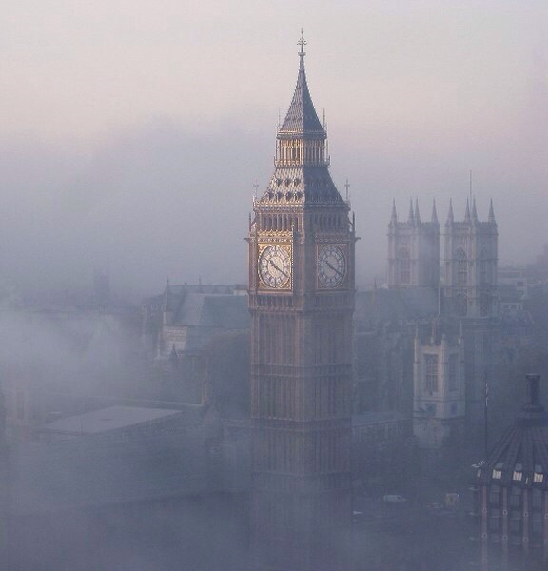
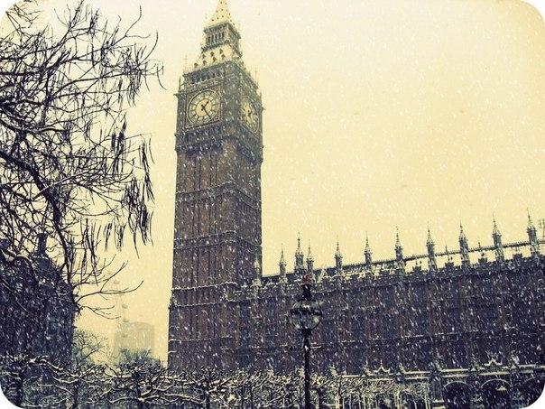
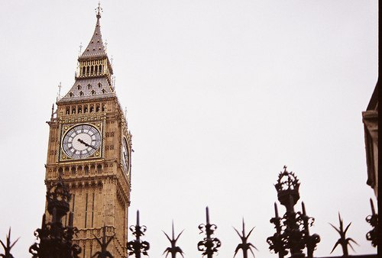
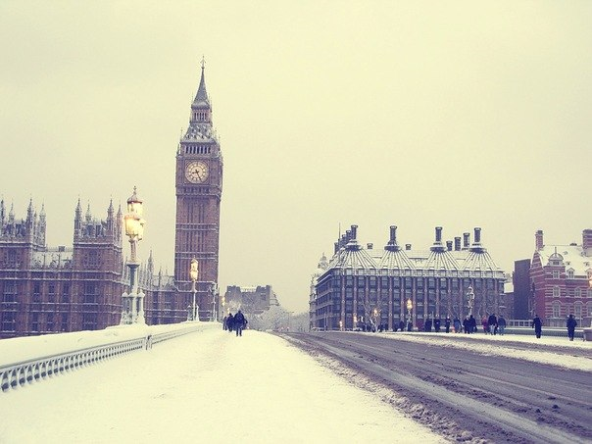

Slide 11
