Slide 1
«Оn the countries and continents»
Municipal autonomous educational institution - Secondary school number 67
Presentation on the topic:
England
Executor: Volkova Alena Yurievna
Head: Vatoropina Elena Vasilievna
1

Slide 2
Contents
Introduction…………………………………………………………………………………………………….2-3
Chapter 1. England………………………………………………………………………………………….4-6
Chapter 2. Photos……………………………………………………………………………………………7-10
Conclusion……………………………………………………………………………………………………….11
Application …………………………………………………………………………………………………….12
2

Slide 3
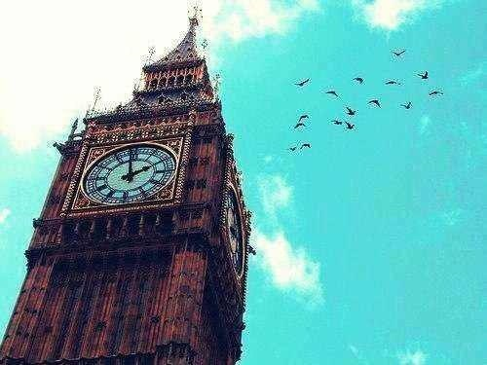
England
In the content
England - the largest historical and administrative part of the United Kingdom of Great Britain and Northern Ireland, a country in its structure, which occupies the south-eastern part of the larger island of Great Britain, known as the English. mainland. The population of England is 83% of the total UK population.
England became a union once warring in 927 counties and takes its name from the Angles, one of the Germanic tribes who settled there in the 5th and 6th centuries. The capital of England - London, the largest city in the United Kingdom and the European Union.
England - the place of origin of the English language and the Anglican Church, and English law forms the basis of the legal systems of many countries, in addition, London was the center of the British Empire, and the country - the birthplace of the Industrial Revolution. Britain was the first industrialized country in the world, but also a country with a parliamentary democracy, constitutional, governmental and legal innovations which were adopted by other nations and countries.
Kingdom of England, including the principality Wales, was a separate state until 1 May 1707, when merged with the Kingdom of Scotland in the United Kingdom.
Further
3

Slide 4
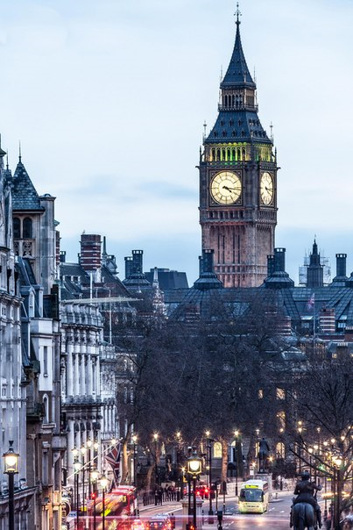
Chapter 1
In the content
The name's origin: England called England after the Angles, the most numerous Germanic tribe who had settled in England in the V and VI centuries BC. e. Some believe that it was the descendants of the tribe of natives who lived on the peninsula of Angeln, land, which is now part of Denmark and northern Germany. Further interpretation of the name are uncertain and unreliable.
The first mention of England was in a work entitled "Germany", written in 98 BC. e. historian Tacitus.
According to the Oxford English Dictionary, the first known use of "England", relating to the southern part of the island of Great Britain, it was in the year 897.
4
Founded | 928
The official language is | English
The capital of | London
The largest cities | London, Birmingham, Leeds, Sheffield, Liverpool, Manchester, Coventry, Leicester.
The dualistic monarchy form of | government (part of the UK, has its own higher authorities)
Queen Prime Minister | Elizabeth II David Cameron
State. religion | Anglicanism
Territory • Total | 133 396 km ²
Population • Evaluation (2011) • Density | 53 012,456 people 396 people. / Km ²
Demonym | Englishman Englishwoman, British
Currency | Pound Sterling
Calling code | +44
Further

Slide 5
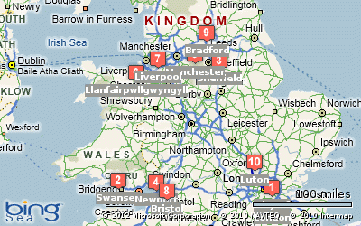
In the content
Route
11 дней по Великобритании (Суонси - Шеффилд - Ньюпорт - Манчестер - Лутон - Сити - Лланвайр Пуллгвингилл - Ливерпуль - Бристоль - Брэдфорд)
Further
5

Slide 6
In the content
Shopping in England
1. Oxford Street
Walk down Oxford Street is an early start (especially if on a calendar - Sunday, when the shops close at 17.00-18.00). On this street there are hundreds of shops - from reputable department stores such as Selfridges and John Lewis stores to smaller ones such as H & M, Topshop, Next, Ecco, American Apparel, Esprit, Monsoon.
2. Selfridges
First on our list - department store Selfridges, which excites their bright shop windows and new collections of thousands of customers every day. In fact, it is a shopping district under one roof, named 2010 best department store in the world.
3. Debenhams department store
Next in line - Debenhams, is not only one of the oldest British department stores, but also one of the most democratic. At the very least, on Oxford Street. Debenhams owners take pride in things that fashion designers they can cost as little as a few tens of pounds.
4. Foyles Bookstore
Walk down Oxford Street underground station Tottenham Court Road and turn right down the street Charing Cross Road. After a couple of minutes you will see a bookstore Foyles, once caught, even in the Guinness Book of Records because of its extraordinary size.
5. Hamleys
Regent Street, located Hamleys - one of the giant toy stores in the world. It has almost everything - from dolls and soft toys and kittens to video games and radio-controlled cars. Both adults and children trekking here is highly recommended!
Further
6

Slide 7
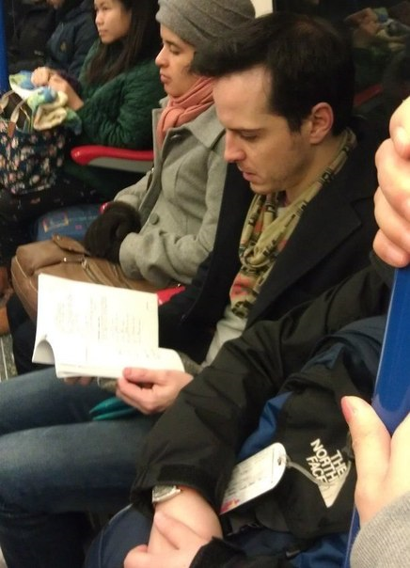
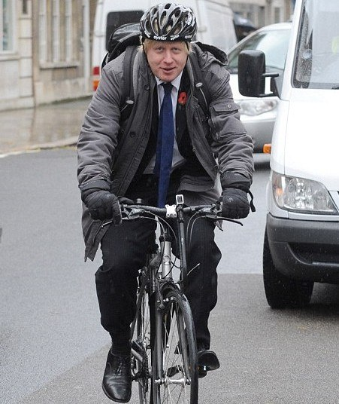
Chapter 2. Photo
London - the city where the mayor goes to work on the bike, and the actors move on the subway:
Andrew Scott Boris Johnson Bradley James
7
In the content
Further

Slide 8
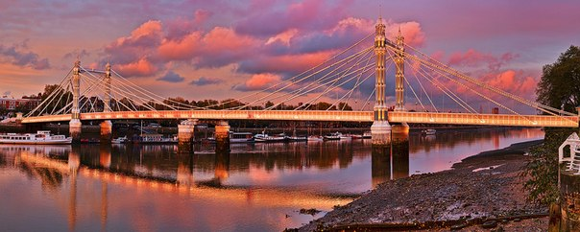
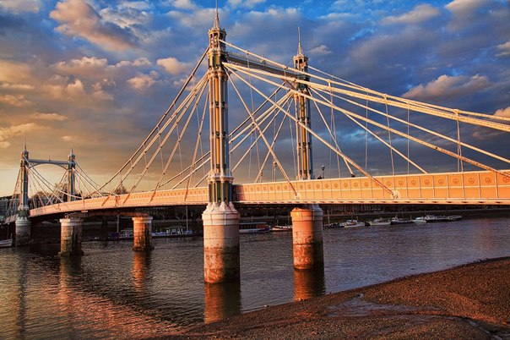
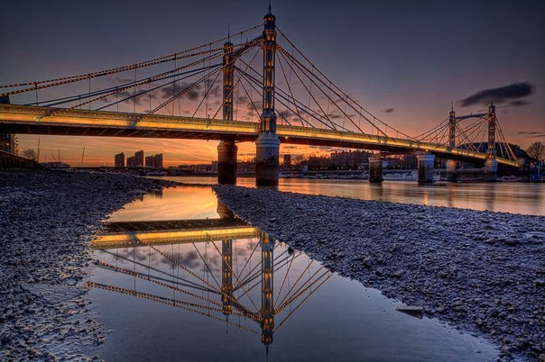
Many Londoners called the most romantic Albert Bridge in London. This view is hard to disagree!
Photography by John Baker
8
In the content
Further

Slide 9
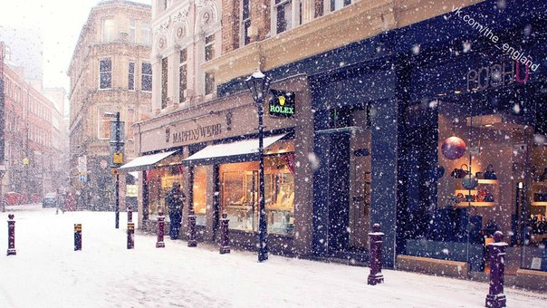
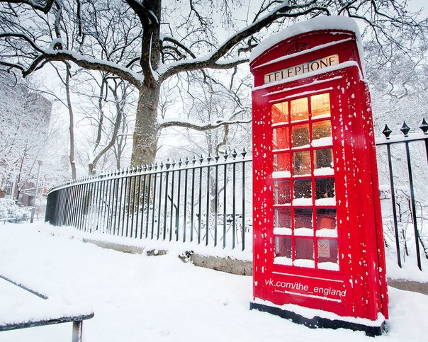
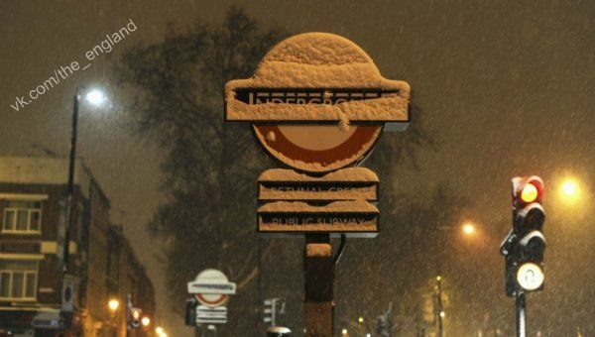
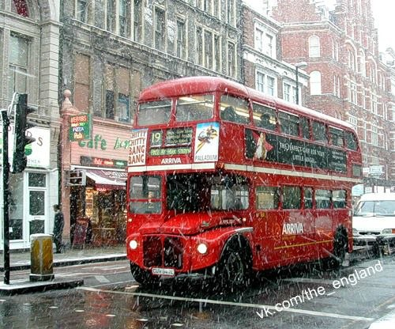
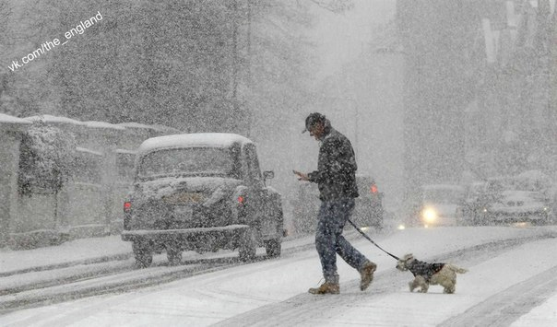
London in the arms of snow:
9
In the content
Further

Slide 10
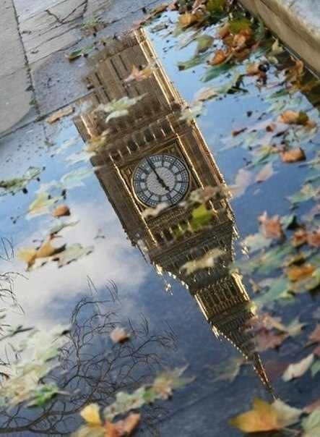
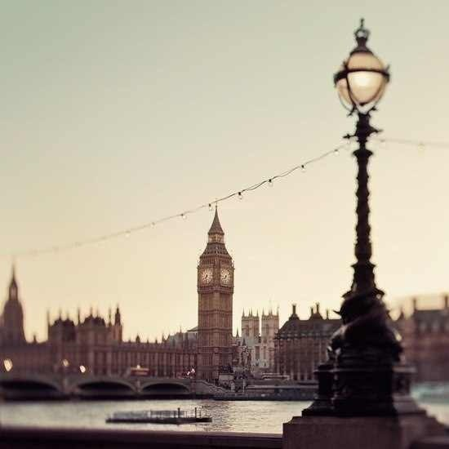
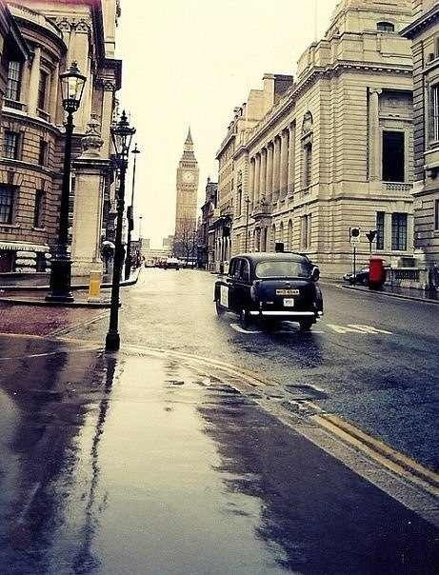
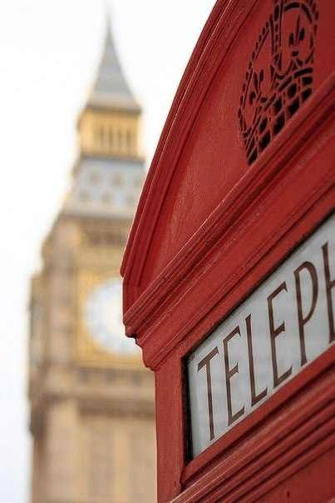
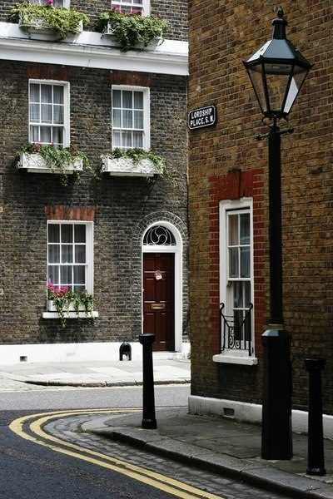
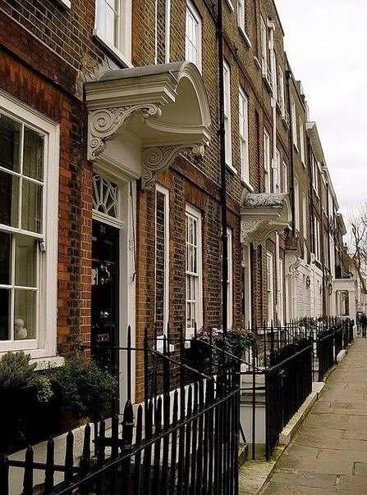
London is the best city in the world !
10
In the content
Further

Slide 11
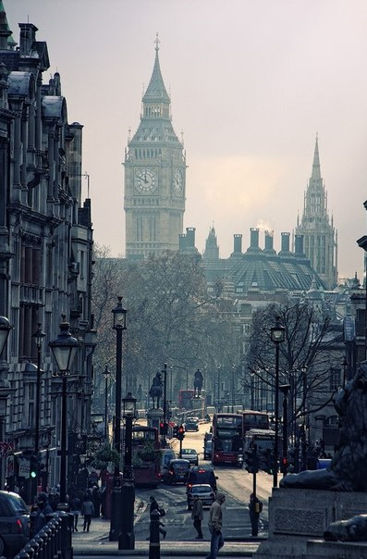
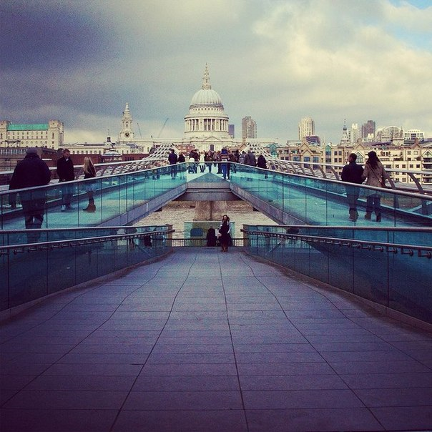
In the content
London is waiting for you!
11
Further

Slide 12
Application
http://vk.com/the_england - Группа об Англии.
http://vk.com/london_official - Группа о Лондоне.
12
In the content

