Slide 1
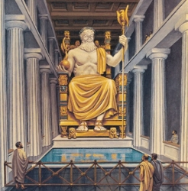
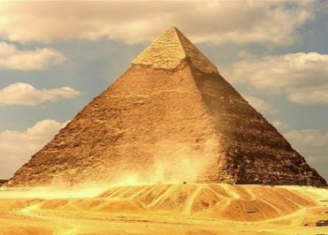
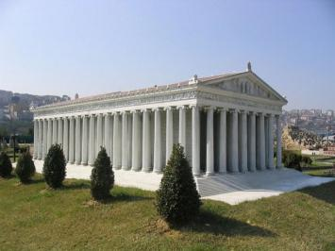
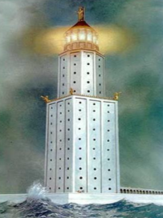
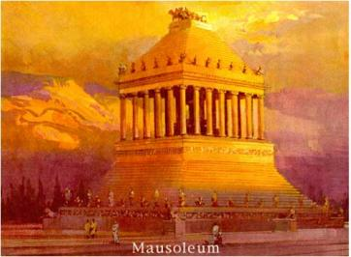
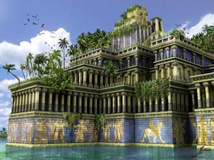
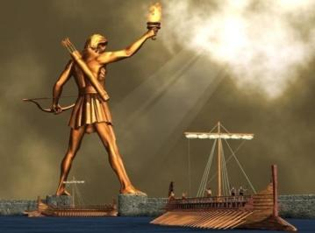
7wonders of the World
Done by
Kalinina Helen
Supervisor:
Parasotskaya O.N.

Slide 2
Pyramid of Cheops
The pyramid is called as “Akhet - Khufu“ - " Horizon of Khufu“ . It was made of limestone blocks, basalt and granite. It was built on a natural hill .
Originally the pyramid was faced harder than the basic blocks of white limestone. The top of the pyramid is crowned with gilded stone – pyramidion. In 1168 BC Arabs burned Cairo. Residents of Cairo trim removed from the pyramid to build new homes.
Pyramid of Cheops (Khufu) is the largest of the pyramids of Egypt. It’s the only one of the "Seven Wonders of the World” which has survived to the present day. Pyramid of Cheops is the highest and most extensive of all the Egyptian pyramids. Its height is about 138,75 m.
HOME

Slide 3
Hanging Gardens of Babylon
In architectural terms, the Hanging Gardens were a pyramid, consisting of four tiers - platforms supported by columns of up to 25 m. Lower tier had the shape of an irregular quadrangle, the largest side of which was 42 m, the lowest - 34 m. The surface of each platform first coated with a layer of reeds mixed with asphalt to prevent seepage of irrigation water, then two layers of brick, bonded plaster solution, on top of everything stacked lead plates . They lay a thick carpet of fertile land where the seeds were planted various herbs, flowers , shrubs, trees. Pyramid is reminded forever as blossoming green hill.
Hanging Gardens of Babylon is one of the Seven Wonders of the World. Hanging Gardens Amitis is a more correct name for this construction because it was the name of the wife of the Babylonian King Nebuchadnezzar II. He made the gardens for her. They were located in the ancient state of Babylon, near the modern town of Hilla.
HOME

Slide 4
Mausoleum at Galikanarse
Height: 45 m
Opening: 353 AD
Purpose: Mausoleum
Mausoleum at Halicarnassus is a tombstone of Carian ruler Mausolus, erected in the middle of IV century BC is the fifth in the list of the Seven Wonders of the Ancient World.
The construction of the mausoleum began before the death of Mausolus in 359 BC and, according to ancient authors, it was the idea of his wife Artemisia. She invited the Greek architects Pytheas and the most famous sculptors of that time Leochares, Scopas and Timothy Briaksida to design the Mausoleum,.
HOME

Slide 5
Temple of Artemis at Ephesus
The temple was adorned with statues of Praxiteles and Scopas’ reliefs inside. The Temple of Artemis at Ephesus is one of the Seven Wonders of the Ancient World, was in the Greek city of Ephesus on the coast of Asia Minor (now the town of Selcuk in the south of the province of Izmir, Turkey). The first major temple was built in the middle of the VI century BC. Gyrostat burned it in 356 BC. It was restored soon. In the III century, in the reconstructed shape, it was plundered by the Goths.
HOME

Slide 6
The construction began in 292 BC. It was Hares who worked on the creation of nearly 36-foot bronze giant statue. When the work was finished, Rhodians saw a tall and slender youth-god with a radiant crown on his head. He was standing on a white marble pedestal, slightly leaning back and staring intensely into the distance. The Statue of the god stood right at the entrance to the harbor of Rhodes and was visible from the nearby islands.
The statue stood for 56 years until Rhodes was hit by the 226 BC Rhodes earthquake. The remains lay on the ground for over 800 years, and even broken, they were so impressive that many traveled to see them
Colossus of Rhodes
HOME

Slide 7
Statue of Zeus at Olympia
The Statue of Zeus at Olympia was a giant seated figure, about 13 m (43 ft) tall. It was made by the Greek sculptor Phidias in 435 BC. The statue was crowned with a sculpted wreath of olive sprays. It had gold sandals, and a golden robe carved with animals and lilies. In its right hand was a small chryselephantine statue of crowned Nike, goddess of victory. Its left hand held a sceptre inlaid with many metals, supporting an eagle. The throne was decorated in gold, precious stones, ebony, and ivory.
HOME

Slide 8
It was named after the island. The total height of the lighthouse is about 120-140 meters. Its light was visible at a distance of 60 km. The lower part is a four-sided prism of 60 meters high with a square base, the side length is 30 m. Its flat roof was decorated with huge statues at the corners of Triton, was the basis of the average. It was a 40-foot octagonal prism tower, lined with white marble. The upper part of the lighthouse was built in the form of a cylindrical colonnades - 8 columns bore dome, topped by 8-foot bronze figure of the ruler of the seas Poseidon .
To keep the flame, required a large amount of fuel. Wood brought a spiral ramp on carts pulled by mules. Flame stood bronze plates to direct the light at sea.
Farossiysky lighthouse
HOME

Slide 9
Thanks for attention!

