Slide 1
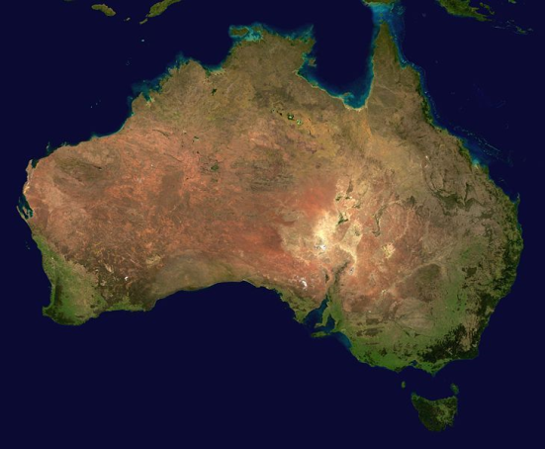
History of Australia

Slide 2
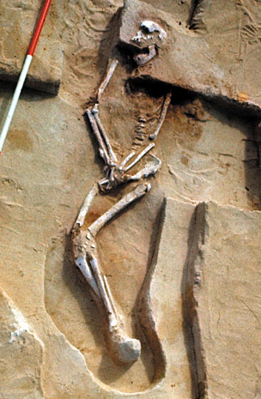
The consensus among scholars for the arrival of humans of Australia is placed at 40,000 to 50,000 years ago, but possibly as early as 70,000 years ago. The earliest human remains found to date are that of Mungo Man which have been dated at about 40,000 years old.

Slide 3
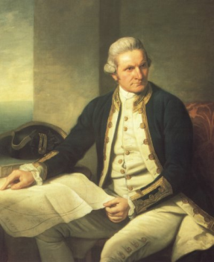
Captain James Cook, R.N. - 1778
Captain James Cook discovered Australia in 1770. He landed south of present day Sydney in New South Wales.

Slide 4
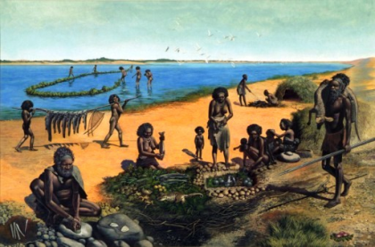
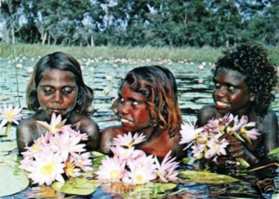
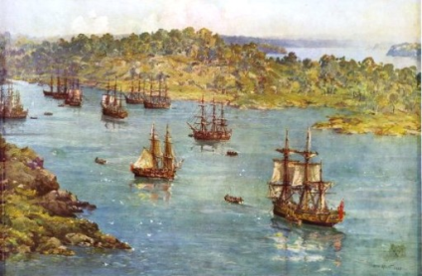
First settlers were greeted by the Aborigines.

Slide 5
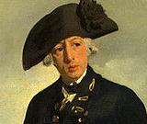
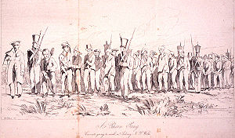
The British Crown Colony of New South Wales started with the establishment of a settlement at Sydney Cove by Captain Arthur Phillip on 26 January 1788. This date later became Australia's national day, Australia Day.
England's solution to crowded prisons was to send prisoners to the far colonies

Slide 6
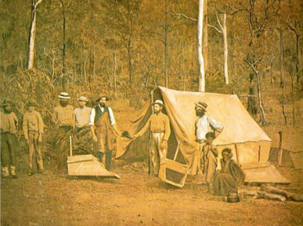
In 1851 gold was discovered about 300 km west of Sydney.
People rushed to the gold field to find their fortunes.

Slide 7
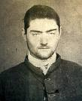
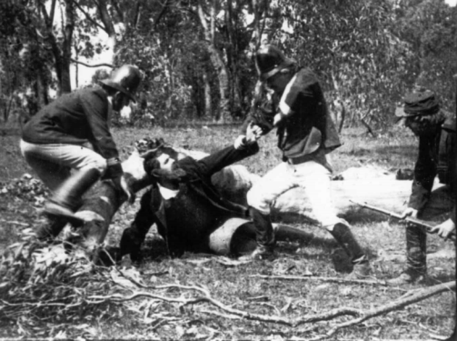
Ned Kelly was a famous bushranger. He was a very clever outlaw.

Slide 8
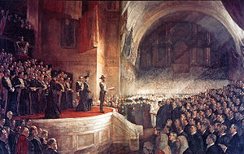
In 1901 Australia became a nation within the British Empire under Queen Victoria's rule. It was called the Commonwealth of Australia

Slide 9
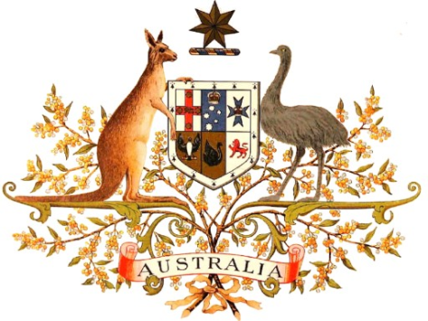
Australia's independence and sovereign nation status was officially recognized by all world nations when the Charter and Articles of the League of Nations legally became International Law in January 1920. British rule ceased at that point. No ruling British Monarch has held any valid legal power of authority since. Australia also became a foundation member state of the United Nations in 1945.

Slide 10
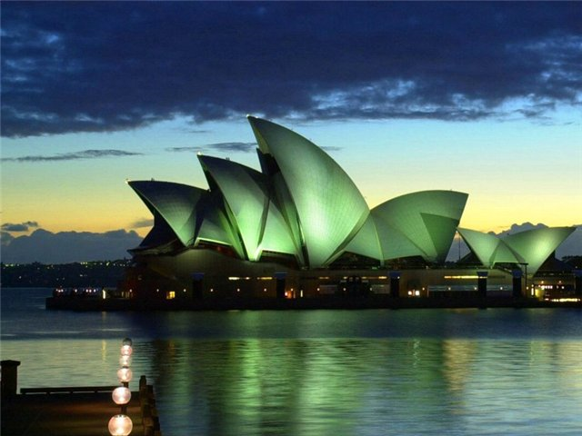
The national anthem

Slide 11
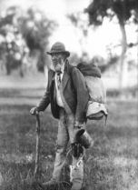
Народный гимн Австралии
Когда-то в Австралии было много бродяг. Они бродили по всей стране, находя то там, то тут временный приют, немного работы и пропитание. Они подрабатывали горняками, стригалями, пастухами. В свои скитания они обычно брали только самое необходимое – чайник, рубаха, бельишко, одеяло. Узелок, завернутый в это самое одеяло, назывался свэг. А бродяга с узелком – свэгменом. Но у узелка было еще одно название, скорее даже, прозвище - Матильда!
…Вы те, кто бродит по дорогам, покрытым пылью, Таща свой свэг, свой дырявый свэг на край земли, Там высоко над вами сияет Южный Крест. Кто со мной? - Вальсирующая Матильда, моя дорогая!..
Покачивающийся за спиной на длинной палке узелок – все время сопровождает путника, и все время пляшет, вальсирует у него за плечами. Отсюда и название.

