Slide 1
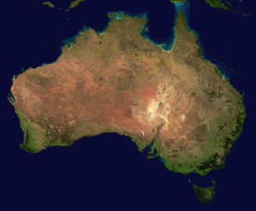
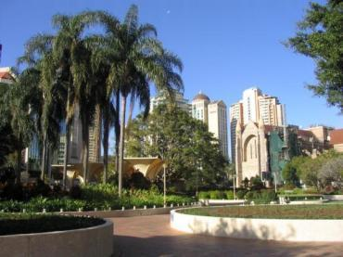
Capital Cities of Australia

Slide 2
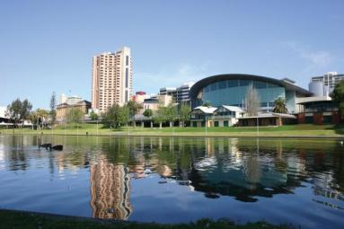
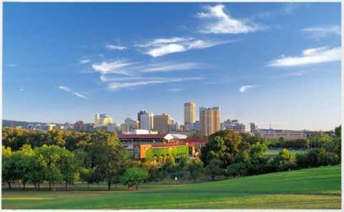
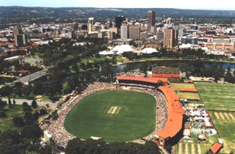
Adelaide
Adelaide (pronounced /ædəleɪd/) is the capital and most populous city of the Australian state of South Australia, and is the fifth-largest city in Australia, with a population of more than 1.1 million.

Slide 3
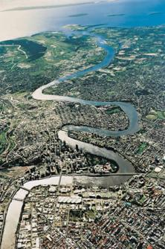
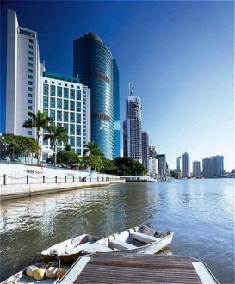
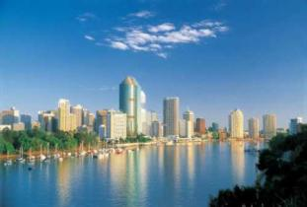
Brisbane
Brisbane (pronounced /brɪzbən/ is the state capital of the Australian state of Queensland and is the largest city in that state. With an estimated population of approximately 2 million, it is also the third most populous city in Australia.

Slide 4
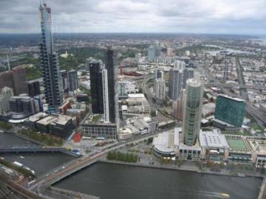
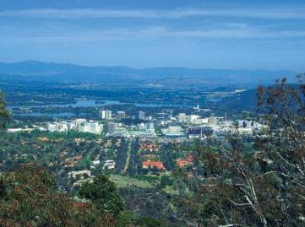
Canberra
Canberra (pronounced /kænb(ə)rə, kænbɛrə/) is the capital city of Australia. With a population of over 345,000, it is Australia's largest inland city and the eighth largest Australian city overall. The city is located at the northern end of the Australian Capital Territory, 280 km (170 mi) south-west of Sydney, and 660 km (410 mi) north-east of Melbourne.

Slide 5
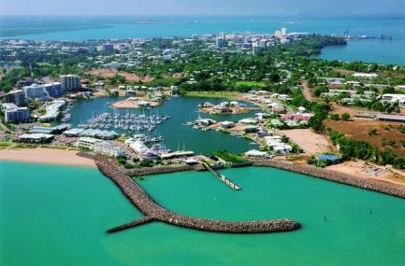
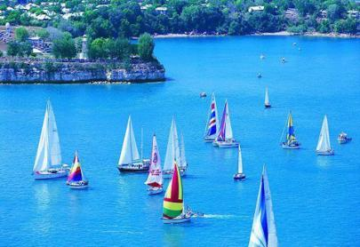
Darwin
It is the capital of NORTHERN TERRITORY. and the most populous city of Australia´s NorthernTerriory. It has a population of 109,478 (est. June 2004) and is located on Australia's far northern coastline.

Slide 6
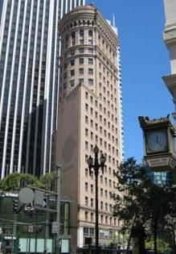
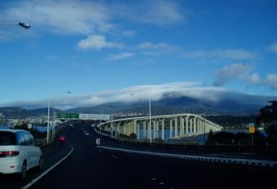
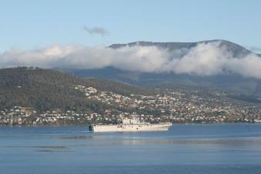
Hobart
Hobart (pronounced /hoʊbɑr/) is the state capital and most populous city of the Australian island state of Tasmania. Founded in 1803 as a penal colony, Hobart is Australia's second oldest capital city after Sydney. The city is the financial and administrative heart of Tasmania, and also serves as the home port for both Australian and French Antarctic operations.

Slide 7
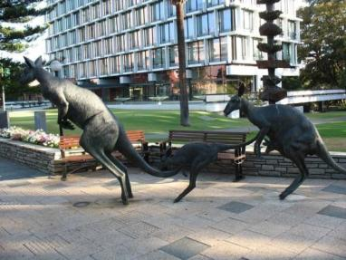
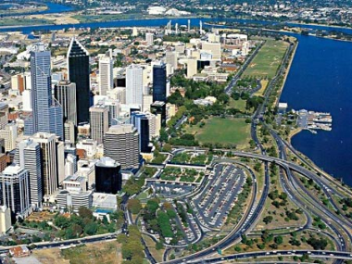
Perth
Perth (pronounced /pɜθ/) is the capital and largest city of the Australian state of Western Australia. With a population of 1,650,000 (2009), Perth ranks fourth amongst the nation's cities, with a growth rate consistently above the national average

Slide 8
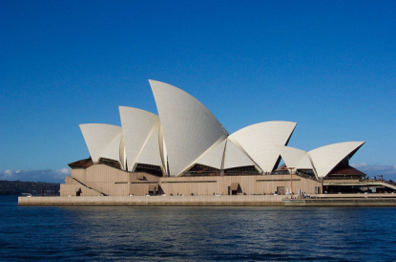
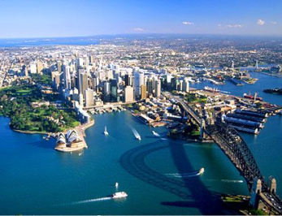
Sydney
Sydney (pronounced /sɪdni/) is the largest city in Australia, and the state capital of New South Wales. Sydney has a metropolitan area population of approximately 4.34 million and an area of approximately 12,000 square kilometres. Its inhabitants are called Sydneysiders, and Sydney is often called "the Harbour City". It is one of the most multicultural cities in the world, reflecting its role as a major destination for immigrants to Australia

Slide 9
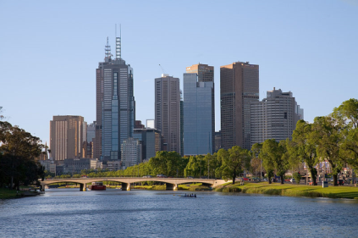
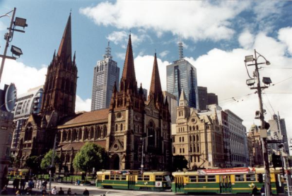
Melbourne
Melbourne (pronounced /mɛlbən/, locally is the capital and most populous city in the state of Victoria, and is the second most populous city in Australia. The Melbourne city centre (also known as the "Central Business District", or "CBD") is the anchor of the greater geographical area and the Census statistical division known as the "Greater Melbourne metropolitan area" - which "Melbourne" is the common name. As of late 2009, it had an approximate population of 4 million. A resident of Melbourne is known as a "Melburnian".

Slide 10
Locate the citieson the map
Darwin
Brisbane
Adelaide
Sidney
Perth
Melbourne
Canberra
Hobart

