Slide 1
Russia and Scotland:
Age — Old Links
under the Saltire...

Slide 2
Saint Andrew cross
This is the flag of Scotland
The Andreyevsky flag is the flag of Russia Navy

Slide 3
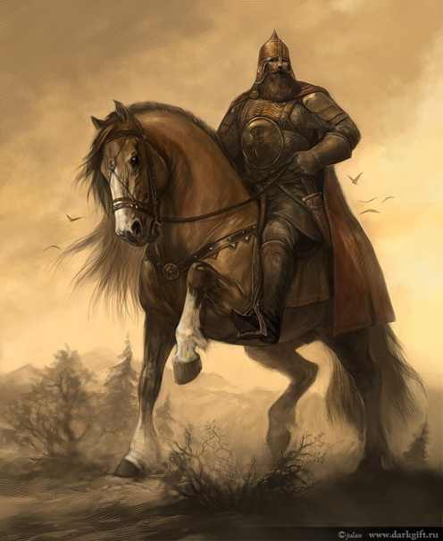
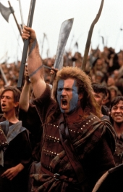
National character
Brave
Independent
Hospitable

Slide 4
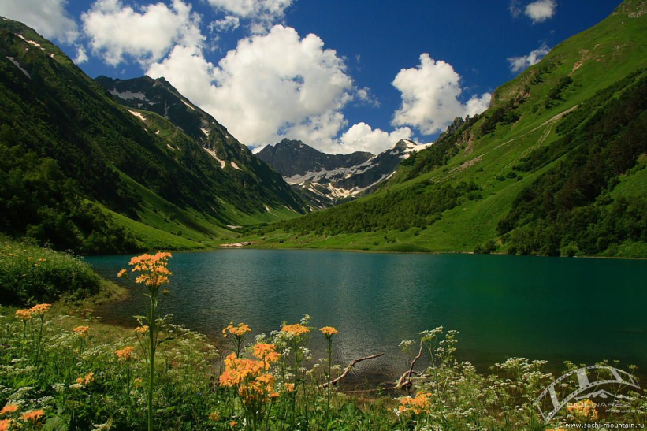
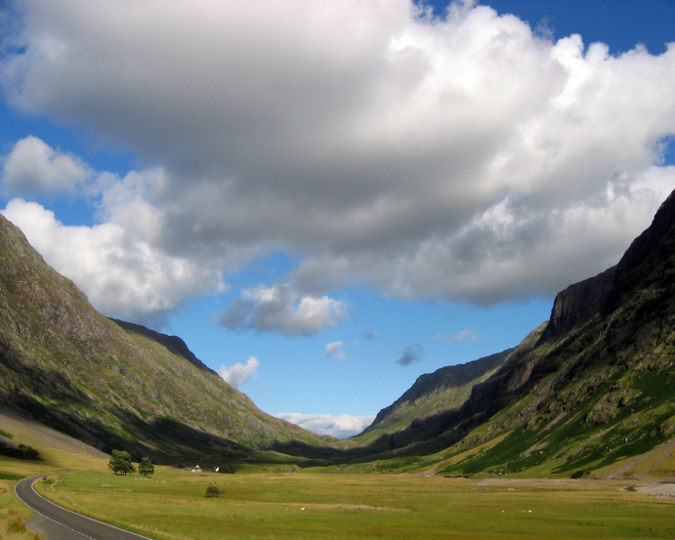
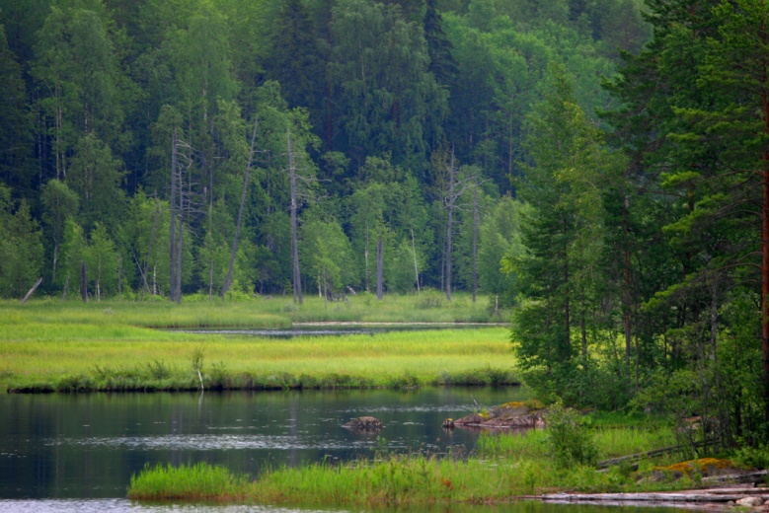
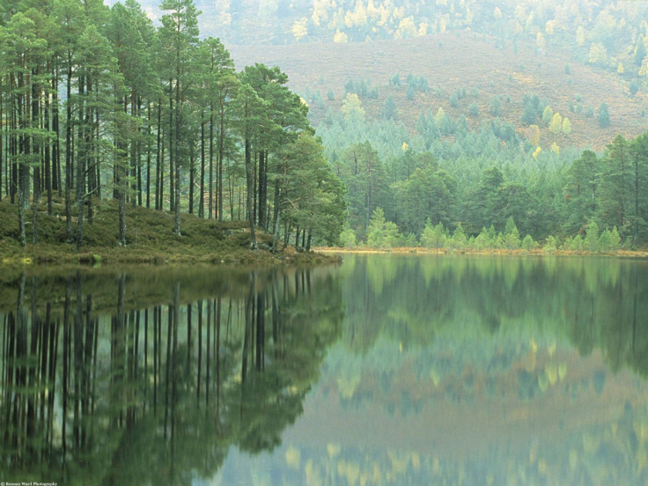
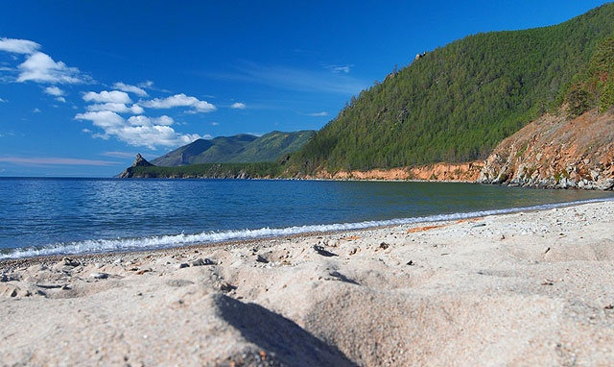
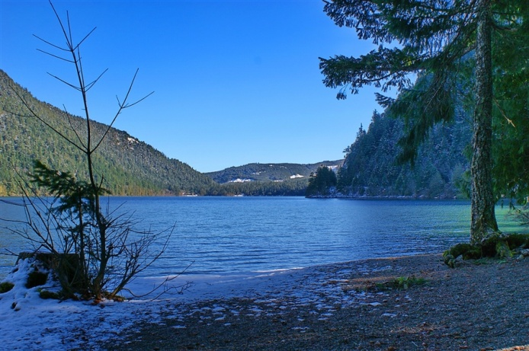
Nature and climate
Russia
Scotland

Slide 5
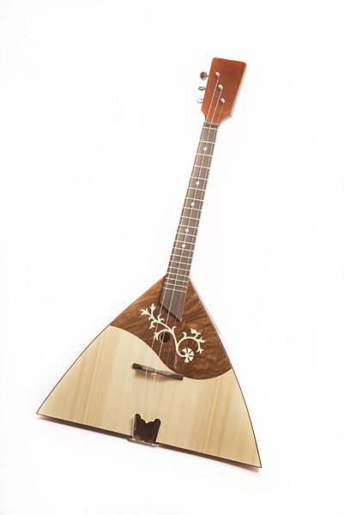
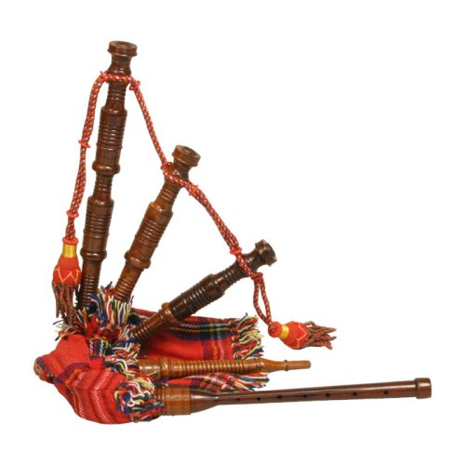
Both love folk music... National musical instruments
Russia — Balalayka
Scotland — Bagpipe

Slide 6
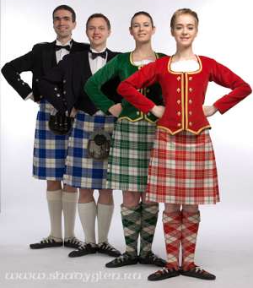
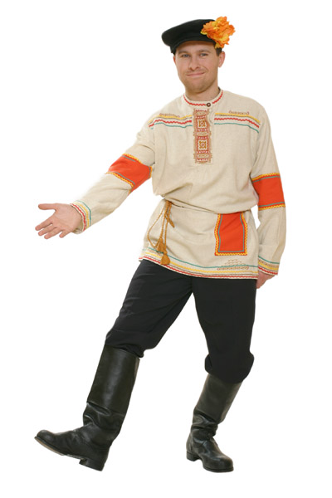
...and folk dances
Russia
Scotland

Slide 7
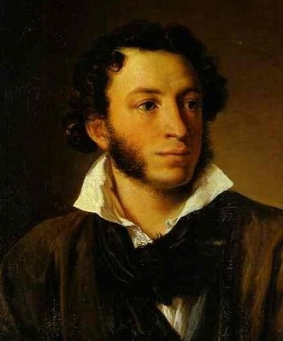
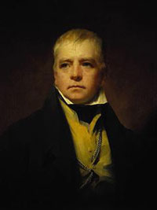
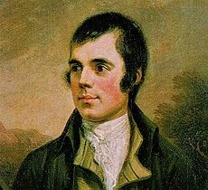
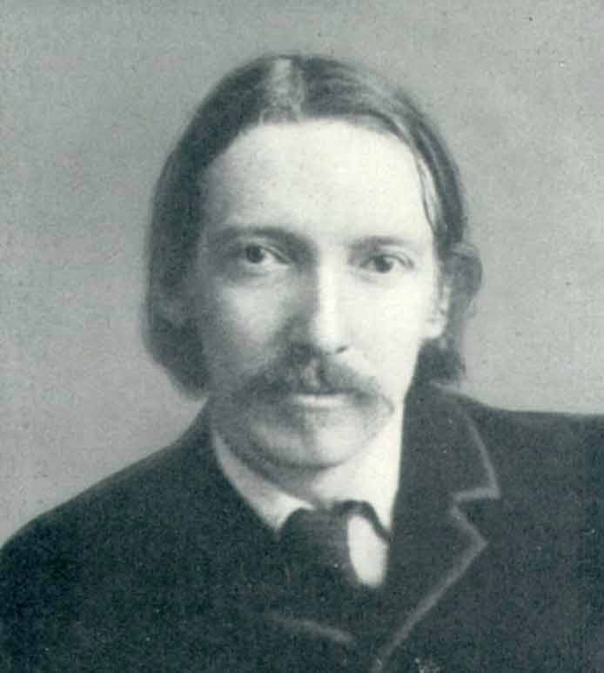
Both have Great poets
Russia
Scotland
Alexander Pushkin
Robert Burns
Vasiliy Zhukovskiy
Walter Scott
Robert Stevenson
Michael Lermontov

Slide 8
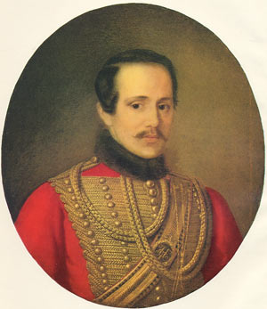
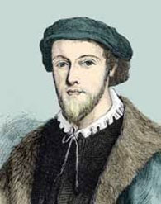
M. Lermontov's ancestors were from Scotland and they were Learmonth
Michael Lermontov
Georg Learmonth

Slide 9
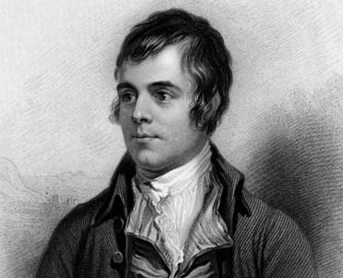
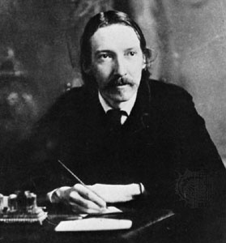
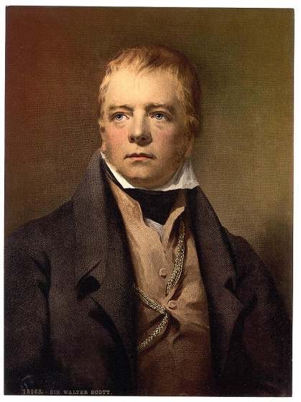
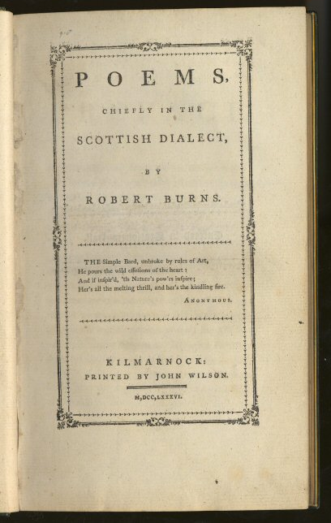
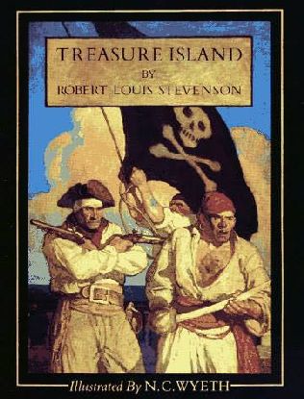
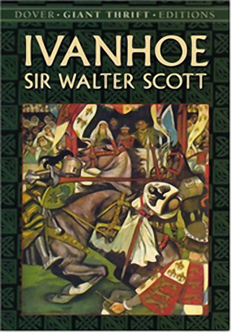
Both like Burns, Scott and Stevenson

Slide 10
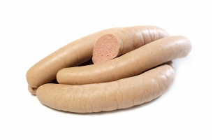
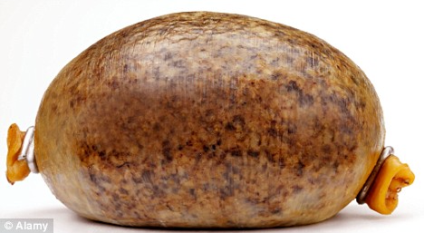
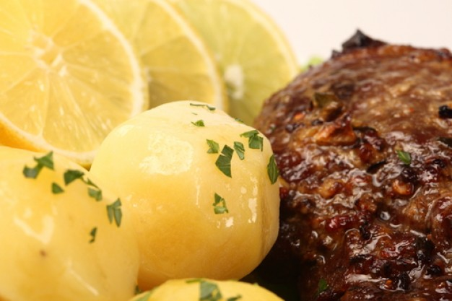
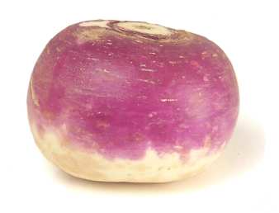
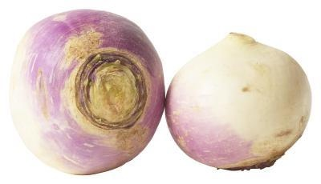
Food Both prefer simple peasant fare
Russia
Scotland
Haggis
Liver sausages
Potatoes
Tatties
Turnip
Neeps

Slide 11
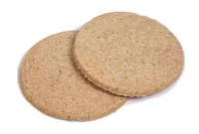
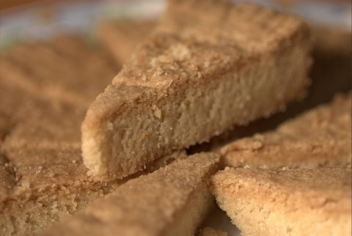
And plenty of sweets
Russia
Blini
Pies
Scotland
Oatcakes
Shortbread

Slide 12
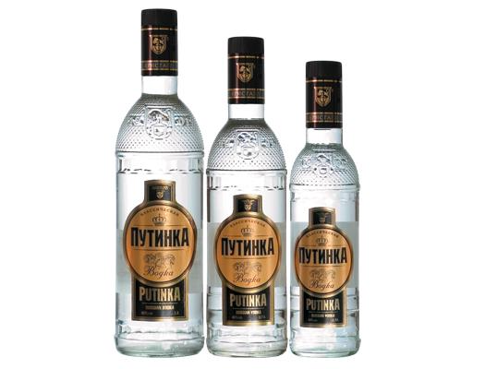
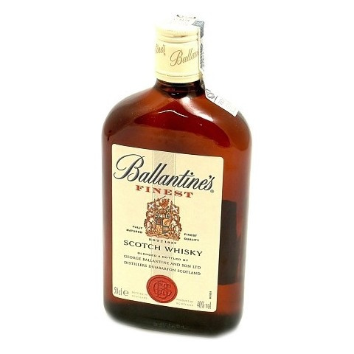
Both prefer good grain spirits
Russia
Scotland
Vodka
Scotch Whisky
Both say:
«Deoch n doras» — выпить на «посошок»

Slide 13
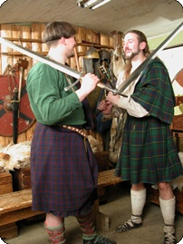
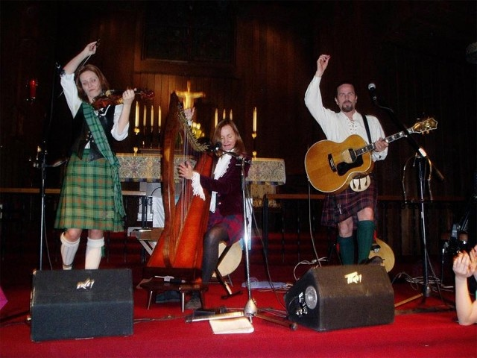
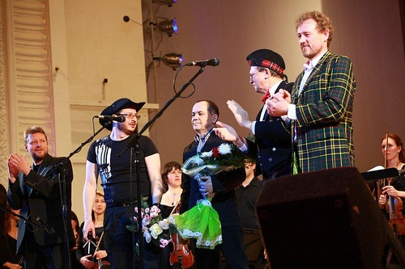
Now Russian-Scotish connections are diverse
Highland games in Moscow
Moscow Caledonian Club — cultural center in Moscow
Scottish Fests in Ekaterinburg, Moscow, Perm, Novosibirsk
«Robert Burn's Night» parties

Slide 14
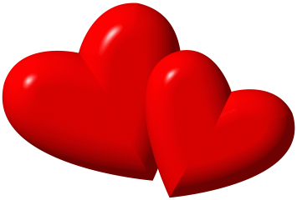
From Russia with Love...
This presentation was done by pupils from school №22

