Slide 1
Winged World
Interactive Quiz
“Guess the Letter”
by
Olga Stepanova
Chadukassinskaya
Main School
Chuvashia
Russia
2014

Slide 2
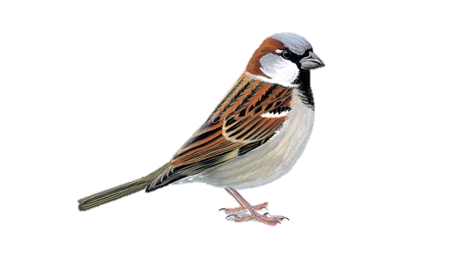
sp…rrow
a

Slide 3
stor…
k

Slide 4
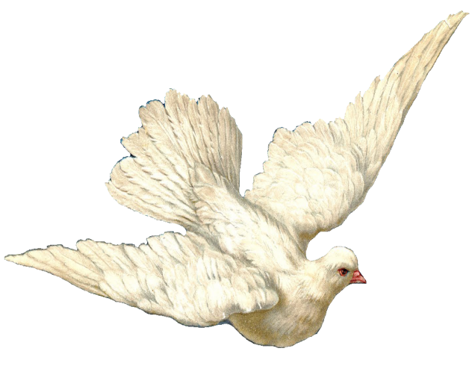
d…ve
o

Slide 5
…oodpecker
w

Slide 6
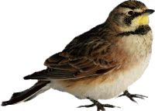
…ark
l

Slide 7
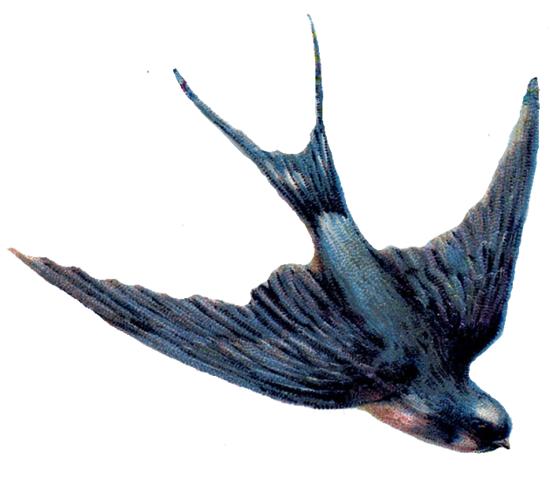
s…allow
w

Slide 8
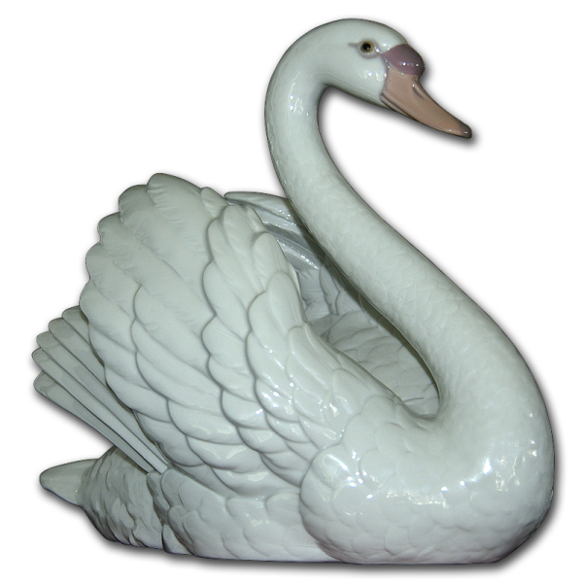
n
swa…

Slide 9
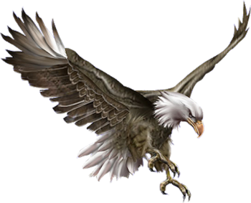
a
e…gle

Slide 10
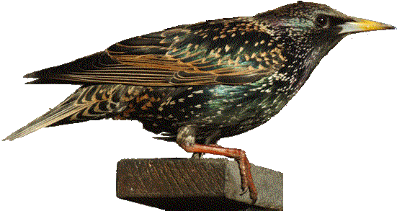
s…arling
t

Slide 11
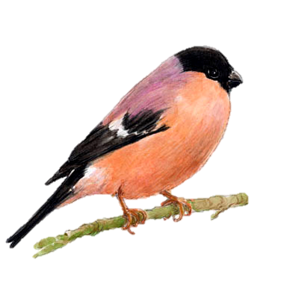
bullfin…h
c

Slide 12
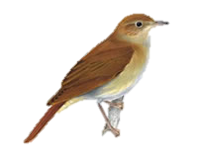
nightin…ale
g

Slide 13
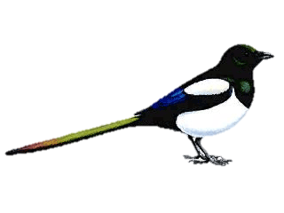
magpi…
e

Slide 14
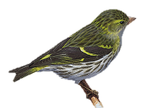
k
sis…in

Slide 15
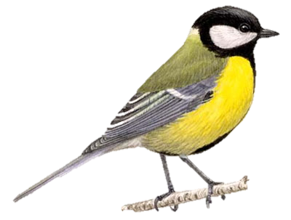
t
tom…it

Slide 16
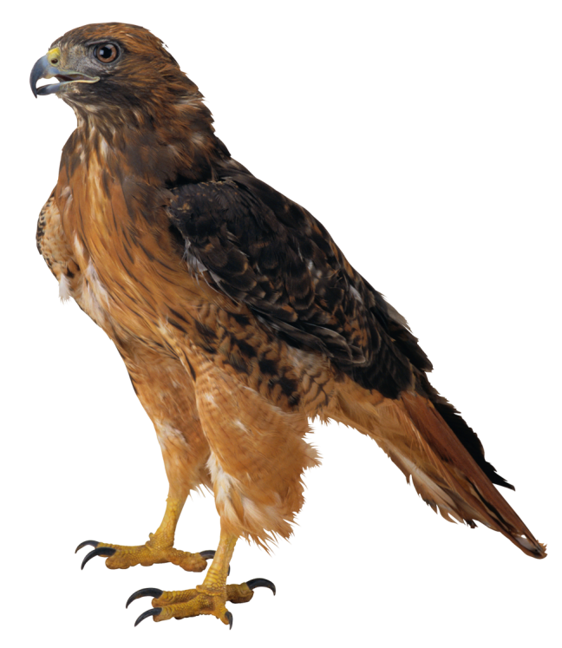
…awk
h

Slide 17
The End
Thank you
for being with us!

Slide 18
Resources
http://img-fotki.yandex.ru/get/5706/svetlera.3ed/0_6381d_2a6da394_XL.jpg
http://quarrlocalnaturereserve.org/wp-content/uploads/2009/11/bullfinchs1.jpg
http://leapingfrogdesigns.blogspot.ru/2012_01_22_archive.html
http://hungarianeagles.ucoz.hu/
http://gallery.yopriceville.com/Free-Clipart-Pictures/Birds-PNG/Hawk_PNG_Picture#.U5mzlPl_uyk
http://www.tuxpaint.org/stamps/stamps/animals/birds/lark.png
http://www.lloydsofdesmoines.com/wp-content/uploads/2013/08/Estate-Sales-Des-Moines.jpg
https://soundcloud.com/parkinggaragepolitics/nightingale-riding-wild
http://www.photobirdireland.com/garden-birds.html
http://www.featherfreezone.com/bird-biology.html
http://zoomuseum-tsu.ru/voices/01/
http://mindprod.com/jgloss/unmaintermite.html
http://myblazon.com/heraldry/symbolism/s/14

