Slide 1
Britain and its 15 Great Inventions
Interactive Quiz
by
Olga Stepanova
Chadukassinskaya
Main School
Chuvashia
Russia
2014

Slide 2
Who invented World Wide Web?
Tim Berners-Lee or Bill Gates?
World Wide Web
Tim Berners-Lee

Slide 3
Who invented magnifying glass?
John Bentley or Roger Bacon?
magnifying glass
Roger Bacon

Slide 4
Who invented postage stamp?
Rowland Hill or Tommy Flowers?
postage stamp
Rowland Hill

Slide 5
Who invented crossword puzzle?
Arthur Wynne or Barnes Wallis?
crossword puzzle
Arthur Wynne

Slide 6
Who invented telephone?
John Logie Baird or
Alexander Graham Bell?
telephone
Alexander Graham Bell

Slide 7
Who invented Electric Motor?
Peter Durand or Michael Faraday?
electric motor
Michael Faraday

Slide 8
Who invented penicillin?
Alexander Fleming or John Puckle?
penicillin
Alexander Fleming

Slide 9
Who invented Military tank?
Ernest Swinton or Peter Hobbs?
military tank
Ernest Swinton

Slide 10
Who invented steam locomotive?
Richard Trevithick or
Charles Babbage?
steam locomotive
Richard Trevithick

Slide 11
Who invented thermos flask?
Sir James Dewar or
Alastair Pilkington?
thermos flask
Sir James Dewar

Slide 12
Who invented the toothbrush?
William Addis or Ernest Swinton?
toothbrush
William Addis

Slide 13
Who invented radar?
Sir Robert Alexander Watson-Watt
or Edwin Beard Budding?
radar
Sir Robert Alexander Watson-Watt

Slide 14
Who invented light bulb?
Thomas Edison or Joseph Swan?
light bulb
Joseph Swan

Slide 15
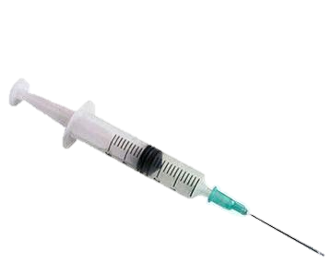
Who invented Hypodermic syringe?
Joseph Priestley or
Alexander Wood?
Hypodermic syringe
Alexander Wood

Slide 16
Who invented knitting machine?
Percy Shaw or William Lee?
knitting machine
William Lee

Slide 17
The End

Slide 18
Resources
http://downloads.bbc.co.uk/tv/fiftygreatestinventions/50_greatest_inventions.pdf
http://www.catehuston.com/blog/2009/10/29/presentation-slides-for-conversation-2-0-twitter/

