Slide 1
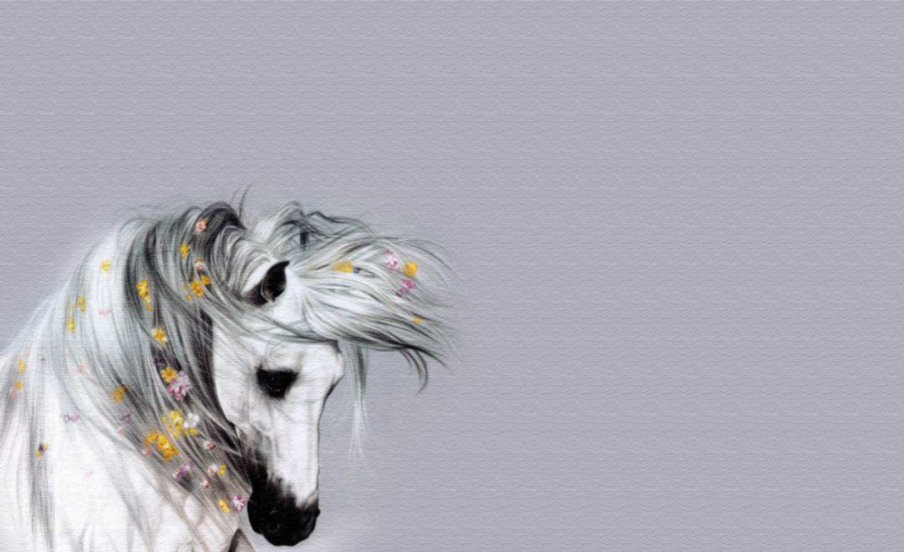
To Horse!
Interactive Quiz
Improve your English reading and refreshing you knowledge about horses and broaden your mind!
by
Olga Stepanova
Chadukassinskaya
Main School
Chuvashia
Russia
2014

Slide 2
What country chose the Horse as its national animal?
Iceland
The Netherland
Ireland
Scotland

Slide 3
Which of Gods is considered to be
a patron of horses and Horse breeding?
Poseidon
Apollo
Mars
Zeus

Slide 4
A contest of skill in lassoing cattle, riding untamed horses is …
Bistro
Audio
Rodeo
Radio

Slide 5
What animal do we call
a river horse?
a hippopotamus
a whale
a dolphin
a shark

Slide 6
What indicates a horse’s age?
its hoofs
its nostrils
its teeth
its eyes

Slide 7
Horses generally dislike
the smell of …
pigs
cows
sheep
geese

Slide 8
Which of these names is translated from Latin into English as a’ horse lover’?
Peter
Michael
Stephan
Philipp

Slide 9
Name the fabulous animal resembling a horse with a single horn on its forehead.
Capricorn
Acorn
Unicorn
Popcorn

Slide 10
The Derby is one of the most famous horseraces in Britain and it takes place every year.
Name Derby month.
July
May
August
June

Slide 11
It is a long rope with a slip-knot used for catching horses and cattle especially in America.
lasso
canoe
shoe
tattoo

Slide 12
How do we call a person who sets to any work with pleasure?
a working horse
a neighing horse
a galloping horse
a willing horse

Slide 13
Who is the author of
"The Bronze Horseman”?
A. Chekhov
A. Pushkin
Turgenev
L. Tolstoy

Slide 14
National Day of the Horse
in the United States is …
13 December
13 March
13 July
13 October

Slide 15
What is the name of the famous
and well-loved horse of Alexander the Great
Biceps
Talentus
Tantalus
Bucephalus

Slide 16
The winged horse of Greek Mythology Pegasus has been regarded as a symbol of …
poetic inspiration
mutual love
respect
sincerity

Slide 17
Don't … horses in midstream
feed
change
chase
ride

Slide 18
To eat like a horse means
to eat …
little food
in a hurry
a lot of food
greedily

Slide 19
an enduring symbol of good luck
A horse shoe is an enduring symbol of …
love
peace
good luck
integrity

Slide 20
The End
Hurray to the Winner!

Slide 21
Resources
http://odvas.ru/photo/361-0-13409
http://horseman.hubpages.com/hub/Horse-Idioms-and-Sayings
http://www.tahoemeadows.com/horse_facts.htm

