Slide 1
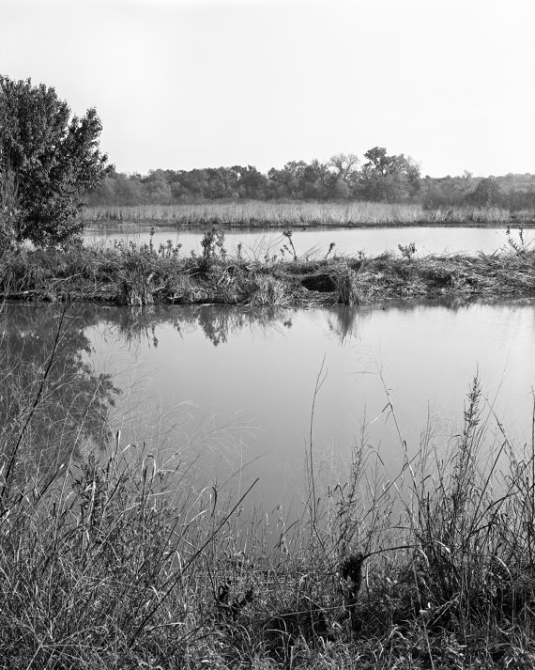
ERNEST HEMINGWAY
by
Olga Stepanova
Chadukassinskaya
Main School
Chuvashia
Russia
2014

Slide 2
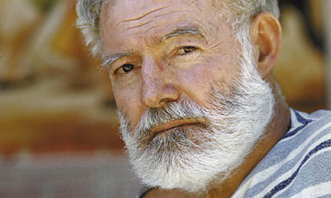
Nobel Prize winner Ernest Hemingway is seen as one of the great American 20th century novelists, and is known for works like A Farewell to Arms and The Old Man and the Sea.

Slide 3
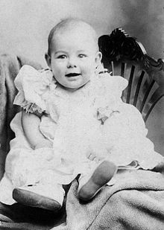
One of the most important authors of the 20th century
Ernest Miller Hemingway is born into a wealthy family in 1899.
in Oak Park, Illinois, a place he will later describe as a town of "wide lawns and narrow minds." He is the second of six children of Clarence Hemingway, a doctor, and Grace Hall Hemingway, a music teacher.

Slide 4
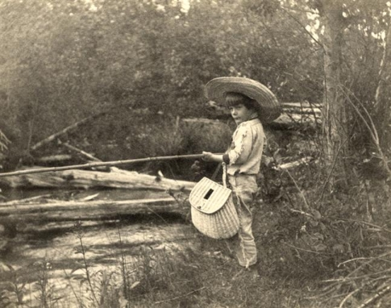
Although yer Mother Grace hoped her musical interests would influence her son, young Hemingway preferred to accompany his father on hunting and fishing trips. This love of outdoor adventure would be reflected later in many of Hemingway's stories, particularly those featuring protagonist Nick Adams.

Slide 5
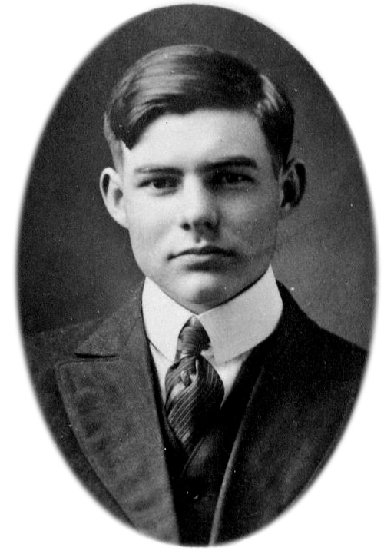
Sep 1913
Hemingway in High School
Ernest Hemingway enters Oak Park and River Forest High School. He proves to be an excellent student athlete who boxes, plays football and writes for the school newspaper and yearbook.

Slide 6
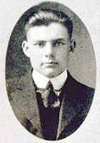
1917
Cub Reporter
Hemingway graduates from Oak Park and River Forest High School. He opts not to go to college, instead taking a job as a cub reporter for the Kansas City Star newspaper. The Star's style guidelines influence his writing style for the rest of his career: Use short sentences, short first paragraphs, and vigorous English.

Slide 7
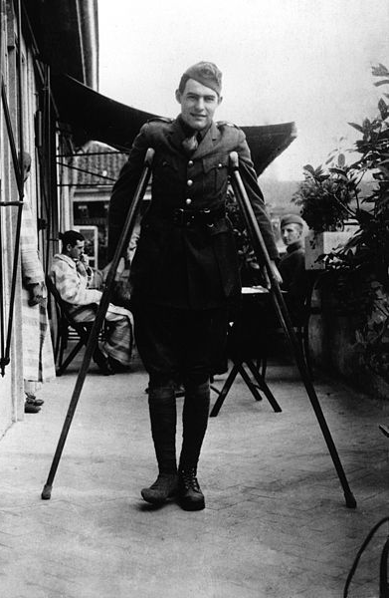
Jul 8, 1918
Hemingway Wounded in Battle
While passing out supplies to soldiers in Italy as a driver with the Red Cross Ambulance Corps , Hemingway is seriously injured by a trench mortar and machine gun. The blast leaves shell fragments in his legs. The Italian government awards him a Silver Medal of Military Valor for dragging a wounded Italian soldier to safety after the attack, but his career as an ambulance driver is over. While recuperating in a Milan hospital, Hemingway falls in love with an American nurse six years his senior named Agnes von Kurowsky. They make plans for her to join him in the United States.

Slide 8
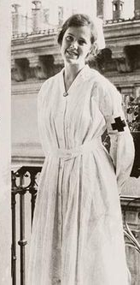
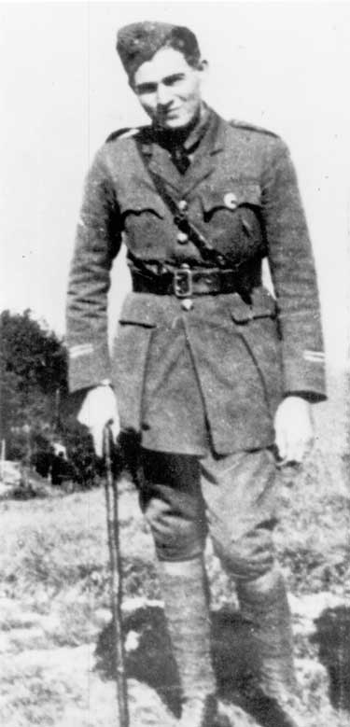
Jan 1919
End of Affair with Agnes von Kurowsky
Hemingway returns to the United States. Agnes soon writes to him to tell him that she has fallen in love with an Italian officer. Hemingway is heartbroken. Their romance inspires the relationship in A Farewell to Arms.

Slide 9
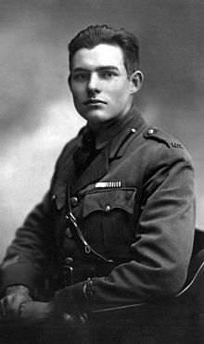
1920
Reporter for Toronto Star
Hemingway moves to Toronto, Ontario to take a job as a reporter for the Toronto Star newspaper. He continues to write for the paper after moving to Chicago later in the year.

Slide 10
Sep 3, 1921
Hemingway's First Marriage
Hemingway marries Elizabeth Hadley Richardson. She turns out to be the first of four wives.

Slide 11
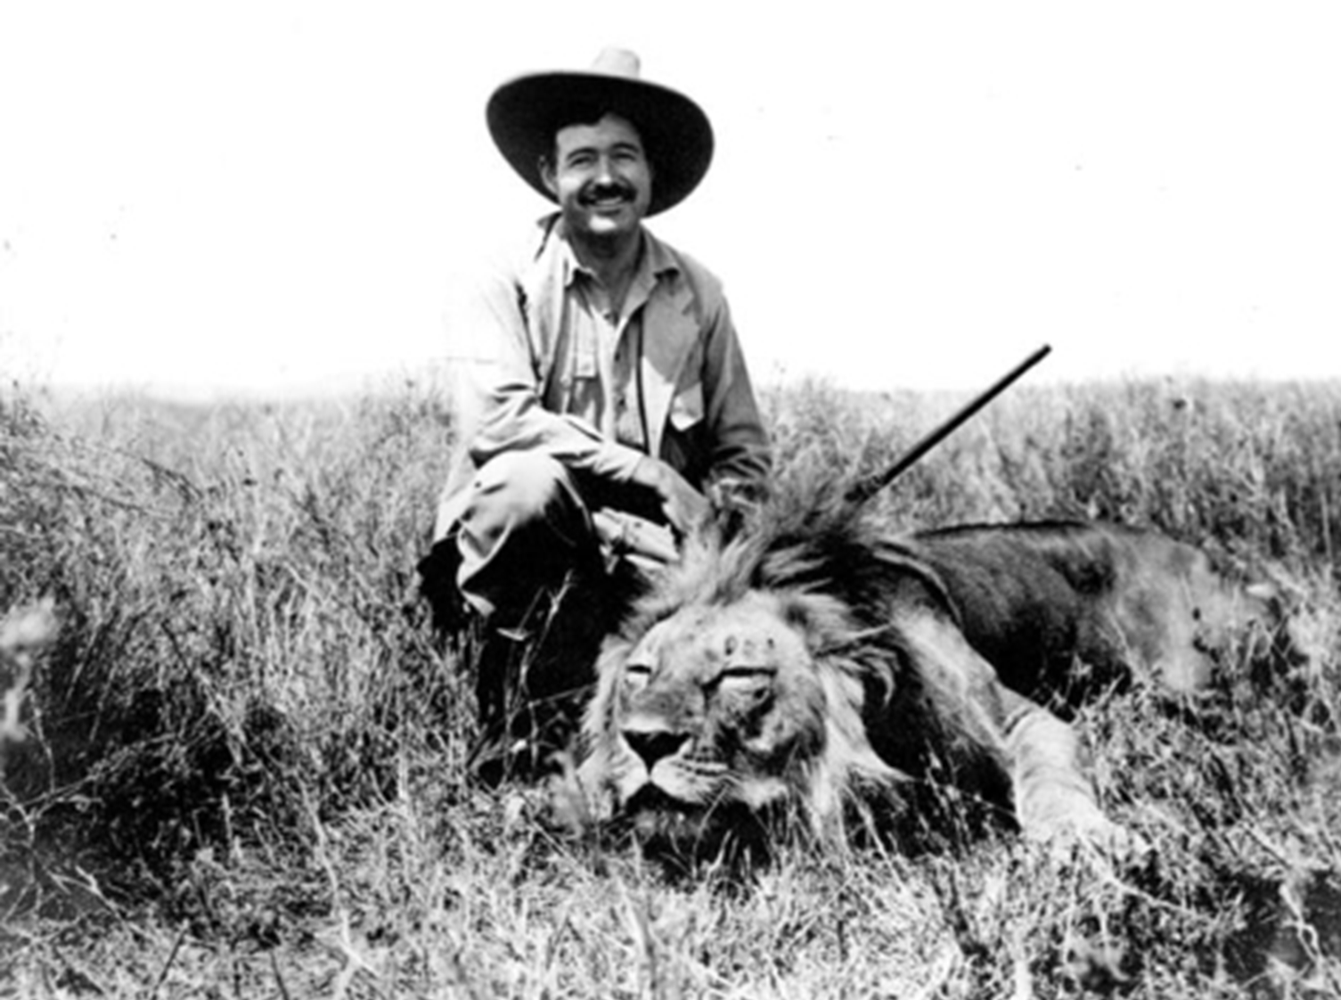
When he wasn't writing, Hemingway spent much of the 1930s chasing adventure: big-game hunting in Africa, bullfighting in Spain, deep-sea fishing in Florida.

Slide 12
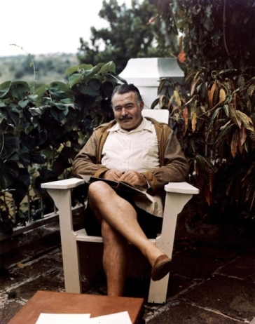
Nobel Prize
Ernest Hemingway is awarded the Nobel Prize in Literature, becoming the fifth American author to receive the award. Hemingway is still recovering from serious injuries sustained in two separate plane crashes and a bushfire accident earlier in the year and is unable to travel to Stockholm to receive the award. The American ambassador John C. Cabot accepts the prize on his behalf and reads his speech aloud.

Slide 13
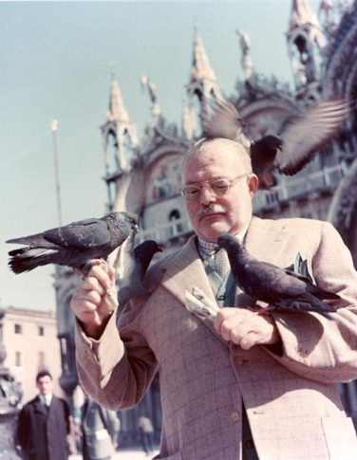
The author continued his forays into Africa and sustained several injuries during his adventures, even surviving multiple plane crashes.
After suffering severe injuries Ernest Hemingway commited suicide with a shotgun at his home in Ketchum, Idaho in 1961.

Slide 14
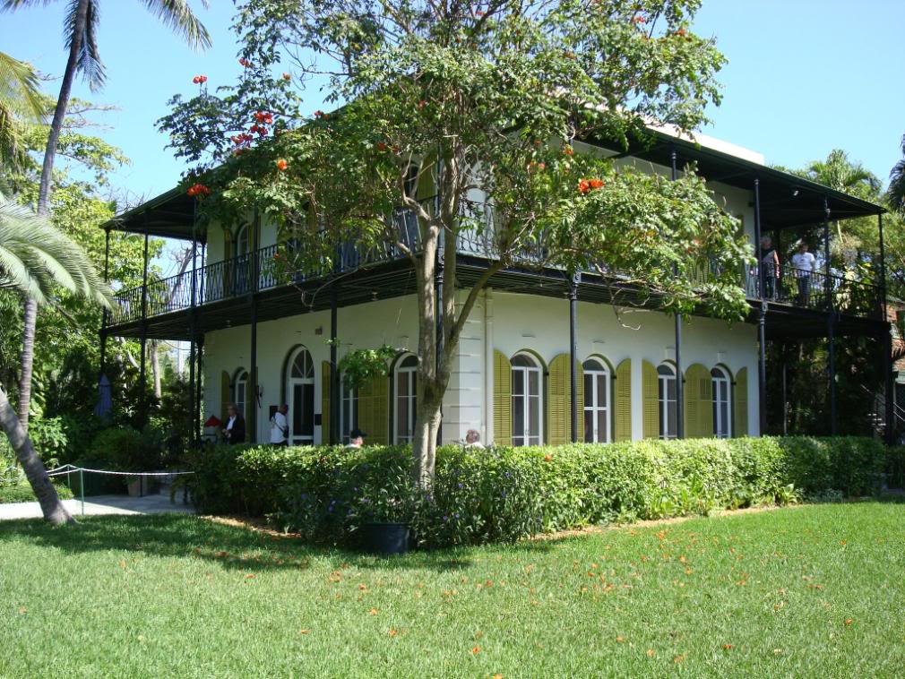
ERNEST HEMINGWAY HOUSE AND MUSEUM
IN KEY WEST FLORIDA

Slide 15
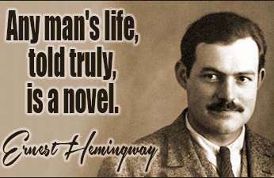

Slide 16
Today is only one day in all the days that will ever be. But what will happen in all the other days that ever come can depend on what you do today.
ERNEST HEMINGWAY, For Whom the Bell Tolls

Slide 17
Every day above earth is a good day.
ERNEST HEMINGWAY, The Old Man and the Sea

Slide 18
Resources:
http://www.theguardian.com/books/2011/jul/15/brief-survey-short-story-ernest-hemingway
http://www.biography.com/people/ernest-hemingway-9334498
http://mrnussbaum.com/authors/ernest_hemingway/
http://en.wikipedia.org/wiki/Ernest_Hemingway
http://www.shmoop.com/ernest-hemingway/timeline.html
http://www.biography.com/news/ernest-hemingway-facts
http://tourskeywest.com/wp-content/uploads/ernest-hemingway-house-key-west-adamsvacation-pb.jpg
http://ehfop.typepad.com/photos/the_ernest_hemingway_muse/hs_eh_cropped_2.html
http://www.lib.udel.edu/ud/spec/exhibits/hemngway/early.htm
http://www.timelesshemingway.com/photos
http://www.myenglishpages.com/site_php_files/reading-ernest-hemingway-biography.php#.U80PJ_l_uyk
http://www.oakpark.com/ArchiveImages/9138a.jpg
http://www.umich.edu/~eng217/student_projects/HemingwayWW1/redcross2.jpg
http://www.notable-quotes.com/h/hemingway_ernest.html
https://lh3.ggpht.com/QNty2Sj6j4fORJBvd8UEOOkcujxXOJ4NtkpFU4ghgQ5fnbKZRGXWifjfmPZmDa0asfDIBA=s85

