Slide 1
Welcome
to the Happy
Photo
Gallery!
Автор:
О. М. Степанова,
учитель английского языка МБОУ «Чадукасинская ООШ» Красноармейского района
Чувашской Республики

Slide 2
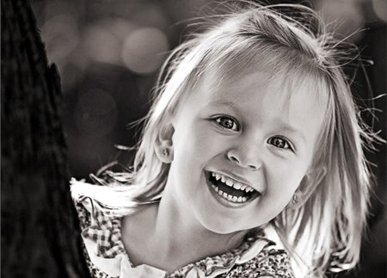
Children are the keys of paradise.
Eric Hoffer

Slide 3
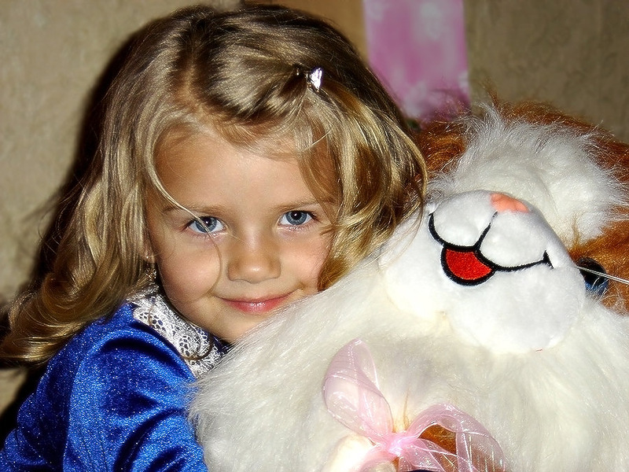
“If you want your children
to be intelligent, read them fairy tales. If you want them to be more intelligent, read them more fairy tales.” ― Albert Einstein

Slide 4
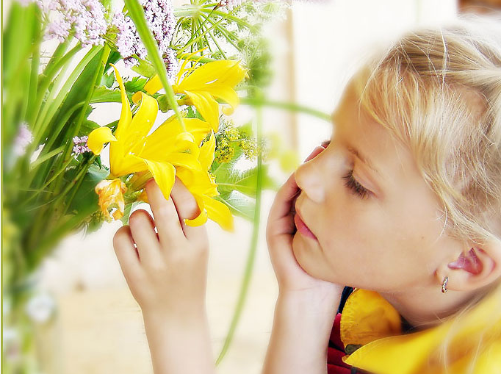
“The soul is healed by being with children.” ― Fyodor Dostoyevsky

Slide 5
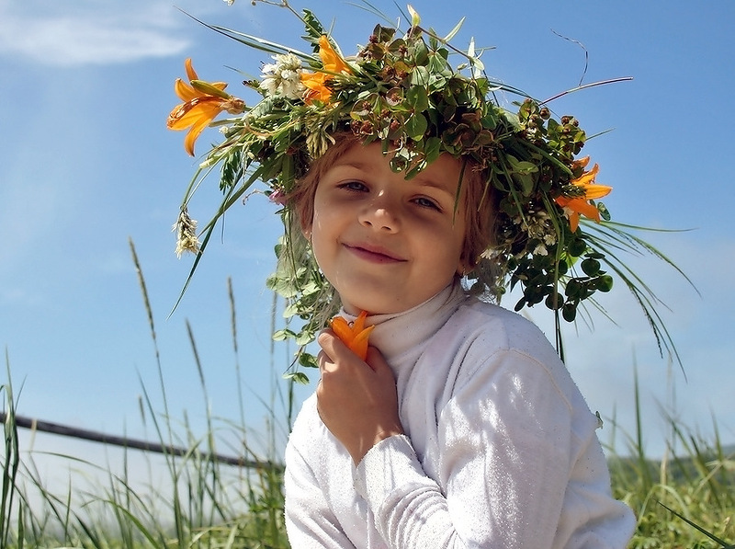
There are two kinds of travel: first class and with children.
― Robert Benchley

Slide 6
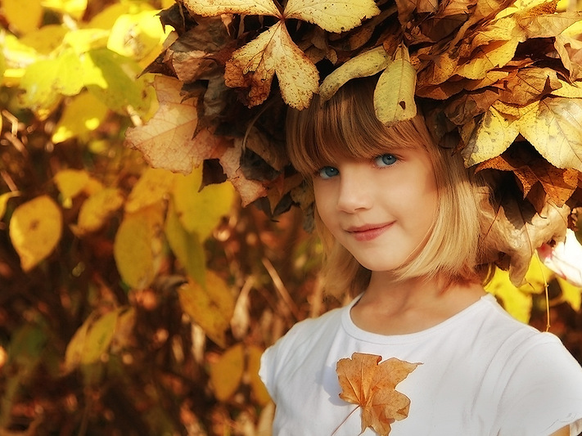
“Children are our greatest natural resource.” ― Herbert Hoover

Slide 7
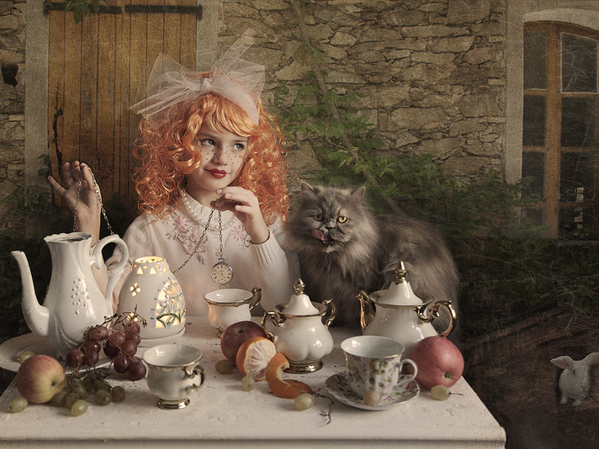
Your children need your presence more than your presents.
Jesse Jackson

Slide 8
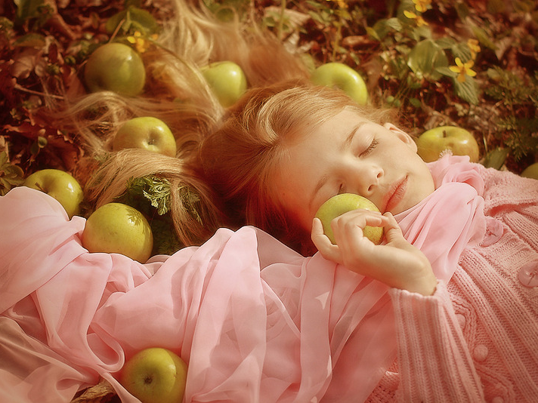
Always kiss your children goodnight -- even if they’re already asleep.
H. Jackson Brown

Slide 9
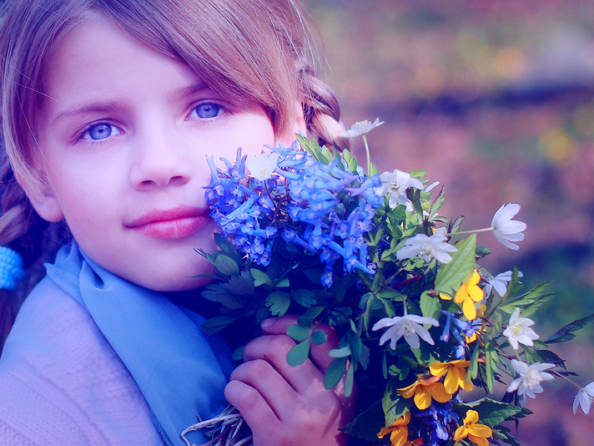
Children need models rather than critics.
Joseph Joubert

Slide 10
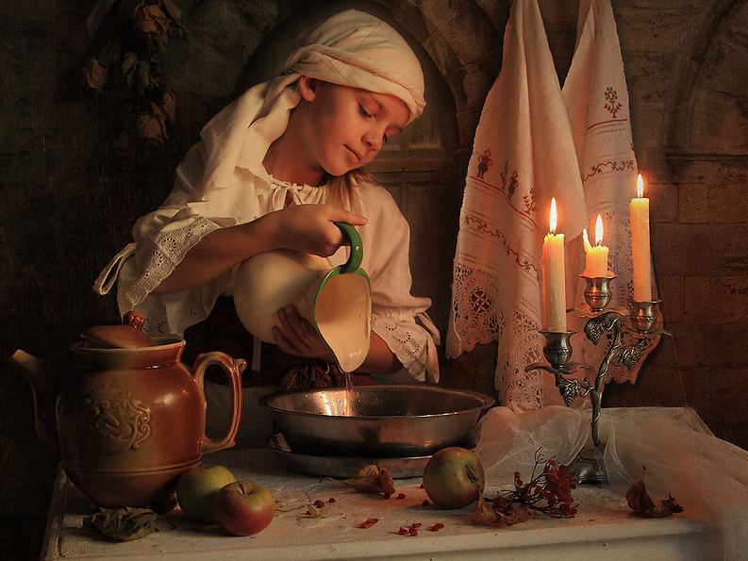
If you want children to keep their feet on the ground, put some responsibility on their shoulders.
Abigail Van Buren

Slide 11
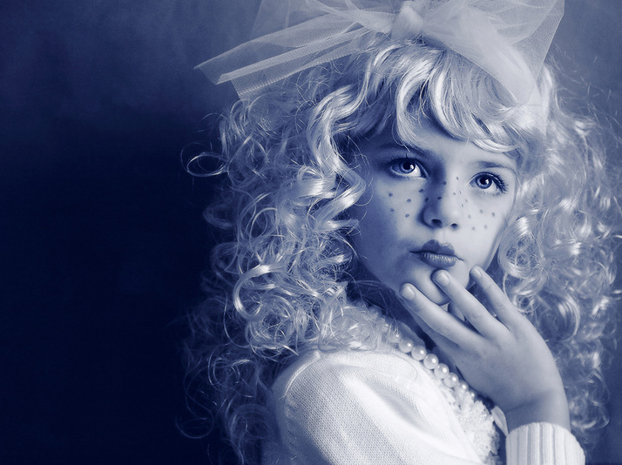
“Love children especially,
for they too are sinless like the angels; they live to soften and purify our hearts and,
as it were,
to guide us.” Fyodor Dostoyevsky

Slide 12
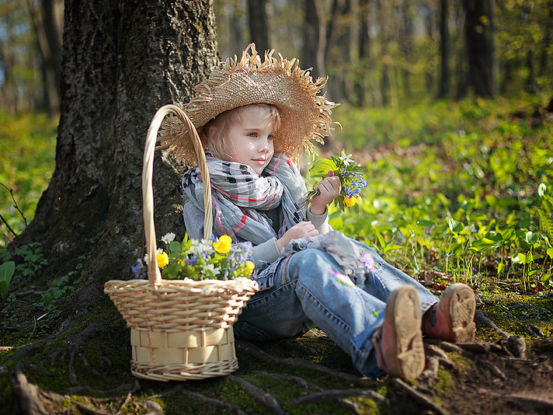
Give a child love, laughter and peace, not AIDS.
Nelson Mandela

Slide 13
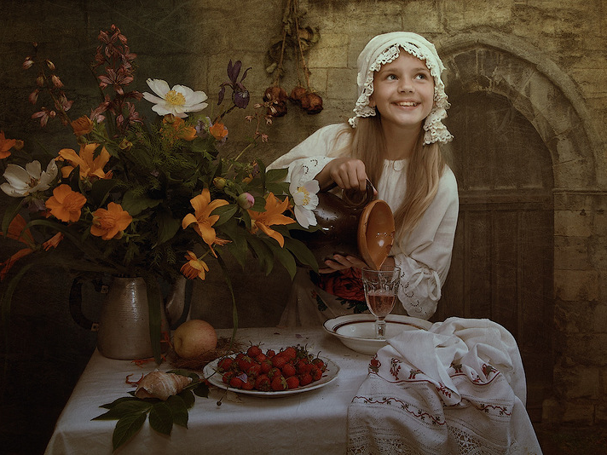
Children show me in their playful smiles the divine
in everyone.
Michael Jackson

Slide 14
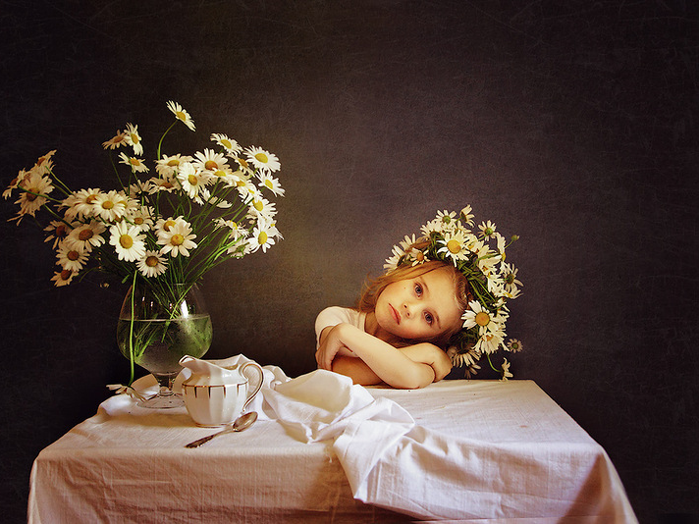
Children have more need of models than of critics.
Carolyn Coats

Slide 15
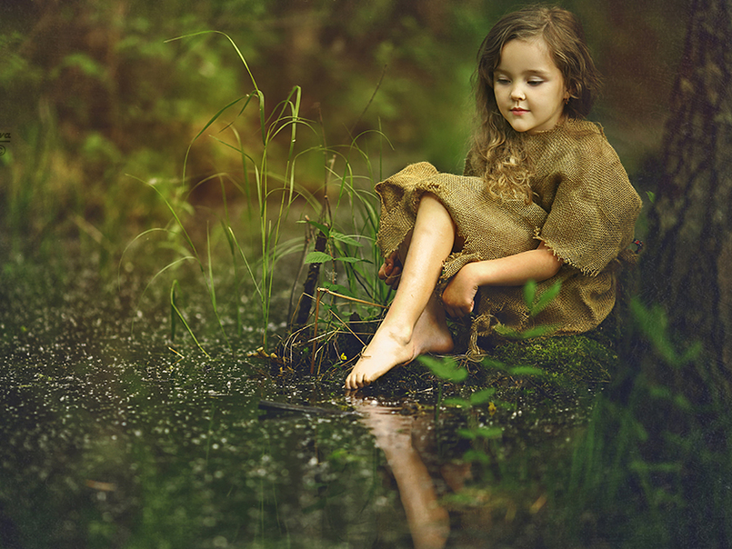
Hugs can do great amounts of good... especially for children.
Princess Diana

Slide 16
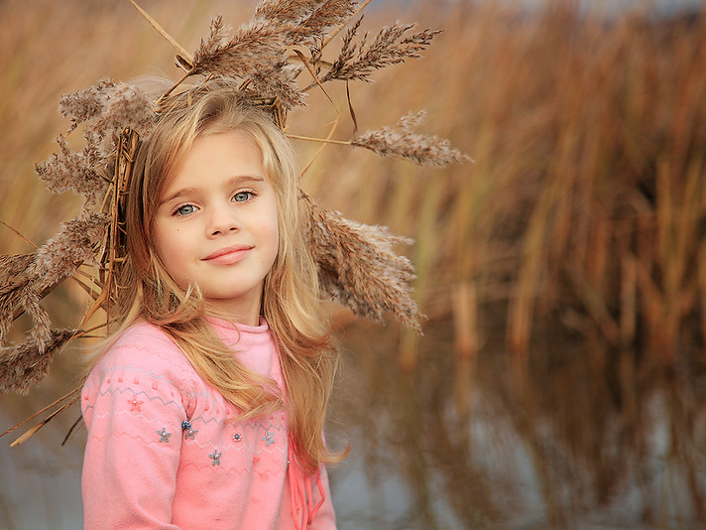
Every child walks into existence through the golden gate of love.
Beecher

Slide 17
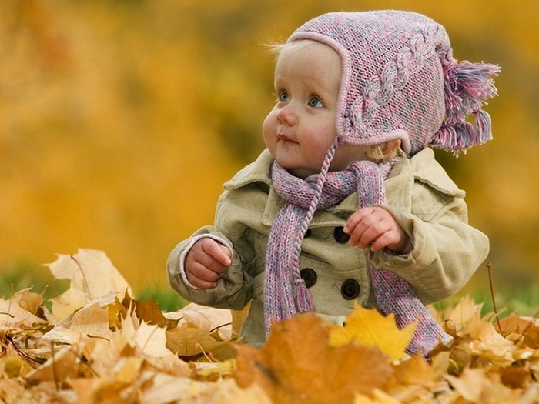
If we are to teach real peace in this world, and if we are to carry on a real war against war, we shall have to begin with the children.
Mohandas Gandhi

Slide 18
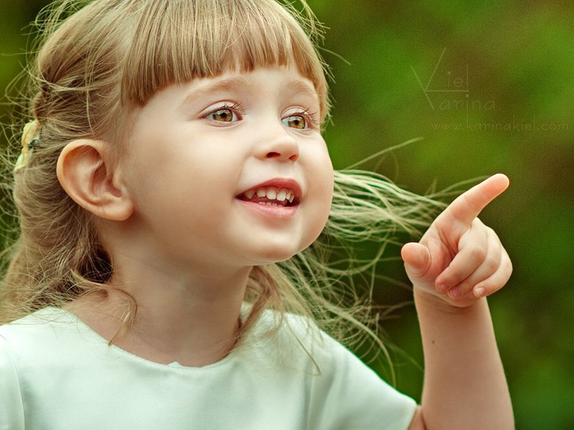
Children see magic because they look for it.
Christopher Moore

Slide 19
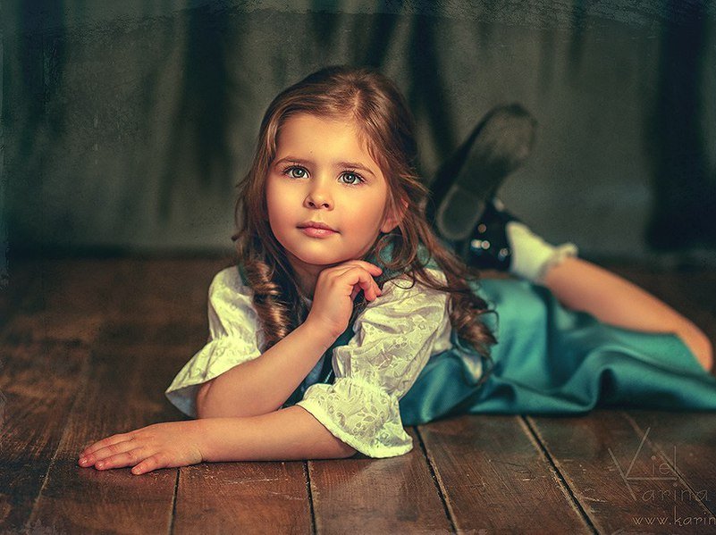
Every child is an artist. The problem is how to remain an artist once we grow up.
Pablo Picasso

Slide 20
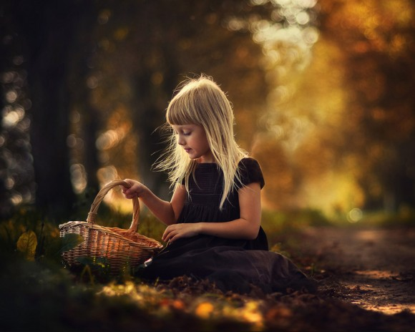
The child is both a hope and a promise for mankind.
Maria Montessori

Slide 21
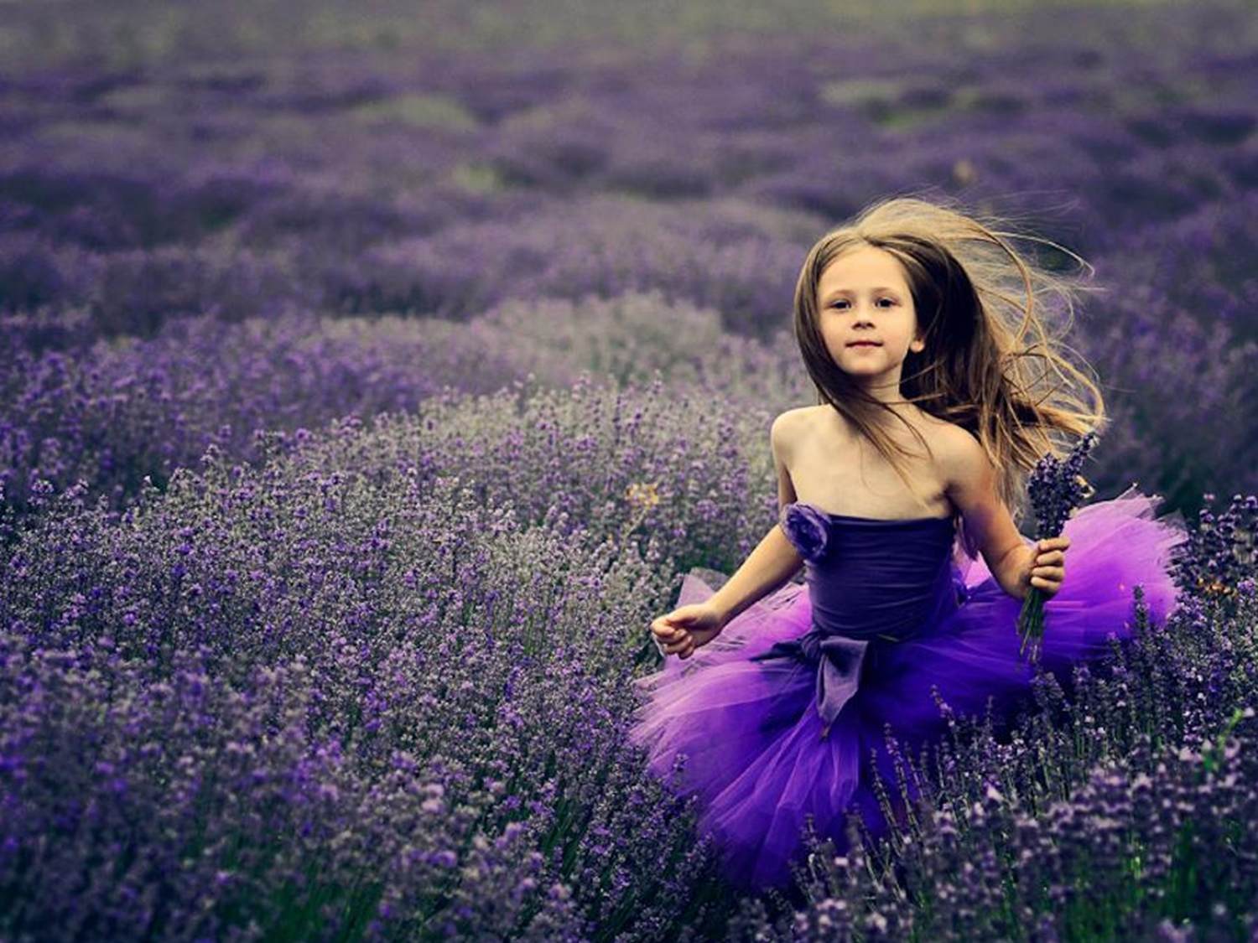
There are two lasting bequests we can give our children: One is roots.
The other is wings.
Hodding Carter, Jr.

Slide 22
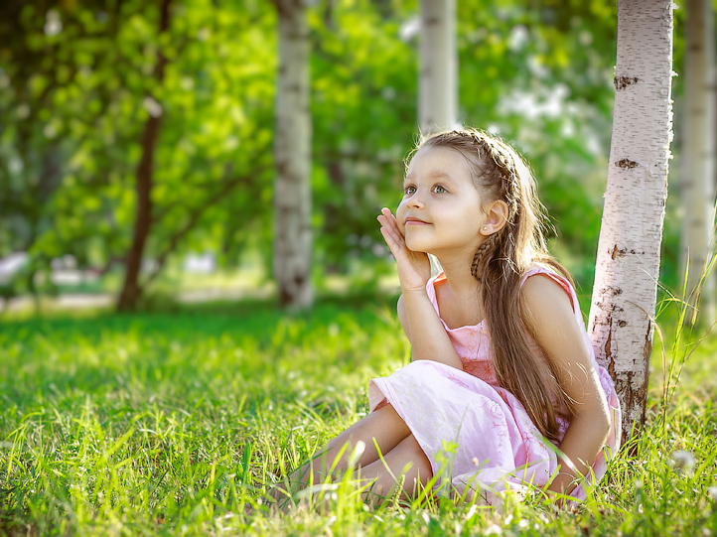
Thank you
for visiting the photo Gallery!
You are always welcome!

Slide 23
http://rasfokus.ru/images/photos/medium/1bca50a512e17a7371754ab7f415e8f5.jpg
http://quotations.about.com/cs/inspirationquotes/a/Child2.htm
http://www.dailymontessori.com/maria-montessori-quotes/
http://img1.liveinternet.ru/images/attach/c/7/98/758/98758431_large_2.jpg
http://img1.liveinternet.ru/images/attach/c/8/99/46/99046493_large_4.jpg
http://lepser.ru/wp-content/uploads/2011/11/milye-deti-foto-big-27-580x464.jpg
http://www.compassion.com/child-advocacy/find-your-voice/famous-quotes/
https://www.goodreads.com/quotes/tag/children?page=12
http://www.liveinternet.ru/users/perooo/post331675765/
http://www.porjati.ru/uploads/posts/2013-09/thumbs/1379673107_our_children_011.jpg
http://poziruy.ru/wp-content/uploads/2013/05/poziruy-ideya-dlya-detskoj-fotosessii-01.jpg
Источники:

