Slide 1
Let’s Harvest!
Интерактивная презентация
«Прочти и угадай»
Автор:
Ольга Михайловна Степанова,
учитель английского языка МБОУ «Чадукасинская ООШ» Красноармейского района
Чувашской Республики

Slide 2
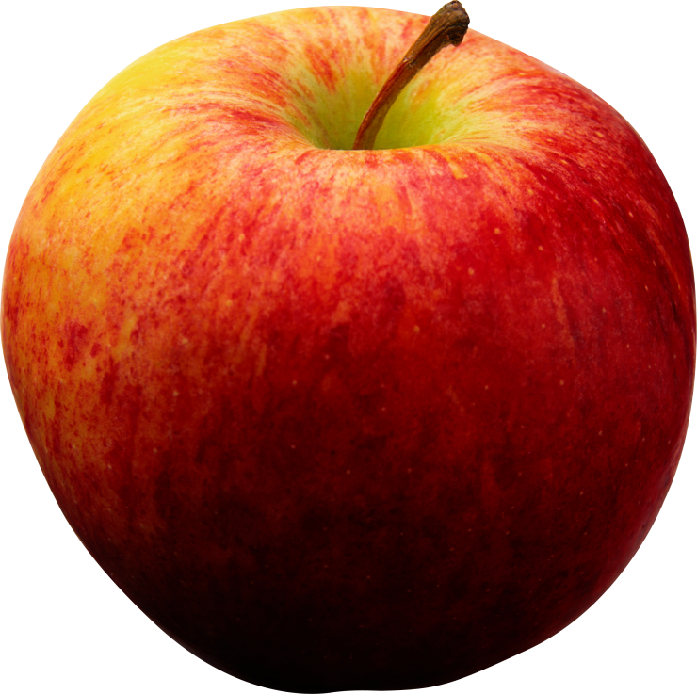
I can be red and yellow. I also can be green. I may be the home of a hungry worm, so make sure I am clean.

Slide 3
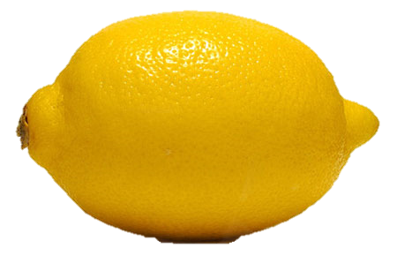
It is a fruit that is always sour. It is yellow both inside and outside. Adults like to drink tea with it.

Slide 4
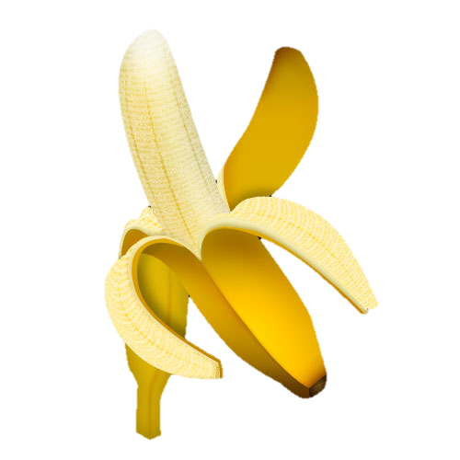
Monkeys eat me, kids do too. Gorillas love me, how about you? It’s fun to tug my yellow peel, my creamy insides to reveal.

Slide 5
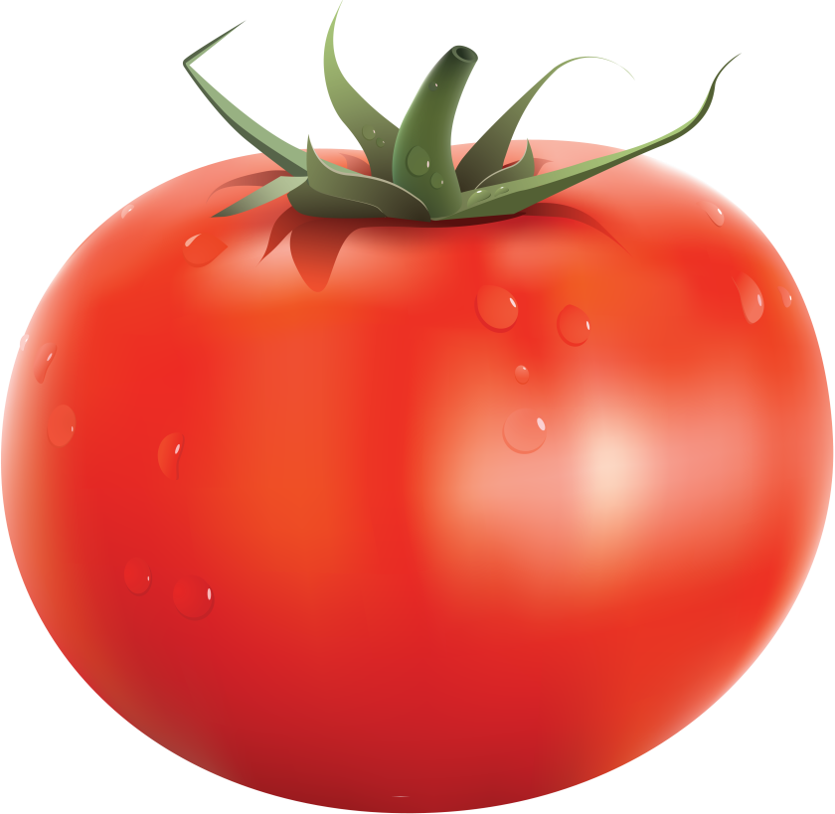
Name a red juicy fruit that we eat in salads or cook it to make ketchup. Some people think that it is a vegetable, but it is a fruit!

Slide 6
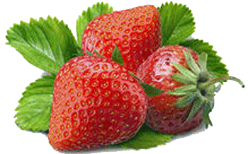
It’s a red sweet fruit
who wears its seeds on the outside. It is small, but so tasty! Kids like to eat it and drink shakes with it.

Slide 7
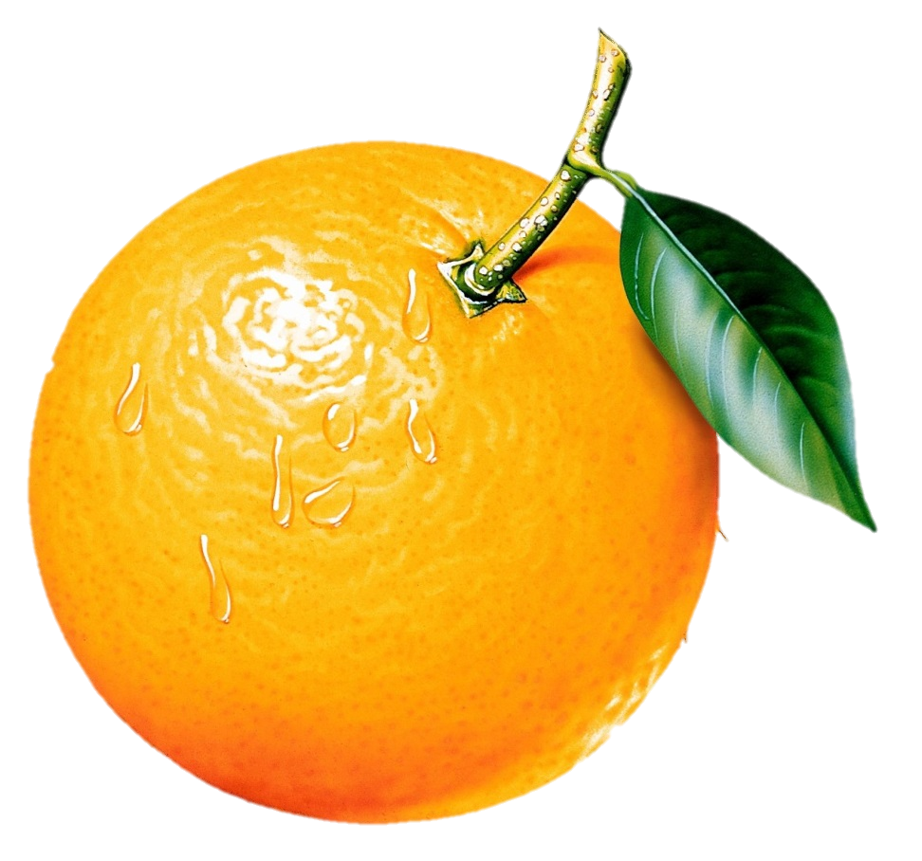
It is a round fruit that grows on a tree. It can be squeezed to make a juice.
It’s the same color as its name.

Slide 8
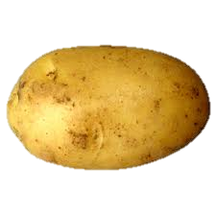
With all my eyes I still can’t see. I grow down underneath the ground. You eat me whole or cut me thin and fry me till I’m golden brown.

Slide 9
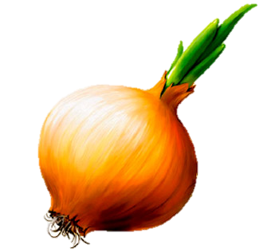
When you cut me up I will make you cry. I smell really strong but I don’t know why. On the white page
I can be found In your garden
I’ll be underground.
What am I?

Slide 10
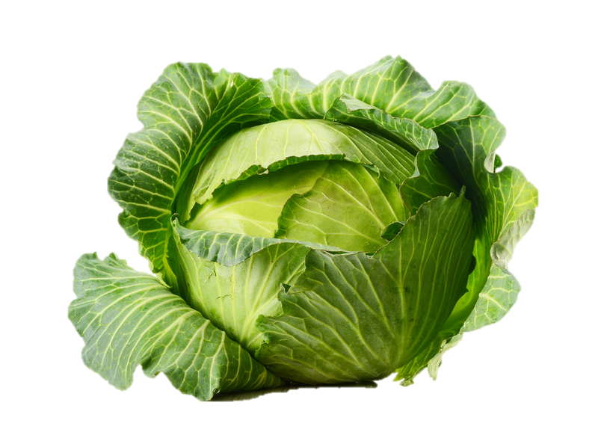
It is green and round, wears a lot of dresses and rabbits like it.

Slide 11
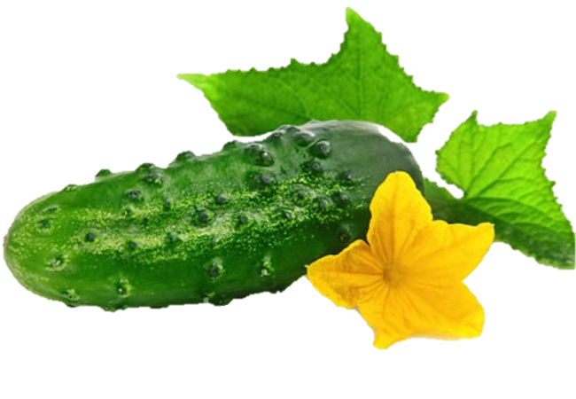
Green outside and
white inside.
When someone is calm and unruffled ,
people say that
he or she is as cool as this vegetable.

Slide 12
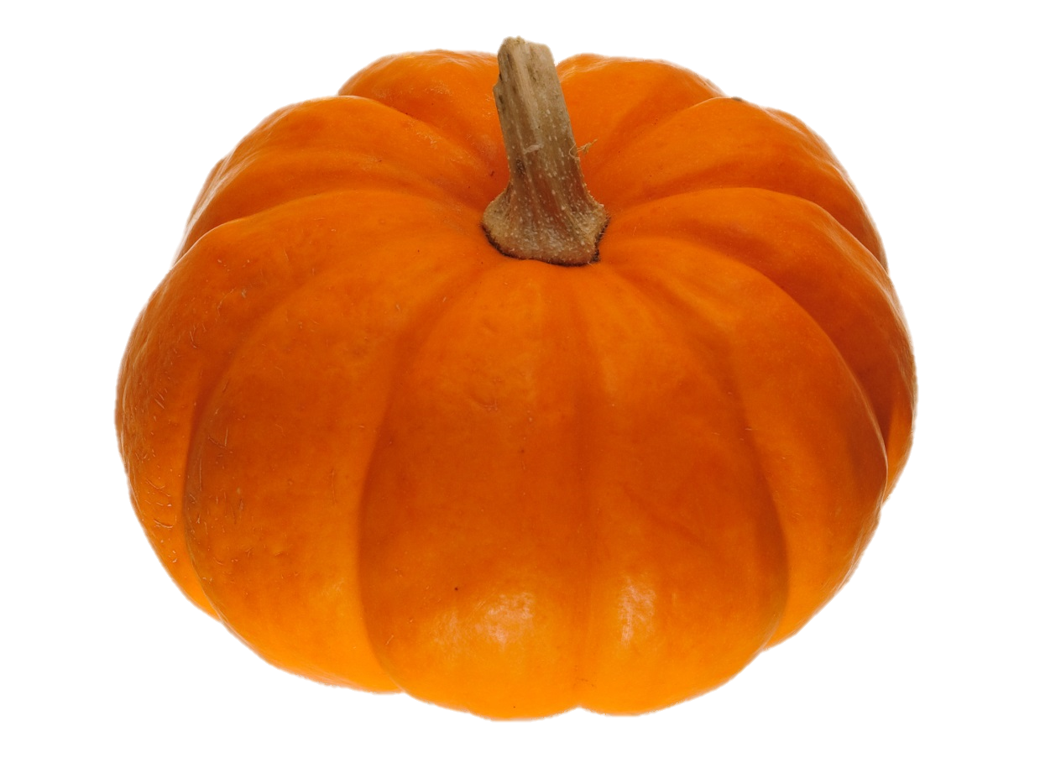
This is a big orange Halloween vegetable! As orange as an orange!

Slide 13
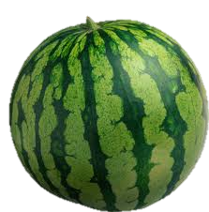
There was a green round house.
Inside the house there was a white house. Inside the white house there was a red house. Inside the red house there were lots of babies. What is it?

Slide 14
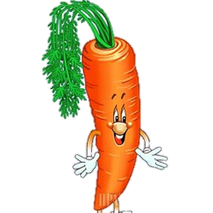
It is a slim lady
in an orange dress
with curly green hair. It is a good vitamin for your eyes.

Slide 15
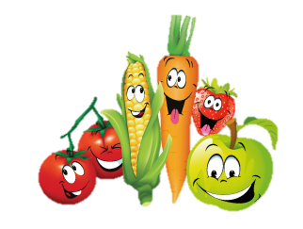
Goodbye! See you!

Slide 16
Sources:
http://kenglish.ru/prostye-zagadki-pro-ovoshhi/
http://kenglish.ru/prostye-zagadki-pro-frukty/
http://img.stapravda.ru/i/w250/p37132.jpg
http://159272.worldinp.web.hosting-test.net/wp-content/uploads/2012/07/%D1%8F%D1%80%D0%BA%D0%B8%D0%B5-D0%BF%D0%BE%D0%BB%D0%BE%D1%81%D0%BA%D0%B8c.png
http://new.luksmed.ru/img/zemlyanika.gif
http://www.naperekus.ru/foto/raznoe/091130190717/Limon.jpg
https://encrypted-tbn1.gstatic.com/images?q=tbn:ANd9GcTTDlXP7aZtrJU3uJF4RsElfMwD2aEl_6Mx49Ql4ENF2HJJeZHG7Q
http://naobed.kz/uploads/posts/2013-08/1377001100_samyy-poleznaya-yagoda-ogurec.jpg
http://ezoman.in.ua/wp-content/uploads/2012/08/%D0%BA%D0%B0%D1%80%D1%82%D0%BE%D1%88%D0%BA%D0%B0.jpg
http://img0.liveinternet.ru/images/attach/c/4/81/862/81862064_luk.png
http://shkolazhizni.ru/archive/0/n-51744/
http://www.coollady.ru/puc/5/frukt/CL-22.jpg
http://krotovroman.ru/pomodoro

