Slide 1
Ideas
for wishing Happy Birthday
to your Friend

Slide 4
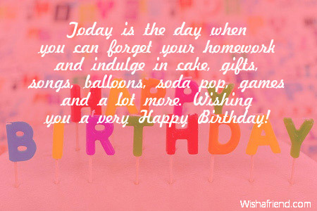

Slide 20
Dear Friend,
now it’s your turn
to make
a Happy Birthday Card for your Friend …

Slide 21
Sources:
http://www.wishescollection.com/wp-content/uploads/2014/03/best-wishes-sms-messages.jpg
http://i.123g.us/c/birth_kids/card/303327.jpg
http://www.wallpapersidol.com/wp-content/uploads/2014/07/kid-birthday-wishes.jpg
http://www.leex.info/wp-content/uploads/2014/03/g.gif
http://www.funtasticecards.com/postcard/images/bday-cute-ted-pink.gif
https://encrypted-tbn1.gstatic.com/images?q=tbn:ANd9GcS04XFs7pv9gVf3xe3P7NjQuXx166jxe1f19OevQae8Ri4ZtzNL
http://zineinfo.com/wp-content/uploads/2014/05/10.gif
http://photo.elsoar.com/wp-content/images/Happy-Birthday-bright-text.jpg
http://2.bp.blogspot.com/-m3YG-5aYOLc/U3G3RJDFXEI/AAAAAAAAAIE/FpGu9um4jIA/s1600/Kids+Birthday+Wishes.jpg
https://encrypted-tbn0.gstatic.com/images?q=tbn:ANd9GcTlqzVVfxYTlF-Kz5I_315ZCX9IjD95CRnMY9tnSxqPvwL-_z5N
http://www.wishafriend.com/birthday/uploads/1902-kids-birthday-wishes.jpg
http://richabhardwaj.neq3.com/wp-content/uploads/2013/10/birthday-wishes-for-best-friend-quotes3-480x261-400x300_c.jpg
http://ekladata.com/F0dFTaUrOehIHbwC4w57Sdrn5ss@500x226.png
http://img114.pp.sohu.com/images/2006/12/9/0/11/10ff7b847be.gif
http://dl10.glitter-graphics.net/pub/2187/2187390ajveeg16k3.gif
http://gallery.yopriceville.com/downloadfullsize/send/2571

