Slide 1
Английский язык
УМК “Spotlight” 9 класс Тест The Rusalka
Автор:
Ольга Михайловна Степанова
учитель английского языка
МБОУ «Чадукасинская ООШ»
Красноармейского района
Чувашской Республики

Slide 2
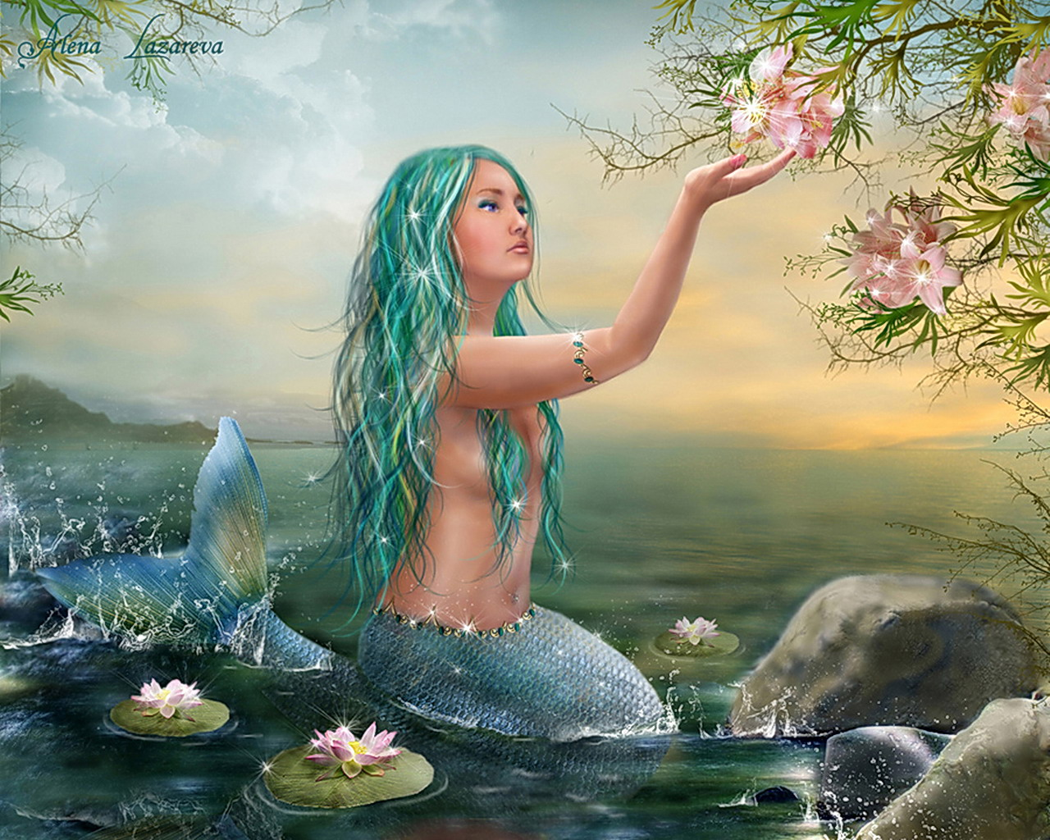
1. According to most traditions, the Rusalkas … fish-women.
a) have
b) are
c) is
d) can

Slide 3
2. The Rusalka is the spirit of a young woman who … .
a) drowned
b) was killed
c) died
d) was lost

Slide 4
3. She has long wet hair that never … .
a) is painted
b) is cut
c) dries
d) is washed

Slide 5
4. The Rusalka lives at the bottom of lakes? Rivers or streams, but when there is a new moon she comes … to a nearby forest or meadow. .
a) back
b) out
c) for
d) along

Slide 6
5. There she sits on a tree and … her hair.
a) combs
b) paints
c) washes
d) cuts

Slide 7
6. Sometimes she … in circles with other Rusalkas.
a) eats
b) plays
c) cries
d) dances

Slide 8
7. When the Rusalka sees a handsome man she mesmerizes him and leads him to the bottom of the water where he …
a) drowns
b) marries her
c) falls asleep
d) fishes

Slide 9
Key to the test
Ключи к тесту
1 | 2 | 3 | 4 | 5 | 6 | 7
b | a | c | b | a | d | a

Slide 10
Источник:
http://www.zagadochnaya-sila.ru/images/stories/picture/rusalka/rusalki_007.jpg
http://en.wikipedia.org/wiki/Rusalka
Шаблон презентации:
http://shkola-abv.ru/vse_dlya_prezentasiy2.html
Вопросы теста взяты из учебника Spotlight-9 - стр 5 Spotlight on Russia

