Slide 1
Английский язык
УМК “Spotlight” 9 класс The Most Haunted Castle
in Britain
Автор:
Ольга Михайловна Степанова
учитель английского языка
МБОУ «Чадукасинская ООШ»
Красноармейского района
Чувашской Республики

Slide 2
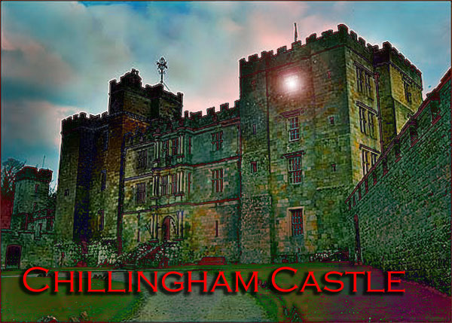
Is it The Most Haunted Castle in Britain?

Slide 3
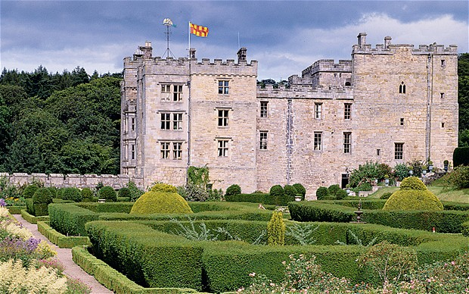
A crumbling northern castle with a proud history has been rescued by an English eccentric,
whose whimsical collections have breathed
new life into the building

Slide 4
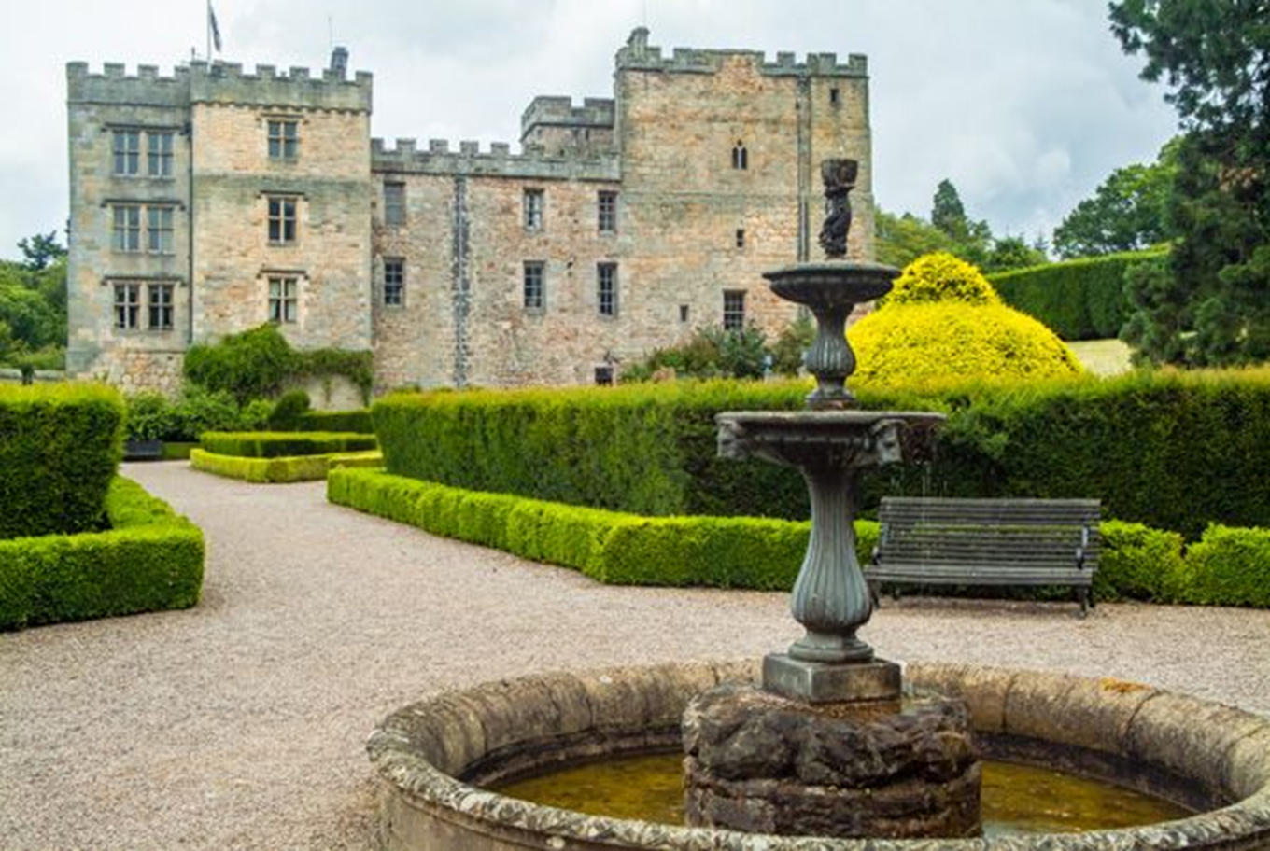
A superb medieval fortress, rich in historical interest, Chillingham Castle was built in the 13th century as a monastery. Chillingham has been in the hands of the Grey family and their descendants since the year 1246.

Slide 5
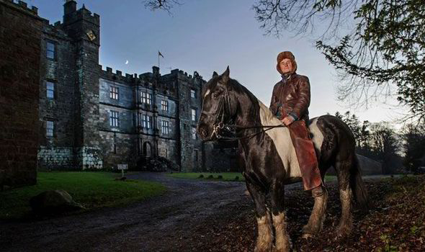
Chillingham Castle is now owned by Sir Humphry Wakefield

Slide 6
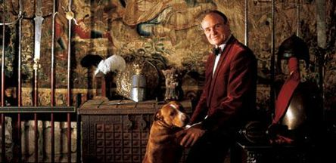
Sir Humphry Wakefield
(born 11 July 1936)
is an English baronet who succeeded his father, Sir Edward Birkbeck Wakefield in the baronetcy in 1969.

Slide 7
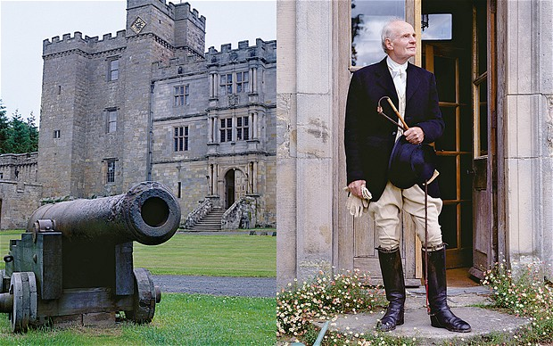
In 1982 he bought Chillinghham Castle, Northhumberland, from the Grey family, of Northumberland, the family of his third wife Catherine, daughter of Lady Mary Grey. He has since restored the ruined castle to a habitable state to house his wide collection of antiquities,
from his own collection and those of his relations.
For 30 years it has been home to Sir Humphry Wakefield and his wife, Katharine.

Slide 8
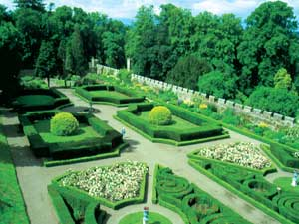
With romantic grounds, the castle commands breathtaking views of the surrounding countryside. As you walk to the lake you will see, according to season, drifts of snowdrops, daffodils or bluebells and an astonishing display of rhododendrons. Lawns, the formal gardens and woodland walks are all fully open to the public.
Chillingham Castle
Gardens

Slide 9
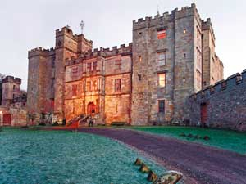
Chillingham Castle exterior

Slide 10
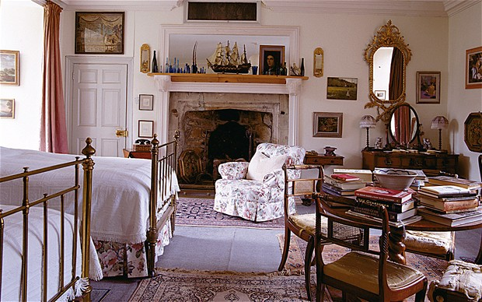
The pink guest room, said to be haunted by a 'singing Blue Boy'

Slide 11
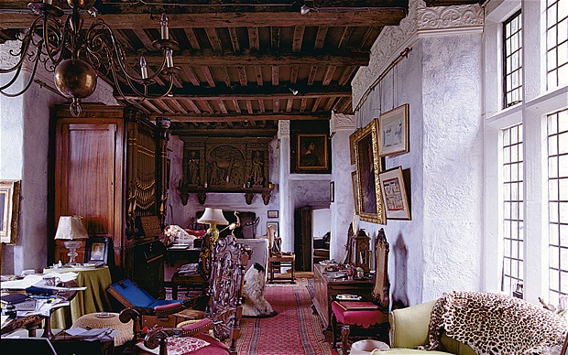
Sir Humphry uses the Long Gallery as his private office

Slide 12
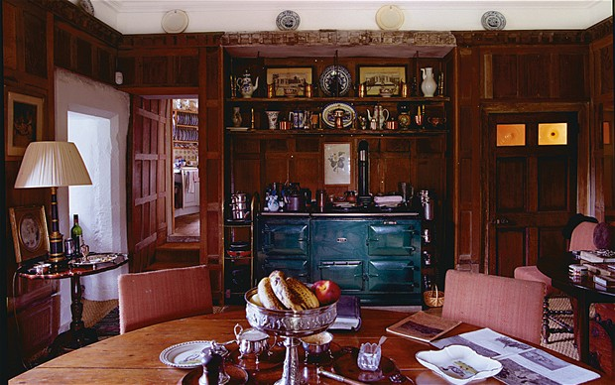
The small informal dining-room is just off the kitchen and used by the family when they are not entertaining

Slide 13
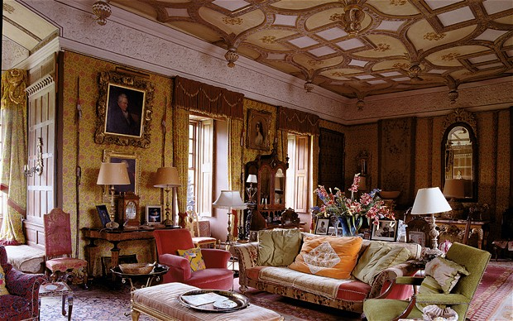
The King James I Room is hung with golden silk
from a design woven for Chatsworth.
The furnishings come from Sir Humphry's Stately Homes collection for Baker Furniture: replicas from the great houses of Britain, Ireland and Russia

Slide 14
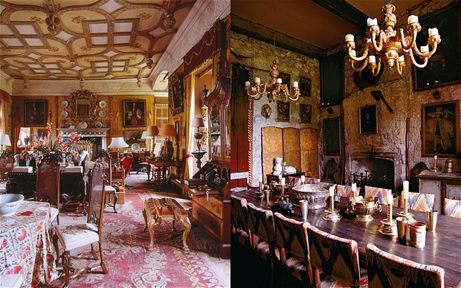
The complex 16th-century ceilings in the King James I room were determinedly restored by Sir Humphry; the candlelit dining-room has gilt-embroidered scarlet velvet curtains and stone walls

Slide 15
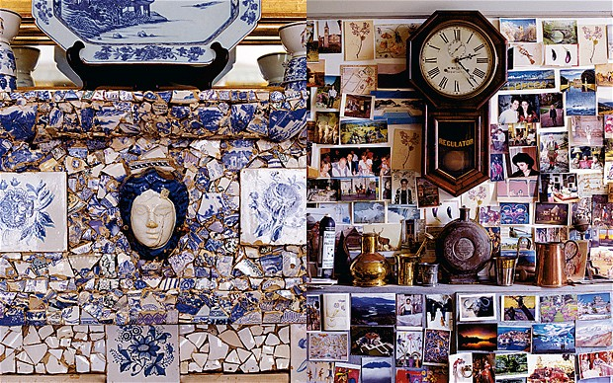
A section of the drawing-room's chimney piece, which Sir Humphry created with fragments of blue and white china he has gathered worldwide.
Far right the kitchen wall, plastered with friends’ postcards surrounding a clock 'with many chimes'

Slide 16
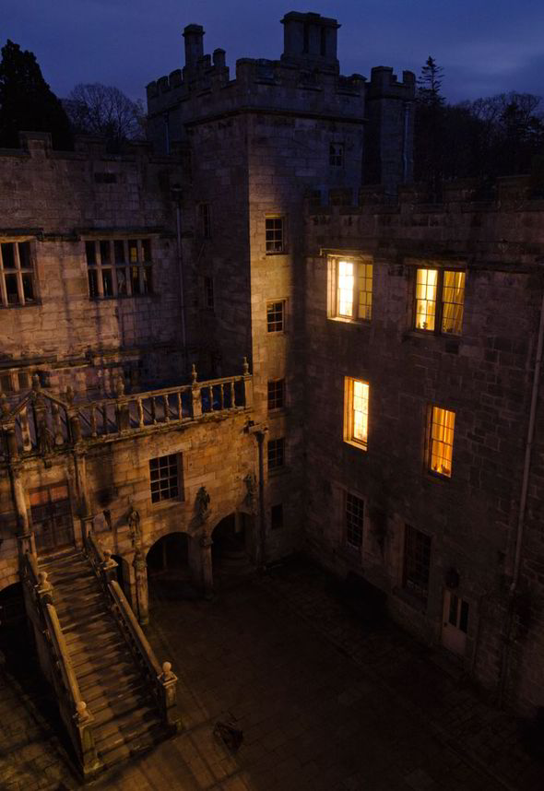
The
castle's
Inner
Courtyard
at
twilight

Slide 17
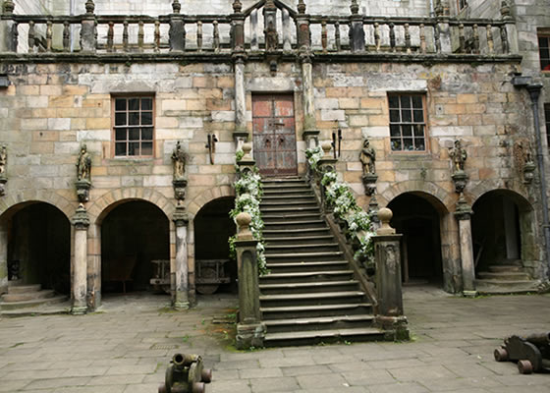
The famous film "Elizabeth" staged
many historic scenes here.
"The Making of Harry Potter" was based
at Chillingham..

Slide 18
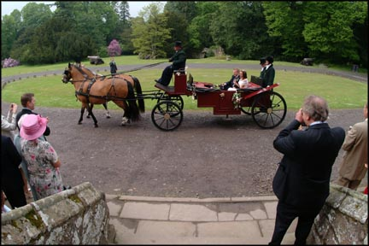
The carriage bearing a bride and groom
enters the gates of Chillingham Castle.

Slide 19
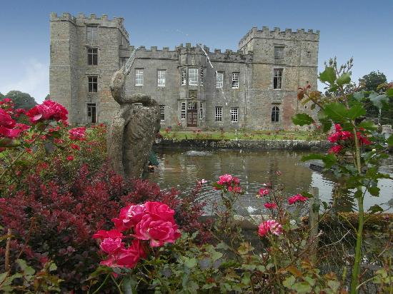
The Beauty of Chillingham
attracts a lot of tourists

Slide 20
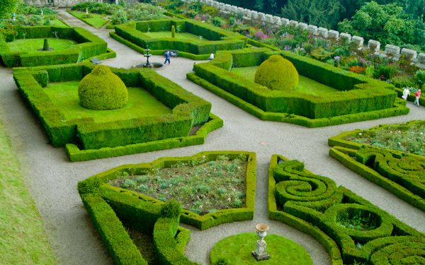
It is difficult to think even that
Chillingham is the most huuanted Castle!

Slide 21
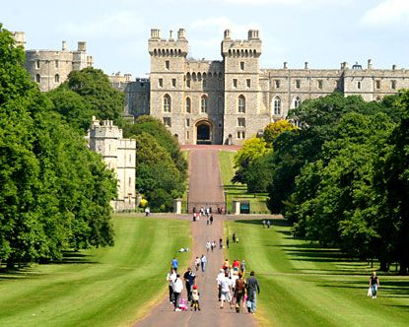
Welcome to Chillingham Castle!

Slide 22
Sources:
http://www.hudsonsheritage.com/North-East/thedms.aspx?dms=3&venue=8110619
http://en.wikipedia.org/wiki/Humphry_Wakefield
http://www.express.co.uk/news/weird/439810/Is-this-Britain-s-most-haunted-house
http://www.bakerfurniture.com/baker/images/collections/sh_main_home.jpg
http://www.britainexpress.com/attractions.htm?attraction=3044
http://www.chillingham-castle.com/Film.asp?S=10&V=1&P=30
http://www.hauntedamericatours.com/image/chillingham_castle.jpg
http://www.masonstudio.co.uk/wch1/wchillc17.jpg
http://www.jurnale.ro/img_1/poze_notite_8673.jpg

