Slide 1
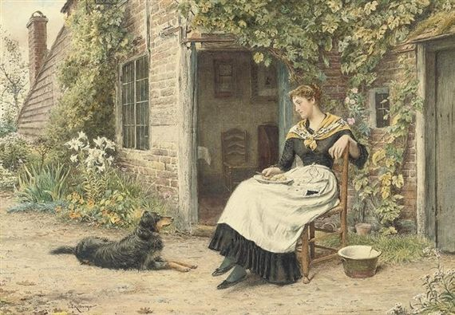
Посвящается
перекрестному Году культуры Великобритании и России 2014
Welcome to
George Goodwin Kilburne
Art Gallery
Автор:
Ольга Михайловна Степанова
учитель английского языка
МБОУ «Чадукасинская ООШ»
Красноармейского района
Чувашской Республики

Slide 2
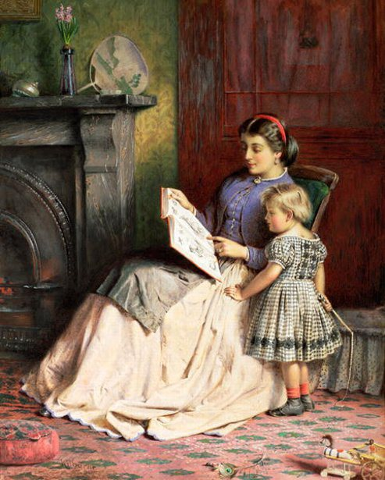
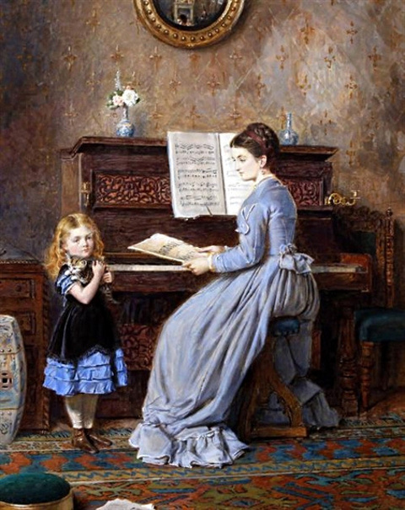
George Goodwin Kilburne (1839-1924) was
an English genre painter specializing in interior scenes.

Slide 3
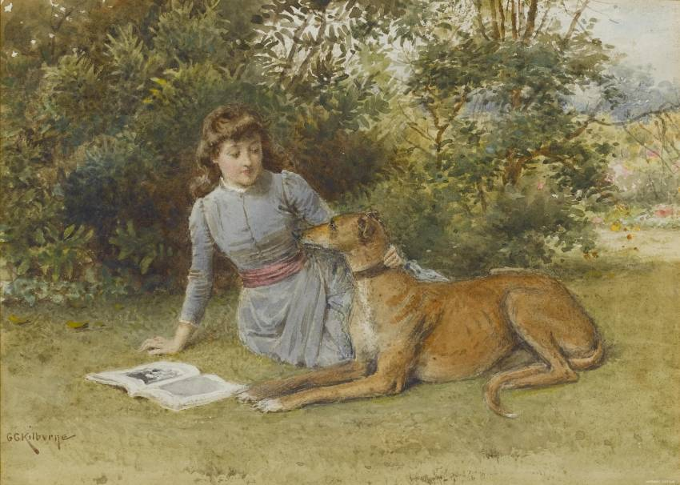
George was born at Hackford in Norfolk
the eldest of the three children of Goodwin Kilburne (1812–1887) and Rebeccca Button (1801–1880).

Slide 4
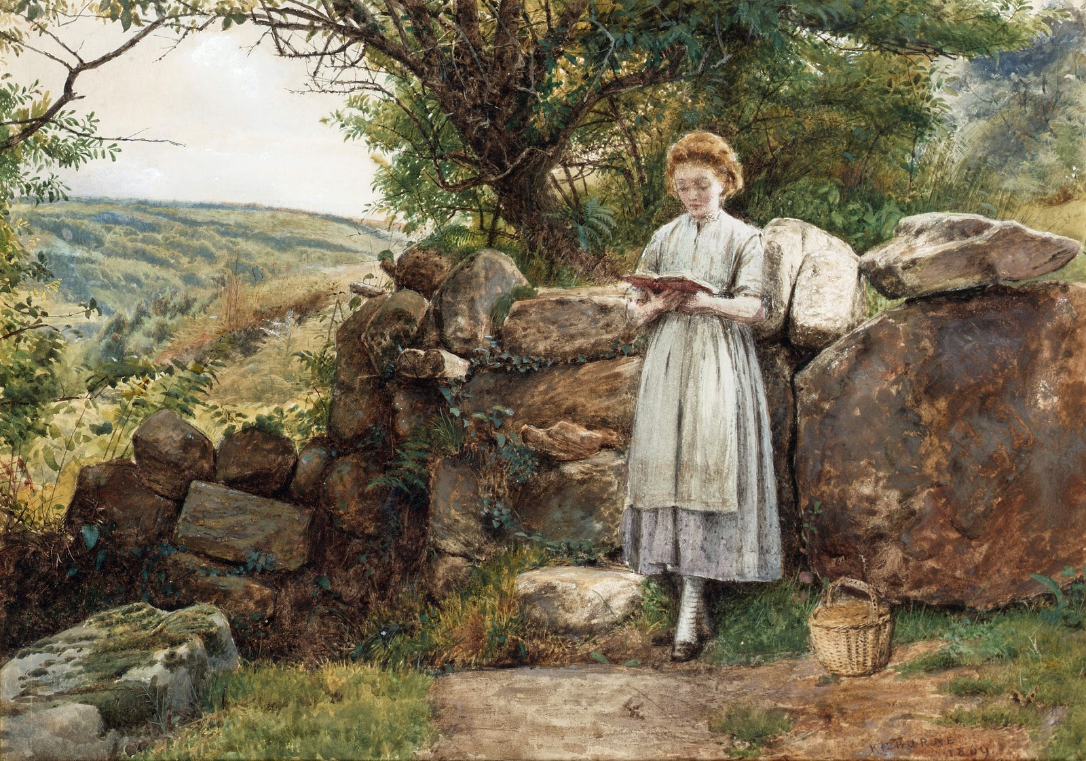
Kilburne was educated at Hawrkhust, Kent - his father's old school. On leaving at the age of 15, he went to London to serve a 5-year apprenticeship as a wood engraver with the Dalziel brothers, engravers and illustrators. He was highly regarded by his employers who described him as "industrious and constant" and "one of the most satisfactory pupils we ever had".
A Peaceful Read (1869)

Slide 5
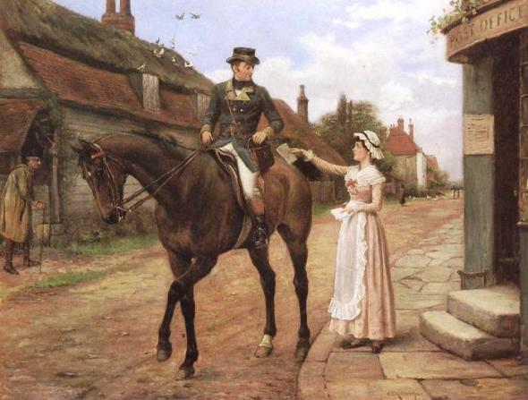
He studied in London, first studied engraving, which was later changed to a more profitable while dealing - watercolor and oil painting.
Quickly became one of the most famous artists of England.

Slide 6
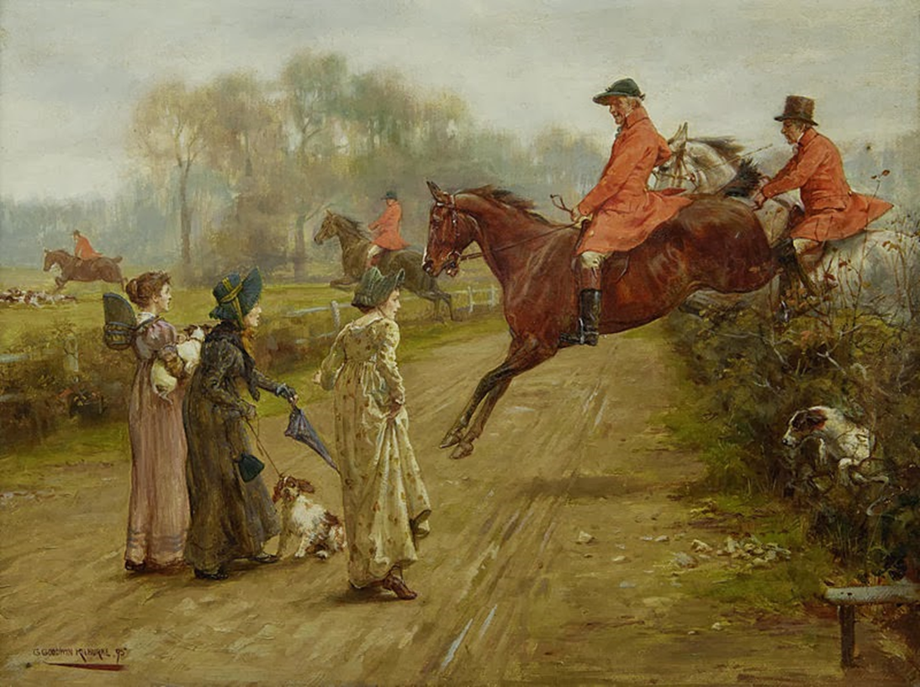
Kilburne was a keen sportsman and equestrian
and involved himself in hunting, cycling and golf.
That is why Horses and hunting scenes are often figured
in his pictures.

Slide 7
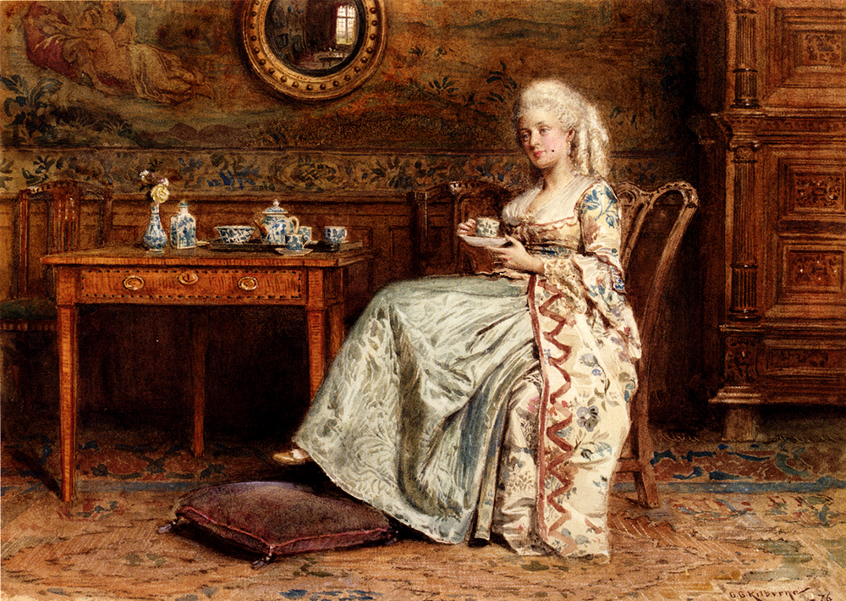
Taking Tea

Slide 8
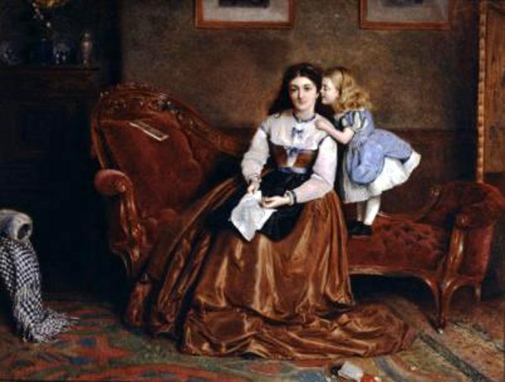
A Secret Shared
Exquisitely portrayed are his images of the ultra-fashionable female beauty. His depiction of this beauty was heightened by dress, a treatment that concentrated heavily on externals and on rich decoration.

Slide 9
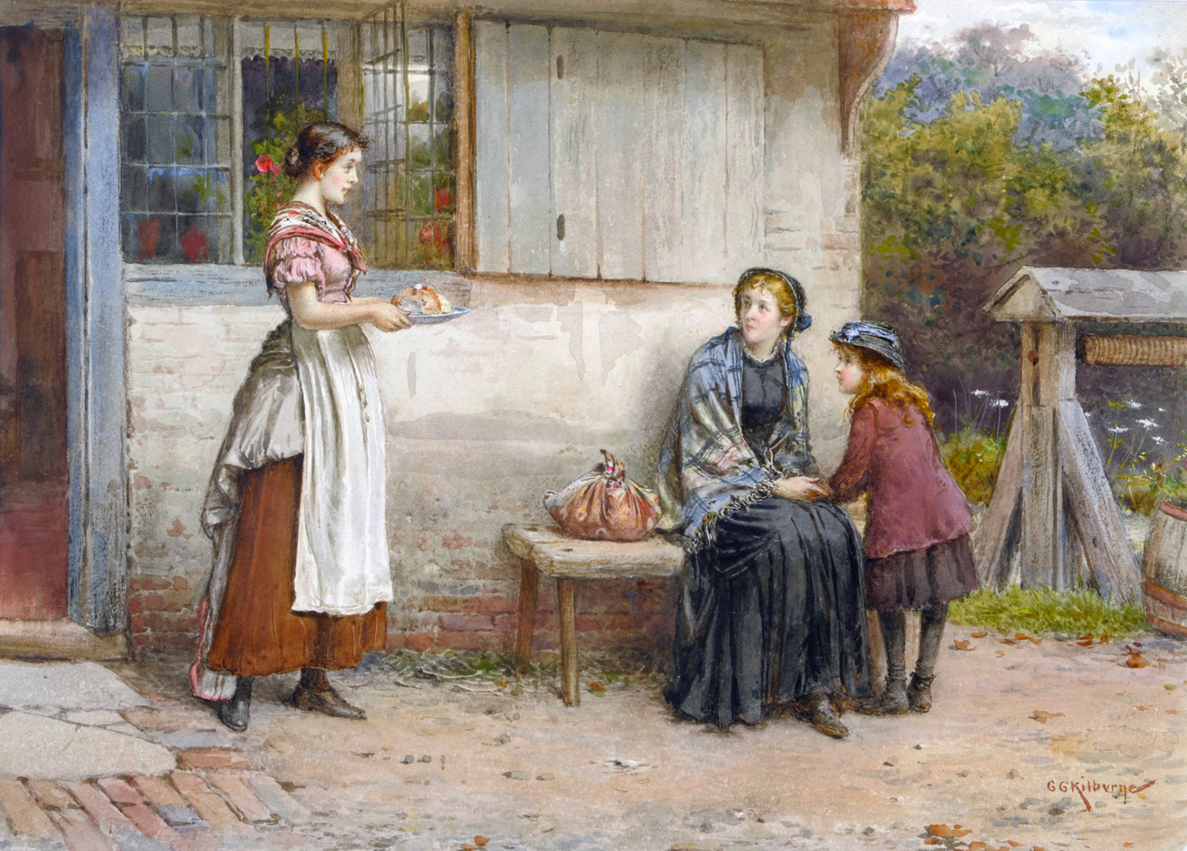
Charity

Slide 10
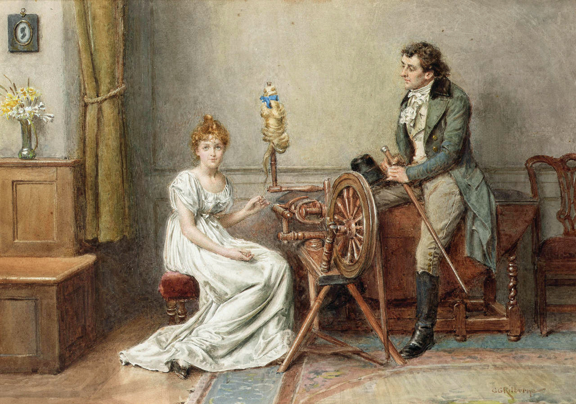
An Encounter at the Spinning Wheel

Slide 11
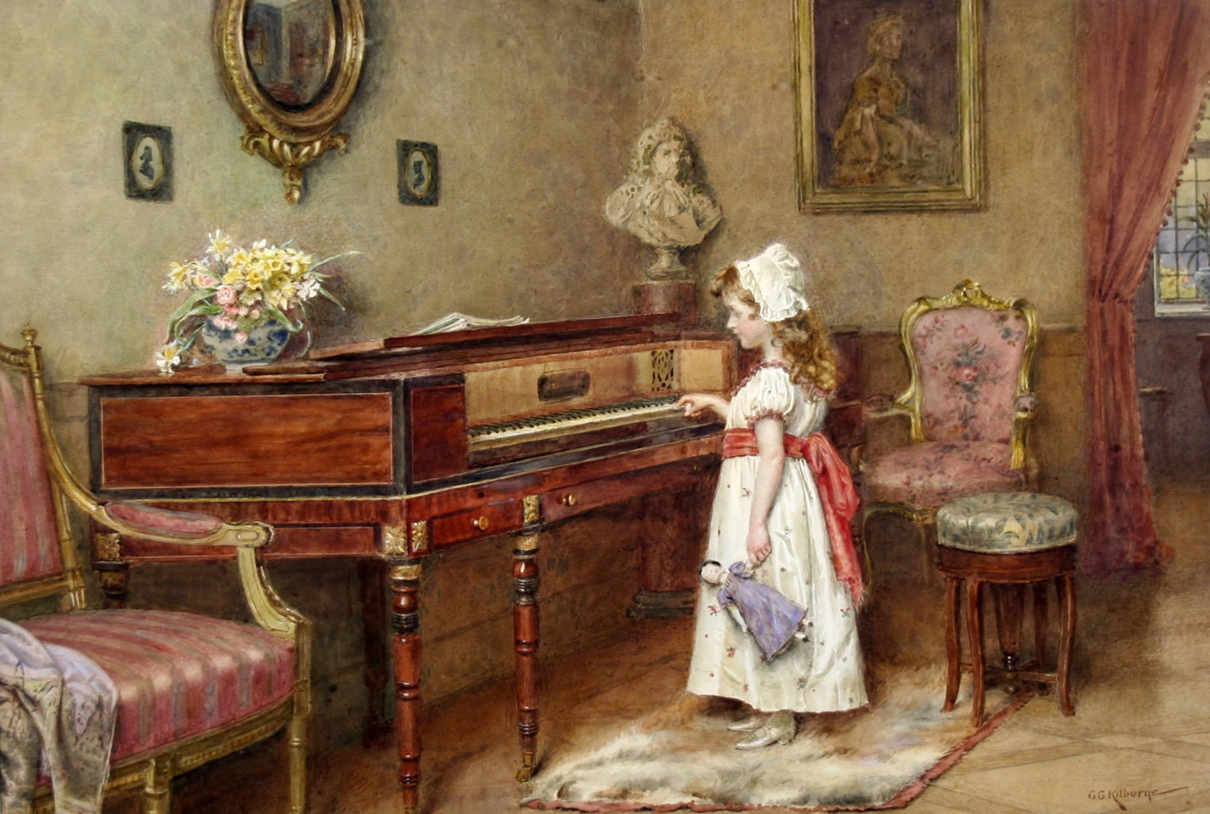
Piano practice

Slide 12
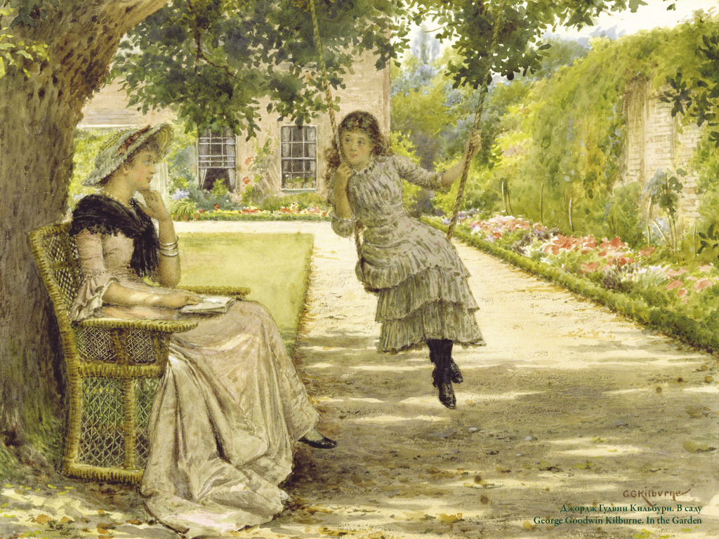
Genre scenes are especially common for the painter

Slide 13
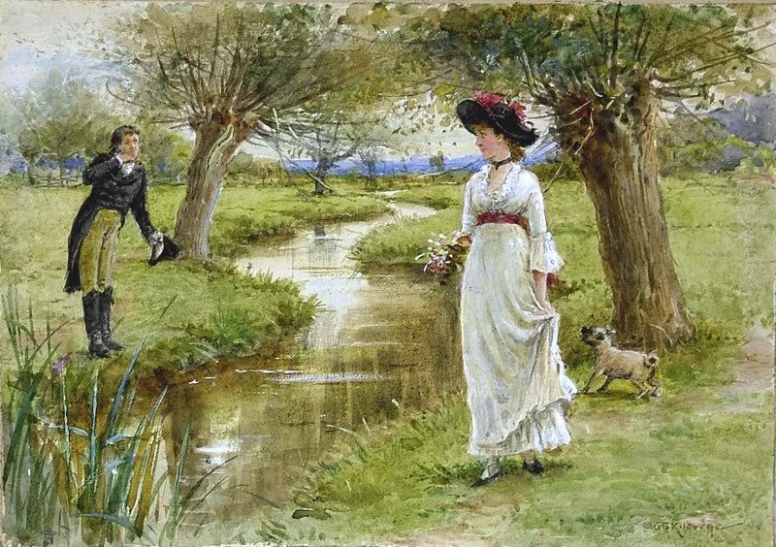
Young woman by a stream with her pug and an admirer

Slide 14
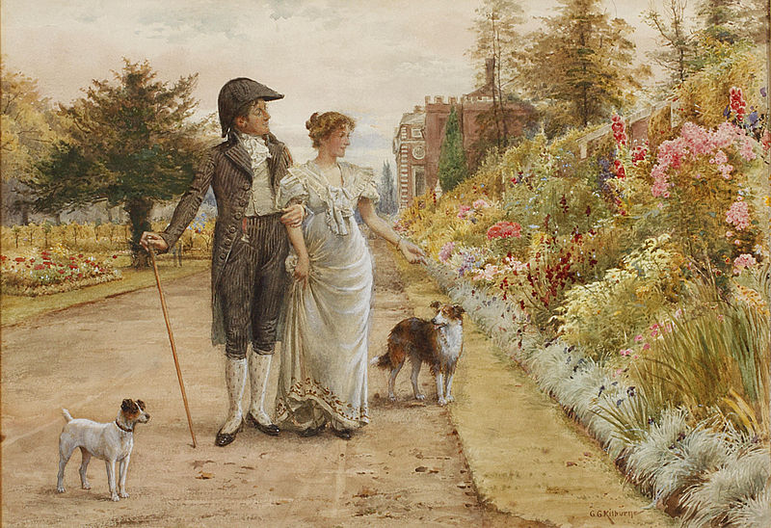
A garden stroll

Slide 15
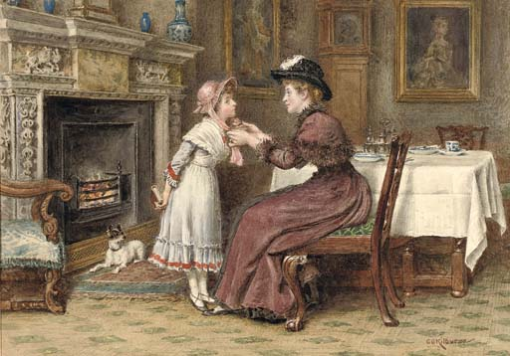
A mother with her daughter
In the painter’s art is very common
Sunday morning

Slide 16
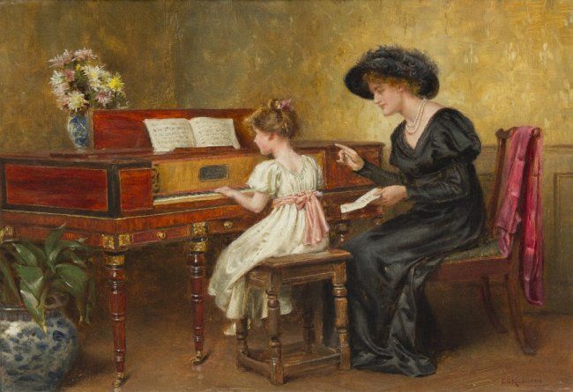
The Music Lesson

Slide 17
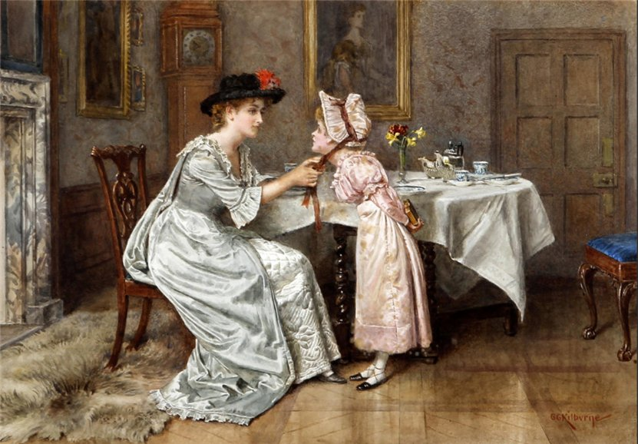
Sunday Morning

Slide 18
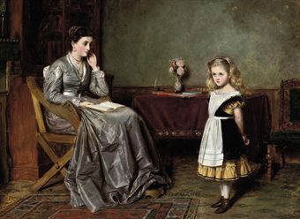
The Recitation

Slide 19
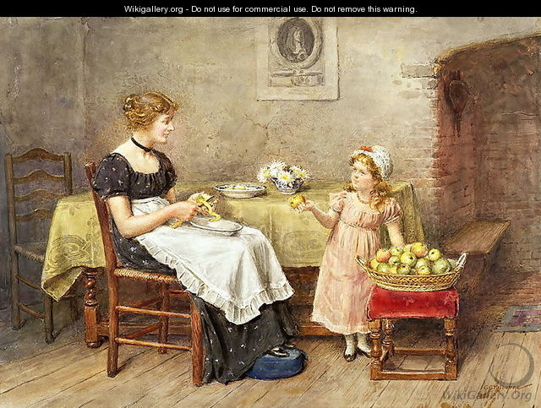
The Little Helpmate

Slide 20
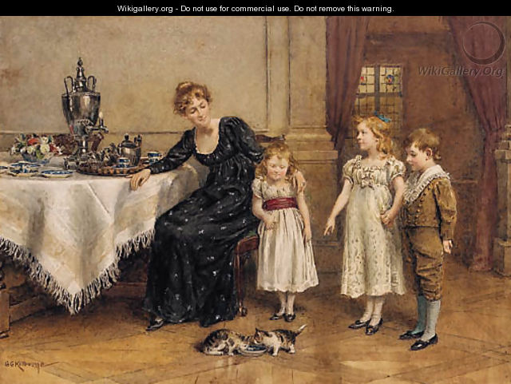
Tea in the nursery.

Slide 21
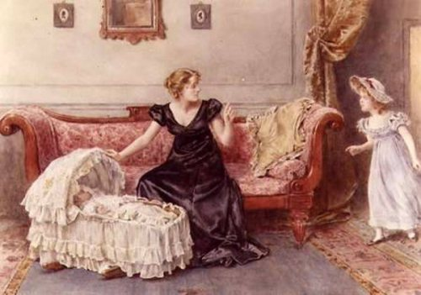
Hush

Slide 22
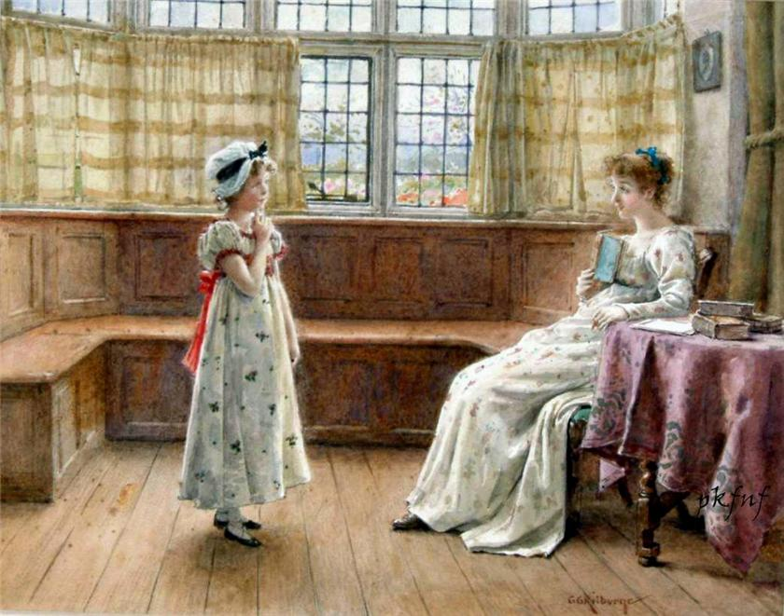
A Difficult Question

Slide 23
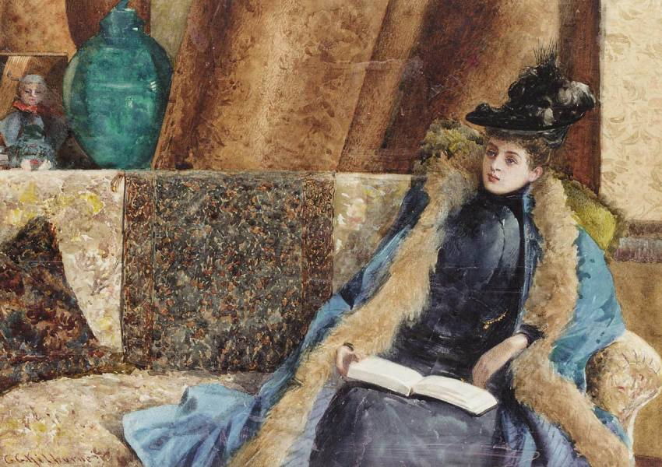
Lady Reading

Slide 24
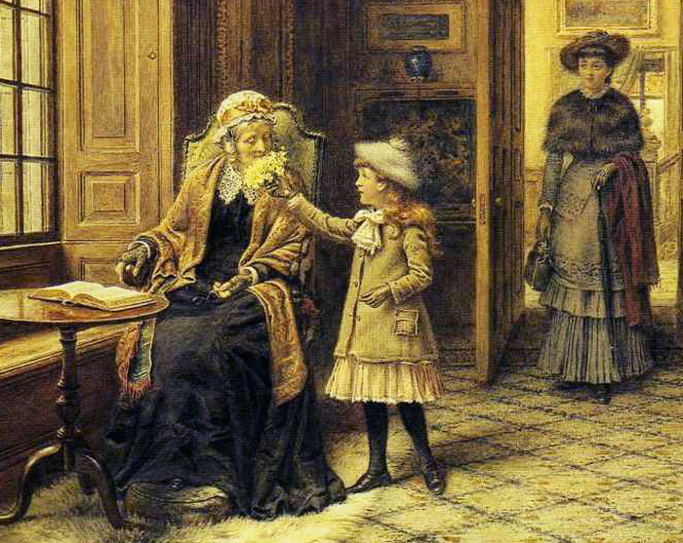
Posy for Grandma.

Slide 25
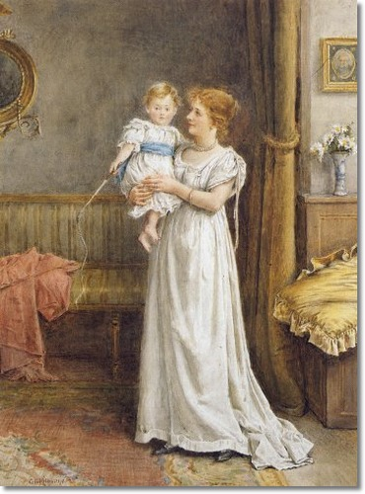
George's paintings often portrayed the upper classes and ultra-fashionable female beauties in opulent settings. His depiction of this beauty was heightened by his attention to detail with dress, and richly decorated interiors.

Slide 26
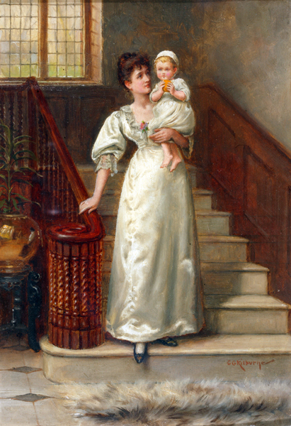
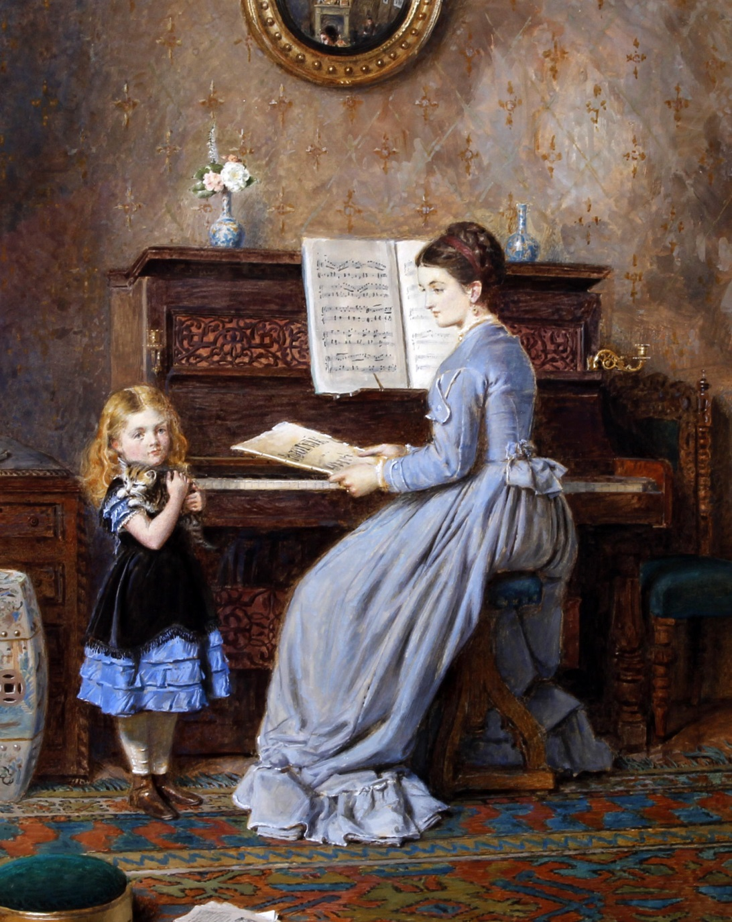
The Beauty of GEORGE GOODWIN KILBURNE

Slide 27
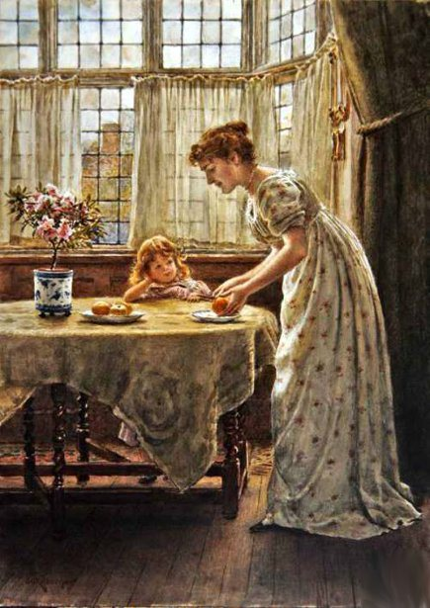
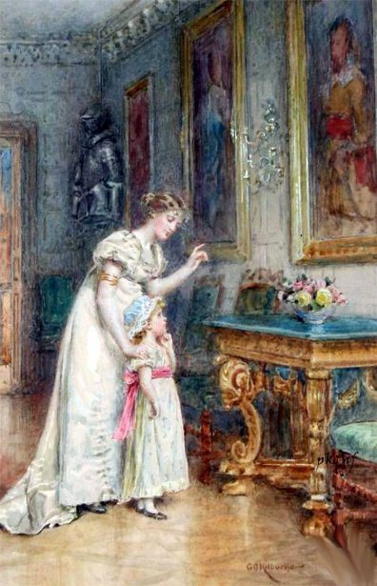
Afternoon Treat

Slide 28
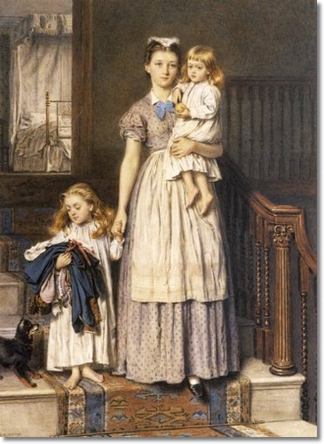
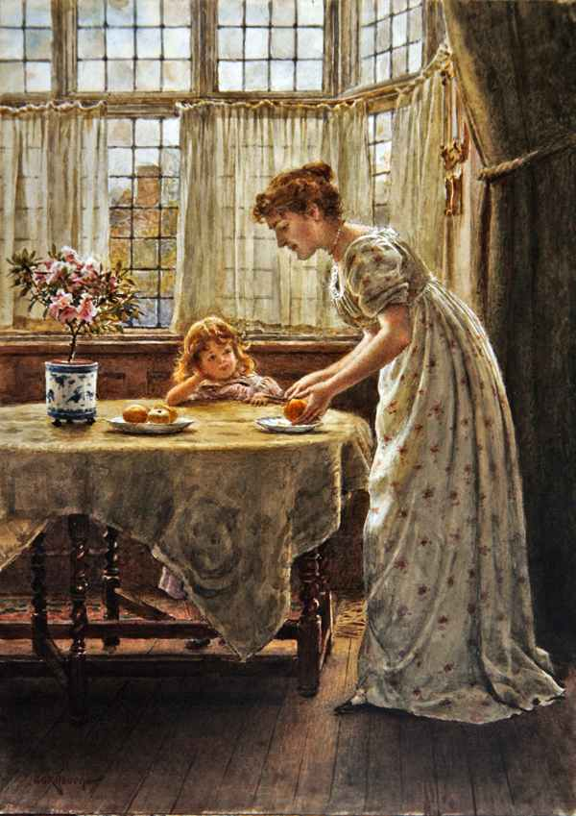
Fantastic Plots of GEORGE GOODWIN KILBURNE

Slide 29
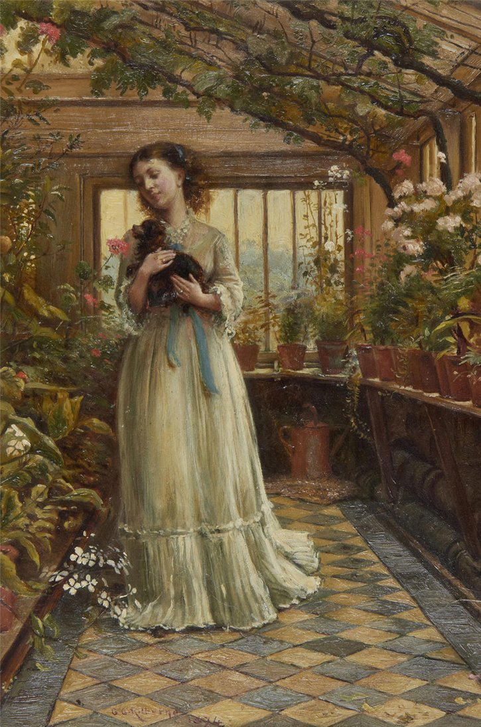
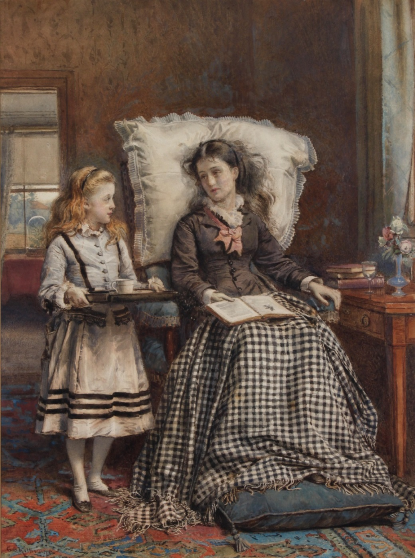
Our Admirations…

Slide 30
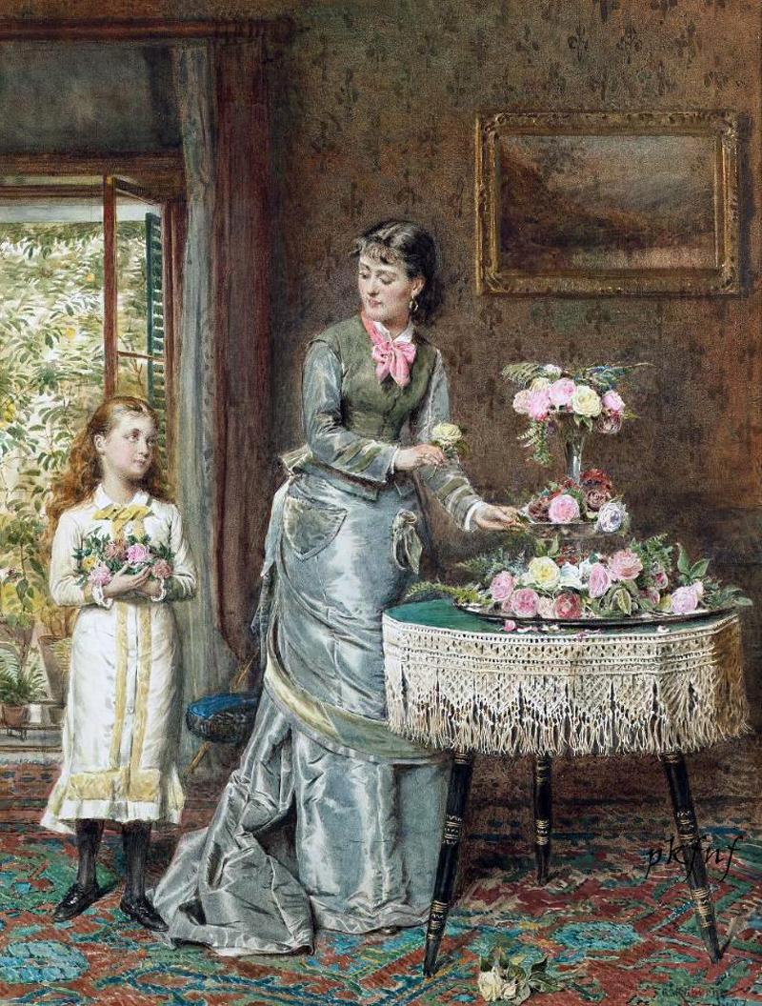
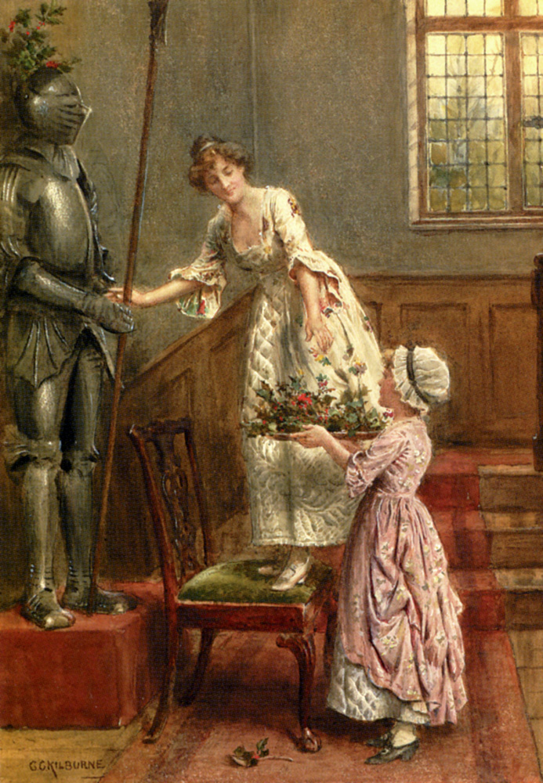
Mather and daughter Series

Slide 31
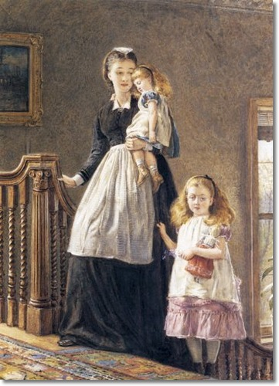
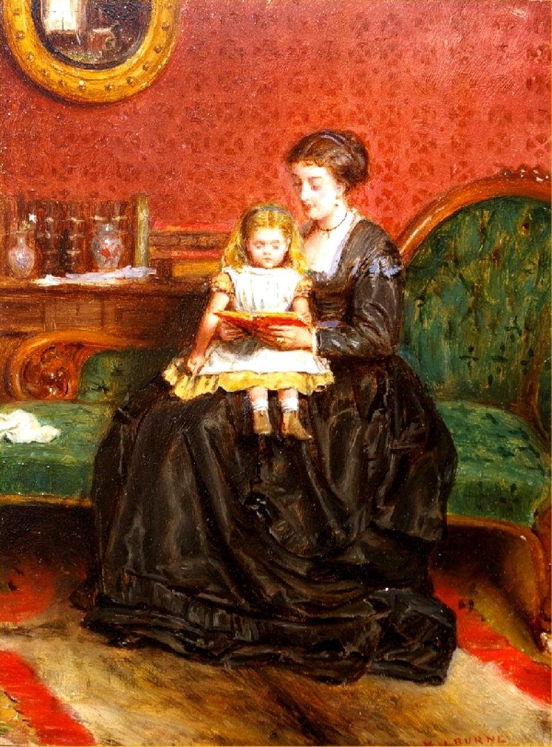
Charming art of GEORGE GOODWIN KILBURNE

Slide 32
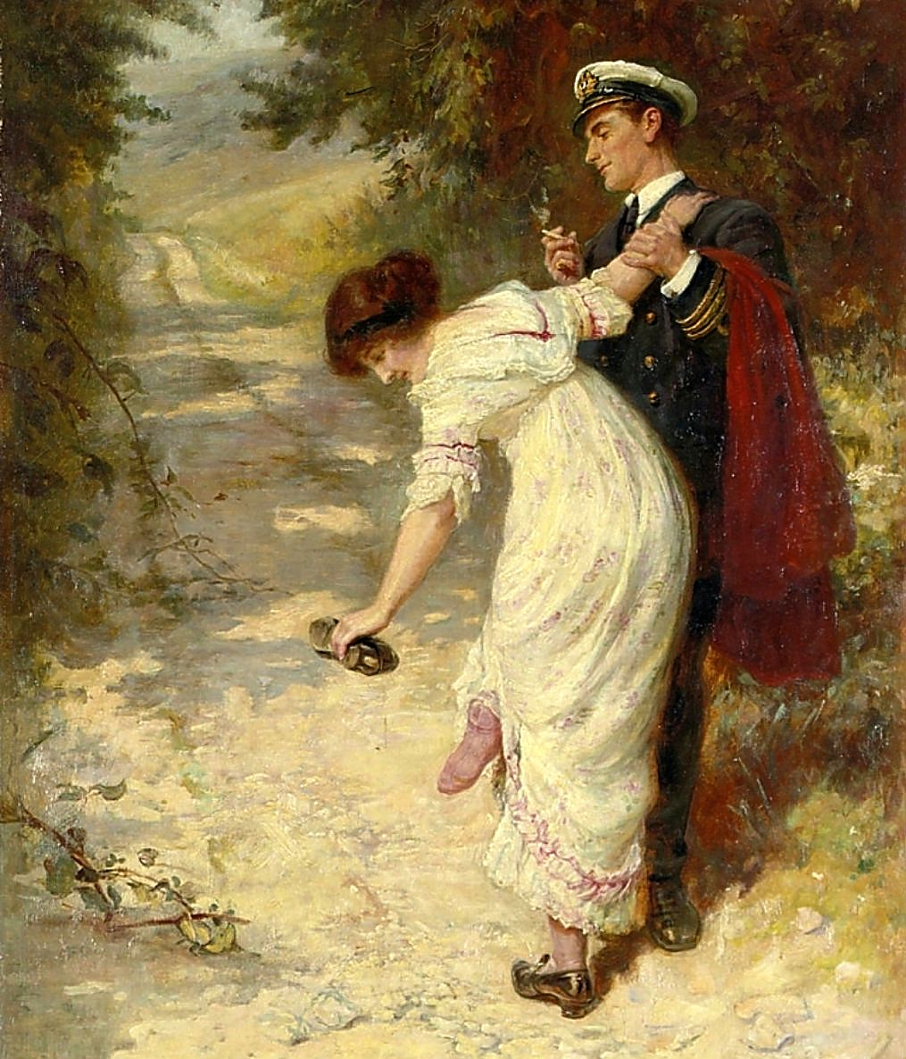
For over fifty years GEORGE GOODWIN KILBURNE
had been the honorary treasurer of the Artists' Society, and he was an assiduous member of the Langham Sketching Club and Life School.

Slide 33
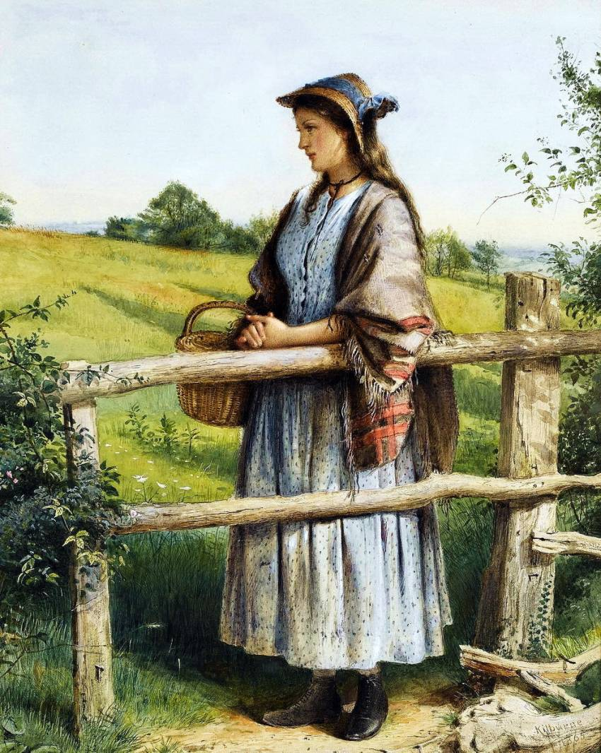
Many of his pictures became popular through prints. His work can be seen in many public and private galleries worldwide including the Walker Art Gallery in Liverpool, Manchester City Art Gallery and the Sheffield Art Gallery.

Slide 34
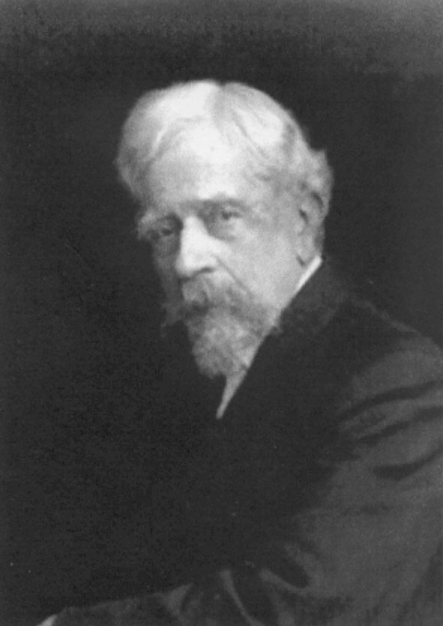
Thank you
for Visiting
GEORGE GOODWIN KILBURNE Art Gallery!
GEORGE GOODWIN KILBURNE
The Master of Art

Slide 35
Sources
http://commons.wikimedia.org/wiki/File:George_Goodwin_Kilburne_A_young_woman_at_a_piano_1880.jpg
http://19thcenturybritpaint.blogspot.ru/2012_10_01_archive.html
http://commons.wikimedia.org/wiki/File:George_Goodwin_Kilburne_Piano_practice.jpg
http://www.wikigallery.org/wiki/painting_268308/George-Goodwin-Kilburne/Tea-in-the-nursery
http://www.wikigallery.org/wiki/painting_203058/George-Goodwin-Kilburne/The-Little-Helpmate
http://www.christies.com/LotFinder/lot_details.aspx?intObjectID=4915027
http://www.christies.com/LotFinder/lot_details.aspx?intObjectID=5375642
http://www.liveauctioneers.com/item/14432734_george-goodwin-kilburne-british-1839-1924-the
http://www.encore-editions.com/george-goodwin-kilburne-the-master-of-the-house-1899
http://www.liveinternet.ru/tags/George+Goodwin+Kilburne/
http://www.haynesfineart.com/artists/george-goodwin-kilburne-uk
http://iamachild.wordpress.com/2013/10/23/george-goodwin-kilburne-1839-1924-english/
http://www.the-athenaeum.org/art/detail.php?ID=80341
http://www.the-athenaeum.org/art/full.php?ID=29469
http://c300221.r21.cf1.rackcdn.com/george-goodwin-kilburne-jr-expectation-pencil-on-mutualartcom-1384913471_b.Jpeg
http://img.photobucket.com/albums/v613/SLQ13/PossiblybyGeorgeGoodwinKilburne1839.jpg
http://commons.wikimedia.org/wiki/Category:George_Goodwin_Kilburne
http://www.passionforpaintings.com/art-gallery/george-goodwin-kilburne-painter/

