Slide 1
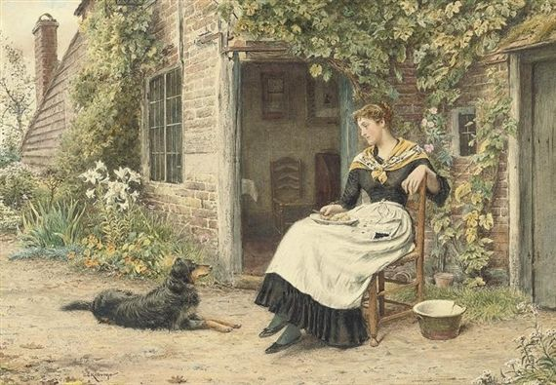
Посвящается
перекрестному Году культуры Великобритании и России 2014
Welcome to
George Frederic Morgan
Art Gallery
Автор:
Ольга Михайловна Степанова
учитель английского языка
МБОУ «Чадукасинская ООШ»
Красноармейского района
Чувашской Республики

Slide 2
When you are attacked
by gloomy thoughts,
something very beautiful
can help you so much
as running to Fred’s paintings… .

Slide 3
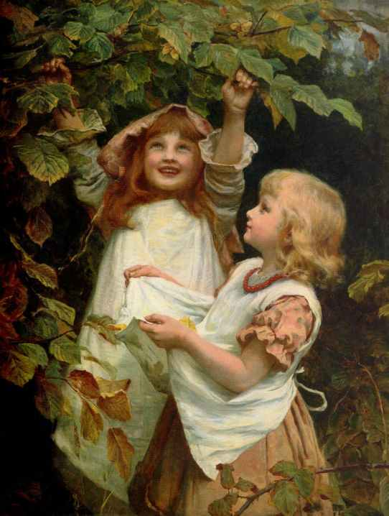
Picking nuts

Slide 4
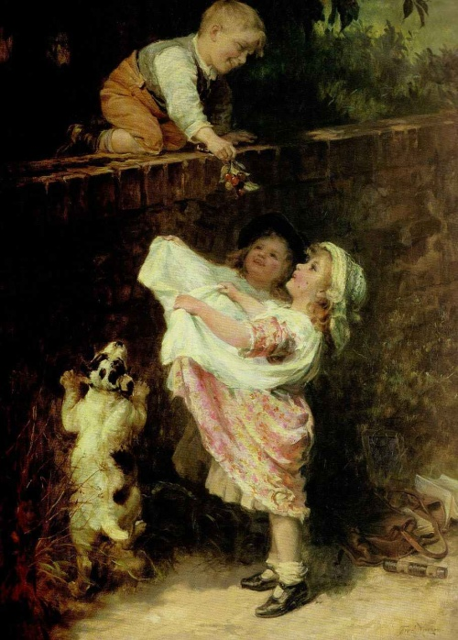
Cherry Pickers

Slide 5
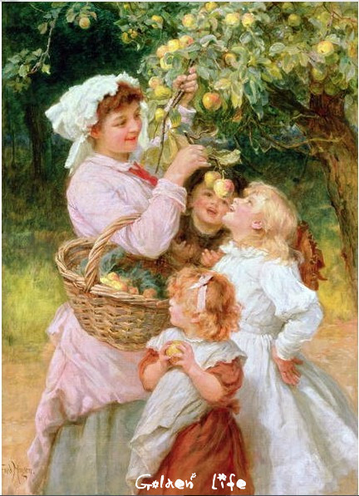
Apple Bob

Slide 6
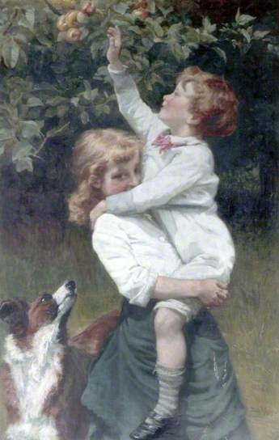
Garden of Eden

Slide 7
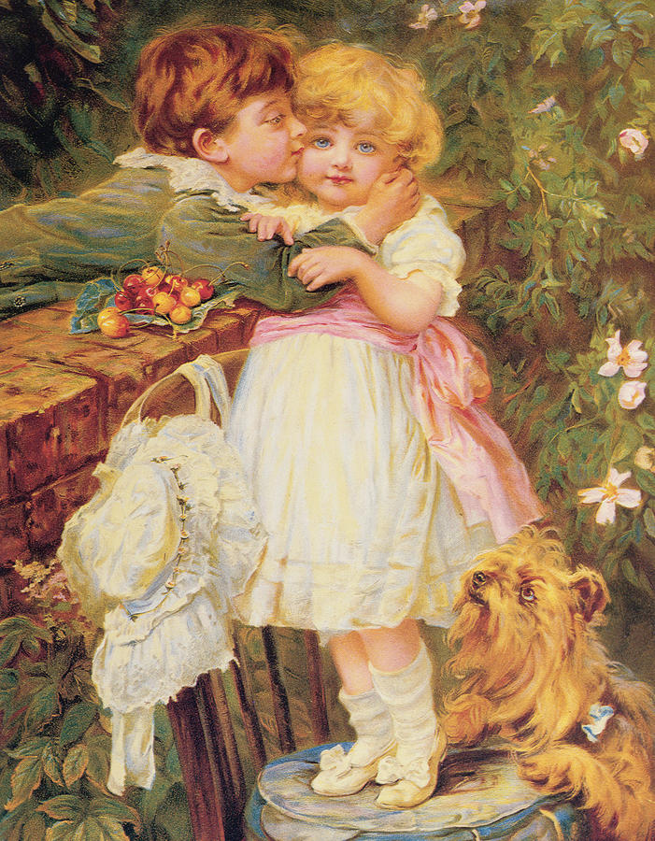
Over the Garden Wall

Slide 8
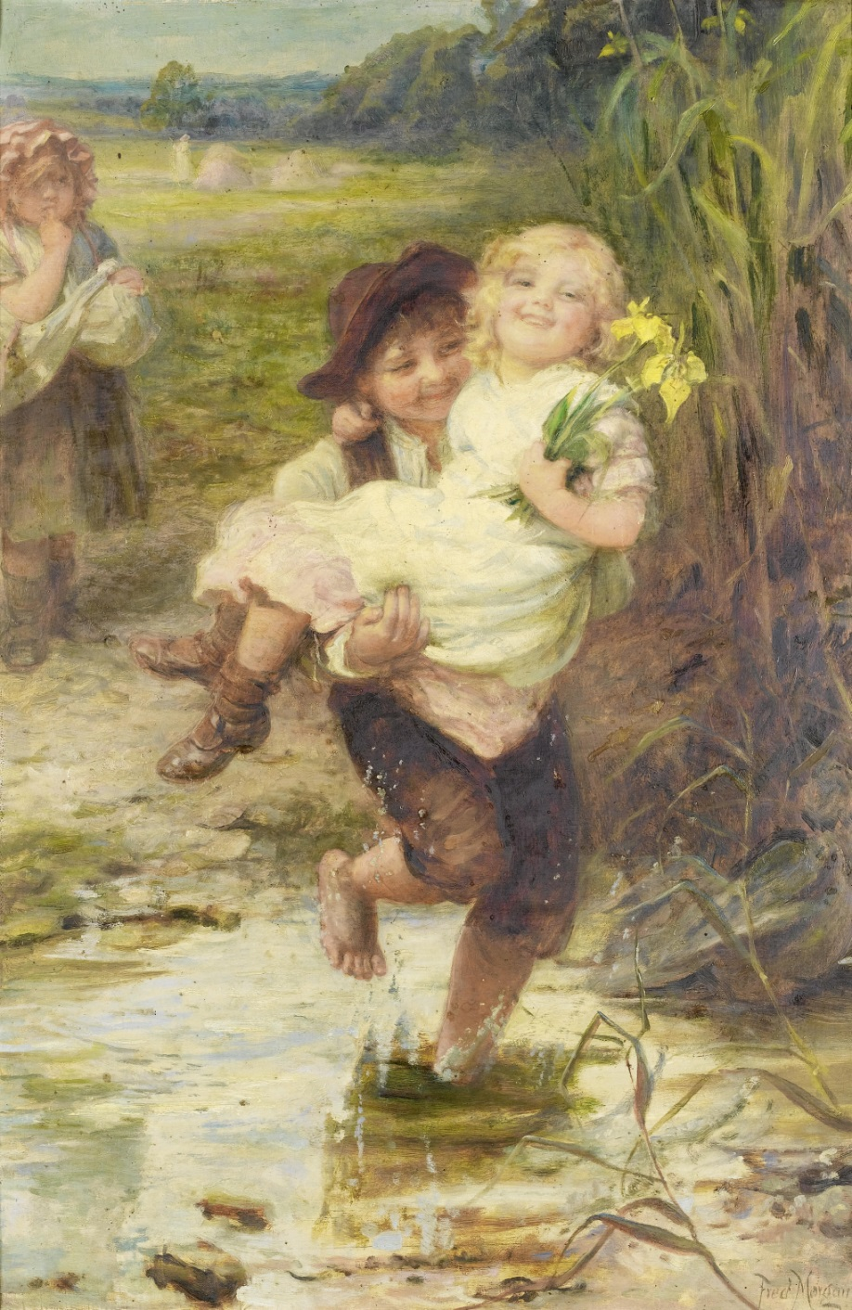
The Young Gallant

Slide 9
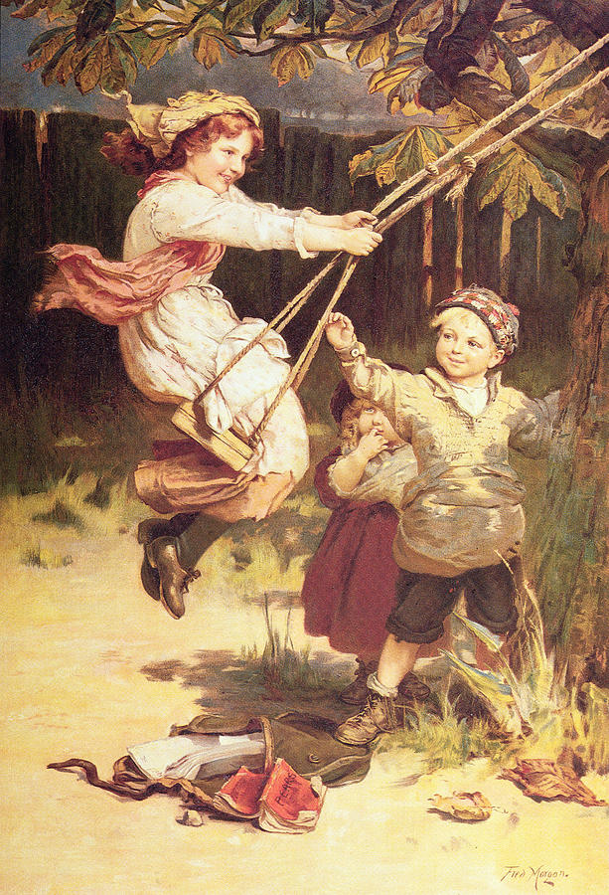
After School

Slide 10
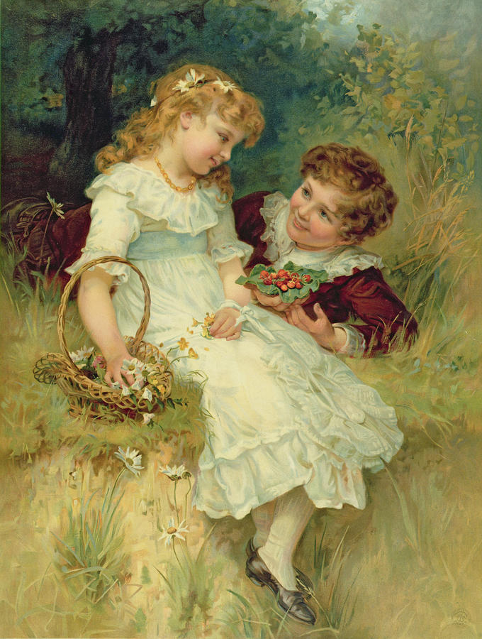
Childhood
Sweethearts
sweethearts

Slide 11
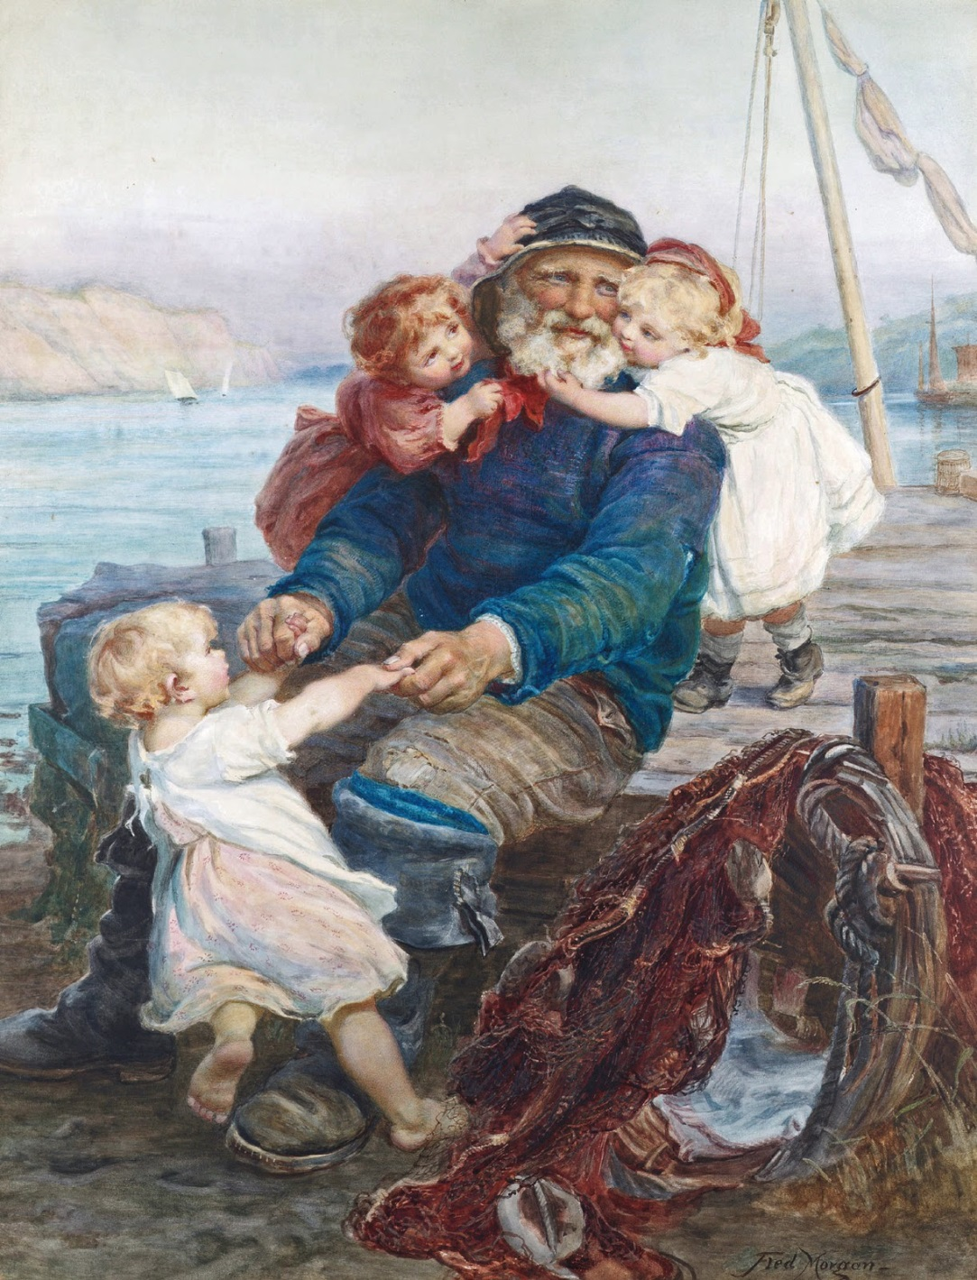
Which do you
love best

Slide 12
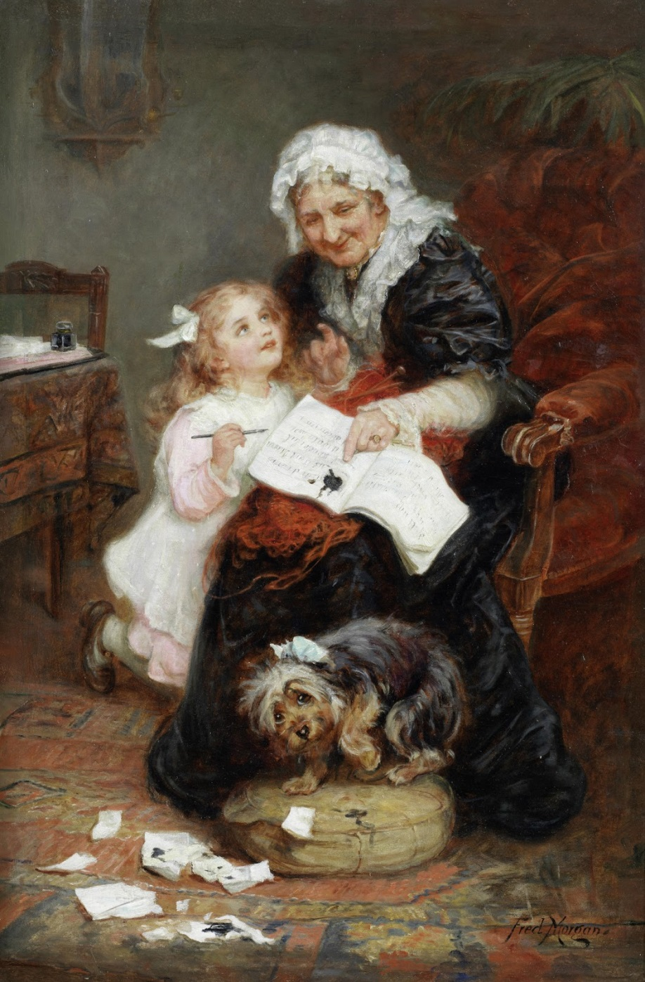
The Penitent Puppy

Slide 13
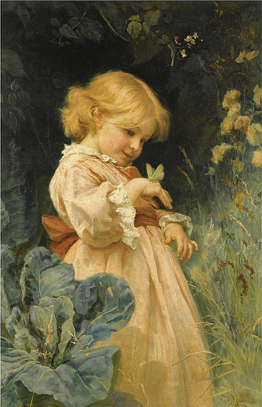
Butterfly

Slide 14
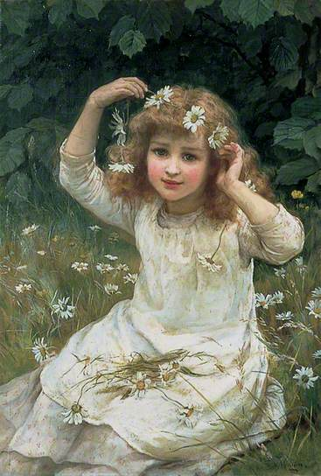
Marguerites

Slide 15
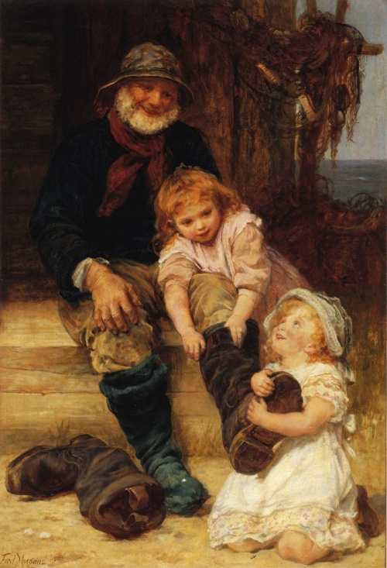
Helping Grandpa

Slide 16
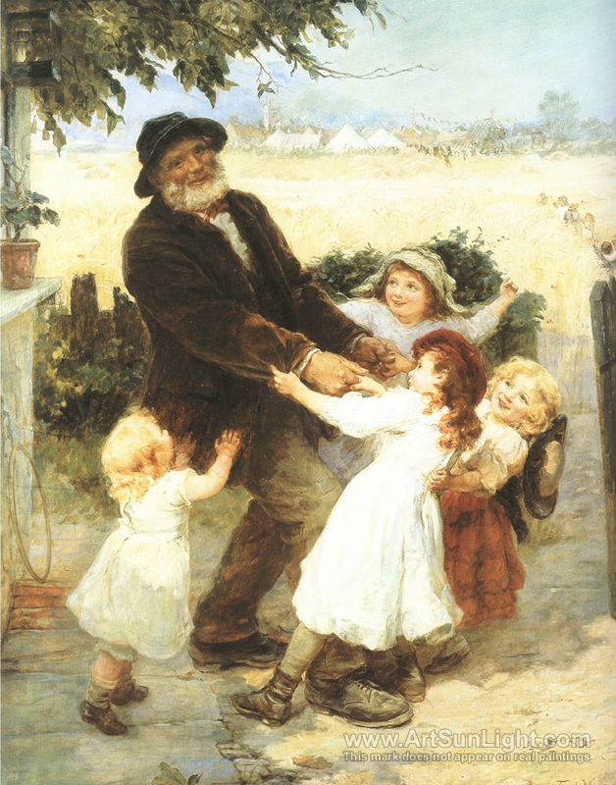
Off to the Fair
Off to the Fair

Slide 17
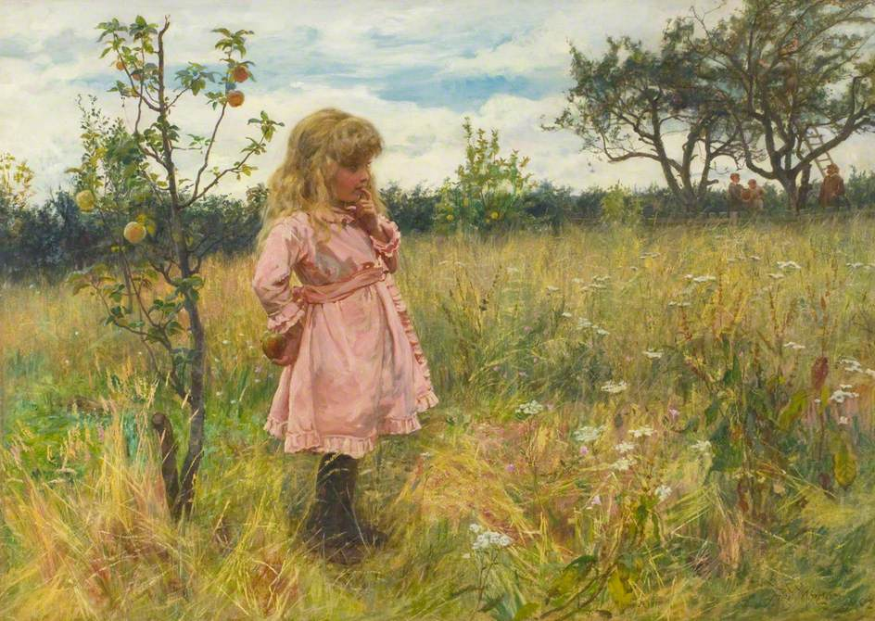
A Modern Eve

Slide 18
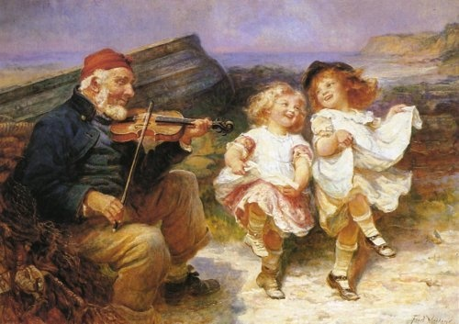
Dancing Joy

Slide 19
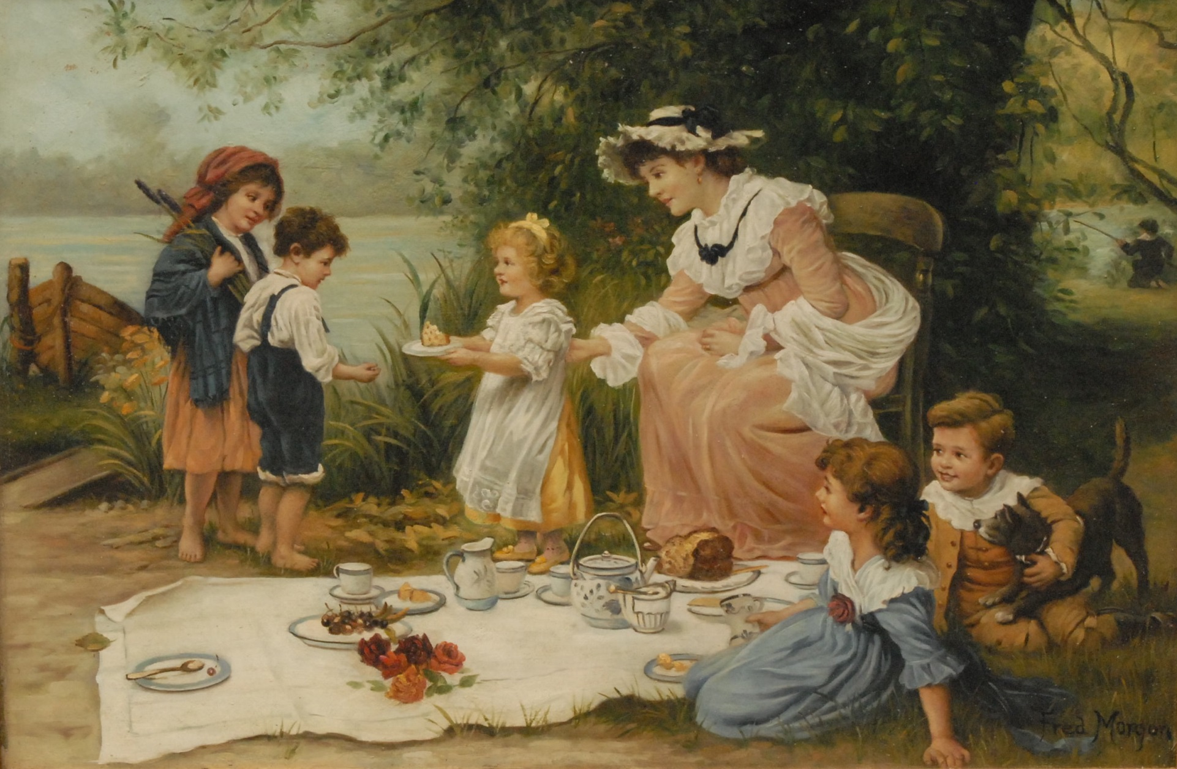
Charity

Slide 20
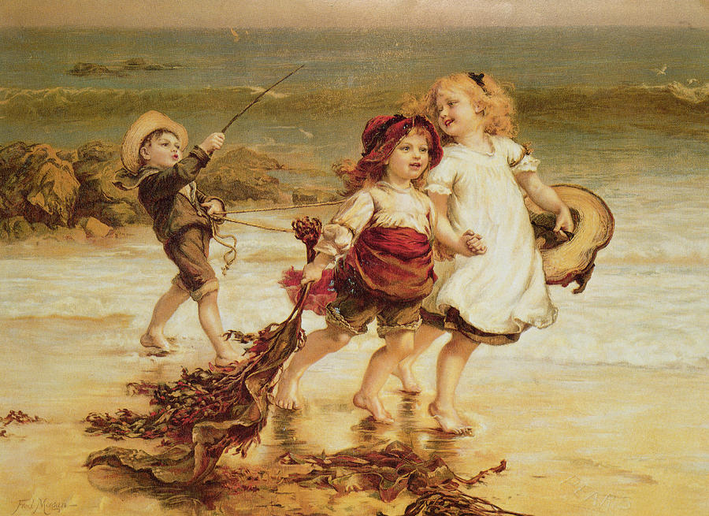
Sea Horses

Slide 21
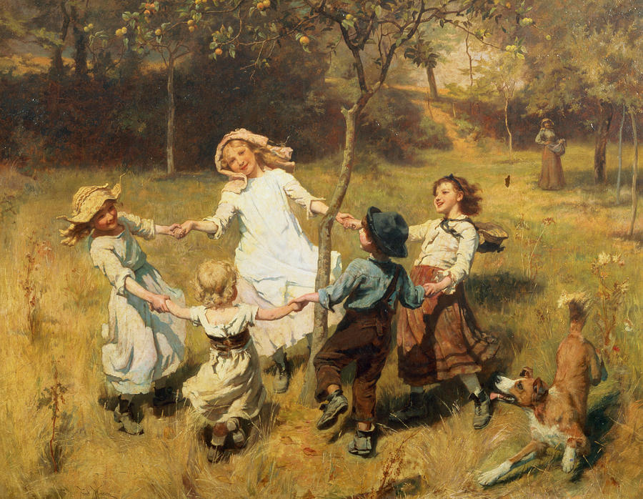
Ring-a-Ring-a-Roses-Oh

Slide 22
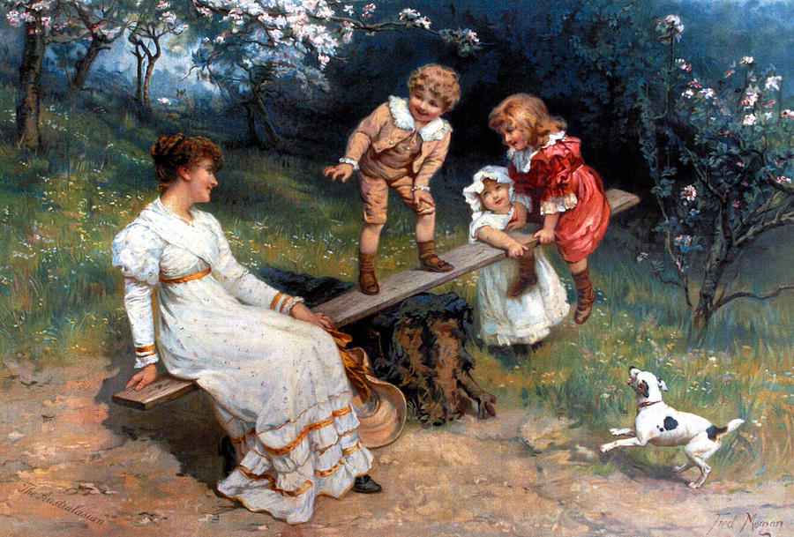
See Saw

Slide 23
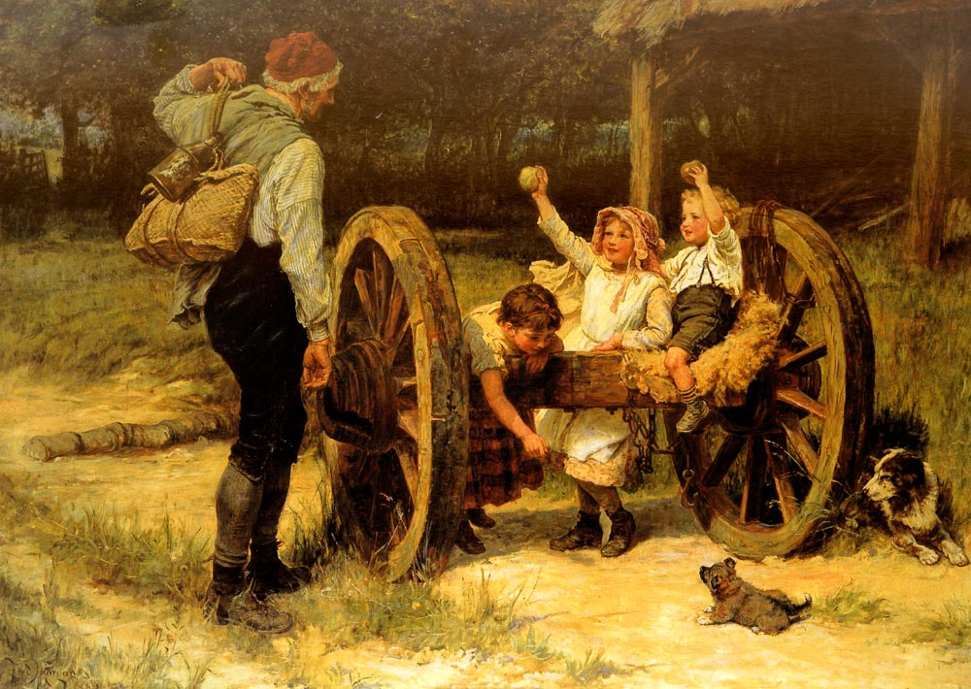
Merry as the day is long

Slide 24
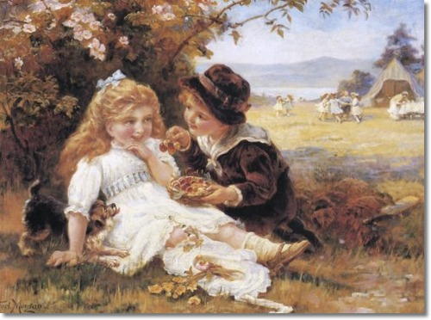
Cherry Earrings

Slide 25
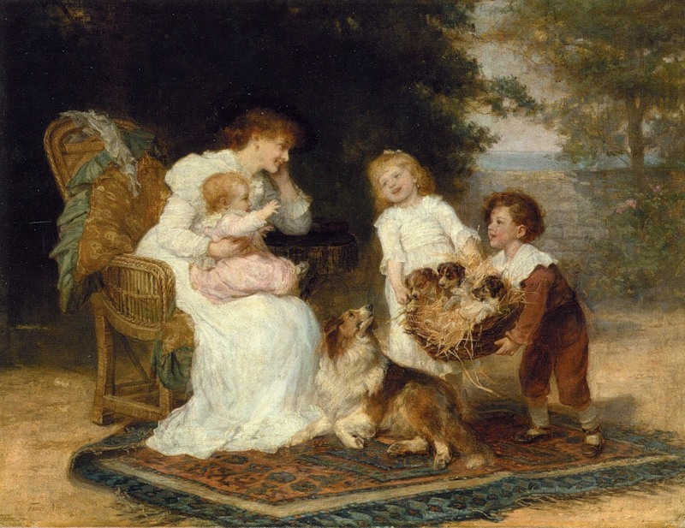
The Little Strangers

Slide 26
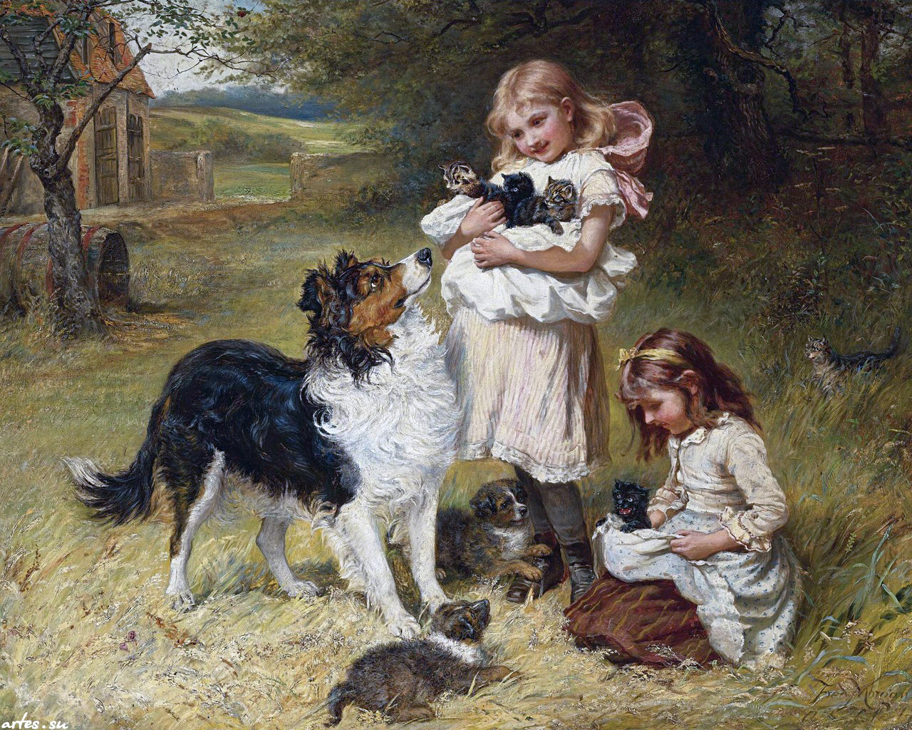
Rival Families

Slide 27
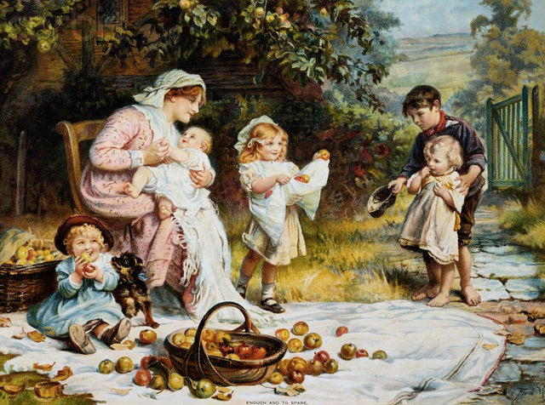
Enough and More to Spare

Slide 28
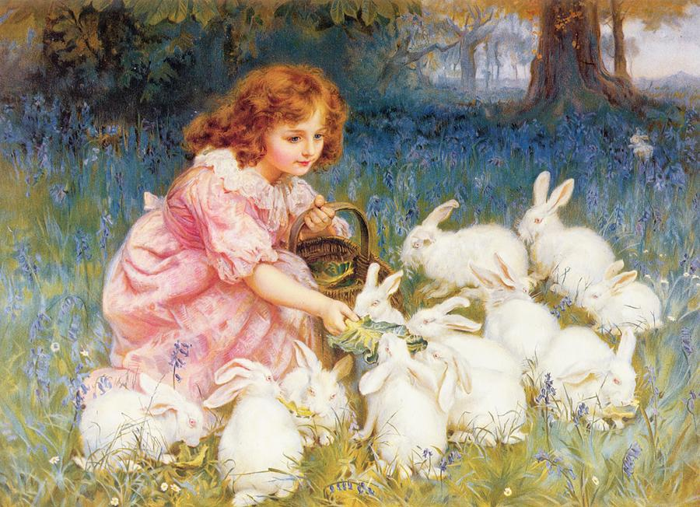
Feeding the Rabbits, Alice in Wonderland

Slide 29
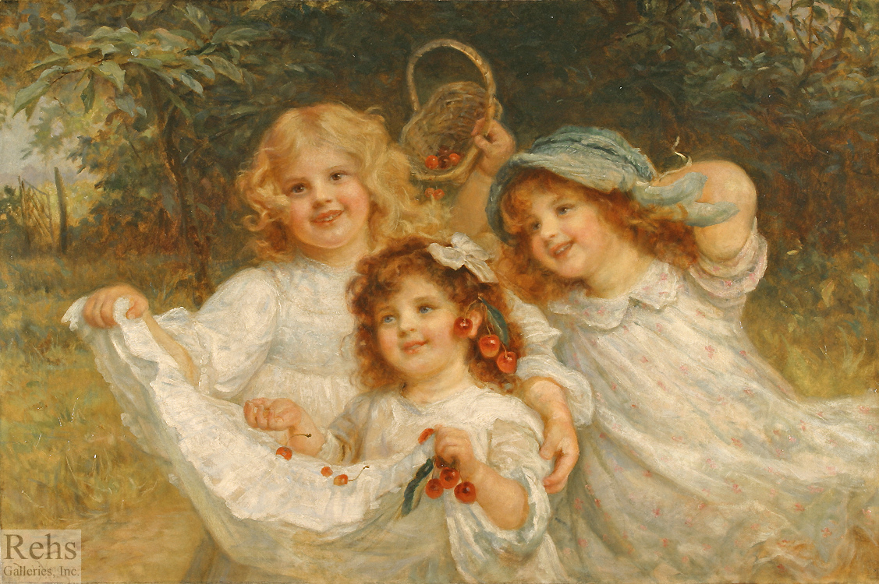
The Cherry Gatherers

Slide 30
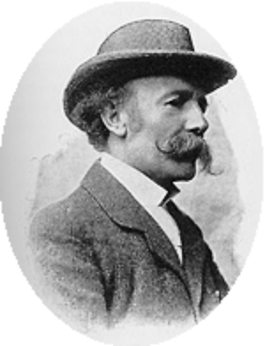
Frederick Morgan
English painter
(1847 - 1927)
He was a genre painter who painted idyllic and romanticized narratives that greatly appealed to Victorian tastes. His father John Morgan was a painter himself; at fourteen years old Morgan left school and went to train with his father in his studio. He trained at the Edinburgh Academy as well. His work remained popular among the upper classes as well, his most famous patron being Queen Alexandra for whom he painted a portrait of her with her grandchildren and pet dogs.

Slide 31
Thank You
for Visiting the Gallery

Slide 32
Sources
http://images.fineartamerica.com/images-medium-large/over-the-garden-wall-frederick-morgan.jpg
http://1.bp.blogspot.com/-Y1SCtsglNPY/UBWxawNEBBI/AAAAAAAAWnA/O3uJKMp_hY4/s1600/Nutting_Morgan.jpg
http://fada.com/catalogimages/frederick_morgan_b1596_the_cherry_gatherers_wm.jpg
http://images.fineartamerica.com/images-medium-large/ring-of-roses-frederick-morgan.jpg
http://images.fineartamerica.com/images-medium-large/sea-horses-frederick-morgan.jpg
http://57ca282b737e713f28c7-fb6752ef56b89db4e87abbc8cef06ac6.r98.cf3.rackcdn.com/661.jpg
http://19thcenturybritpaint.blogspot.ru/2013/04/frederick-morgan.html
http://www.picturesofbabies.net/wp-content/uploads/2014/02/arthur_john_elsley_fred_morgan_ruff_play.jpg
http://1.bp.blogspot.com/-HLxFBpmX6jw/Teb8LPznJMI/AAAAAAAAAQY/eJVTZJQ4BXY/s1600/tumblr_kzm8ecEmZ01qad6aso1_500.jpg
https://c1.staticflickr.com/5/4036/4323516328_046f110b1f.jpg
http://ichef.bbci.co.uk/arts/yourpaintings/images/paintings/dagmo/large/dun_dagmo_272_1987_382_large.jpg
http://www.bbc.co.uk/arts/yourpaintings/paintings/search/painted_by/frederick-morgan
http://nevsepic.com.ua/art-i-risovanaya-grafika/page,3,6145-victorian-artist-frederick-morgan-1856-1927-108-rabot.html
http://www.liveinternet.ru/users/3162595/post326265651/
http://www.pinterest.com/honabe/art-work-frederick-morgan/

