Slide 1
Посвящается
перекрестному Году культуры Великобритании и России 2014
Heywood Hardy and his Dogs
Автор:
Ольга Михайловна Степанова
учитель английского языка
МБОУ «Чадукасинская ООШ»
Красноармейского района
Чувашской Республики

Slide 2
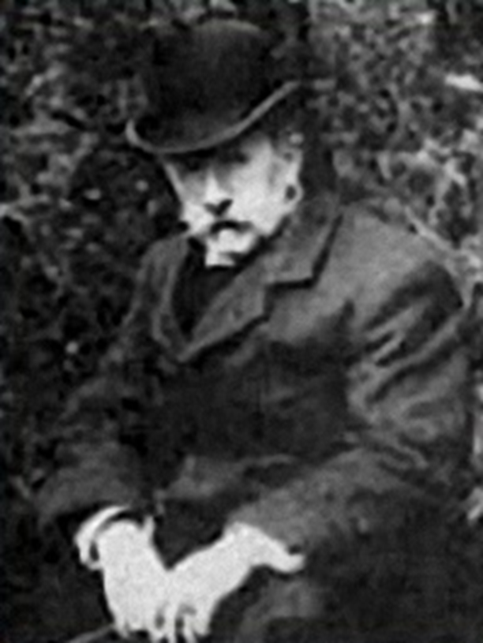
Heywood Hardy (1843 - 1933)
A n English painter of equestrian, hunting and genre scenes Famed for his sensitive portrayal of animals , horses and dogs

Slide 3
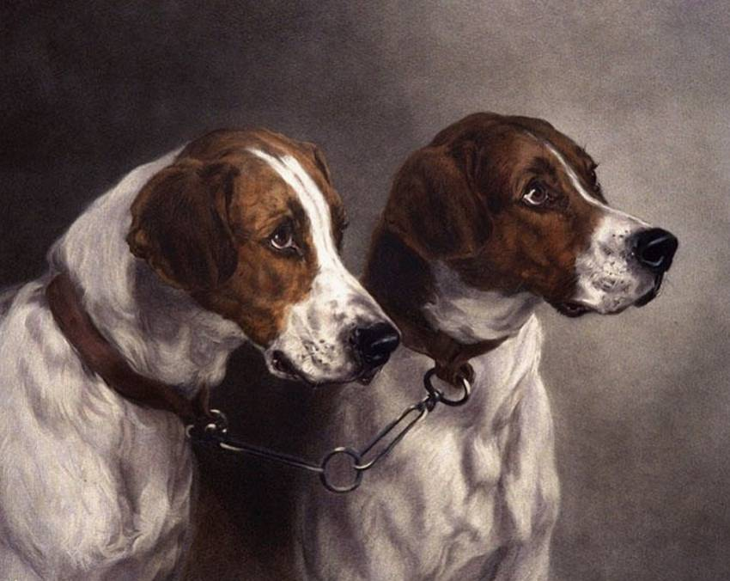
Missing about the Master…
A dog is a friend,
never to end.
A dog is a thing
never to sin.
A dog is a friend,
that
gets you up high,
Whatever you do,
he won't tell a lie.
by Dan, Age 9 Texas USA

Slide 4
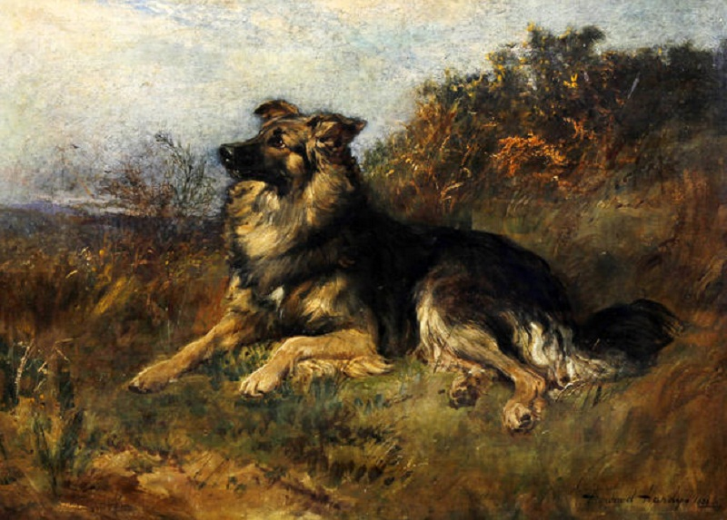
Lovely day, no hunting…
A dog sits waiting
in the cold autumn sun.
Too faithful to leave,
too frightened
to run.
He’s been here for days now
with nothing to do,
but sit by the road waiting for you…
-Kathy Flood

Slide 5
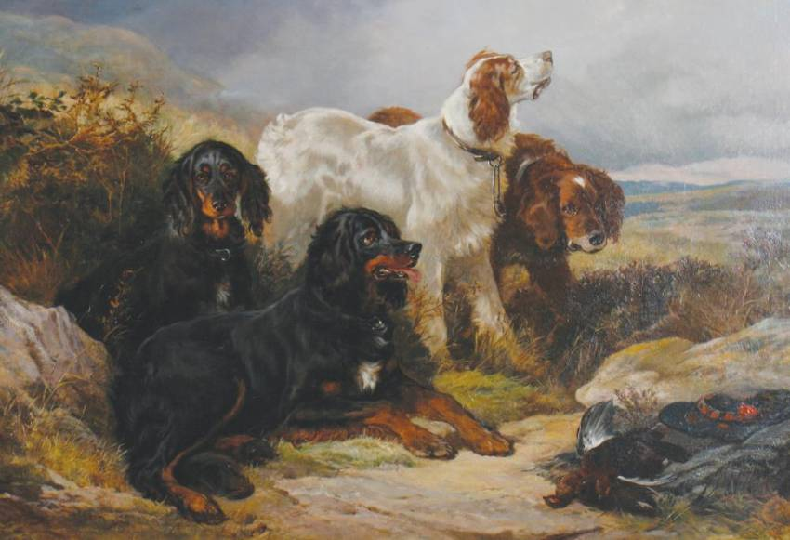
Relaxing after the hunting

Slide 6
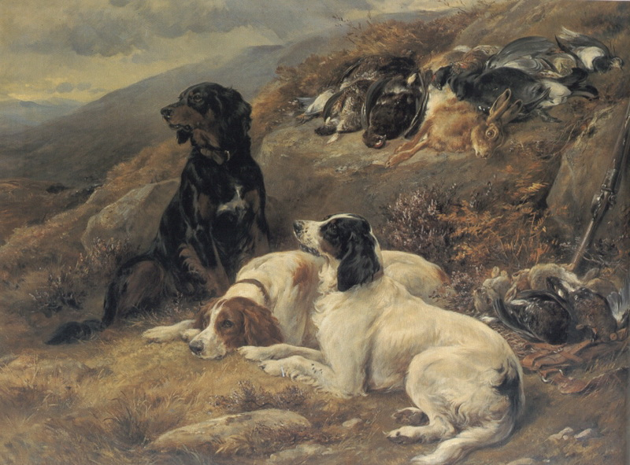
Break when hunting

Slide 7
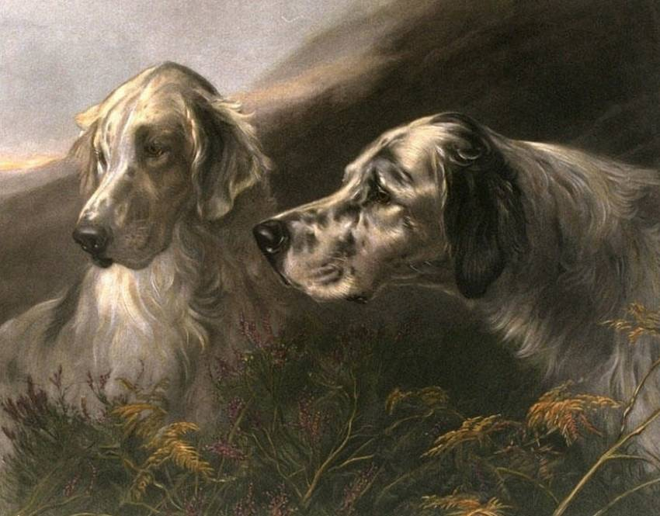
Waiting for adventures…

Slide 8
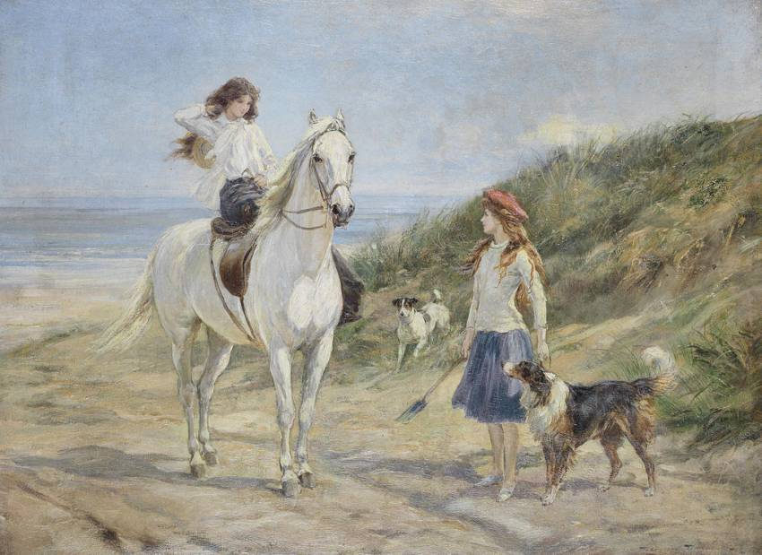
Fantastic friends

Slide 9
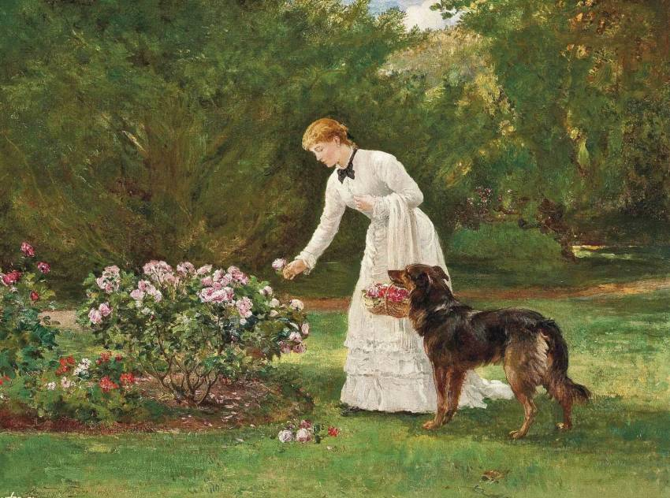
Helping In the Flower Garden

Slide 10
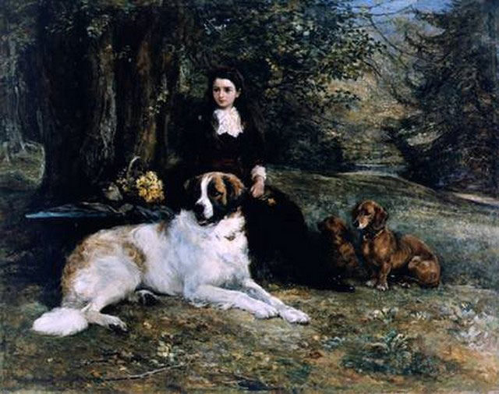
Resting in the Forest

Slide 11
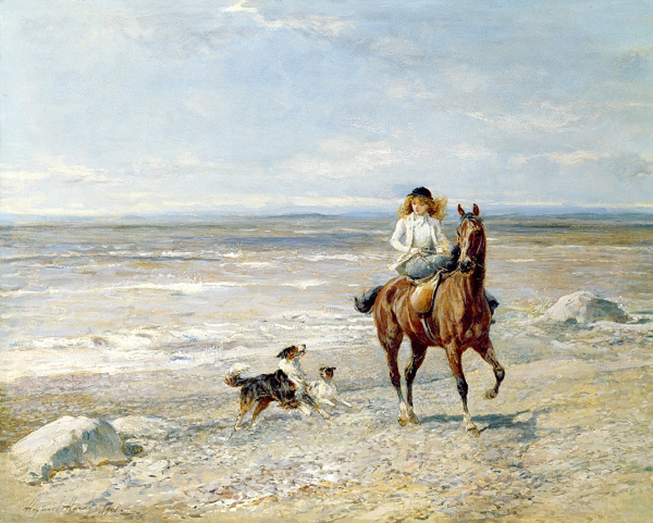
At the seaside

Slide 12
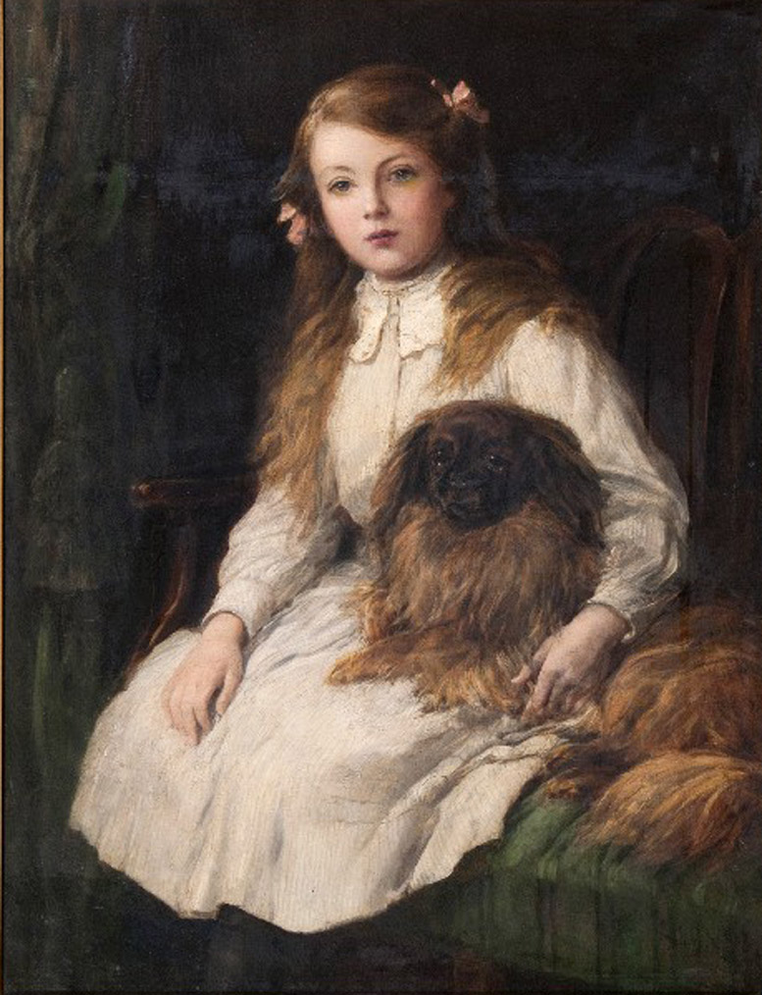
Together forever
The Dachshund's affectionate
He wants to wed with you:
Lie down to sleep,
And he's in bed with you.
Sit in a chair,
He's there.
Depart,
You break his heart.
E.B. White

Slide 13
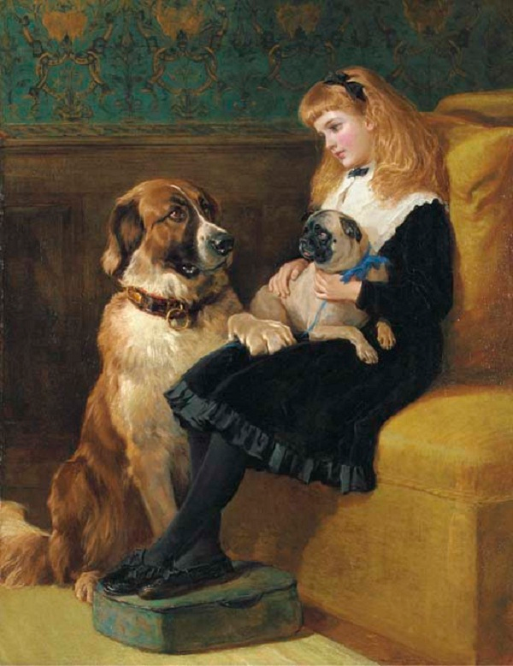
The Girl has two pet friends now
You're only a dog, old fellow; a dog, and you've had your day; But never a friend of all my friends has been truer than you alway.
Julian Stearns Cutler

Slide 14
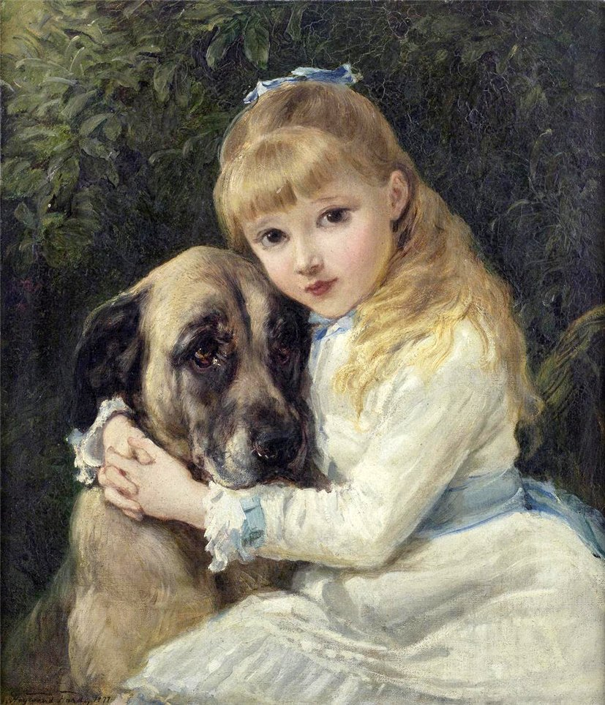
She will never let him bully…
My sunshine doesn't come from the skies, It comes from the love in my dog's eyes.
Unknown Poet

Slide 15
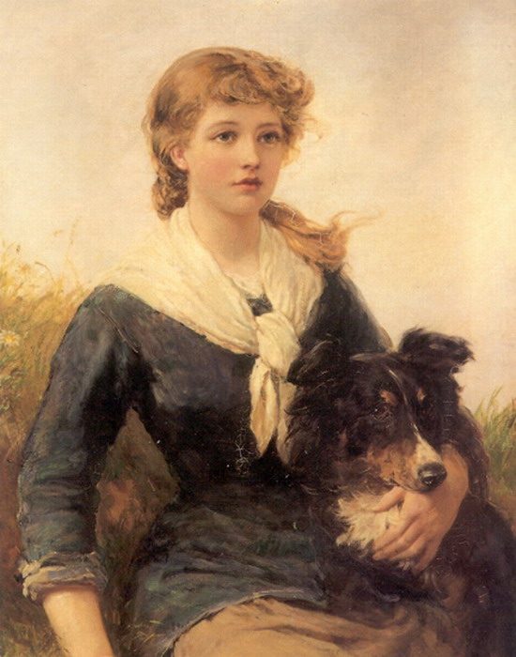
Waiting her friend together
With eye upraised his
master's look to scan, The joy, the solace, and
the aid of man: The rich man's
guardian and the poor
man's friend, The only creature
faithful to the end. George Crabbe

Slide 16
Dogs are very special
They give you so much love They are one of God’s creations
Sent to you from above.
All they need is lots of love Show them how much you care
Because if you do then you will see
That they will always be there.
-Debbie Bongiovanni-Sharp
Я свято верю, что собака - Последний Ангел на Земле... Когда затянет душу мраком - Она одна придет ко мне. Когда меня друзья оставят, Когда надежды предадут, Поверить в искренность заставят Глаза собачьи, что не лгут... Когда мелком последней боли Жизнь подведет черту свою, Усилием собачьей воли Она лизнет ладонь мою. И даже там, в раю собачьем, По мне тоскуя в тишине, Она вернется в час назначенный Последним Ангелом ко мне.
ЛАРЕНКО

Slide 17
When God had made the earth and sky, the flowers and the trees.
He then made all the animals and all the birds and bees.
And then His work was finished, and not one was quite the same
He said I’ll walk this earth of mine and give each one a name.
And so he traveled land and sea, and everywhere He went
a little creature following him, until its strength was spent.
When all were named upon the Earth, and in the sky and sea,
A little creature said, Dear Lord, there’s not one left for me.
The Father smiled and softly said, I’ve left you to the end,
I’ve turned my own name back to front
and called you “Dog” my friend.
Author Unknown

Slide 18
Love your Dog
for He is a creature from a God

Slide 19
Sources:
http://www.proza.ru/2012/04/20/1846
http://rogallery.com/Hardy_Heywood/hardy-biography.html
http://i041.radikal.ru/1102/07/ac25f5999f47.jpg
http://www.dogquotations.com/dog-poems.html
http://www.loveyourdog.com/poetry1.html

