Slide 1
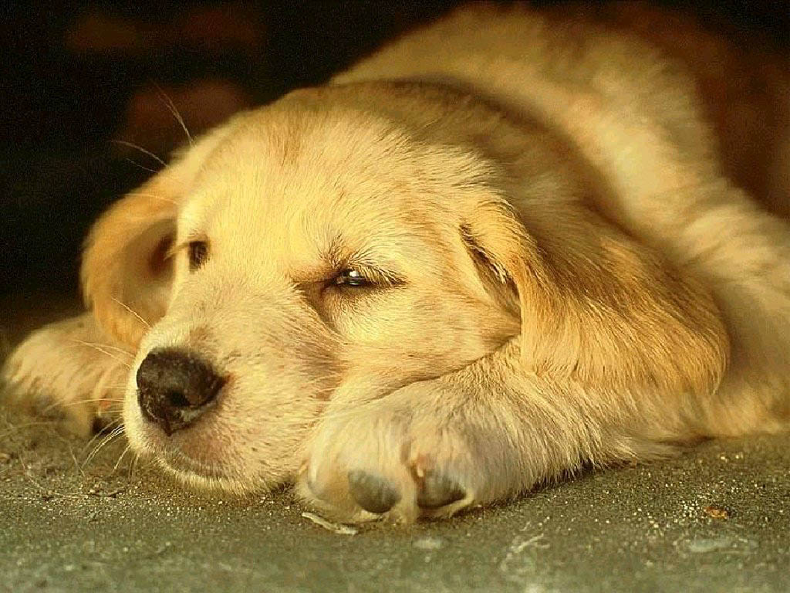
Ten Favors
a Dog Asks from a Man
Interactive Quiz
by
Olga Stepanova, Chadukassinskaya main School, Chuvashia
by
Olga Stepanova, Chadukassinskaya main School, Chuvashia

Slide 2
Favor #1 a Dog Asks from a Man
- My life lasts between ten to fifteen years. Every separation from you means …… for me. Think about this before you decide whether or not to take me!
suffering |  | healing |  | smiling |  | doubting

Slide 3
Favor #2 a Dog Asks from a Man
- Give me …… to understand what you are asking from me.
a bone |  | water |  | flowers |  | time

Slide 4
Favor #3 a Dog Asks from a Man
- Instill confidence in me - I …… on it!
blame |  | suspect |  | thrive |  | cry

Slide 5
Favor #4 a Dog Asks from a Man
- Do not be angry with me for a long time and do not lock me up for punishment! You have your work, your ……. , your joy - I have only you.
treasure |  | pleasure |  | leisure |  | measure

Slide 6
Favor #5 a Dog Asks from a Man
- Talk often to me! Even if I do not understand you completely, I do understand the tone of your voice when you …… to me.
turn |  | talk |  | listen |  | confess

Slide 7
Favor #6 a Dog Asks from a Man
- Know that, no matter how I am being treated, I shall never ……. it!
forget |  | forbid |  | permit |  | promise

Slide 8
Favor #7 a Dog Asks from a Man
- Keep in mind, before you …… me , that my jaws could crush the knuckles of your hand with ease, but that I do not make use of them.
choose |  | hug |  | feed |  | hit

Slide 9
Favor #8 a Dog Asks from a Man
- Before you scold me when working with me, consider: perhaps I am uncomfortable from digesting my last meal, perhaps I was exposed to the sun too long, or perhaps I have a worn out ……
liver |  | heart |  | stomach |  | chest

Slide 10
Favor #9 a Dog Asks from a Man
- …… care of me when I am old - you too are going to be old one day.
find |  | do |  | make |  | take

Slide 11
Favor #10 a Dog Asks from a Man
- Be with me when my going gets rough. Everything is easier for me when you are …… me.
backside |  | beside |  | outside |  | inside

Slide 12
Dogs have given us their absolute all.
We are the center of their universe,
we are the focus of their love and faith and trust.
They serve us in return for scraps…
Love Dogs
for they love us…
http://rlv.zcache.com/red_paws_and_dog_bones_magnetic_picture_frame-r0c2f627a79344f26b82b036e8e3b1575_fumar_8byvr_324.jpg

Slide 13
Sources
http://www.w8themes.com/wp-content/uploads/2013/09/Dog-Wallpaper-For-Computer.jpg
http://rlv.zcache.com/red_paws_and_dog_bones_magnetic_picture_frame-r0c2f627a79344f26b82b036e8e3b1575_fumar_8byvr_324.jpg
http://www.germanshepherds.com/forum/general-information/117549-ten-favors-dog-asks-man.html

