Slide 1
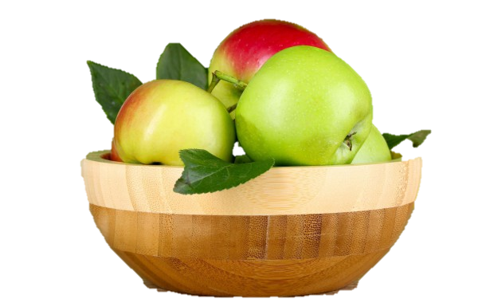
Посвящается
перекрестному Году культуры Великобритании и России 2014
Apples in the English Art
Автор:
Ольга Михайловна Степанова
учитель английского языка
МБОУ «Чадукасинская ООШ»
Красноармейского района
Чувашской Республики

Slide 2
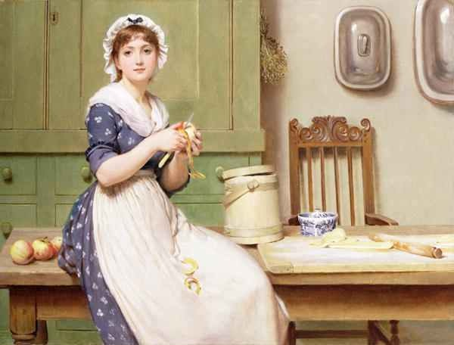
Apple Dumplings
George Dunlop Leslie was an English genre painter, author and illustrator
Born 2 June 1835
London
Died 21 February 1921 (aged 85)
Nationality British
Elected Royal Academy

Slide 3
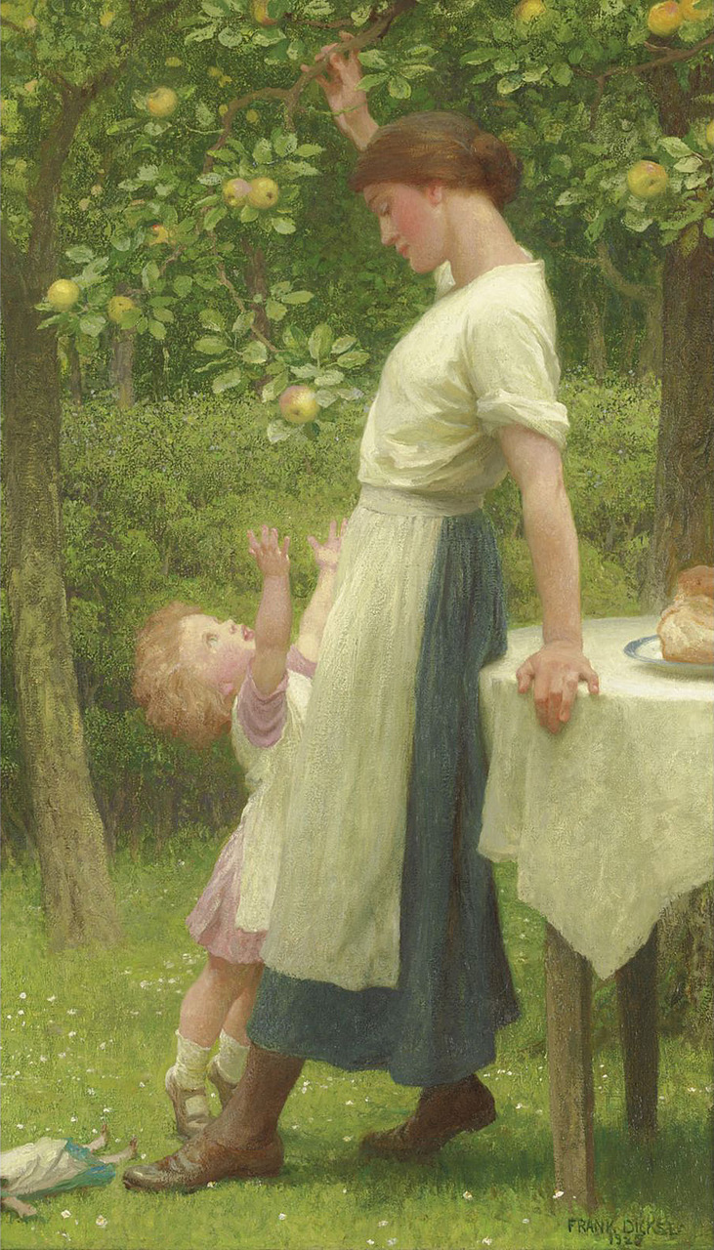
The daughters of Eve
Sir Francis Bernard Dicksee is a famous English painter and illustrator. He studied in the studio of his father, Thomas Francis Dicksee (1819-95), who painted portraits and historical genre scenes; he then entered the Royal Academy Schools, London.
He illustrated the editions of Longfellow's Evangeline (1882), Shakespeare's Othello (1890) and Romeo and Juliet (1884).

Slide 4
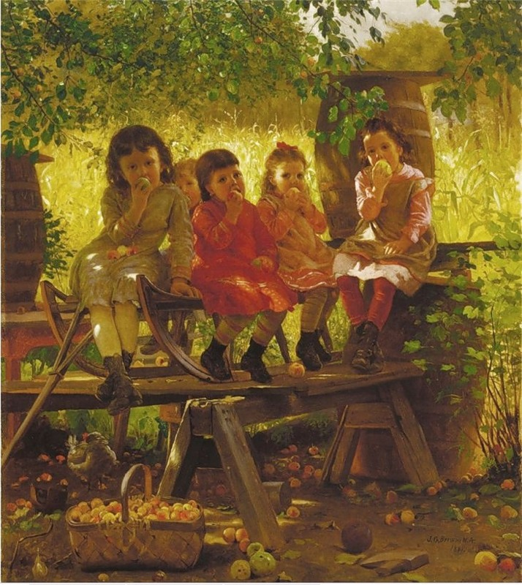
The Cider Mill
John George Brown (1831 –1913) was a British citizen and an American Painter born in England on November 11, 1831. He studied at the Edinburgh Academy. His parents apprenticed him to the career of glass worker at the age of fourteen in an attempt to dissuade him from pursuing painting. After moving to New York City in 1853, he studied at the National Academy of Design where he was elected a National Academician

Slide 5
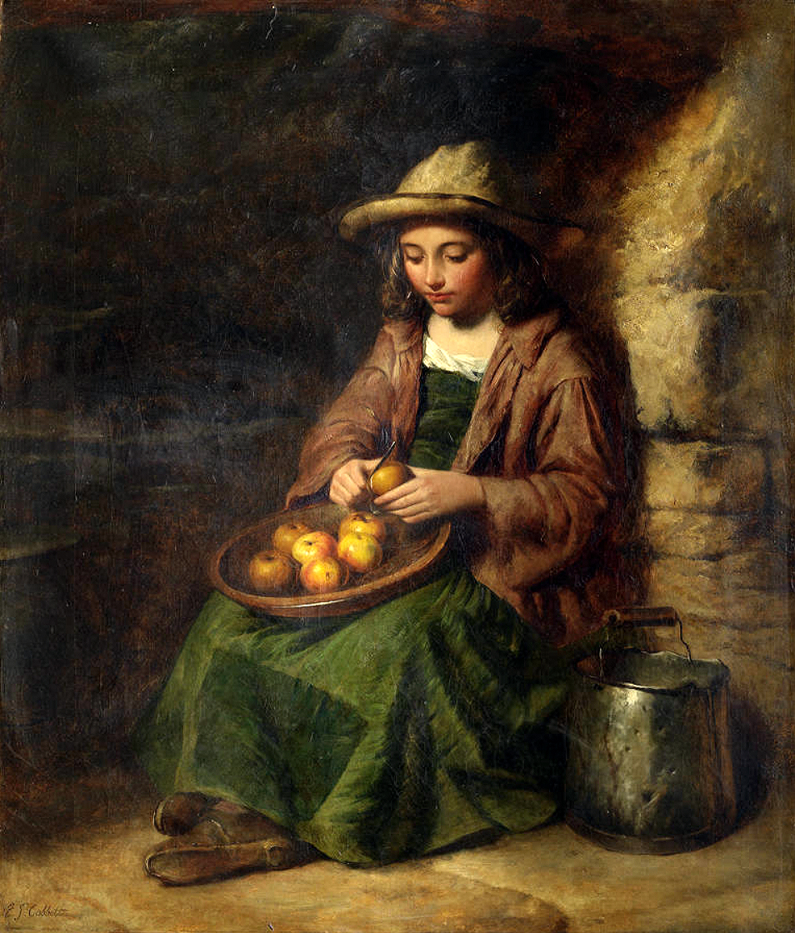
Peeling Apples
The English painter Edward John Cobbett was born in London, England in 1815. Cobbett apprenticed under landscape painter J. W. Allen. Cobbett had a successful career and exhibited at the Royal Academy from 1833 to 1880. He was also a member of the Society of British Artists. Cobbett passed away
in 1899.

Slide 6
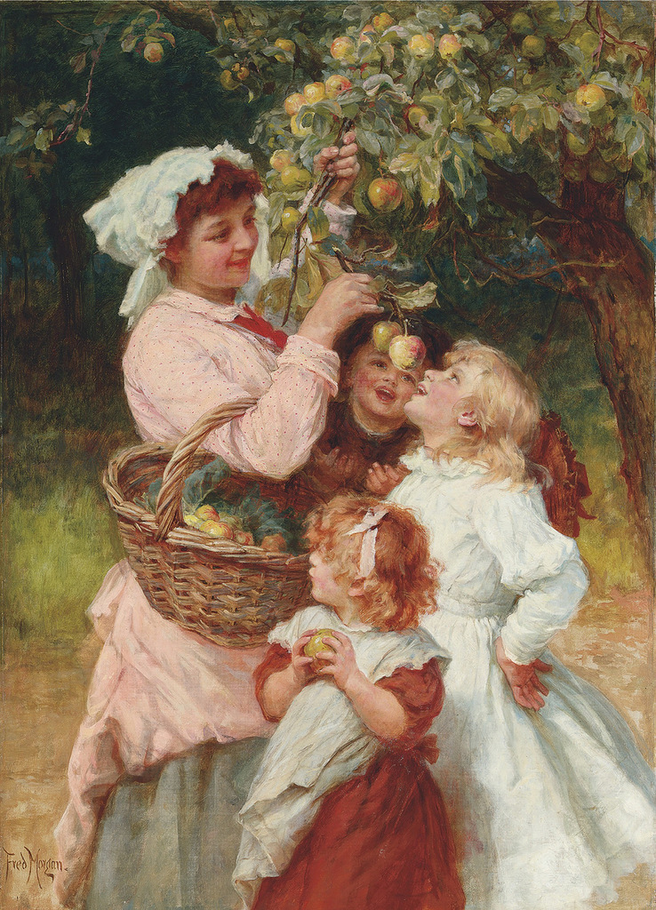
Bob Apple
Frederick Morgan (1847 - 1927), was an English painter of portraits, animals, domestic and country scenes. He is known mostly for his romantic and sentimental paintings of children in the same style as his contemporary Arthur John Elsly. His paintings achieved great popularity in his lifetime and were widely published.

Slide 7
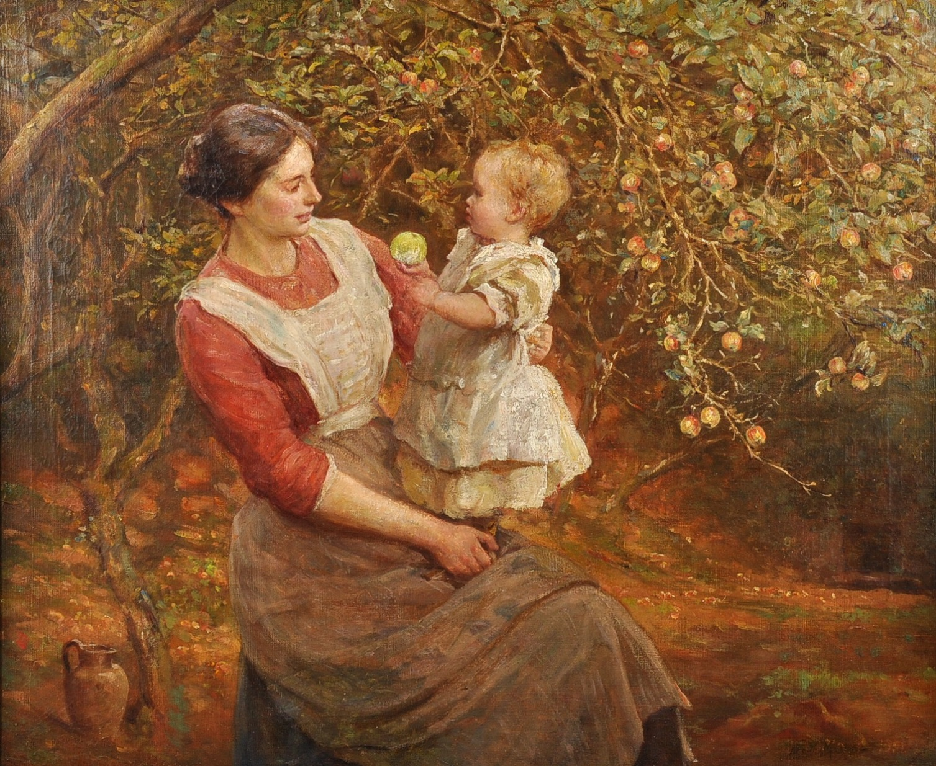
In The Apple Orchard
Frederic Morgan and Havers regularly included their children in their works - their son Valentine
and their daughter Lillian

Slide 8
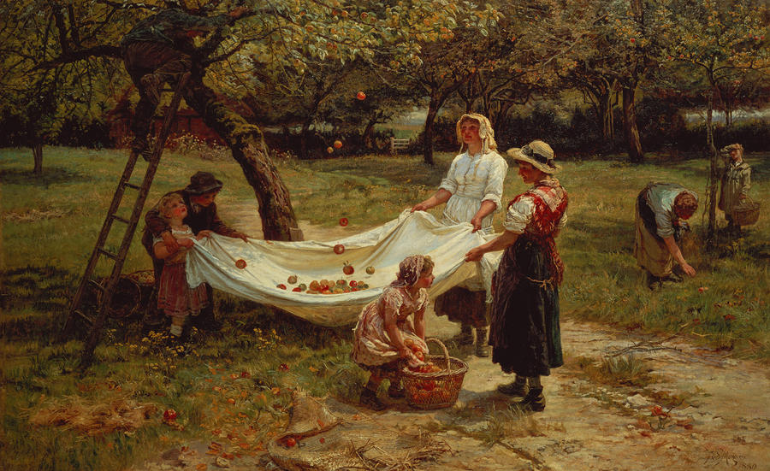
The Apple Gatherers
by Frederic Morgan

Slide 9
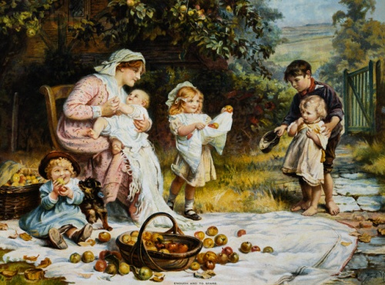
In the Apple Garden
by Frederic Morgan
Victorian artist Frederick Morgan

Slide 10
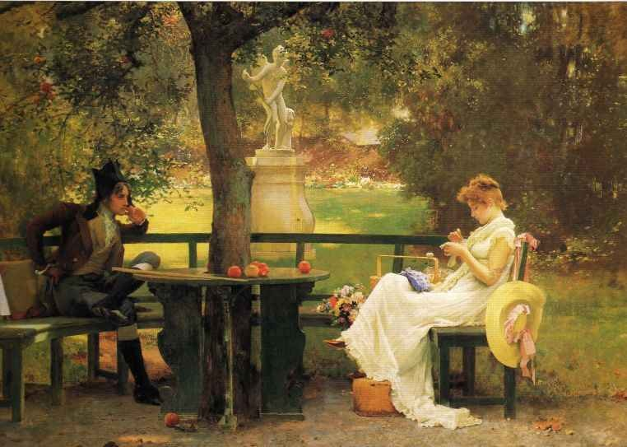
Marcus Stone a famous English painter was trained by his father and began to exhibit at the Royal Academy before he was eighteen; and a few years later he illustrated with much success books by Charles Dickens, Anthony Trollope, and other writers, friends of his family.
One of his canvases is in Tate . Most of his works have been engraved, and medals were awarded to him at exhibitions in all parts of the world.
In Love

Slide 11
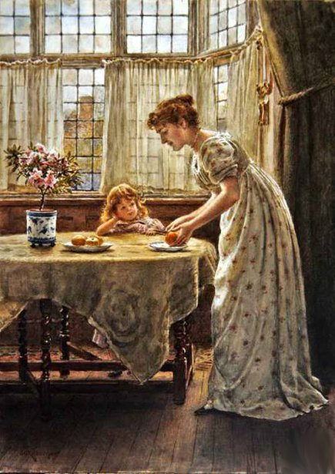
Mother and Daghter
George Goodwin Kilburne, (1839 – 1924 London) was an English genre painter specializing in accurately drawn interiors with figures. He favoured the watercolour medium although he also worked in oils, pencil and - in his early career – engraving.

Slide 12
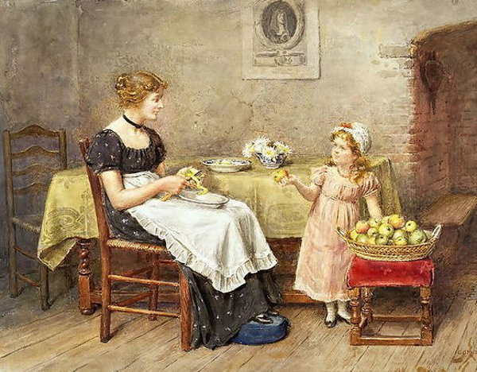
Mother Peeling an Apple
George Goodwin Kilburne’s paintings often portrayed the upper classes and ultra-fashionable female beauties in opulent late 18th and early 19th-century settings. His depiction of this beauty was heightened by his attention to detail with dress, and richly decorated interiors.

Slide 13
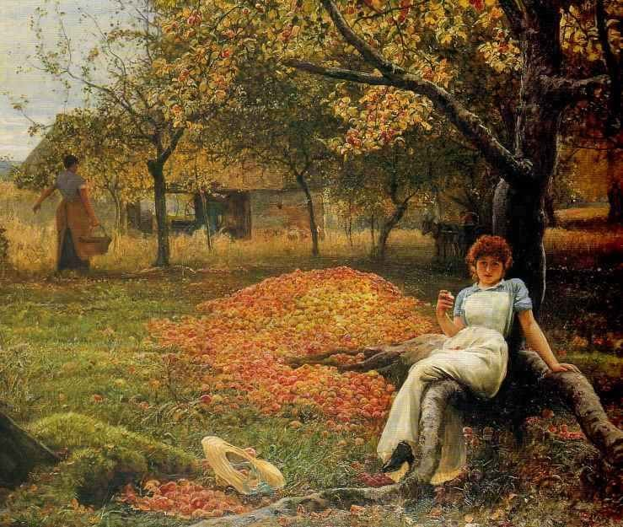
In the Cider Orchard
Robert Walker Macbeth RA (1848 –1910) was a Scottish painter, etcher and watercolourist specializing in pastoral landscape and the rustic genre.

Slide 14
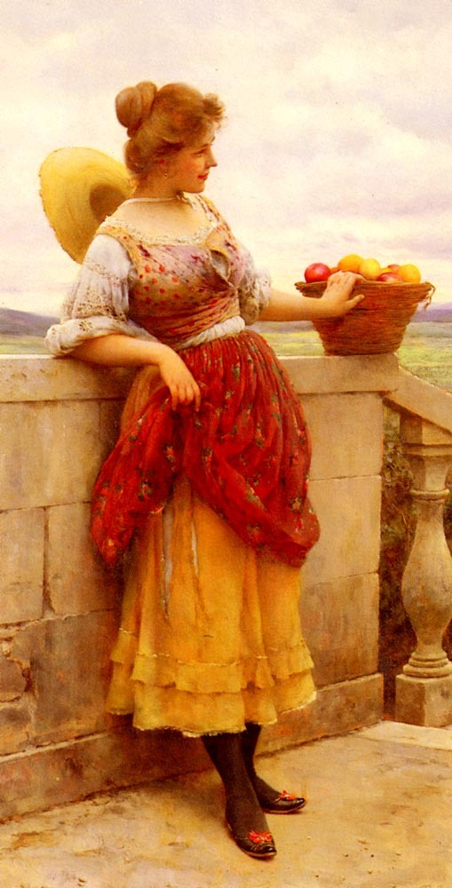
The Flower Girl
Eugene de Blaas, (24 July 1843 – 10 February 1932), one of the favorite painters in England, was an Italian painter in the school known as Academic Claccicism. Eugene de Blaas' paintings were exhibited at the Royal Academy, Fine Art Society, New Gallery and Arthur Tooth and Sons Gallery in London, and also at the Walker Art Gallery in Liverpool.

Slide 15
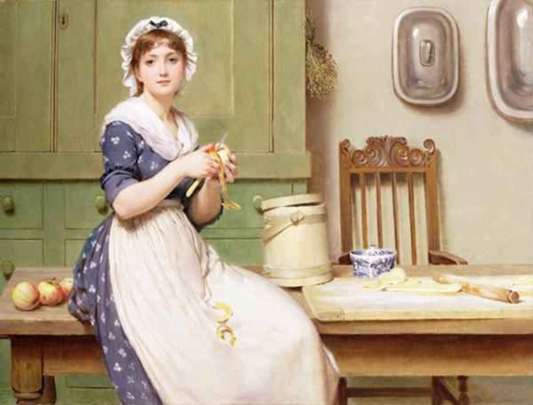
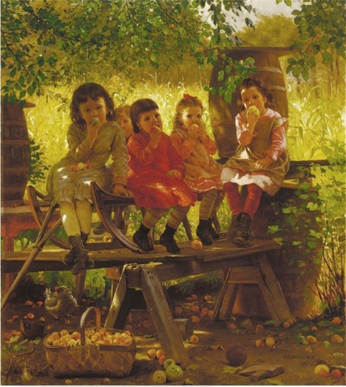
How attentive are you? Name the paintings!
Which painting did you like best of all? Why?

Slide 16
Sources:
http://www.liveinternet.ru/users/3535126/post134104502/
http://en.wikipedia.org/wiki/George_Dunlop_Leslie
http://www.artmagick.com/pictures/artist.aspx?artist=frank-dicksee
http://en.wikipedia.org/wiki/John_George_Brown
http://www.invaluable.com/artist/cobbett-edward-john-r.b.a-85xirf0vu7
http://en.wikipedia.org/wiki/Frederick_Morgan_(painter)
http://en.wikipedia.org/wiki/Marcus_Stone
http://en.wikipedia.org/wiki/George_Goodwin_Kilburne
http://en.wikipedia.org/wiki/Robert_Walker_Macbeth
http://en.wikipedia.org/wiki/Eugene_de_Blaas
http://wallex.pro/upload/preview/big/4b27b471717e45ecddd77ee94adb1238.jpg

