Slide 1
So
God Made
a Dog
by Wendy Francisco
Made with Love
by
Olga Stepanova, Chadukassinskaya Main School, Chuvashia

Slide 2
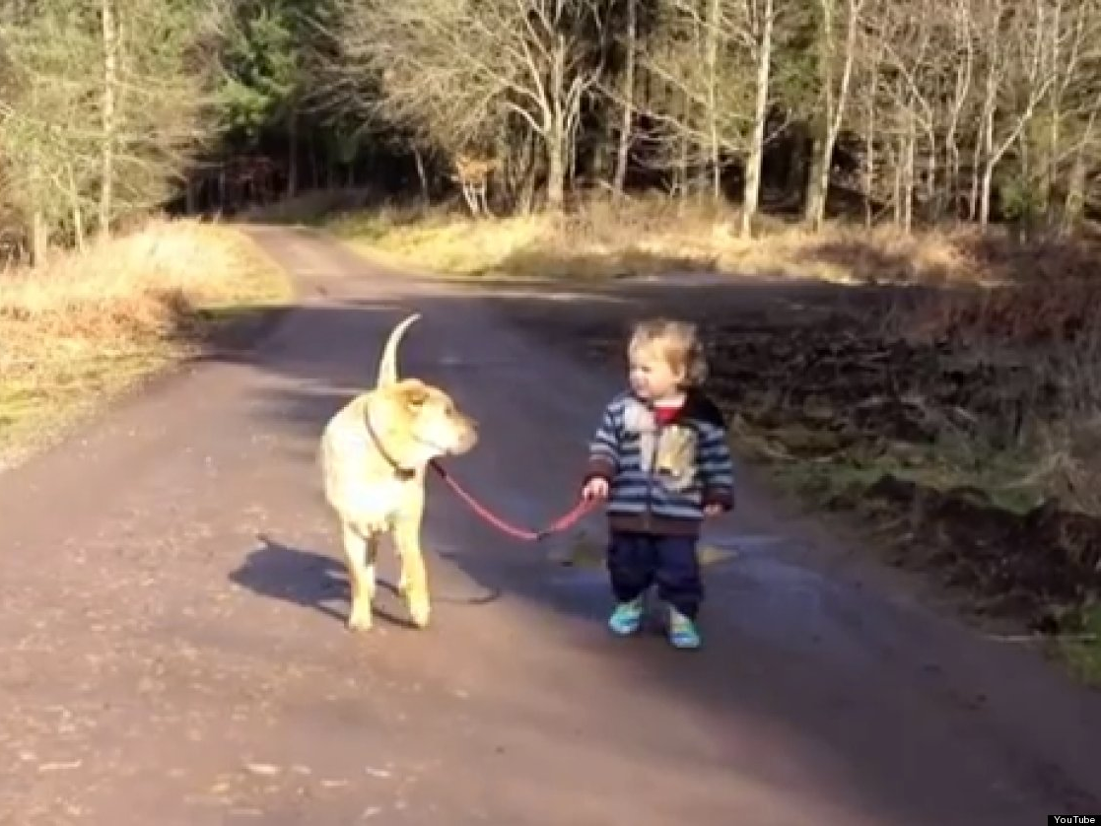
And on the 9th Day God
looked down
on his wide
eyed
children
and said
they need
a companion... So God made a Dog

Slide 3
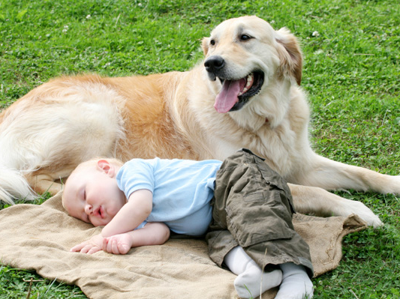
God said I need somebody to wake up and give kisses,
pee on a tree,
sleep all day,
wake up again … So God made a Dog

Slide 4
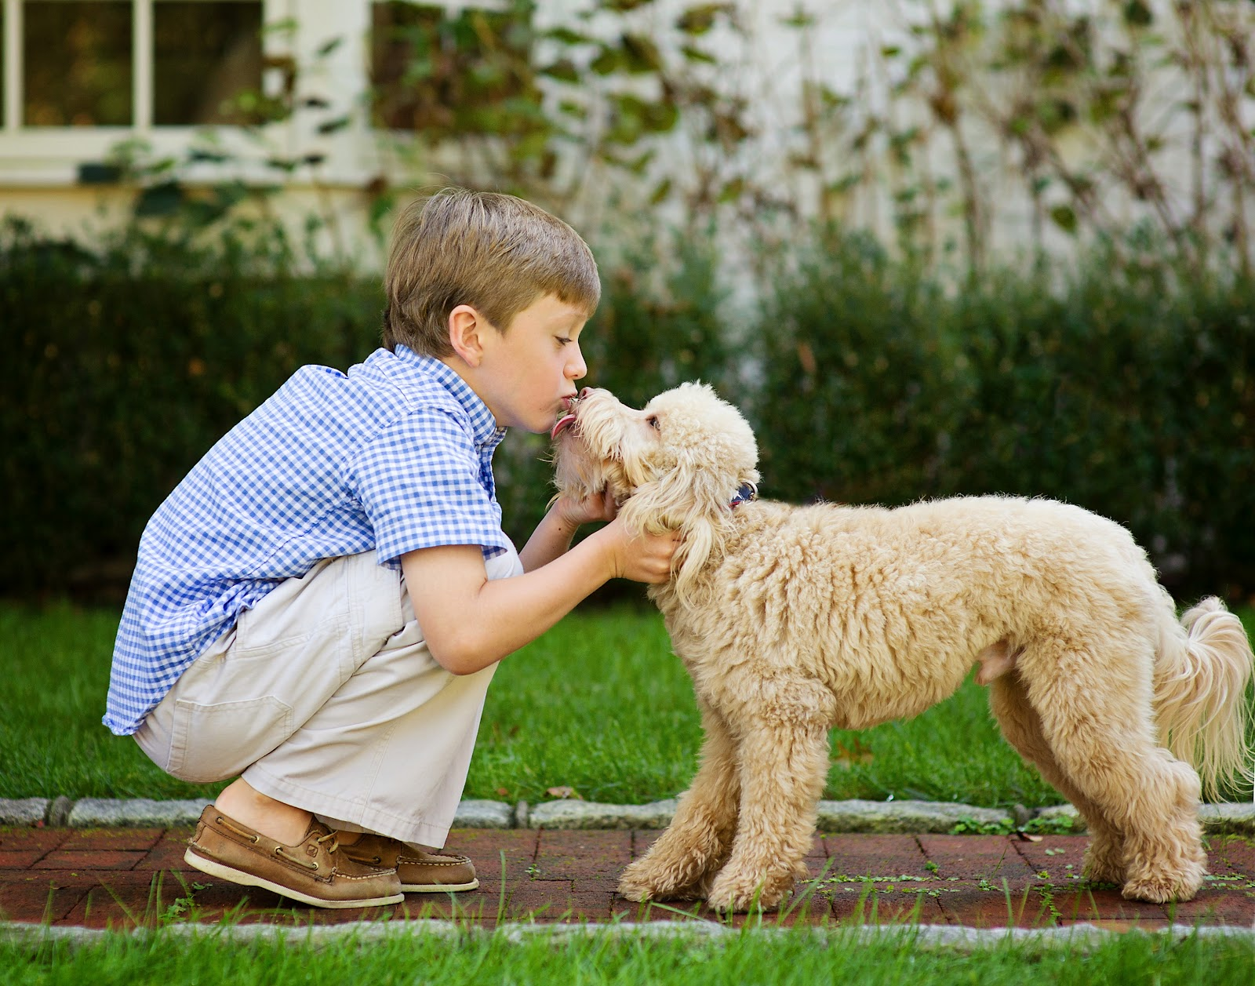
God said I need somebody to give more kisses, and then stay up till midnight basking in the glow of the television set… So God made a Dog

Slide 5
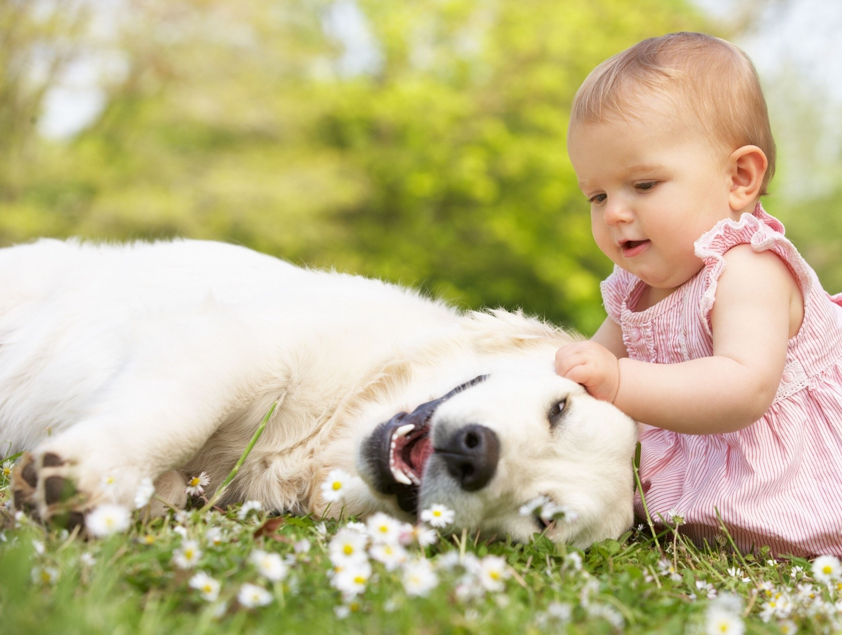
God said I need somebody willing to sit, then stay, then roll over then with no ego or complaint dress in hats they do not need and costumes they do not understand. I need somebody who can break wind without a first thought or second thought…
So God made a Dog

Slide 6
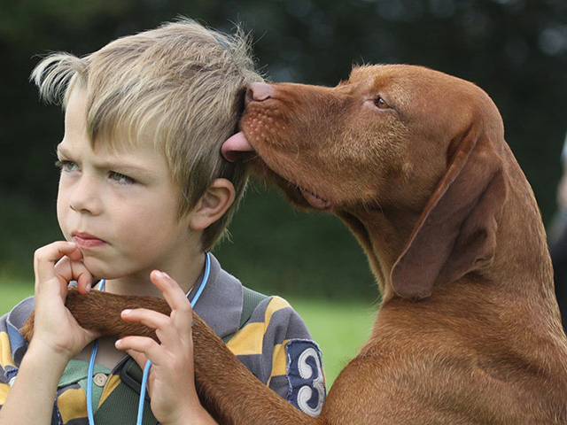
God said I need somebody Who can chase tails,
sniff crotches,
fetch sticks and
lift spirits with a lick. Somebody no matter what you didn’t do,
or couldn’t take,
or didn’t win,
or couldn’t make
will love you without judgment just the same...
So God made a Dog

Slide 7
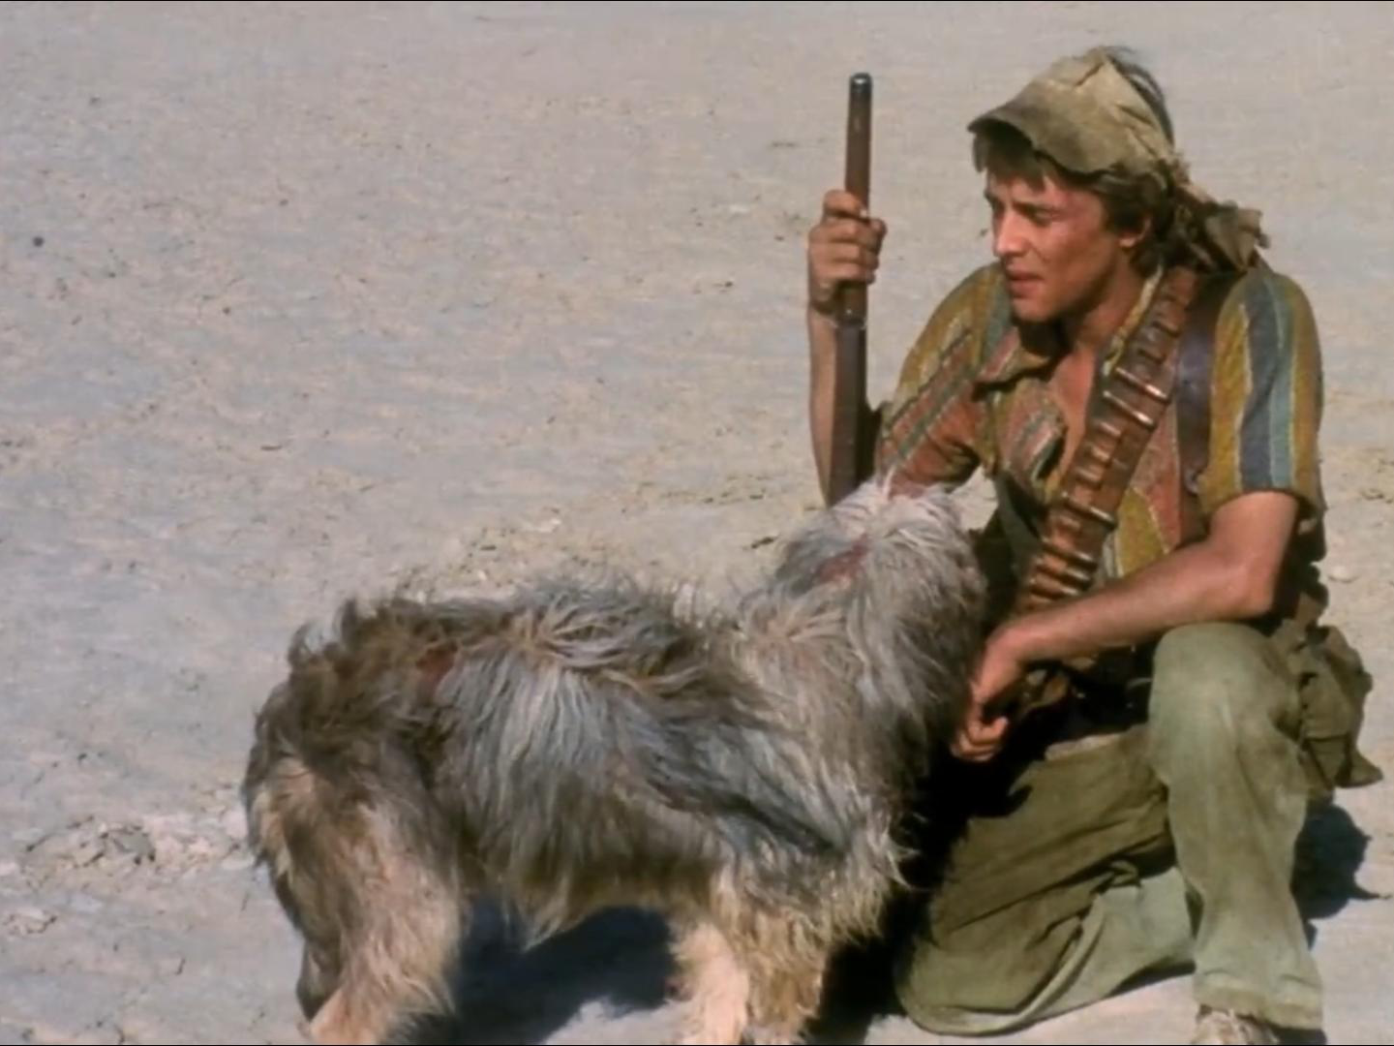
God said I need somebody strong enough to pull sleds and find bombs,
yet gentle
Enough
to love babies
and
lead the blind...
So God made a Dog

Slide 8
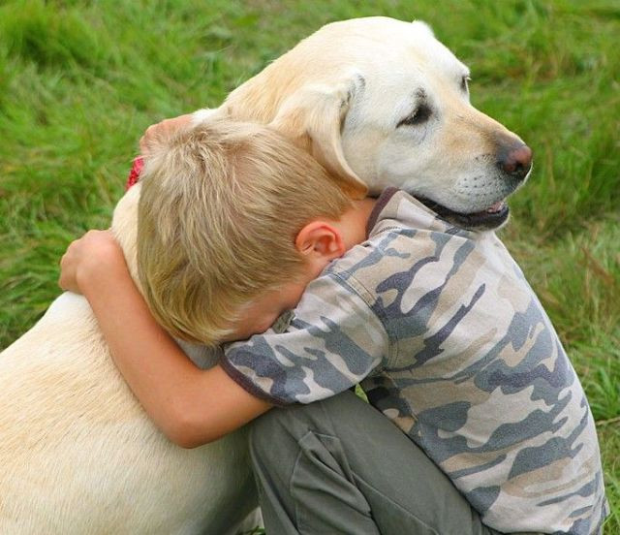
God said I need Somebody
who will
spend
all day
on a couch
with
the resting head and supportive eyes
to lift the spirits
of a broken heart…
So God made a Dog

Slide 9
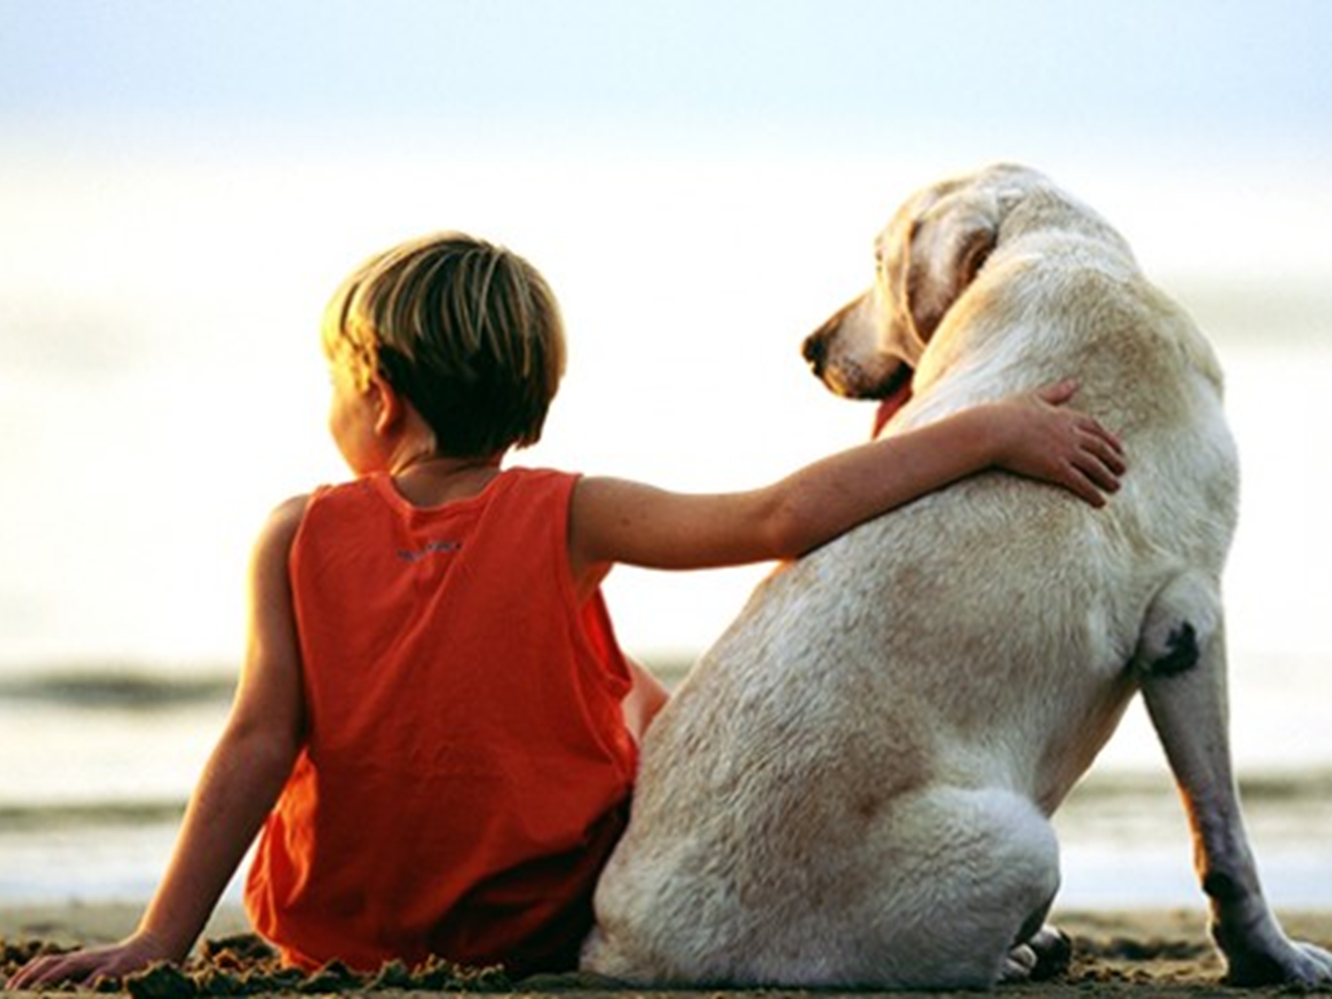
God said I need Somebody to care, cuddle, snuggle
and nuzzle,
and cheer
and charm
and
snore and
slobber and
eat the trash
and
chase
the squirrels…
So God made a Dog

Slide 10
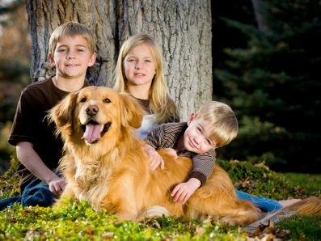
God said I need Somebody
who would
bring
a family
together
with
selflessness
of
an open
heart.. So God made a Dog

Slide 11
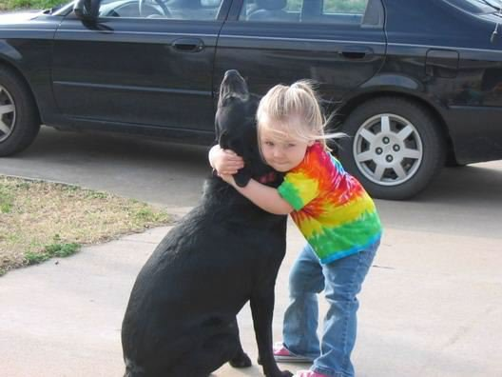
God said I need Somebody
who would bark,
and then pant,
and then reply
with the
rapid wag of tail
when their best friend
says
lets go for a ride
in the car… So God made a Dog

Slide 12
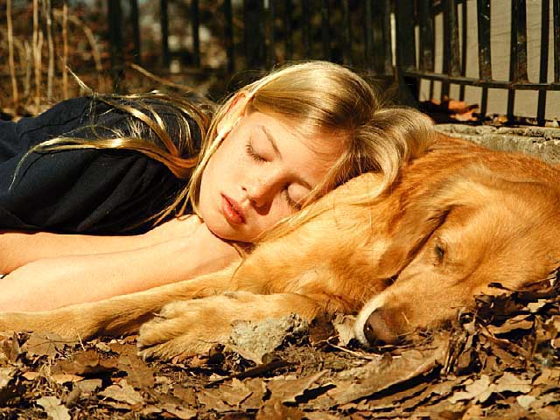
God said I need somebody
who would
stand at
your side
when the world
around you
collapses…
So God made a Dog

Slide 13
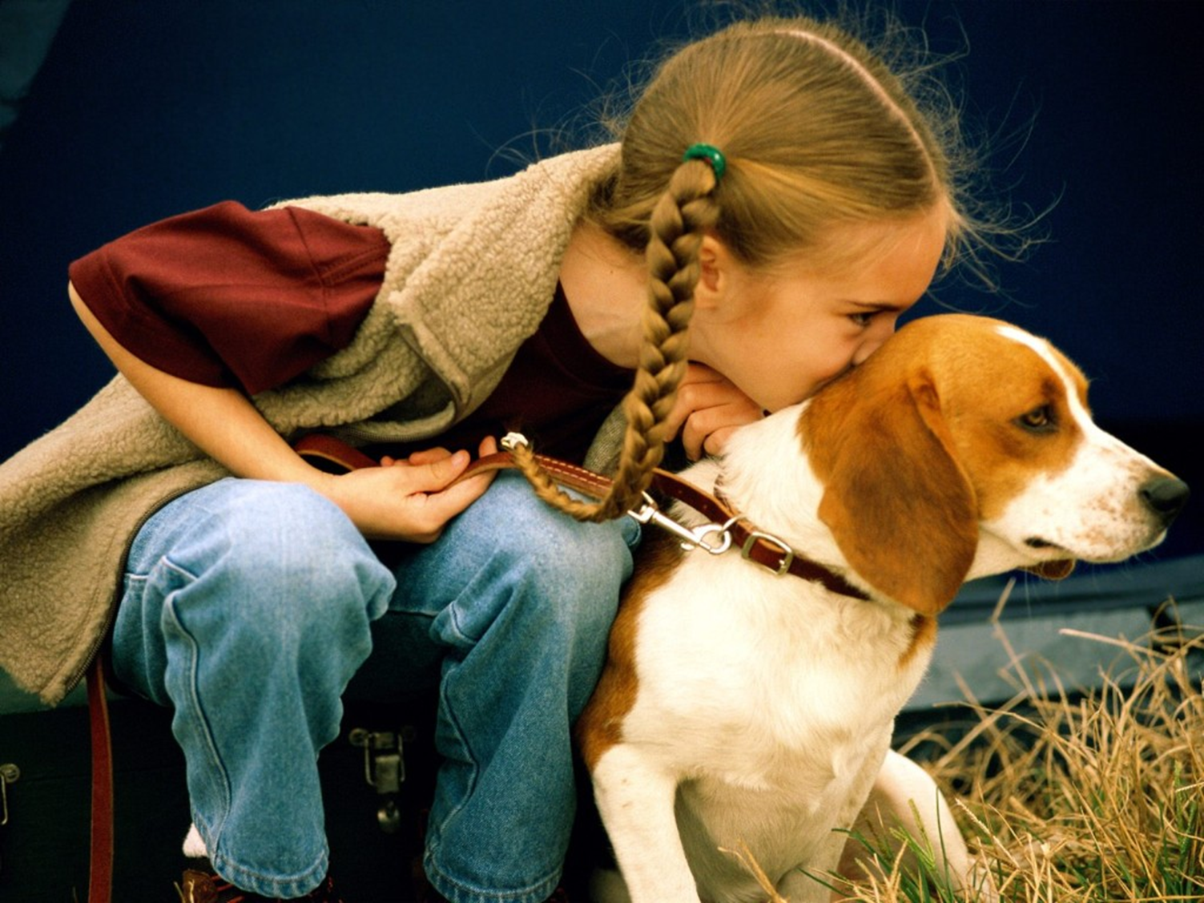
God said I need Somebody
to lie next
to you during the long nights of pain and sorrow when it hurts
to move,
or talk,
or think,
or be…
So God made a Dog

Slide 14
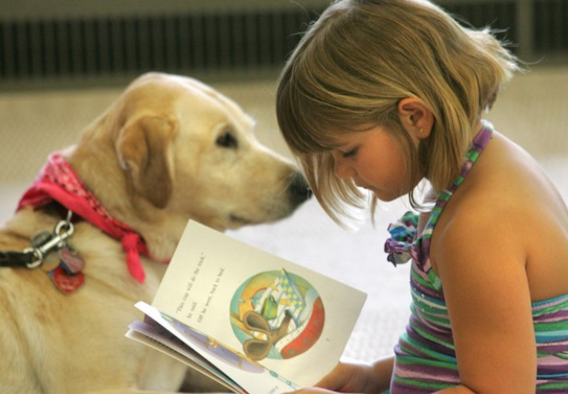
God said I need
Somebody
to stand
guard,
play games,
snore
for hours,
and repeat
as needed ...
So God made a Dog

Slide 15
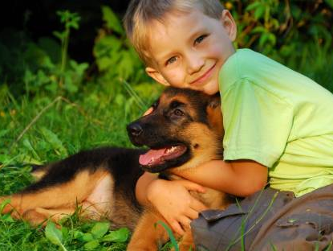
God said
I need
Somebody
to give you
strength
when you have
none
of your own…
So God made a Dog

Slide 16
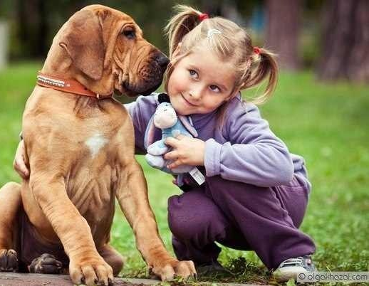
God said
I need
Somebody
to fight when
you have
no fight left,
to hold onto your soul
as if it were their favorite toy, playing tug of war to keep you in this world…
So God made a Dog

Slide 17
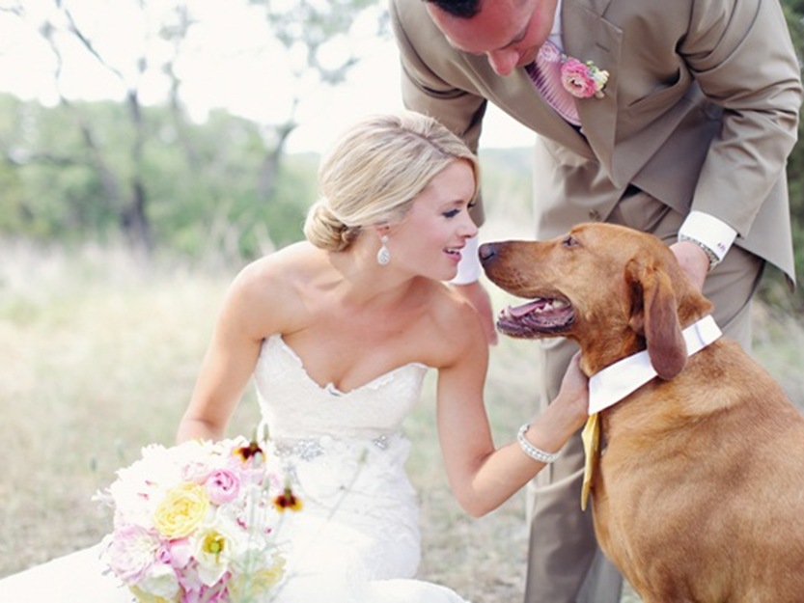
God said I need
Somebody to be your companion and
guide in this world and
the next. Somebody
to wait for you
on the other side or stand guard in your absence until they can join you for eternity… So God made a Dog

Slide 18
Enjoy this story again watching and listening
So God Made a Dog

Slide 19
Enjoy God and Dog Song

Slide 20
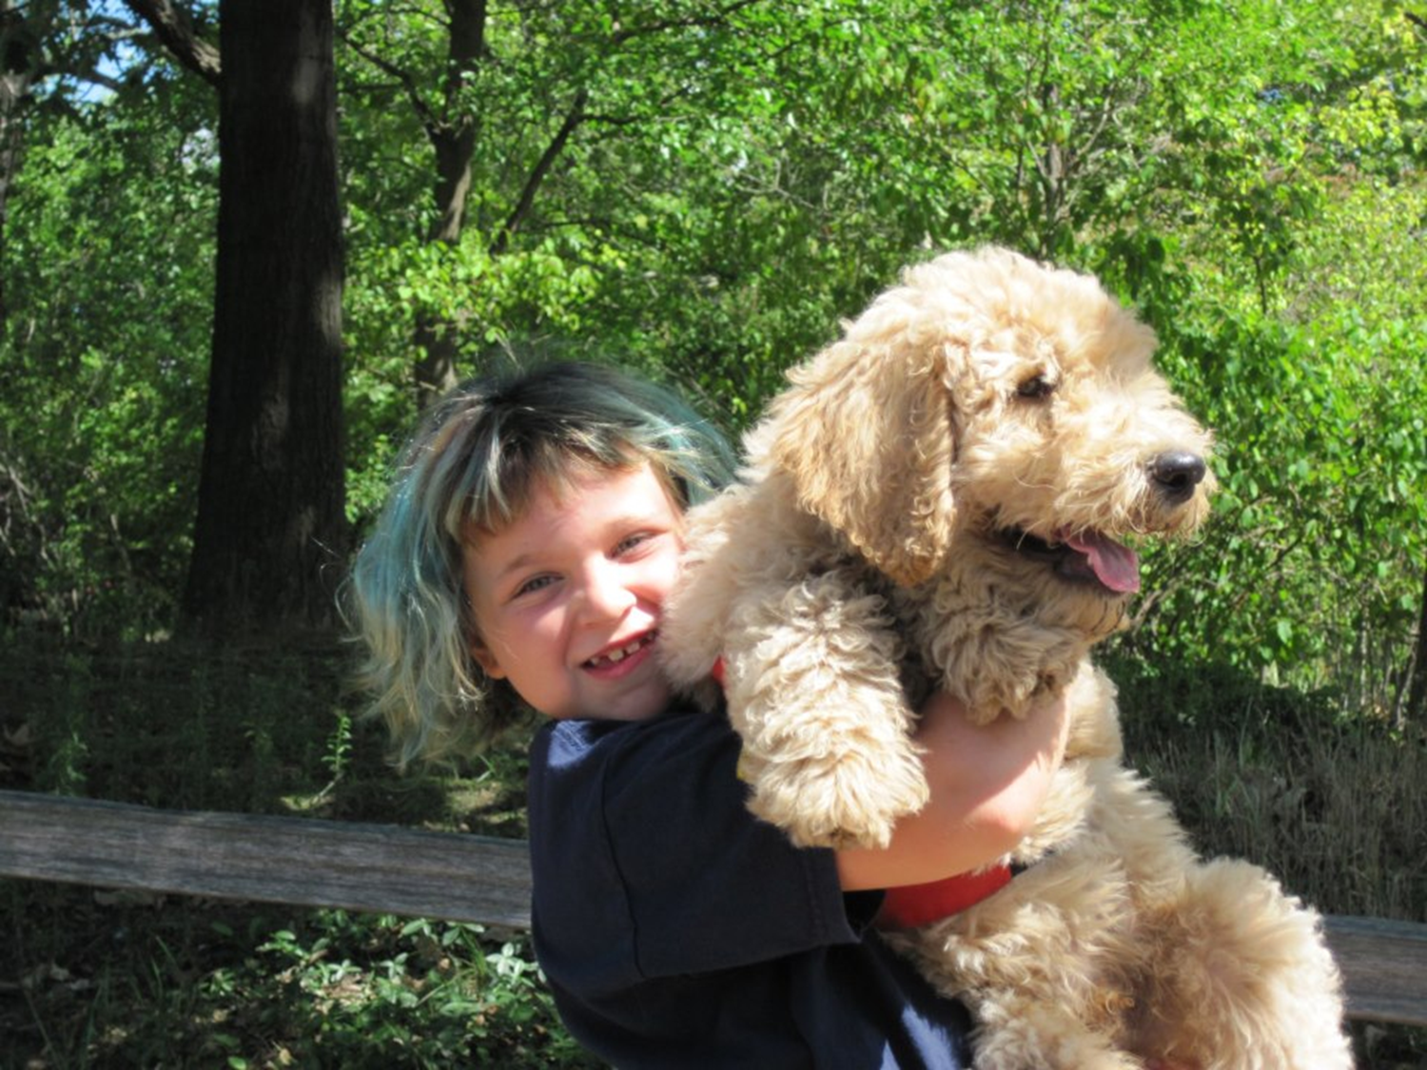
GoD and DoG
by Wendy Francisco
I look up and I see God, I look down and see my dog.
Simple spelling G O D, same word backwards, D O G.
They would stay with me all day. I'm the one who walks away.
But both of them just wait for me, and dance at my return with glee.
Both love me no matter what - divine God and canine mutt.
I take it hard each time I fail, but God forgives, dog wags his tail.
God thought up and made the dog, dog reflects a part of God.
I've seen love from both sides now, it's everywhere, amen, bow wow.
I look up and I see God, I look down and see my dog.
And in my human frailty...I can't match their love for me.

Slide 21
Sources
http://cdn.womensunitedonline.com/articles/2011/06/baby-with-dog.jpg
http://wallpaperscraft.com/image/baby_toddler_girl_grass_dog_game_80631_2560x1600.jpg?orig=1
http://www.rantlifestyle.com/wp-content/uploads/2014/04/child-dog-11.jpg
http://www.szentorban.com/zalakaros/images/stories/szent-orban-borozo-zalakaros/allatbarat-szallas.jpeg
http://www.nannyreviews.com/wp-content/uploads/2013/07/LEAD-BestDogsForFamilies-631x352.jpg
http://yuq.me/users/29/333/kCvAKHLrJ8.png
http://apftp.us/ftpAP/JE/Anchor%20Digital/Advanced_Reader_series/Amazing%20Tails%201%20Folder/Links/Boy%20and%20Dog%20123rf%202903362_high.jpg
http://communicationdesignyear1.files.wordpress.com/2010/02/children_and_dog2.jpg
http://blog-photos.dogvacay.com/wp-content/uploads/2012/03/baby-flash-games-211.jpg
http://2.bp.blogspot.com/-AF24zrv4kxU/UekmmiHkAmI/AAAAAAAAACY/qO1EsaZx5Iw/s1600/grass-dogs-children-HD-Wallpapers.jpg
http://www.singleparentcenter.net/wp-content/uploads/2012/07/Pets-And-Children.jpg
http://bms.24open.ru/images/e5e26af47ccaf643a4fca4edea2d800a
https://lh6.googleusercontent.com/-oI6D7eDPW78/UIF0U73ZxqI/AAAAAAAAAZ4/gPf1Qh4EX4s/s960/Photo%252520Oct%25252019%25252C%2525202012%25252C%25252011%25253A38%252520AM.jpg
http://www.aslowerpace.net/wp-content/uploads/2011/08/AbbeyDog.jpg
http://caninetofivedetroit.com/wp-content/uploads/2012/11/sad-dog.jpg
http://soloshideawayfunpages.com/_classics/031/godmadeadog.htm
http://www.musictory.com/music/Wendy+Francisco/GoD+and+DoG

