Slide 1
As … as … Idioms
Enjoy Learning
Interactive Quiz
Check Yourself and Enrich your English
by
Olga Stepanova, Chadukassinskaya Main School, Chuvashia

Slide 2
The Language game and its rules
This is a Language Game, bright and colorful, which is to develop your vocabulary and enrich it. It’s really fun! You have to click one of five icons on the slide to choose the right word. If you are wrong the icon disappears. If you click on the right icon the slide turns into ‘Congratulations!’ Enjoy!

Slide 3
Ready? Steady? Go!
Find!

Slide 4
1
About a lamb
2
About a bee
3
About a fox
4
About a lion
5
About a lark
6
About a pig

Slide 5
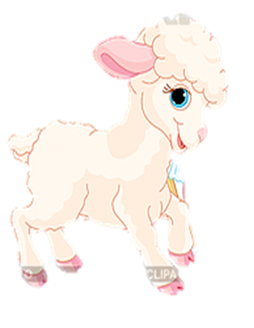
As … as a lamb
shy
sleepy
proud
lazy
beautiful
quick

Slide 7
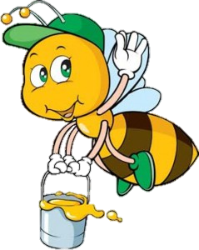
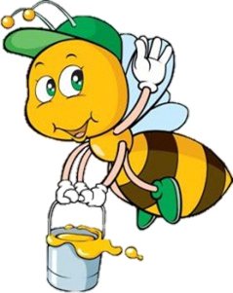
As … as a bee
bored
crazy
busy
noisy
pretty
patient

Slide 9
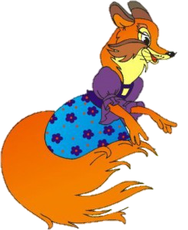
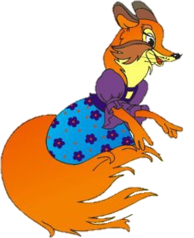
As … as a fox
honest
smart
active
creative
curious
sly

Slide 11
As … as a lion
confident
selfish
brave
greedy
reliable
arrogant

Slide 13
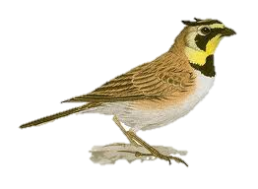
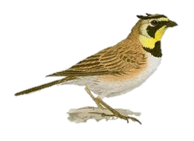
as … as a lark
serious
happy
eager
sad
boastful
successful

Slide 15
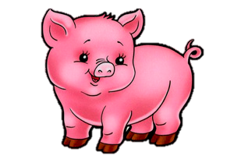
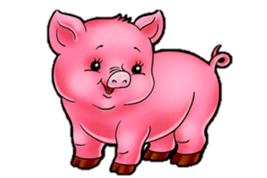
as … as a pig
kind
noble
rude
funny
fat
generous

Slide 17
The End!
Happy End!

Slide 18
Sources
http://www.youngwritersproject.org/node/46189
http://demiart.ru/forum/uploads/post-5054-1182872657.jpg
http://birdtattoodesigns.org/wp-content/uploads/2012/03/lark-tattoo-2.jpg
http://mamaschool.ru/wp-content/uploads/2013/08/zagadki-pro-svinju.jpg
http://usefulenglish.ru/idioms/idioms-of-comparison
http://клипарт.рф/%D0%B8%D0%B7%D0%BE%D0%B1%D1%80%D0%B0%D0%B6%D0%B5%D0%BD%D0%B8%D0%B5/3185821-%D0%BF%D0%B0%D1%81%D1%82%D1%83%D1%88%D0%BA%D0%B0-%D1%81-%D1%8F%D0%B3%D0%BD%D0%B5%D0%BD%D0%BA%D0%BE%D0%BC/

