Slide 1
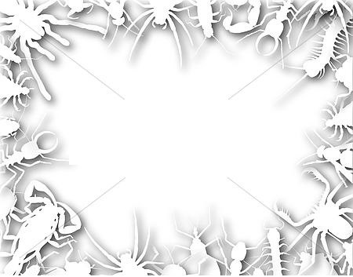
Английский язык
УМК “Spotlight” 9 класс Тест Insects? Phew!
Автор:
Ольга Михайловна Степанова
учитель английского языка
МБОУ «Чадукасинская ООШ»
Красноармейского района
Чувашской Республики

Slide 2
1. Bedbugs are always … to find a warm place in your home.
a) glad
b) hungry
c) thirsty
d) afraid

Slide 3
2. Keep your bedroom … if you don’t want to see bedbugs there!
a) wet
b) warm
c) cool
d) dry

Slide 4
3. Dust mites are too … to see.
a) crazy
b) small
c) busy
d) clever

Slide 5
4. Dust mites like eating … skin and hair.
a) dead
b) dirty
c) injured
d) clean

Slide 6
5. Vacuuming a lot helps to get rid of these … insects.
a) naughty
b) nervous
c) disgusting
d) selfish

Slide 7
6. Cockroaches live in … places.
a) important
b) horrible
c) expensive
d) warm

Slide 8
7. Cockroaches prefer … places, too.
a) smoggy
b) dark
c) snowy
d) rainy

Slide 9
8. Cockroaches can’t stand living in … bright areas.
a) crowded
b) clean
c) muddy
d) tiny

Slide 10
9. Cockroaches can carry … diseases , so don’t let them live in your house.
a) poor
b) cruel
c) funny
d) nasty

Slide 11
10. Able to live for up to a week , cockroaches are so … .
a) dangerous
b) boring
c) angry
d) aggressive

Slide 12
Key to the test
Ключи к тесту
1 | 2 | 3 | 4 | 5 | 6 | 7 | 8 | 9 | 10
a | c | b | a | c | d | b | b | d | d

Slide 13
Source
Фон презентации:
http://comps.canstockphoto.com/can-stock-photo_csp3669065.jpg
Вопросы теста взяты из учебника Spotlight-9 - стр 30 Модуль 2, Урок 2с, Упражнение 1.

