Slide 1
Ecological problems
Купцова Евгения, ученица 8 класса МБОУ «Шенкурская СОШ»
г. Шенкурск Архангельской области;
Доильницына Е.Ю., учитель английского языка
МБОУ «Шенкурская СОШ»
г. Шенкурск Архангельской области

Slide 2
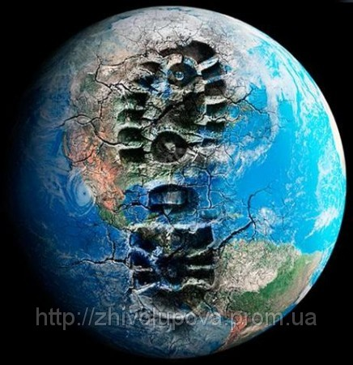
There are a lot of ecological problems in the world.

Slide 3
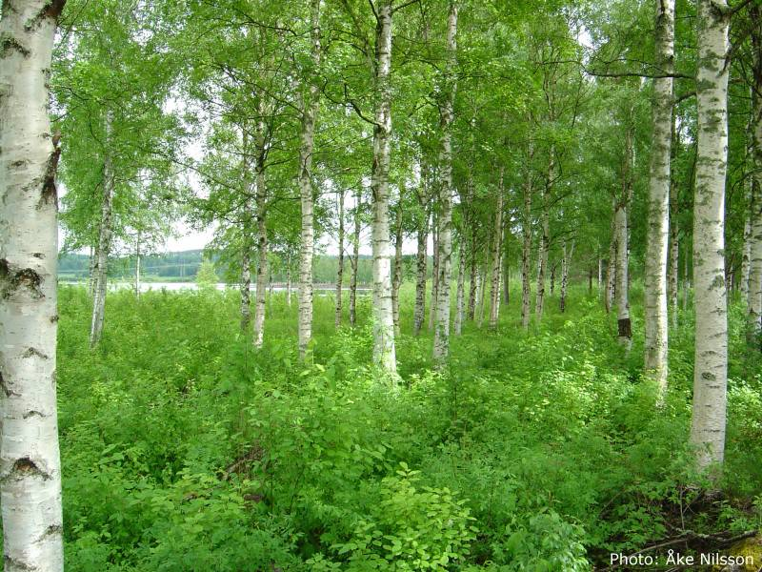
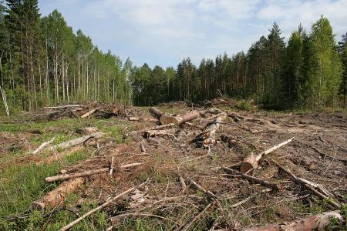
Trees give us oxygen to breathe but peaple cut down too many trees.

Slide 4
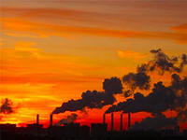
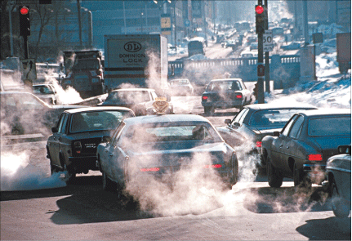
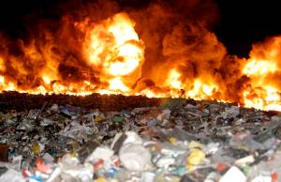
Factories, cars, burning litter pollute the atmosphere with dangerous chemicals.

Slide 5
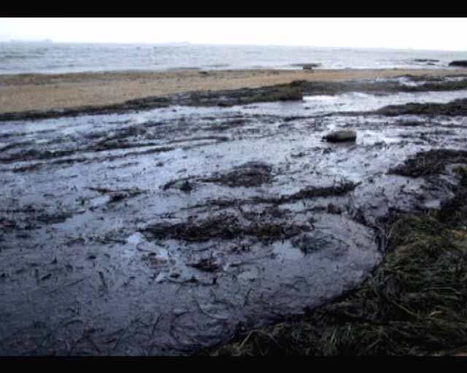
Rives, lakes, seas and oceans are polluted with toxins too.

Slide 6
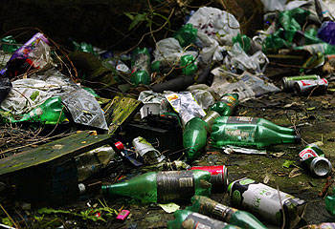
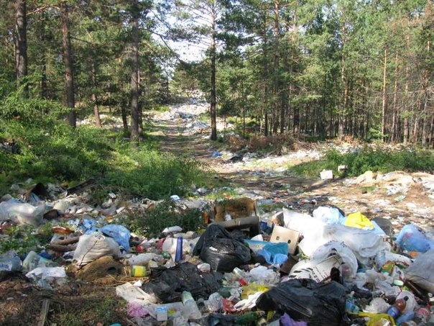
Tins, glass and plastic bottles last in the ground for a long time.

Slide 7
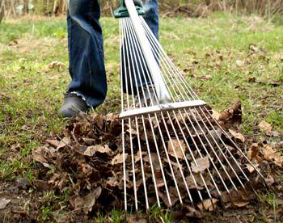
Everyone can do something to save the enviroment.

Slide 8
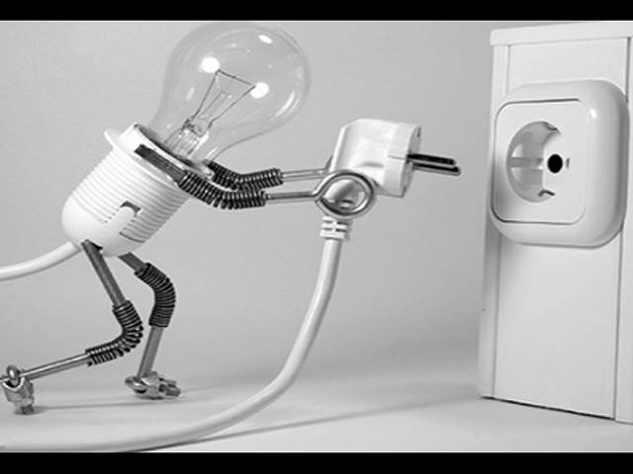
We must turn off the light and water when we do not need them.

Slide 9
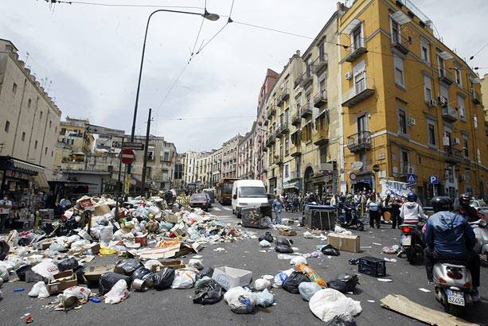
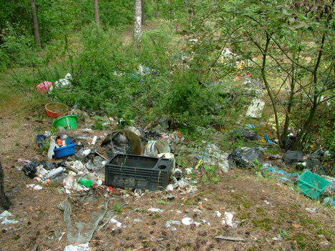
We must not drop litter in the streets and in the forest.

Slide 10
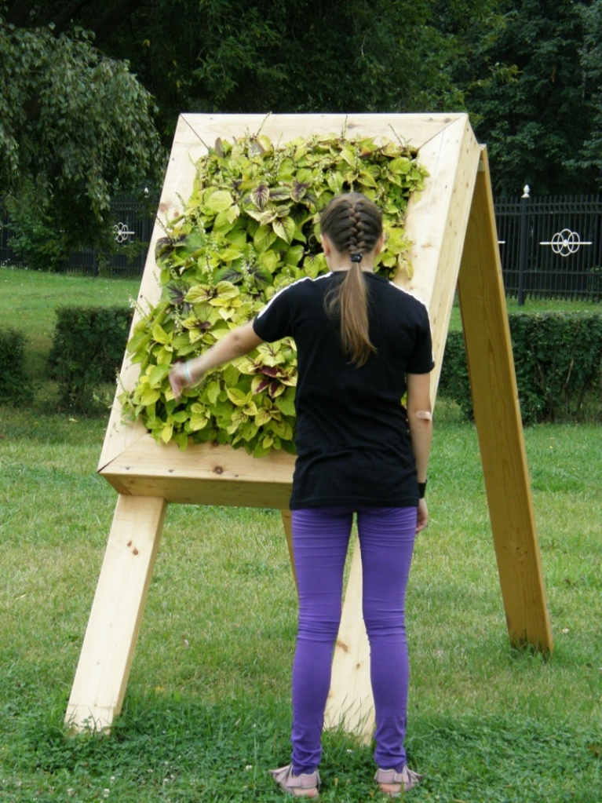
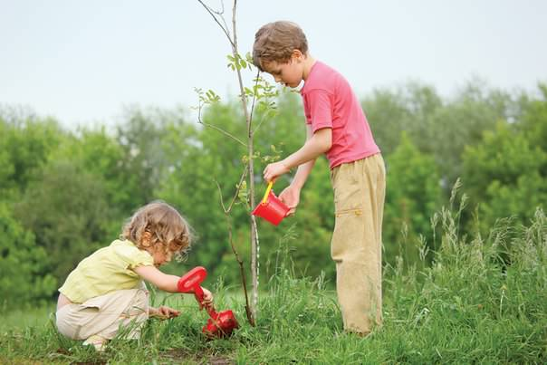
To make the world a better place we can plant trees and flowers.

Slide 11
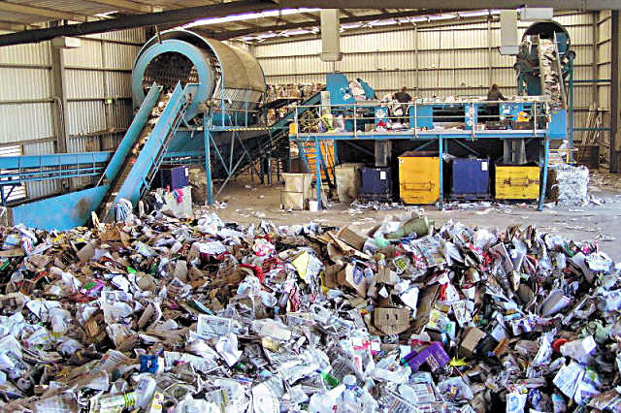
It in important to build special factories that can recycle rubbish.

Slide 12
The Earth is our home and we must protect it for ourselves and for the future generation.

Slide 13
Created by Kuptsova Evgeniya

