Slide 1
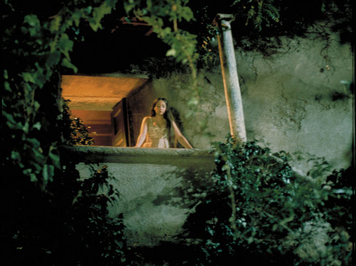
Juliet’s Birthday
Автор:
Ольга Михайловна Степанова
учитель английского языка
МБОУ «Чадукасинская ООШ»
Красноармейского района
Чувашской Республики

Slide 2
To celebrate or not to celebrate? That's the question that can only receive a resounding Yes when it comes to the eponymous heroine in Shakespeare's Romeo And Juliet.

Slide 3
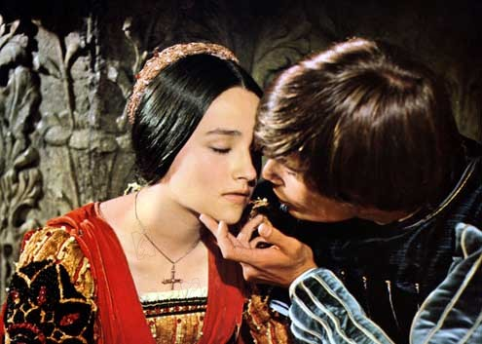
The city of Verona celebrates every year, on September 16, the birthday of its famous heroine.
JULIET´S BIRTHDAY

Slide 4
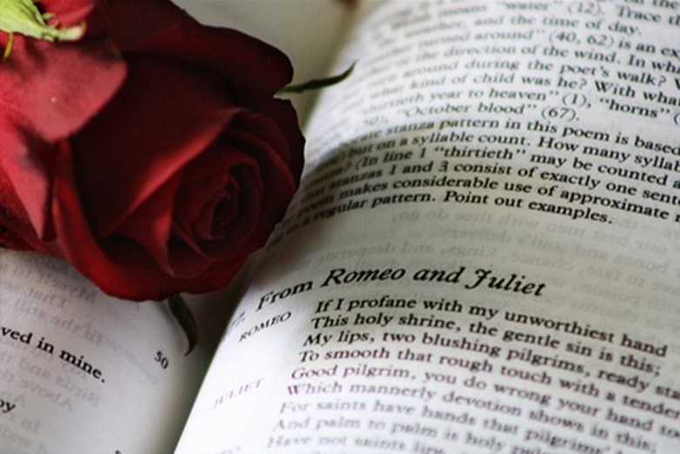
The date is based on the "novella" by Luigi Da Porto (1531), the first writer who told the story of Romeo and Juliet. He was a captain in the service of the Venetian Republic and he claimed that one of his bowmen, named Pellegrino da Verona, told him the true story of two unfortunate young lovers who had lived at the beginning of the 14th century and belonged to two rival families, the Capulets and the Montagues.
His novel inspired a lot of other European writers, until it reached the peak of artistic expression in Shakespeare´s "Romeo and Juliet" (1596).

Slide 5
Juliet Cappello (her real name) was born on 16th September 1284
in Verona, Italy.

Slide 6
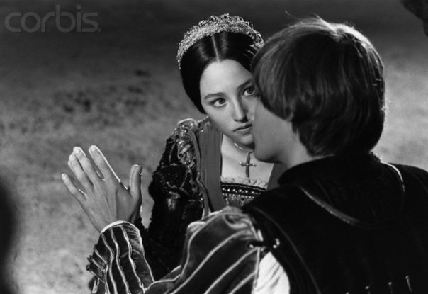
There were many legends and poems about her romance with Romeo, and in 1596, William Shakespeare wrote his famous play about the couple.

Slide 7
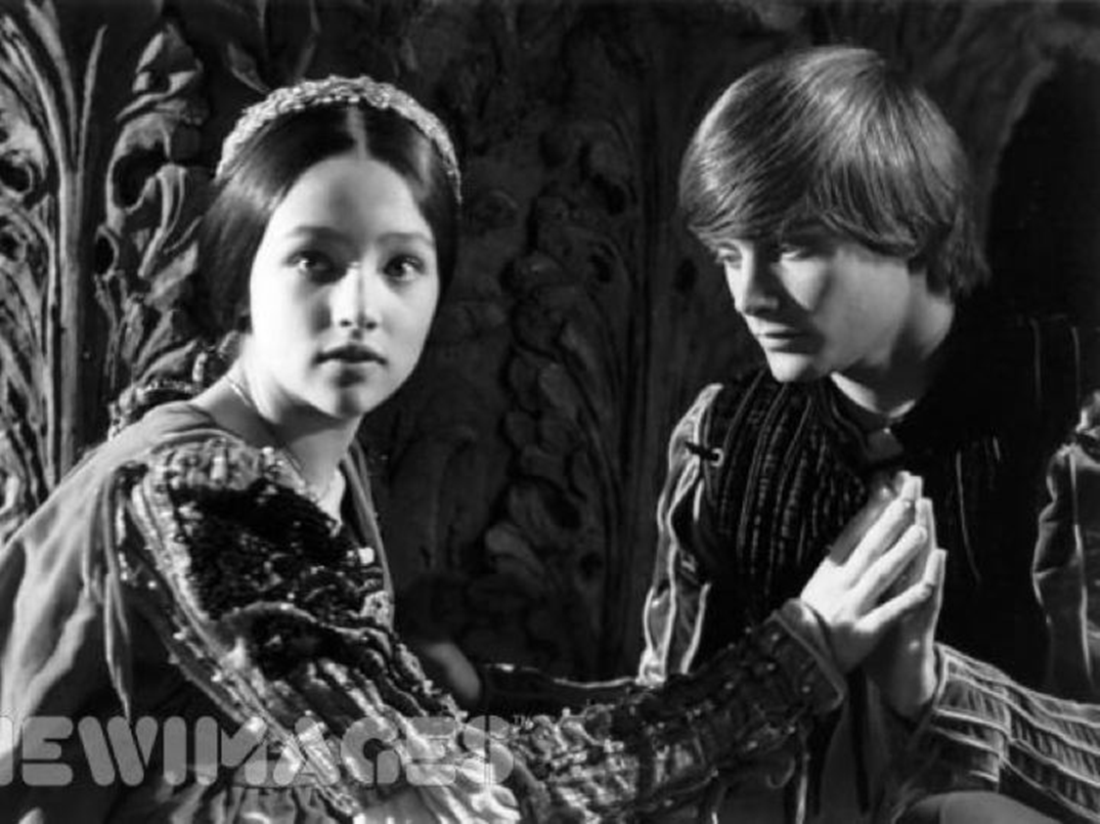
Hundreds of thousands of tourists visit Juliet’s house
every
year

Slide 8
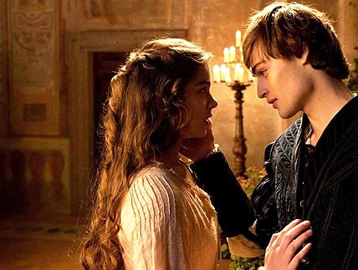
On 16th September, there is
a festival in Verona to celebrate Juliet’s birthday.

Slide 9
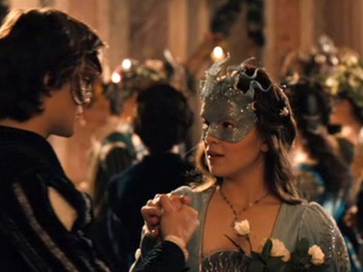
Revelers roam the streets of Verona, dressed in romantic period costumes, to celebrate the young love-struck heroine’s birthday. Festivities include parades of the infamous Courts of Montague’s and Capulet’s, dancing, street artists, musicians and lots of food.

Slide 10
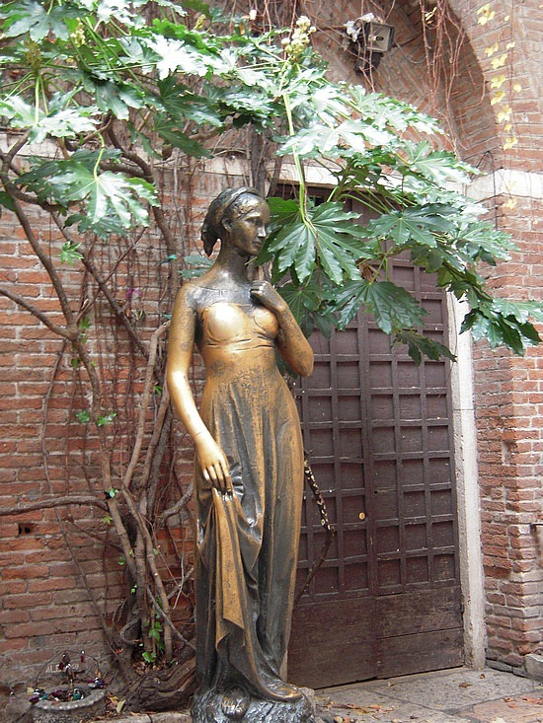
A house thought to be the Capulets' ,with balcony and all, is one of the most visited sites in Verona. In the house’s small courtyard, stands a bronze statue of Juliet. Legend has it that if a person strokes the right breast of the statue, that person will have good fortune. Many have tried as is evidenced by the statue’s very worn right breast

Slide 11
Sardines come from all over the world to pack themselves in and around the courtyard of "Juliet's House". They hang up their padlocks with the names of their lovers.

Slide 12
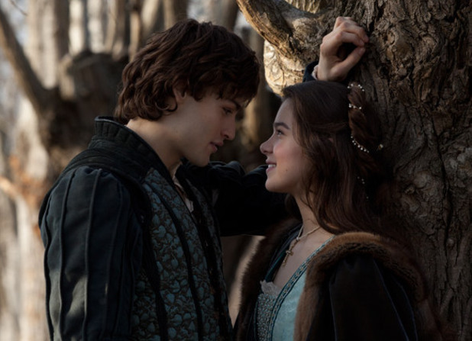
Visitors can also gaze at the Wall of Letters that Juliet receives, written and sent by love stuck and truly romantic people from around the world, There are notes from Australia, India, the US, England, Italy and many more countries. It’s hard not to feel touched by the genuineness and passion in the thousands of notes that adorn Juliet’s Wall.

Slide 13
In 1937, a letter arrived at Juliet’s tomb, addressed to “Juliet, Vernona”. It told a sad story of love. And people with romantic problems continue to write to Juliet from all around the world.

Slide 14
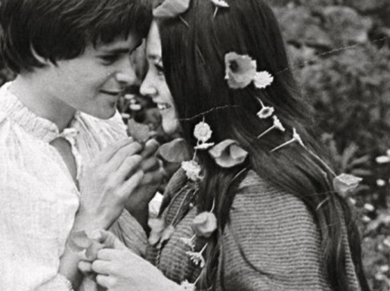
Every minute there's a new sardine on the balcony, waving like Lady Di to their beloveds below, who fervently photograph. Inside the house where one can enter with payment, one can take pictures of the bed, of the chairs, of the walls.

Slide 15
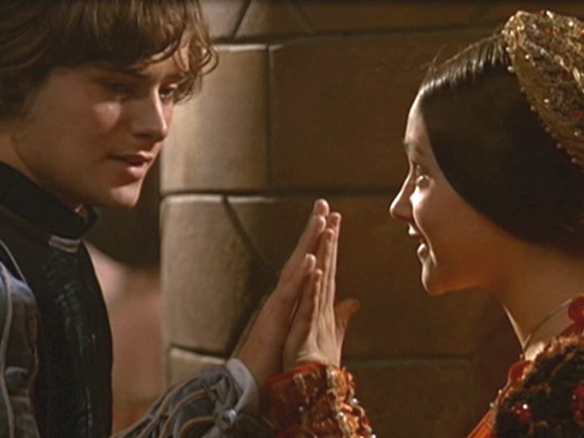
The tradition of sending letters to Juliet may go back centuries. It began by people starting to leave notes on a local landmark said to be Juliet's tomb. Later, people started sending mail directly to the city.

Slide 16
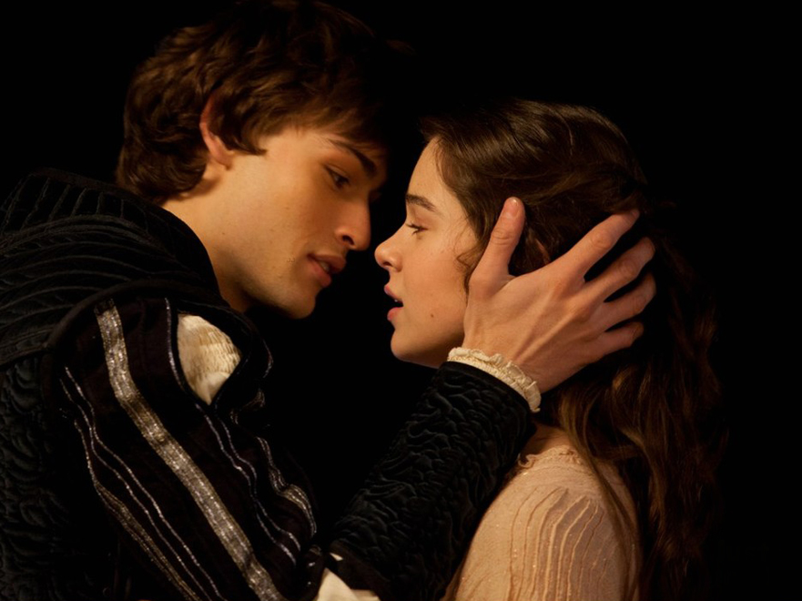
By the 1990s, Verona was receiving so many letters; it created an office to handle it – the Juliet Club. Each year the club office receives more than 6,000 letters and they are all answered by hand. The club also organizes Juliet’s Birthday celebration and festivities.

Slide 17
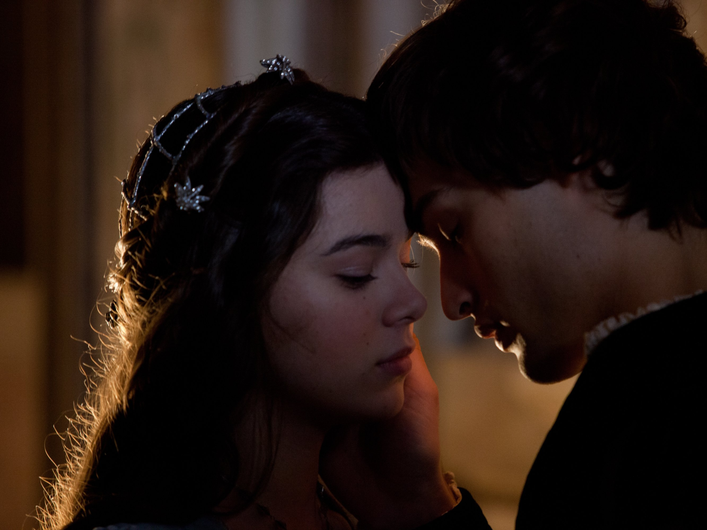
There is even a Romeo & Juliet store in the courtyard! ONLY, Shakespeare never made it to Verona in his lifetime. The city of Verona bought this house because it was suitable scenery to the story Shakespeare wrote using the name Verona!

Slide 18
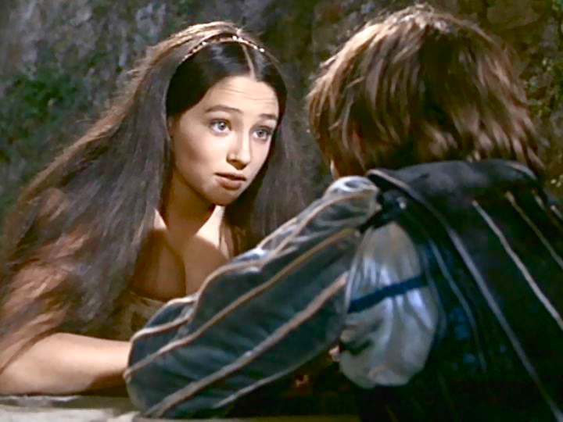
So powerful is the legend of Juliet that over half a million tourists flock here every year to visit the simple courtyard and home that are considerably less affluent-looking than the sumptuous Franco Zeffirelli version as you may remember it (the movie was filmed in Tuscany)

Slide 19
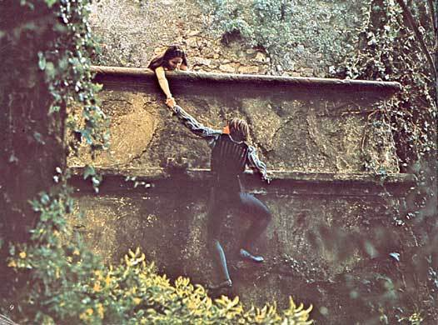
Couples like to be photographed standing on the famous balcony where Juliet declared her love to Romeo.

Slide 20
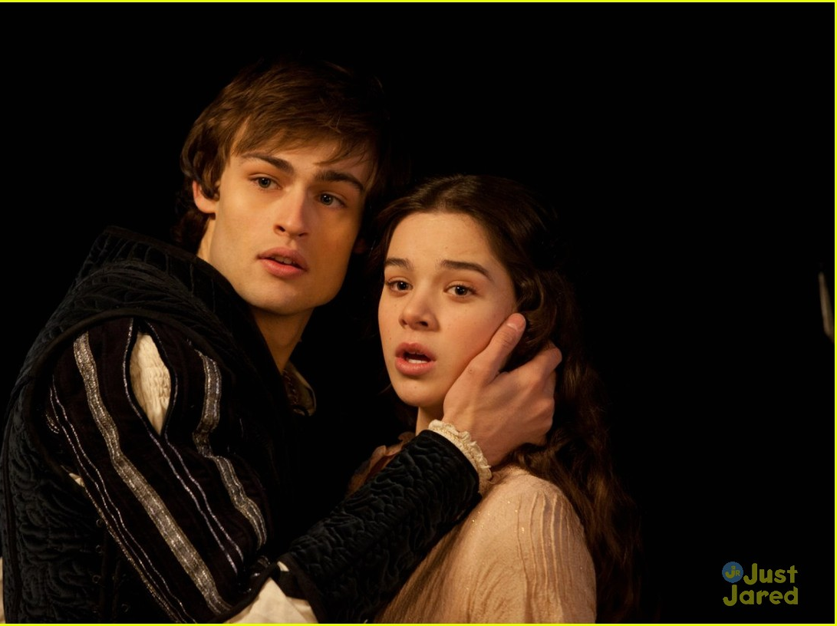
If you are fortunate enough to be in Verona during the festival, there will be plenty of photo ops and chance
to go back
in time for what promises to be
a day filled
with romance
and magic.

Slide 21
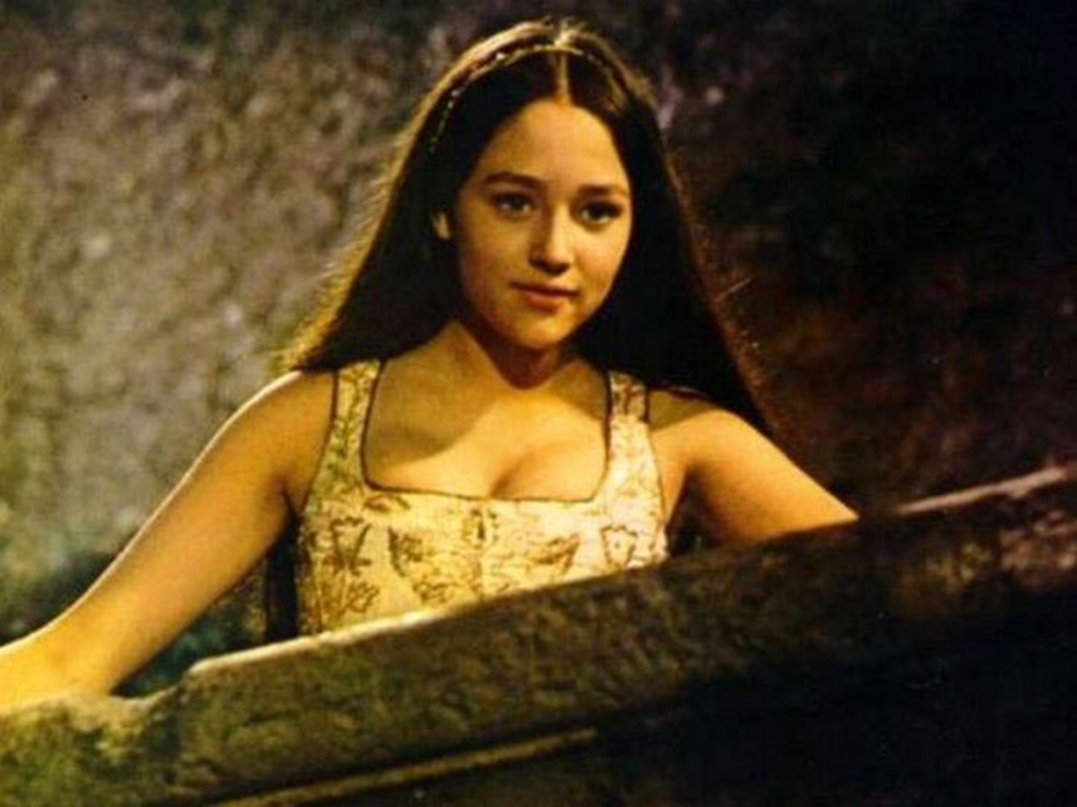
Sources
http://viola.bz/happy-birthday-juliet-capulet/
http://images5.fanpop.com/image/photos/24600000/Leonard-Whiting-Olivia-Hussey-1968-romeo-and-juliet-by-franco-zeffirelli-24649315-720-540.jpg
http://www.raisingarizonakids.com/wp-content/uploads/2013/10/ROMEO-JULIET-Amber.jpg
http://i2.cdnds.net/13/15/618x447/movies-romeo-and-juliet-douglas-booth-hailee-steinfeld.jpg
http://images4.fanpop.com/image/photos/22900000/Juliet-Capulet-Montague-1968-romeo-and-juliet-by-franco-zeffirelli-22928524-1382-1029.jpg
http://insiderlouisville.com/wp-content/uploads/2014/01/romeo-and-juliet.jpg?db97dd
http://fast.swide.com/wp-content/uploads/Romeo-and-juliet-2013-movie-douglas-booth-hailee-steinfeld-kissing.jpg
http://images6.fanpop.com/image/photos/35800000/Romeo-and-Juliet-romeo-and-juliet-2013-35804501-3000-2000.jpg
http://images2.fanpop.com/image/photos/10800000/olivia-leo-romeo-and-juliet-1968-10866580-604-415.jpg
http://images1.fanpop.com/images/photos/1800000/Stills-romeo-and-juliet-1968-1847815-526-390.jpg
http://viola.bz/wp-content/uploads/2012/09/Romeo-and-Juliet-3.jpg
http://viola.bz/wp-content/uploads/2012/09/Romeo-and-Juliet-Statue-Central-Park-New-York-NY.jpg
http://viola.bz/wp-content/uploads/2012/09/Romeo-and-Juliet-1.jpg
http://www.italiarail.com/verona/events/juliets-birthday
http://cdn4.vtourist.com/4/7139950-Juliu00EBts_Balcony-Verona.jpg
http://www.virtualtourist.com/travel/Europe/Italy/Veneto/Verona-140824/Things_To_Do-Verona-Romeo_Juliet-BR-1.html
http://images4.fanpop.com/image/photos/21300000/Romeo-Juliet-1968-1968-romeo-and-juliet-by-franco-zeffirelli-21346588-720-540.jpg
http://www.italymagazine.com/news/whats-italy-september-2014
http://www.newdvdreleasedates.com/images/posters/full/romeo-and-juliet-2013.jpg
http://d3gtl9l2a4fn1j.cloudfront.net/t/p/w780/qTCdJVgpC0ORKanJfMvx2ls8exs.jpg

