Slide 1
The Year of the Goat devoted to
Wonderful Creature the Goat
Interactive quiz
Автор:
Ольга Михайловна Степанова
учитель английского языка
МБОУ «Чадукасинская ООШ»
Красноармейского района
Чувашской Республики
2014

Slide 2
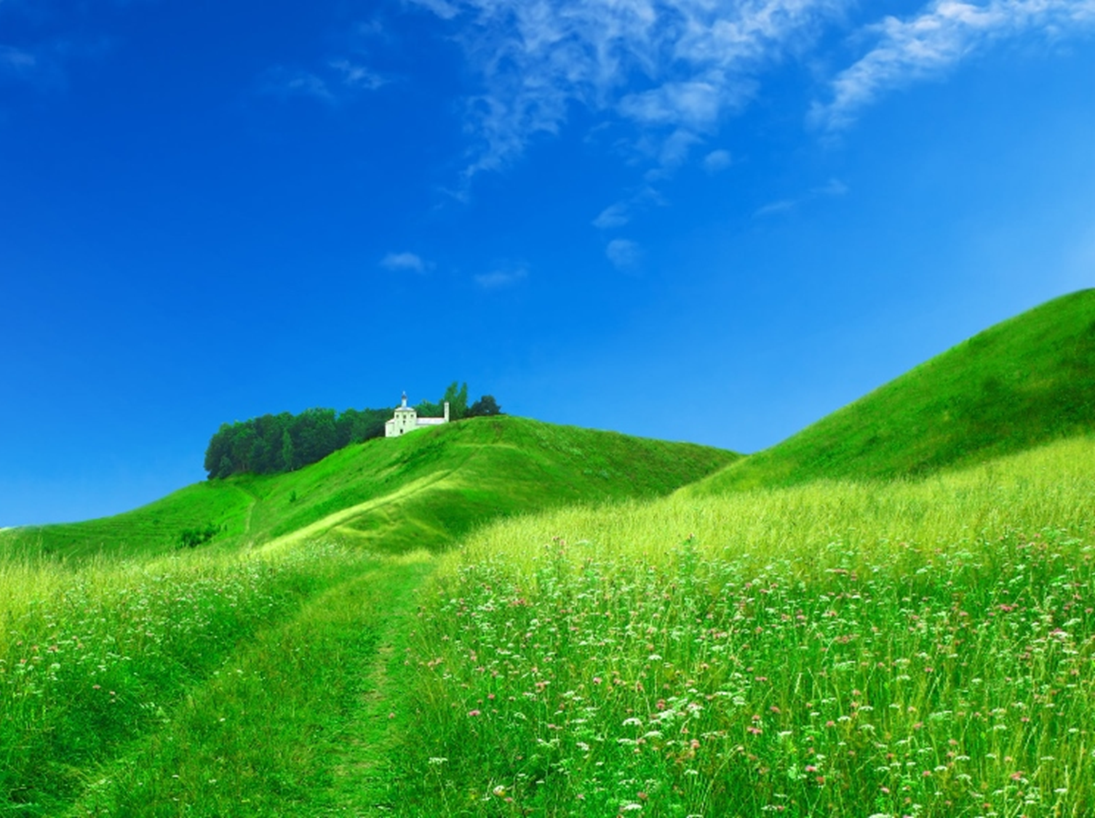
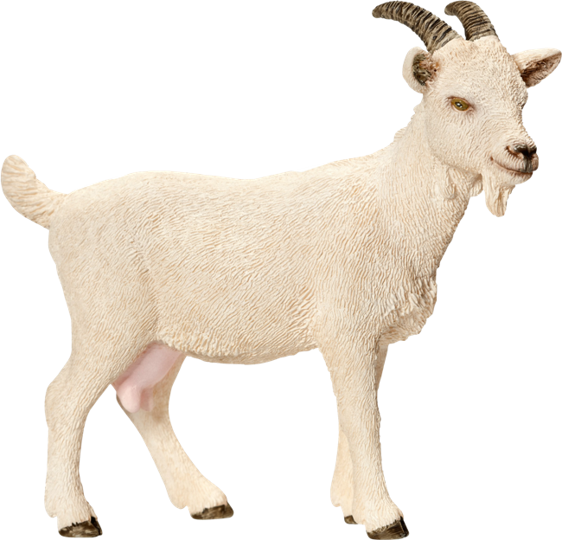
Goats were first brought to America by ….. in 1493.
James Cook |  | Christopher Columbus |  | Charles Darwin |  | Ferdinand Magellan

Slide 3
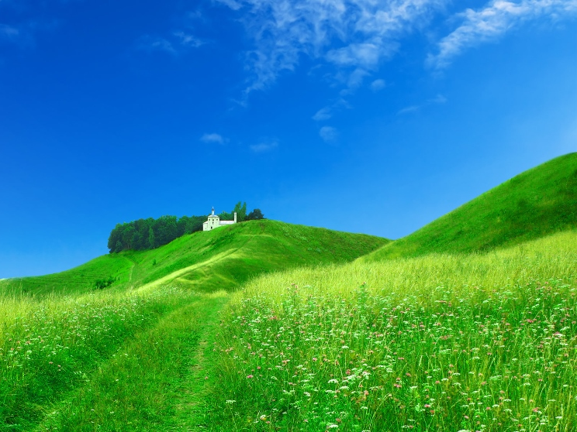
The goat is one of the 12 ….. zodiac animals, representing introversion, creativity, shyness and being a perfectionist.
Chinese |  | Japanese |  | American |  | Russian

Slide 4
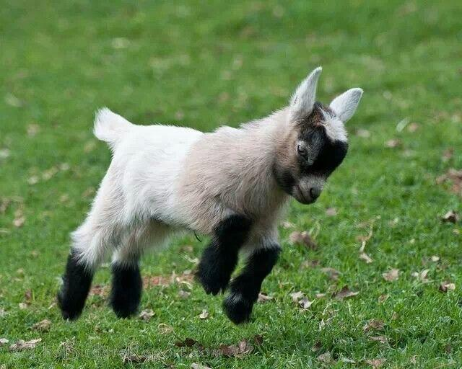
A baby goat is called a “….. ”
kid |  | pete |  | seek |  | fat

Slide 5
The female goat is called a “doe” or “….. ”.
liddy |  | patty |  | minny |  | nanny

Slide 6
The male goat is called a “buck” or “….. ”.
milly |  | tilly |  | billy |  | silly

Slide 7
Before coins were used for money, goats were traded for ….. because they were so valuable
silver |  | gold |  | cooper |  | iron

Slide 8
Abraham Lincoln’s sons had ….. goats that lived in the white
house with them.
two |  | three |  | four |  | five

Slide 9
Goats discovered …..
cola |  | lemonade |  | coffee |  | juice
.

Slide 10
Goats cannot live in a herd of ….. . African Proverb
horses |  | cows |  | leopards |  | crocodiles

Slide 11
Put ….. on a goat and it is still a goat. Irish Proverb
velvet |  | silk |  | chiffon |  | satin

Slide 12
When the goat goes to ….. , he does not stop till he gets to the altar. Irish Proverb
church |  | shop |  | museum |  | garden

Slide 13
Where there are no sheep, they call the goat ….. . Turkish Proverb
lady |  | miss |  | queen |  | princess

Slide 14
The quarrel of the ….. doesn't concern the goats. African Proverb
elephants |  | sheep |  | giraffes |  | tigers

Slide 15
Even on old goat likes to lick ….. .
Hungarian Proverb
marmalade |  | sweets |  | salt |  | sugar

Slide 16
Использованные ресурсы:
http://upload.wikimedia.org/wikipedia/commons/f/ff/Domestic_goat_kid_in_capeweed.jpg
https://lh3.ggpht.com/3K9nOv9bQcZPDqhXR0kFySl7FKu2WmpA4E4HbvOiGAegRGZaBe76ytnRsi-iuwQ6Z3udcA=s89
https://lh3.ggpht.com/zkNwPOkbjebNo_aqg6O61RsajRQXNnrljy9_a15GbC0ptvXprQFXnLBUH47ildqMbpBT=s136
http://www.onekind.org/be_inspired/animals_a_z/goat/
http://swampyacresfarm.com/RandomGoatFacts.html
http://www.special-dictionary.com/proverbs/keywords/goat/

