Slide 1
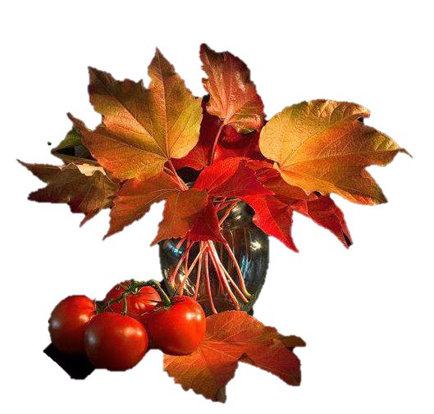
Virtual Tour
Still Nature Art
Multimedia Exhibit
Автор:
Ольга Михайловна Степанова
учитель английского языка
МБОУ «Чадукасинская ООШ»
Красноармейского района
Чувашской Республики
2014

Slide 2
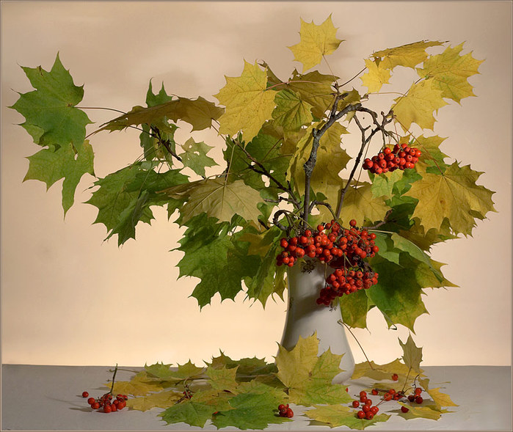
“Autumn is a second spring when every leaf is a flower.” Albert Camus

Slide 3
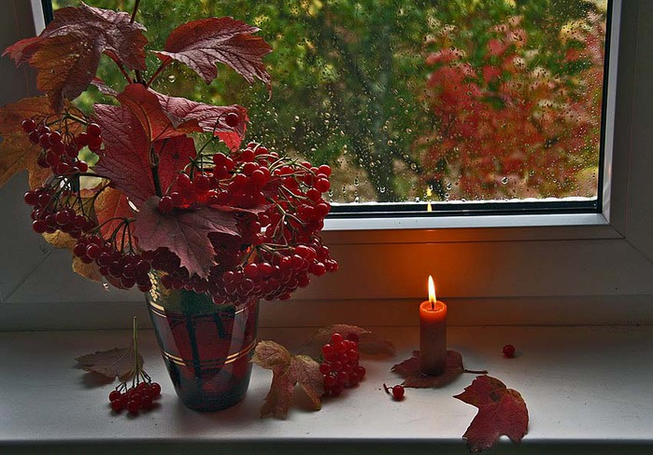
“Night, which in Autumn seems to fall from the sky so suddenly, chilled us...” Jules Barbey d'Aurevilly

Slide 4
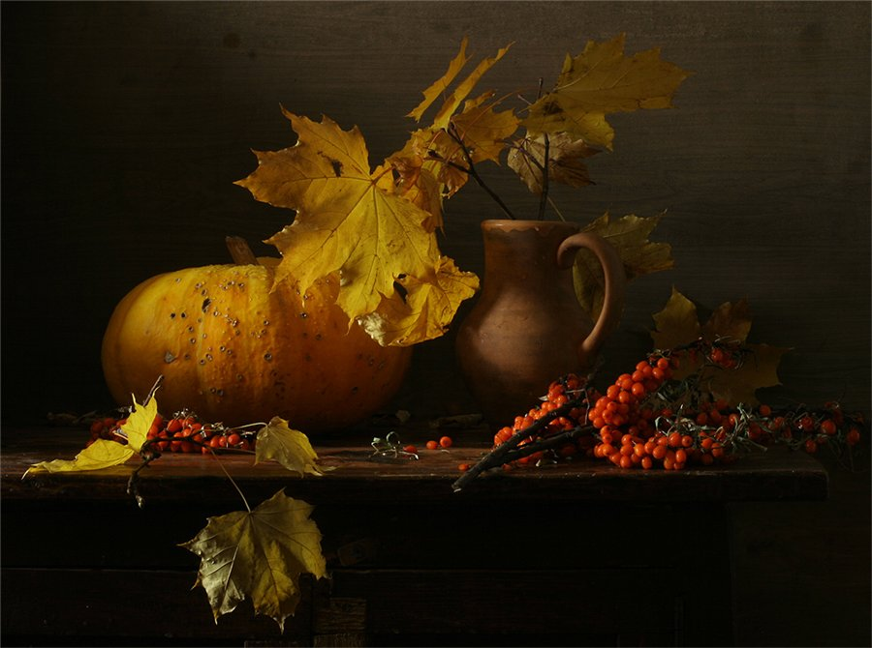
"Autumn begins with a subtle change in the light, with skies a deeper blue, and nights that become suddenly clear and chilled…” Glenn Wolff and Jerry Dennis

Slide 5
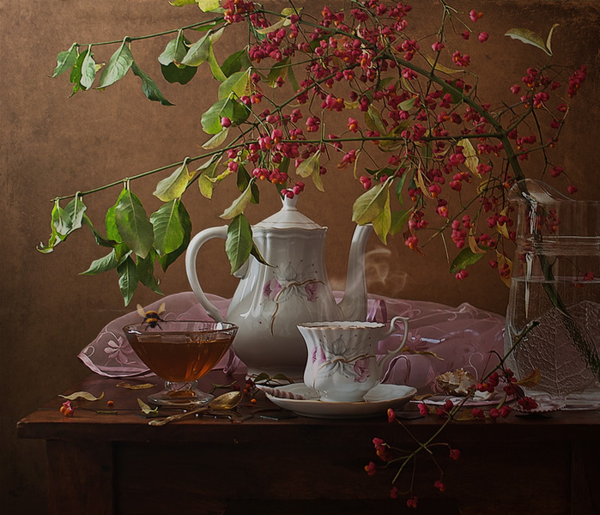
“When the autumn meets the tranquillity, there you can see the King of the Sceneries!” Mehmet Murat ildan

Slide 6
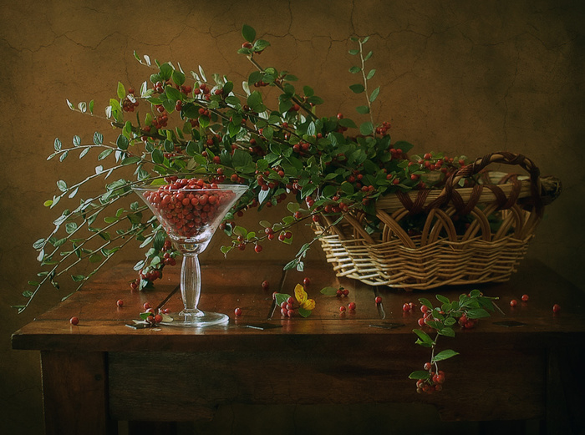
“Autumn is a classical music; when it begins, the gravity disappears!” Mehmet Murat ildan

Slide 7
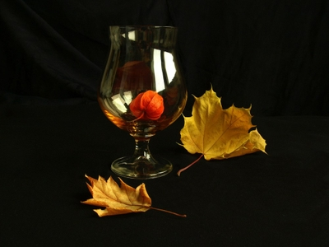
“Anyone who thinks fallen leaves are dead has never watched them dancing on a windy day.”
Shira Tamir

Slide 8
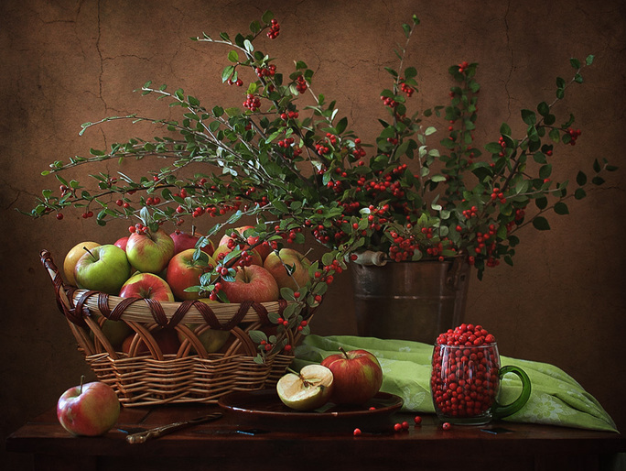
"There is a harmony In autumn, and a lustre in its sky, which through the summer is not heard or seen, as if it could not be, as if it had not been!“
Percy Bysshe Shelley

Slide 9
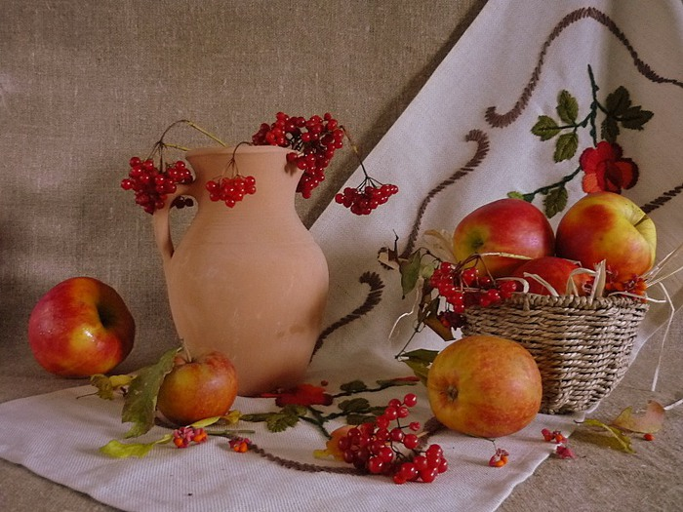
Autumn is the final trick in nature's year-long magic show: It masks death
with a
spectacular
display
of beauty.
KEITH HANSEN

Slide 10
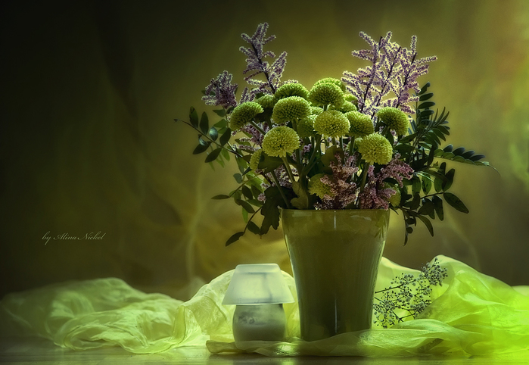
“Autumn is an honest month; it does not delude man like spring does! It shows him the dark face of life, the tragedy, the rot, the separation, the sadness!” Mehmet Murat ildan

Slide 11
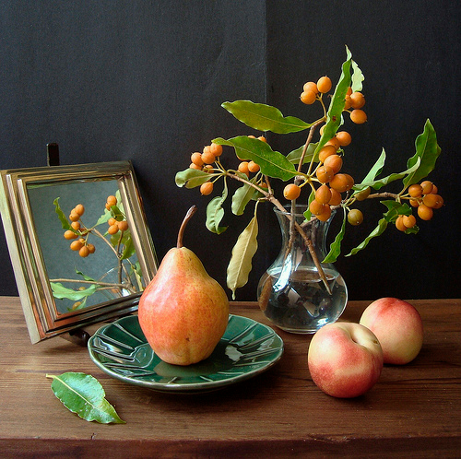
“There is so much beauty in autumn and so much wisdom; so much separation and so much sorrow!” ― Mehmet Murat ildan

Slide 12
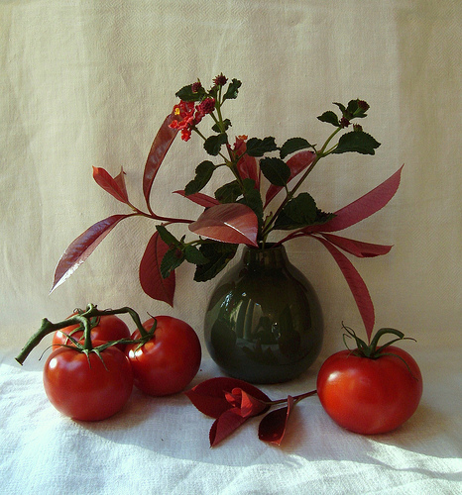
Autumn is the mellower season, and what we lose in flowers we more than gain in fruits.
Samuel Butler

Slide 13
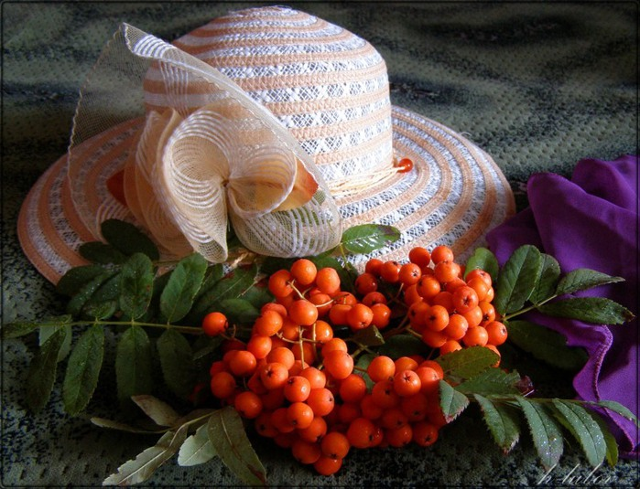
Lady Autumn, Queen of the Harvest, I have seen
You
in the setting
Sun with Your long auburn
tresses... Deirdre
Akins

Slide 14
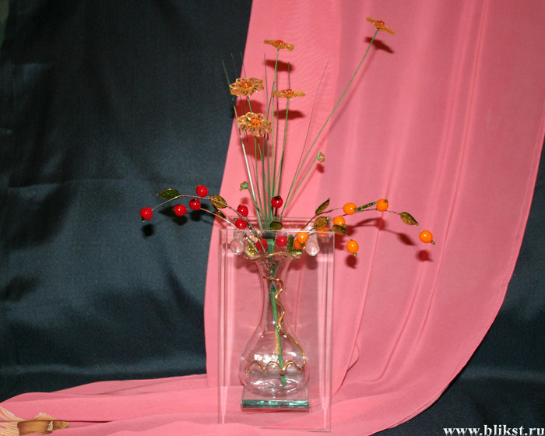
"Autumn is the eternal corrective. It is ripeness and color and a time
of maturity; but
it is also breadth, and depth, and distance… “
Hal Borland

Slide 15
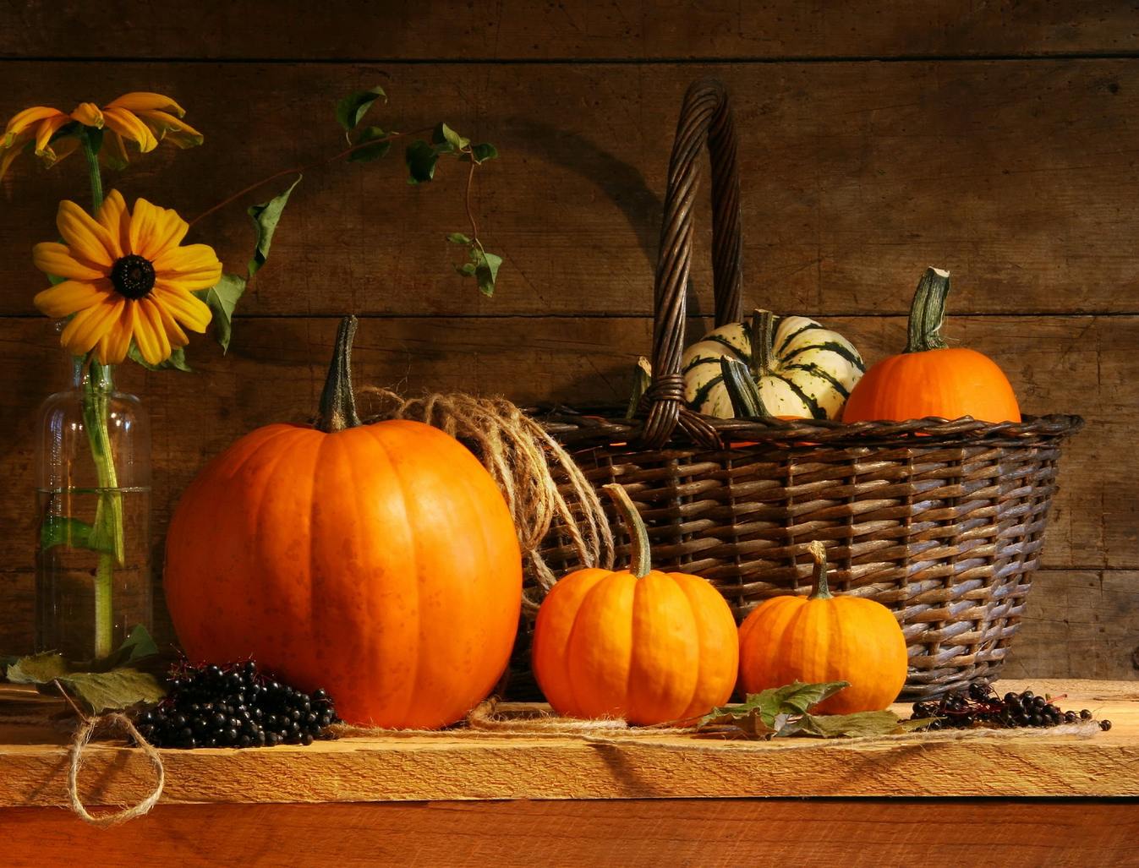
“I would rather sit on a pumpkin, and have it all to myself, than be crowded on a velvet cushion.” ― Henry David Thoreau

Slide 16
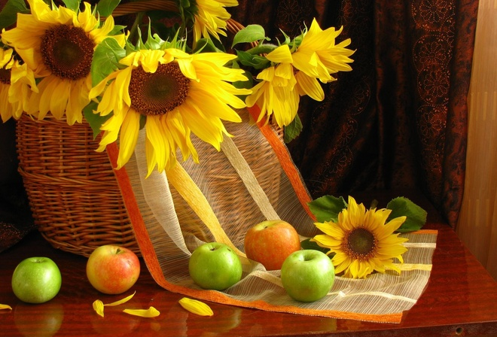
“Autumn carries
more
gold in its pocket than all the other seasons.” ― Jim Bishop

Slide 17
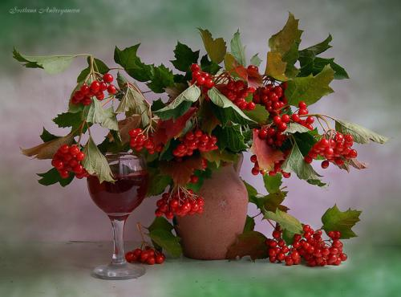
Autumn is the perfect time to take account of what we’ve done, what we didn’t do, and what we’d like to do next year.
Author Unknown

Slide 18
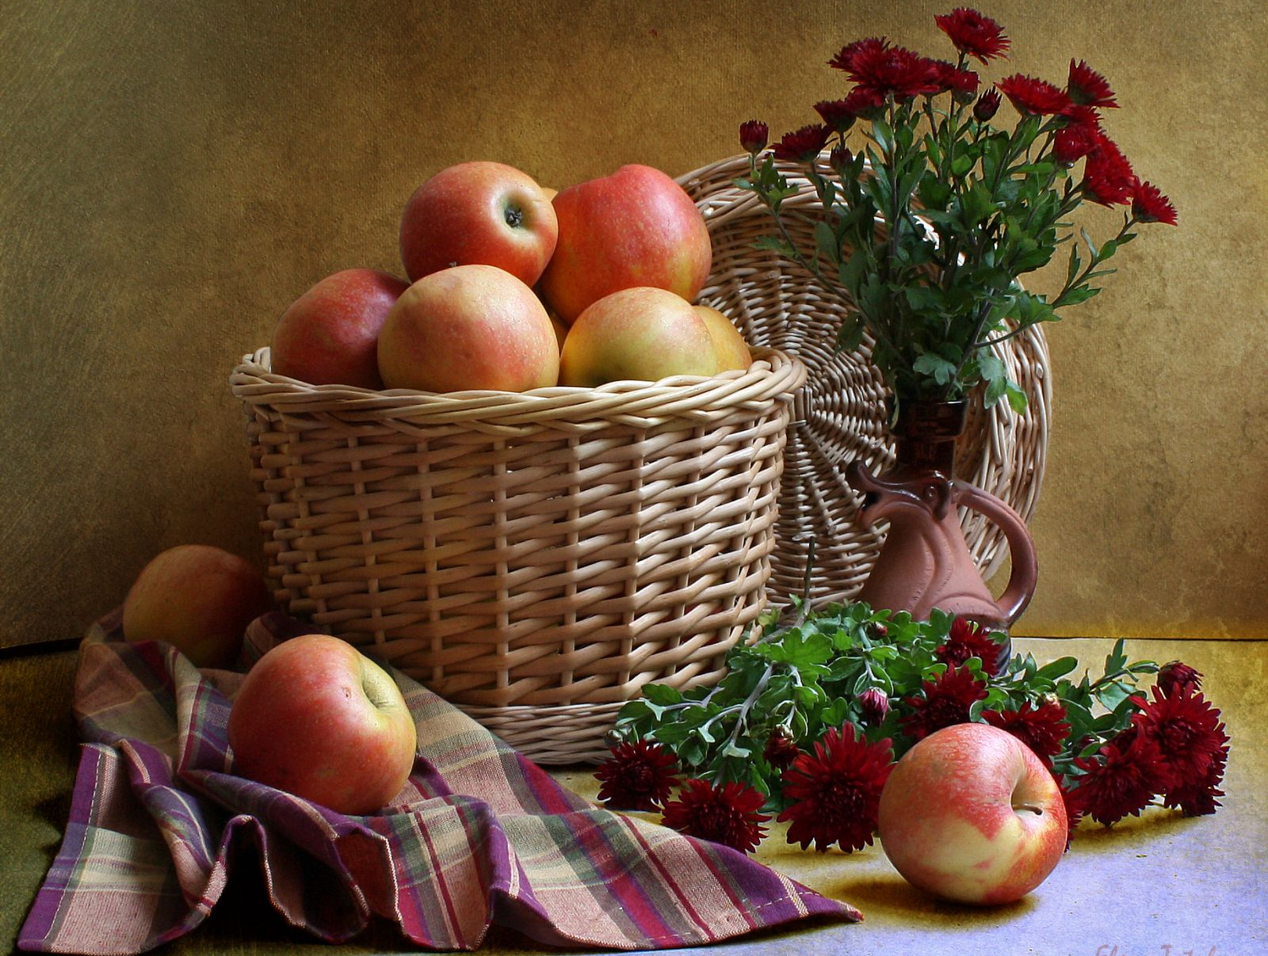
"Delicious autumn! My very soul is wedded to it, and if I were a bird I would fly about the earth seeking the successive autumns.“
George
Eliot

Slide 19
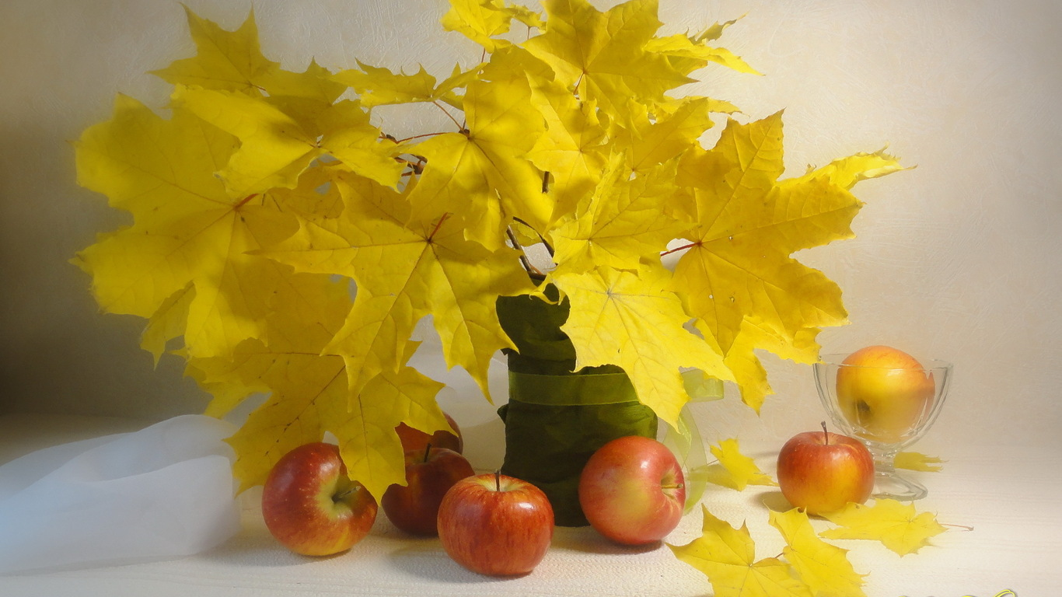
The leaves are all falling, and they're falling like they're falling in love with the ground.” ― Andrea Gibson

Slide 20
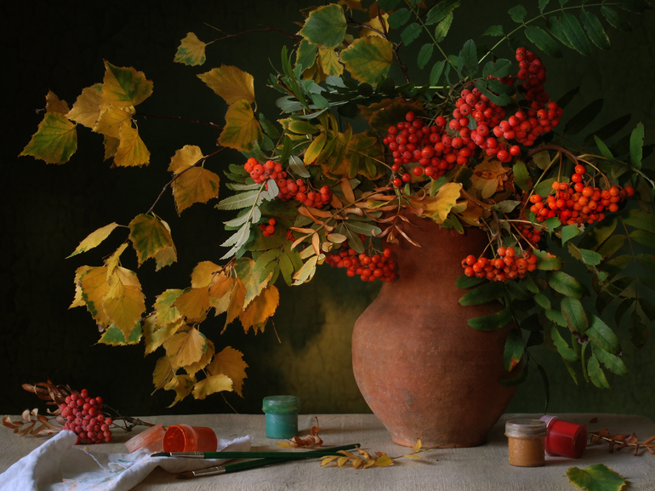
“There is something incredibly nostalgic and significant about the annual cascade of autumn leaves.” Joe L. Wheeler

Slide 21
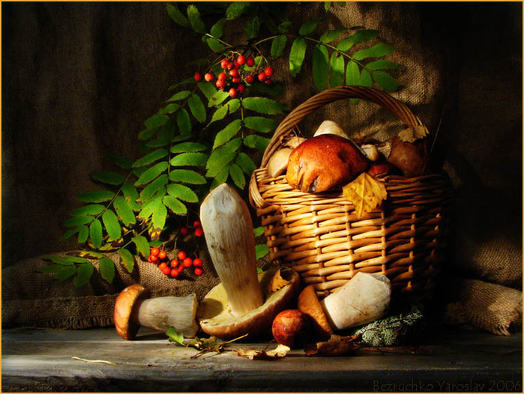
Winter is an etching, spring a watercolor, summer an oil painting and autumn a mosaic of them all.
Stanley Horowitz

Slide 22
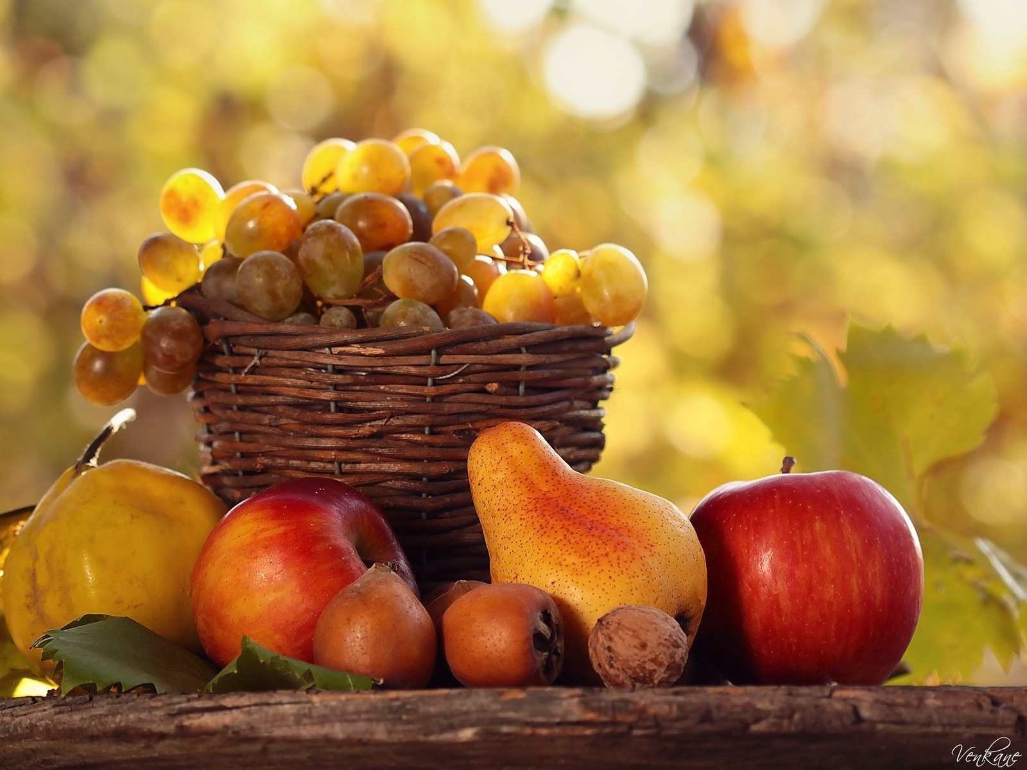
No Spring, nor Summer beauty hath such grace, As I have seen in one Autumnal face.
JOHN DONNE

Slide 23
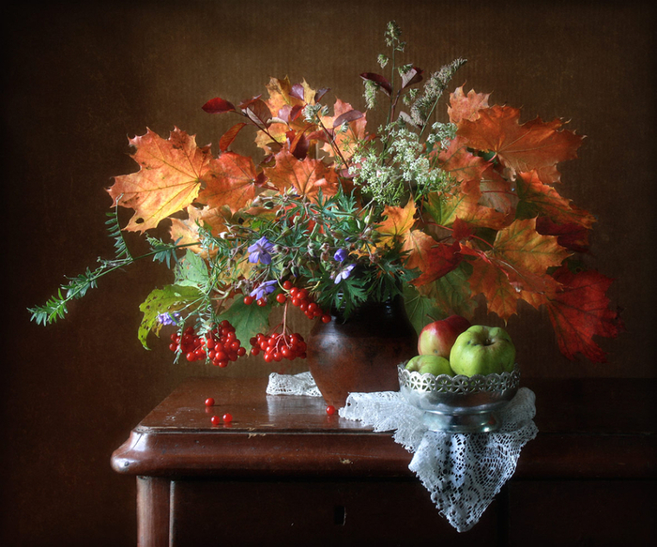
“Autumn...the year's last, loveliest smile." William Cullen Bryant

Slide 24
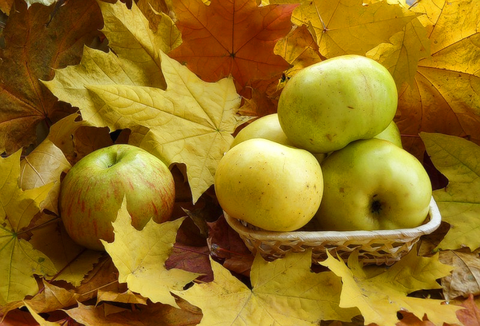
Thank You
for Visiting
My Multimedia
Autumn Exhibit

Slide 25
Использованные ресурсы:
http://img0.liveinternet.ru/images/attach/b/4/117/231/117231416_105082521_large_6421797_c44a299b.jpg
http://img1.liveinternet.ru/images/attach/b/4/117/231/117231421_4786085_large.jpg
http://img1.liveinternet.ru/images/attach/b/4/117/231/117231425_4780655_large.jpg
http://img0.liveinternet.ru/images/attach/b/4/117/231/117231432_4778680_large.jpg
http://img0.liveinternet.ru/images/attach/b/4/117/232/117232074_5656442_thumb.jpg
http://img1.liveinternet.ru/images/attach/b/4/117/231/117231437_223160.jpg
http://img0.liveinternet.ru/images/attach/b/4/117/232/117232084_92347740_large_2488891.jpg
http://img0.liveinternet.ru/images/attach/b/4/117/232/117232088_5061937572_b4d1f13bca1.jpg
http://img1.liveinternet.ru/images/attach/b/4/117/232/117232095_4630300215_0d4268512e.jpg
http://img-fotki.yandex.ru/get/9109/39663434.3d3/0_8c8e6_2e09bde4_orig

Slide 26
http://img1.liveinternet.ru/images/attach/b/4/117/231/117231455_111471677_87029609_0_4ab10_97f68054_XL.jpg
http://img1.liveinternet.ru/images/attach/b/4/117/231/117231459_pr0060.jpg
http://hdwallpapers.cat/wallpaper_1680x1050/still_life_old_autumn_flowers_cup_nature_1680x1050_hd-wallpaper-1584418.jpg
http://img1.liveinternet.ru/images/attach/c/8/104/976/104976569_4061676_48236859_1251802426_image012web.jpg
http://cache.photosight.ru/img/c/bfd/3942782_large.jpg
http://iclass.home-edu.ru/pluginfile.php/483037/mod_page/content/1/osen/%D1%82%D1%8B%D0%BA%D0%B2%D1%8B/1291801334_12_041.jpg
http://file.mobilmusic.ru/1c/6f/c6/973404.jpg
http://www.nastol.com.ua/large/201205/24975.jpg
http://mtdata.ru/u9/photo78B9/20390665466-0/original.jpg

