Slide 1
Body
Parts
Quiz
Автор:
Ольга Михайловна Степанова
учитель английского языка
МБОУ «Чадукасинская ООШ»
Красноармейского района
Чувашской Республики
2014

Slide 2
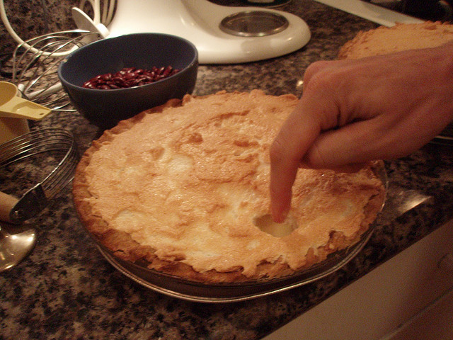
To have a finger in every pie
you are pursuing various activities at the same time

Slide 3
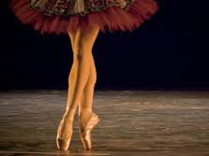
To be on one’s toes
To be aware and energetic

Slide 4
To set one’s heart
on smth
to want to get or achieve something very much
.

Slide 5
To give a hand
to help someone do something, especially something that involves physical effort

Slide 6
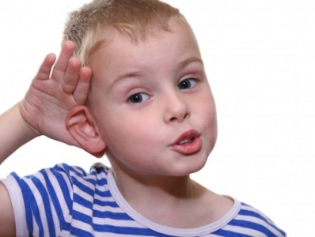
To be all ears
to be very eager to hear what someone is going to say

Slide 7
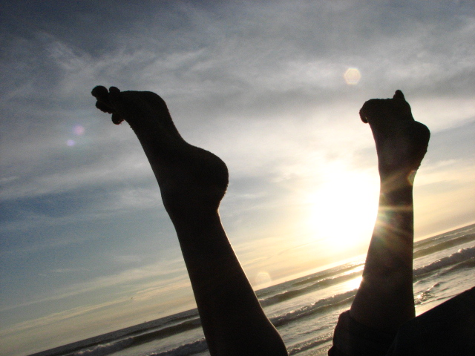
To put one’s feet up
to relax and do very little

Slide 8
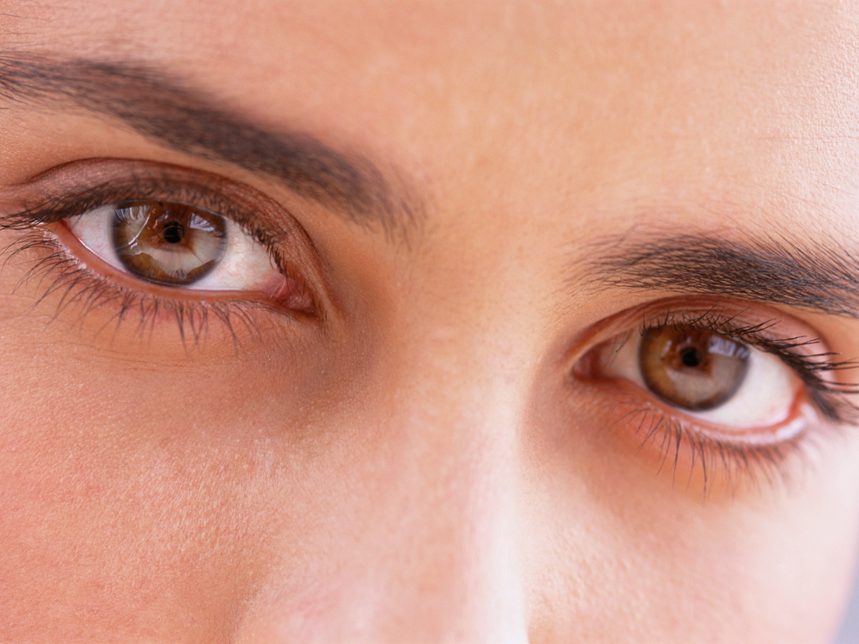
only have eyes for somebody/something
to be interested in just one person or thing

Slide 9
keep your nose clean
to avoid trouble , to avoid getting into trouble or doing anything illegal

Slide 10
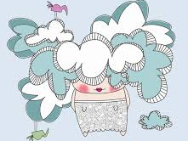
To have ones’ head in the clouds
To be out of touch with the everyday world and to be unrealistic because of it. To be living in a fantasy (world). To have impractical ideas or dreams. Sometimes the person doesn’t know the facts or reality of the situation.

Slide 11
Sources
https://lh4.ggpht.com/W--i5j_feaQHhs6dVF6kueyyET_VPTs7vHUcwyf-h8VJpCHWGsDyxEOaiXL5VZKkZ_nvTw=s114
https://lh3.ggpht.com/FiR5XRyxWBCs7VVYCpZJ52S8sQDZ-JxlCBN4om0LvM7-2NCfeDQFmUV6lF_09SKrTlmU=s155
https://lh3.ggpht.com/rqYK8OwRUMvlXEucmO1hsxPaHPj5ZQBJHPNsXUBnPwXXjz5z32Xdpm09Vorteg0Uqp1LCA=s114
https://lh6.ggpht.com/FAEQOSGuiHBwy5MEJxwHVqCKgRsFyQcOv2RzaUQMy2BN5mcIoM7RTwN9IDyRXh55eEIjbQ=s128
https://lh3.ggpht.com/1WhpJIr0n89sJd5Mfx-RaKyNPnVk6xZV18FyflWOBfCYDjYIPPfFcEKLx9OZl4XpU0eq=s113
https://lh5.ggpht.com/fq1KkE1LP5YkT9ZfVVhOVcoNnIjeqEvvRRFnNwIEnwe_B6j2gR7LO0VsWAUjGBOfODMpjQ=s127
https://lh4.ggpht.com/E6gtiz2SfbC5UnQF0R60L8t9OxYLMOnkApkYl47agQOboCXpCDHR1ZH3TYzo1pCaXRcQ=s114
https://lh6.ggpht.com/I2uxjKapIGB5MLWVZKanMcpKAnOJqhOFxSvOlIdL8s39XO2EVk4C_aIGJaSXfZ3upNpOvQ=s85
http://www.wherewoman.ru/uploads/posts/2013-09/1380450280_hearing2.jpg

