Slide 1
Посвящается
перекрестному Году культуры Великобритании и России 2014
Jane Maday’s kittens,
birds and flowers
Interactive Quiz
Интерактивная викторина
Автор:
Ольга Михайловна Степанова
учитель английского языка
МБОУ «Чадукасинская ООШ»
Красноармейского района
Чувашской Республики
2014

Slide 2
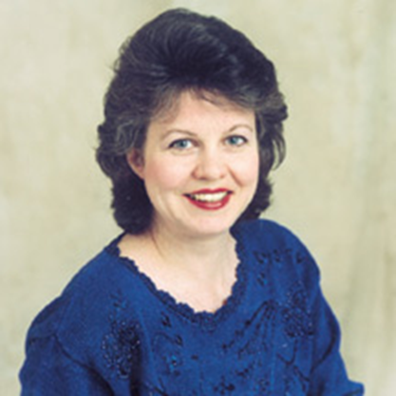
Jane Maday
Jane Maday was born in a small fishing village in England in 1965. Though her family immigrated to the United States when she was a young child, she considers frequent trips to England to be an important source of inspiration.

Slide 3
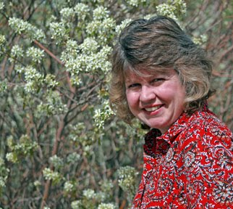
Jane was 14 when she was discovered at an art show and immediately began working at the University of Florida as a scientific illustrator. After receiving a bachelor’s degree from the Ringling School of Art and Design, she was recruited by Hallmark cards as an illustrator.
Jane left the corporate
world
after her children
were born,
and moved to beautiful Colorado.
Her work has adorned
25 children’s books, including
Adorable Animals You Can Paint,
Cute Country Animals You Can Paint,
Landscapes in Bloom, and Draw Baby Animals, as well as collector plates, ornaments, cards, and many other collectibles. In addition to the breathtaking Colorado landscape,
Jane has two children, a menagerie of animals, and a garden for inspiration,
and a wonderful husband to share it all.

Slide 4
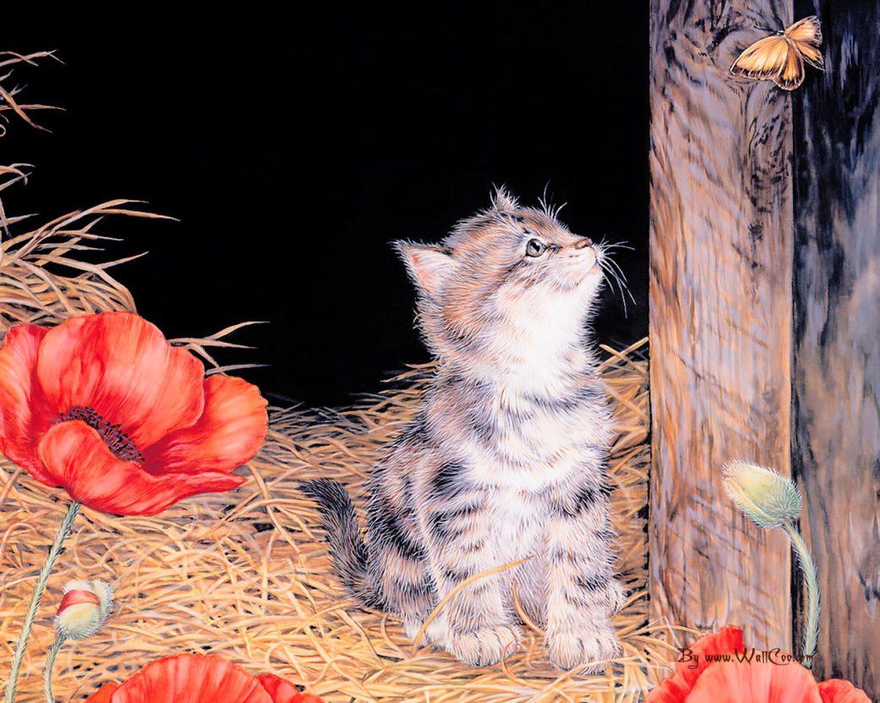
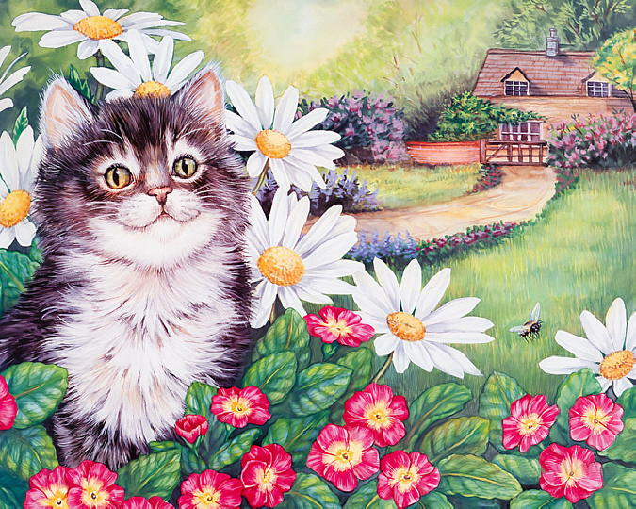
Enjoy Jane Maday’s kittens,
birds and flowers !
Enjoy the Quiz!

Slide 5
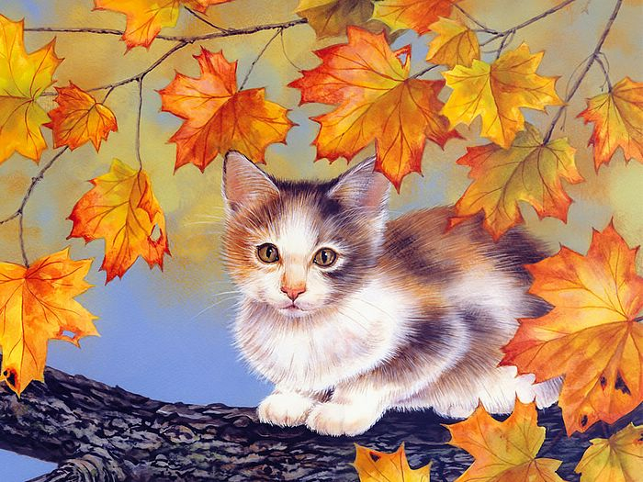
The kitten is watching …
winter |  | spring |  | autumn |  | summer

Slide 6
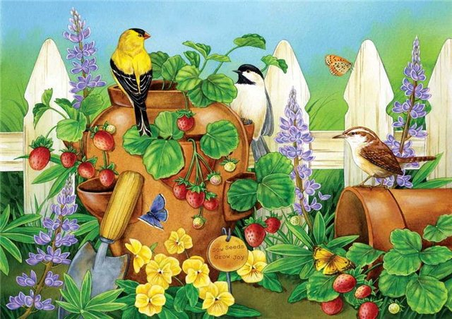
three |  | four |  | two |  | five
There are … birds on the picture

Slide 7
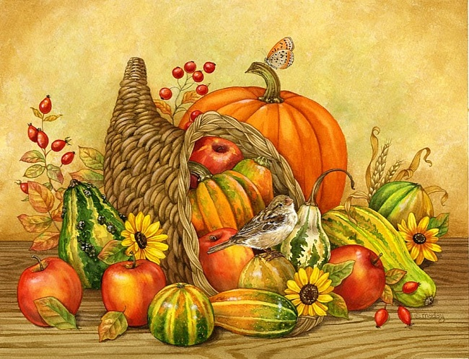
The flowers are …
pink |  | red |  | blue |  | yellow

Slide 8
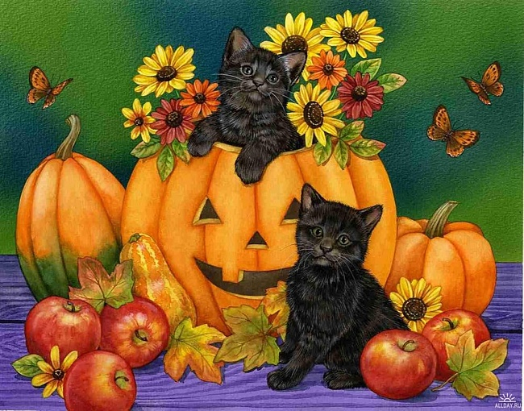
Christmas |  | St. Valentine |  | Halloween |  | Thanksgiving
The kittens are celebrating …

Slide 9
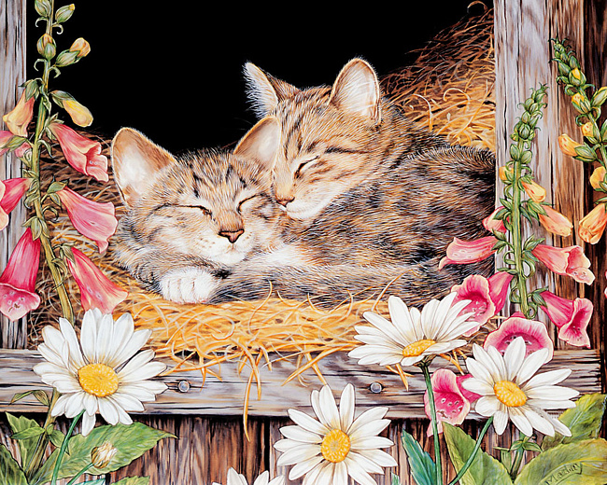
The kittens are …
skipping |  | sleeping |  | singing |  | speaking

Slide 10
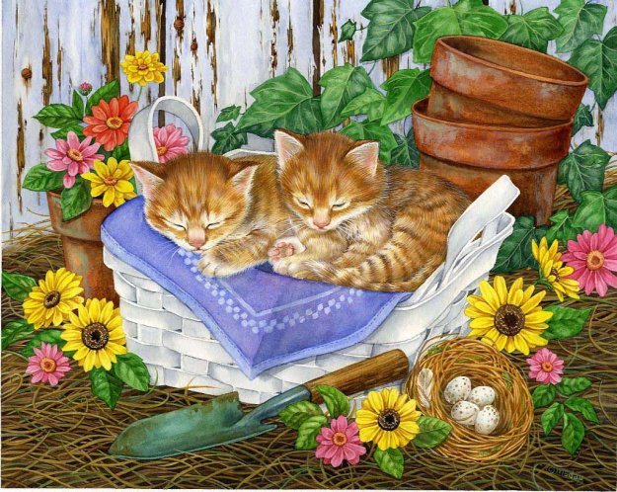
There are four … in the nest.
nuts |  | apples |  | plums |  | eggs

Slide 11
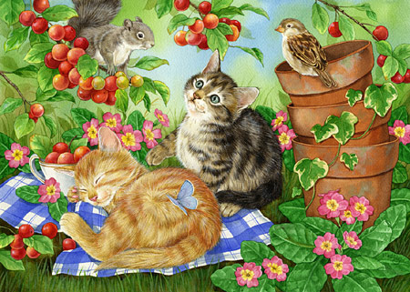
squirrel |  | bird |  | snail |  | snake
The kitten wants to touch a …

Slide 12
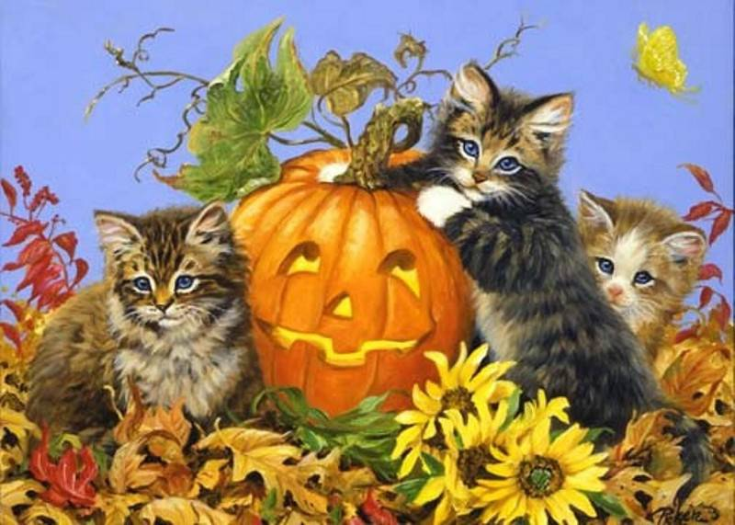
tiny |  | large |  | long |  | short
The pumpkin is …

Slide 13
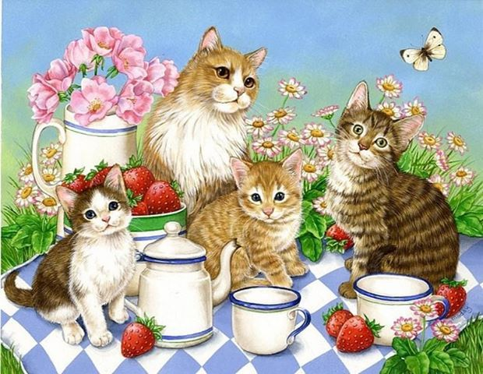
The kittens want to drink …
water |  | tea |  | coffee |  | milk

Slide 14
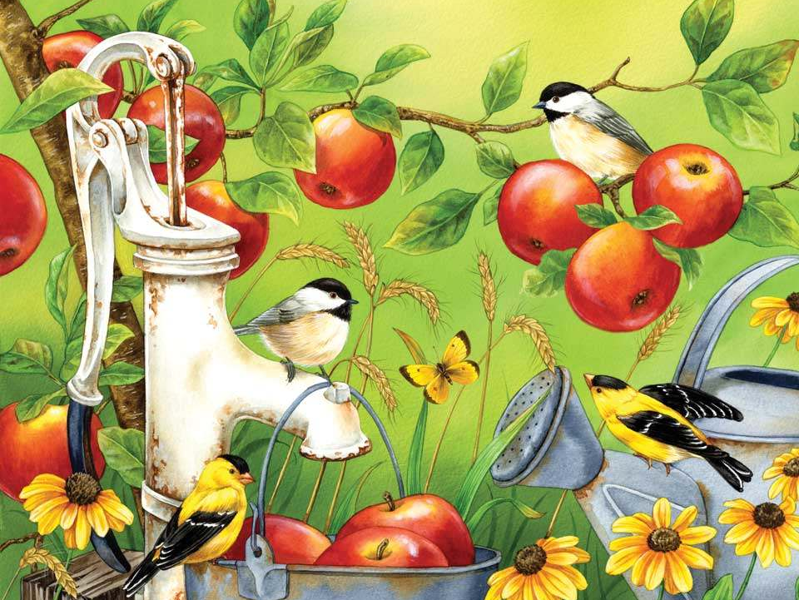
The butterfly looks like a …
flower |  | bird |  | apple |  | leaf

Slide 15
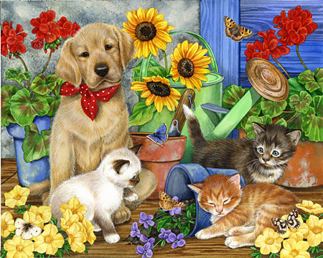
The grey kitten is afraid of a…
dog |  | butterfly |  | puppy |  | flower

Slide 16
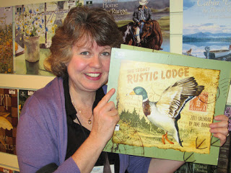
Well Done! Good Luck!

Slide 17
Resources
http://www.janemadayart.com/photos/bird-portfolio/LemonsAndLavenderFlatLowRescopyright.jpg
http://alinamix.com/post340519464/
http://mtdata.ru/u4/photoC428/20735520310-0/original.jpg
http://blueskyartanddesign.com/wp-content/gallery/jm_puppies_kittens/jm_babysitting.jpg
http://img0.liveinternet.ru/images/attach/c/0/30/429/30429136_Jane_Maday.jpg
http://blueskyartanddesign.com/wp-content/gallery/jm_puppies_kittens/jm_under_cherry_tree.jpg
http://pics.livejournal.com/levkonoe/pic/004t5xx0
http://www.liveinternet.ru/users/4248621/post243722696/
http://1.bp.blogspot.com/-CcpfDs_PZaY/Txs5RRMuhEI/AAAAAAAAAhk/zGS8TeFCcU0/s320/me%2Bwith%2Bcalendar.jpg

