Slide 1
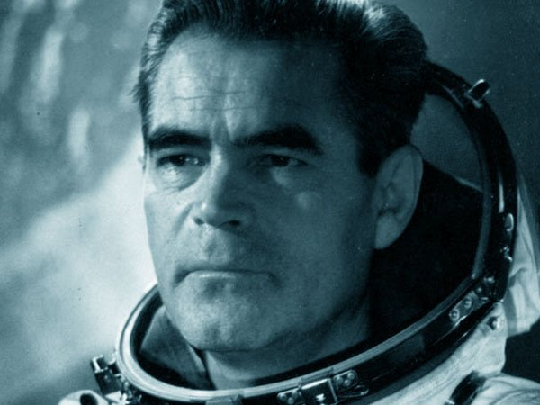
Andrian Nikolaev
Cosmonaut who held the space endurance record
Interactive Quiz
Автор:
Ольга Михайловна Степанова
учитель английского языка
МБОУ «Чадукасинская ООШ»
Красноармейского района
Чувашской Республики
2014

Slide 2
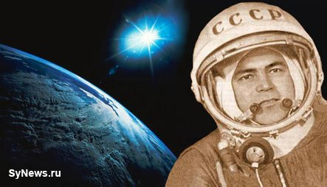
His birthday is 5 … 1929
September |  | October |  | November |  | December

Slide 3
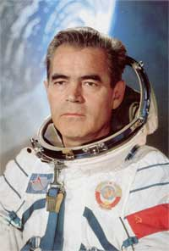
His Birthplace is … .
Tatarstan |  | Chuvashia |  | Kazakhstan |  | Ukraine

Slide 4
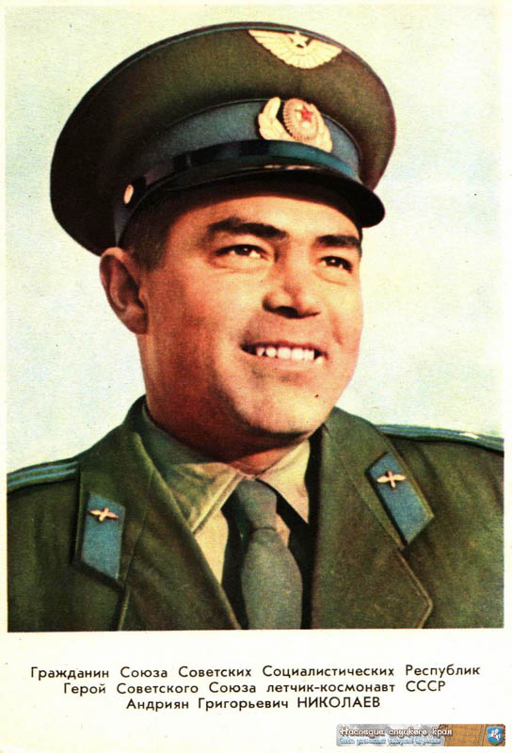
He was an ethnic Chuvash .
Belorussian |  | Tartar |  | Russian |  | Chuvash

Slide 5
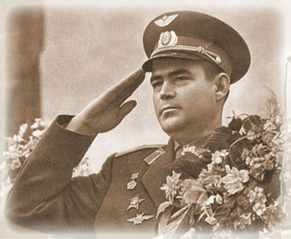
Andrian Nikolayev liked … .
ice hockey |  | gymnastics |  | skiing |  | skating

Slide 6
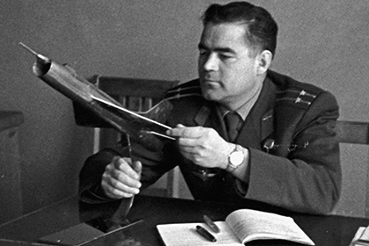
After leaving the local secondary school, Andrian decided to be a …
driver |  | engineer |  | teacher |  | doctor

Slide 7
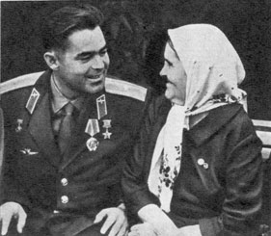
Clearly, the medical course was not to his taste, and his brother Ivan soon persuaded him to transfer to a … school.
flying |  | cookery |  | forestry |  | driving
Andrian with his Mother

Slide 8
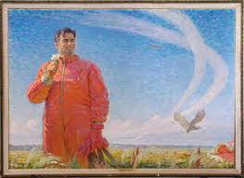
His life changed completely once he was drafted into the Soviet … Force in 1950.
Marine |  | Military |  | Air |  | Armed

Slide 9
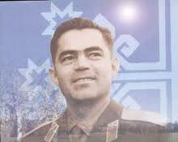
After initial training as an aircraft gunner and radio operator, he was sent to Chernigov Air Force Pilots School, transferred to the Frunze fighter pilot training school in 1951, he graduated three years later and was assigned to MiG-17 … units in the Moscow area.
aviator |  | fighter |  | pilot |  | steward

Slide 10
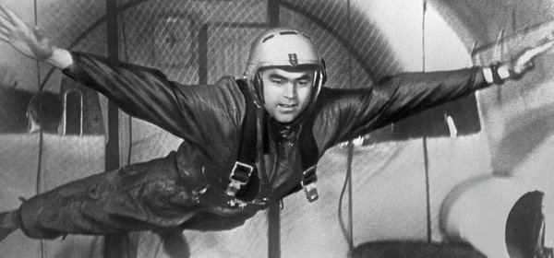
Nikolayev flew on two space flights: Vostok 3 (effectively becoming the third Soviet cosmonaut) and Soyuz 9. His call sign in these flights was … : (Со́кол).
Baby |  | Miss |  | Woman |  | Falcon

Slide 11
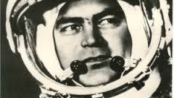
Nikolayev was also the first person to make a television … from space, in August 1962.
Program |  | Broadcast |  | Show |  | Film

Slide 12
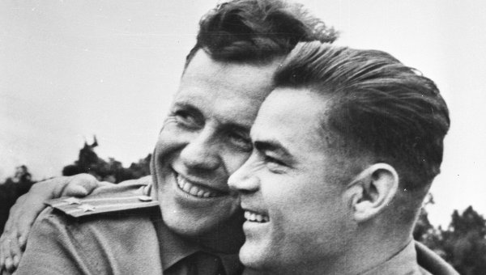
Vostok 3 was part the first dual space flight, with … on Vostok 4.
Pavel Popovich |  | German Titov |  | Aleksey Leonov |  | Viktor Gorbatko

Slide 13
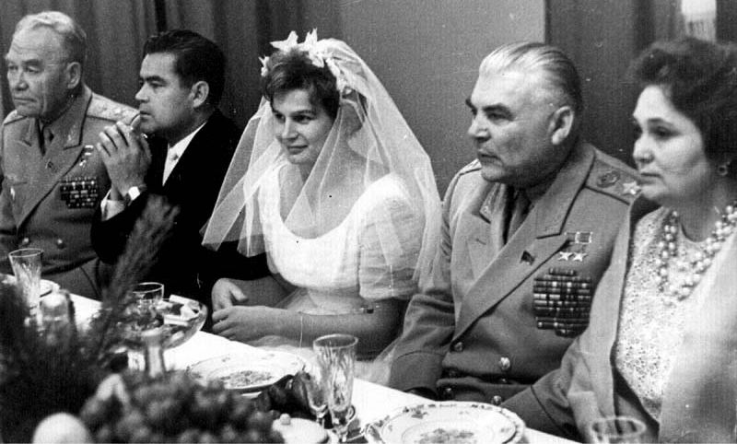
On 3 November 1963, he married …, the first woman to have flown in space.
Marina Popovich |  | Svetlana Savitskaya |  | Valentina Tereshkova |  | Anastasia Popova

Slide 14
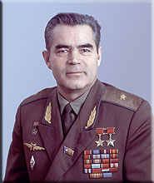
Andriyan Nikolayev was awarded the title of Hero of Soviet Union (twice), Order of Lenin, Order of the Red Star , numerous medals and other foreign orders , including Order of the … .
Nile |  | Mississippi |  | Volga |  | Thames

Slide 15
The End

Slide 16
Source
http://synews.ru/uploads/posts/2011-03/1299070918_nikolaev-synews1.jpg
http://upload.wikimedia.org/wikipedia/ru/a/a3/NikolaevAG.jpg
https://encrypted-tbn3.gstatic.com/images?q=tbn:ANd9GcTp5858bOlF96-42aQ2CAfPHec2pzpuDQhJndeTYDacSm090aTa
http://времячувашии.рф/upload/Image/kosm_05s.jpg
http://icdn.lenta.ru/images/2014/07/25/13/20140725130455265/pic_0173429b5d750eb6a0cb976774a8ae4f.jpg
http://epizodsspace.airbase.ru/bibl/letunov/govorit-kosm/v24.jpg
https://encrypted-tbn3.gstatic.com/images?q=tbn:ANd9GcTlJ5JDwjJyowK0H7R5LGIi4VT6guR3j_GdWDs2NGiWLT8Q5ZOH
https://encrypted-tbn2.gstatic.com/images?q=tbn:ANd9GcSt5pkuZMmNCKQM5tW7Tj9bnSJ-t2nE7CfWmL_zala-ivam75xSNg
http://inmosreg.ru/images/59980/57/599805752.jpg
https://encrypted-tbn2.gstatic.com/images?q=tbn:ANd9GcTokmhNC38dhJ95o1OLmdYS4I9BaZbvTd6bG8s7xItwB2SpA7EMnw
http://cdn5.img22.ria.ru/images/72093/58/720935886.jpg
http://img-fotki.yandex.ru/get/6407/39067198.a4/0_64d2d_7307cc4b_XL.jpg
http://sm.evg-rumjantsev.ru/img04/nikolaev.jpg
http://www.independent.co.uk/news/obituaries/andrian-nikolayev-6165274.html
http://polit.ru/media/photolib/2014/09/04/thumbs/nikolaev1_1409845820.jpg.600x450_q85.jpg

