Slide 1
Ознакомительная лекция
Автор:
Ольга Михайловна Степанова
учитель английского языка
МБОУ «Цивильская СОШ№2»
города Цивильск
Чувашской Республики
2014

Slide 2
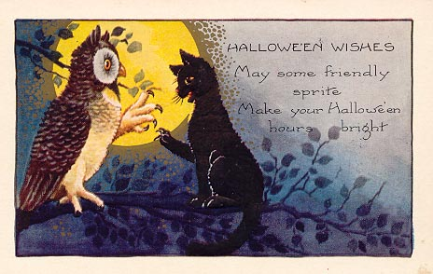
May some friendly sprite
Make your Halloween hours bright!

Slide 3
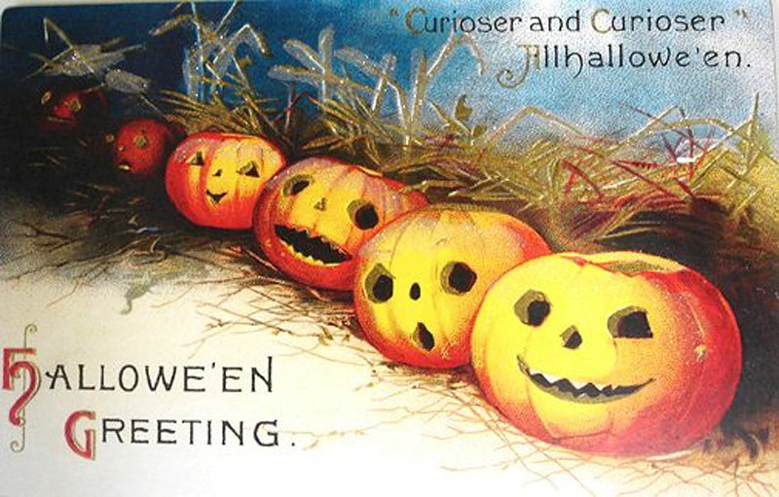
Sending you good wishes for a Happy Halloween. Have fun hanging with the gang!

Slide 4
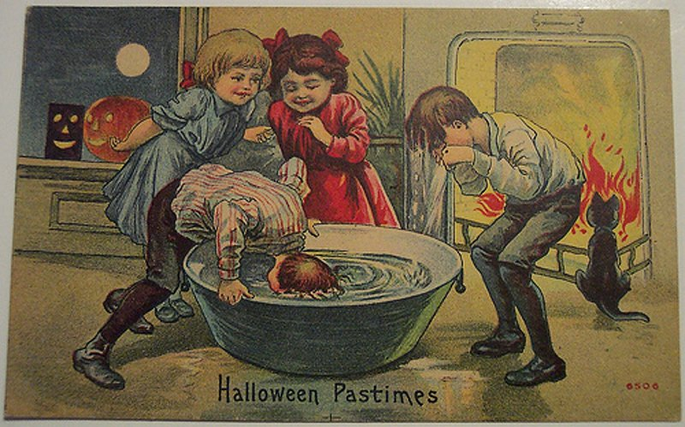
Wishing you a fun Halloween filled with magical surprises! May you get lots of treats that are good to eat!
Wishing you a fun Halloween filled with magical surprises! May you get lots of treats that are good to eat!

Slide 5
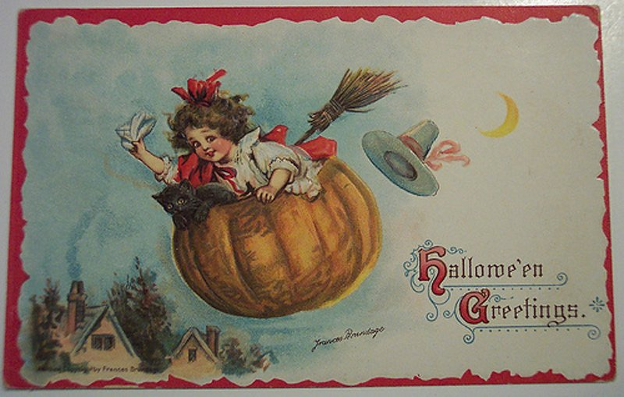
You are the only treat I need for this evening! Halloween hugs and kisses to you!

Slide 6
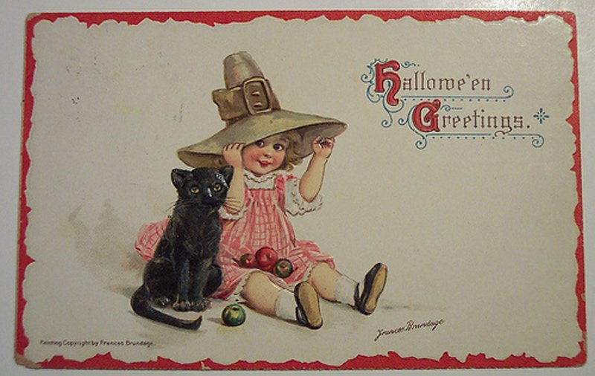
Happy Halloween to someone very special. Hoping your night rocks, just like you!

Slide 7
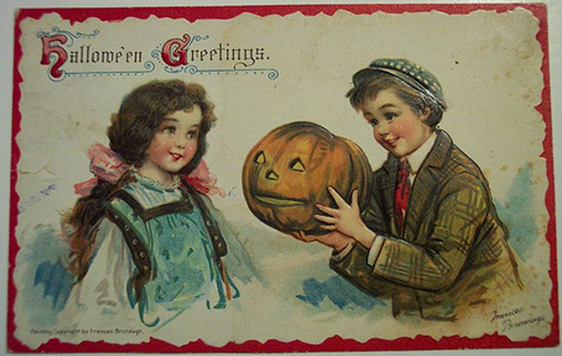
Having you in my life is the sweetest treat! Wishing you a very Happy Halloween!!

Slide 8
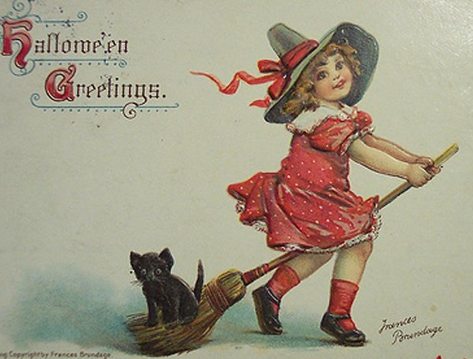
Hope your Halloween is fun and spooky. Eat, drink and be scary!

Slide 9
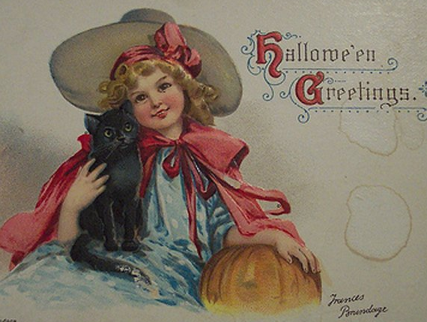
Everybody is scared of something. I hope you find yours!

Slide 10
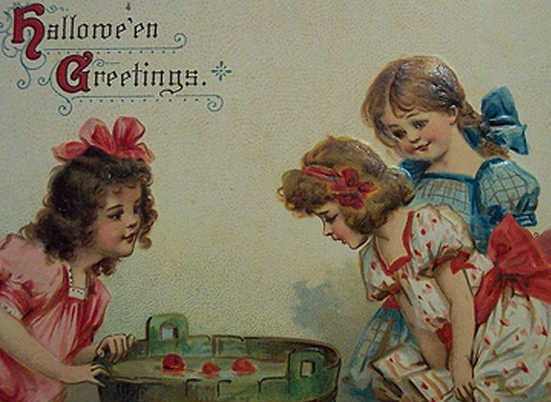
Are you ready for some pumpkin smashing?! Have lots of spooky fun!

Slide 11
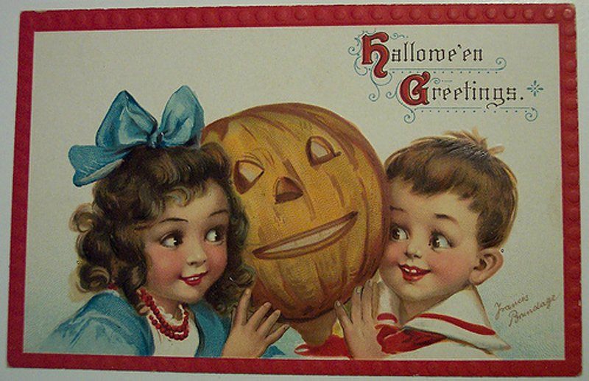
I hope tonight you are able to dance like a ghost. Wishing you a smashing time!

Slide 12
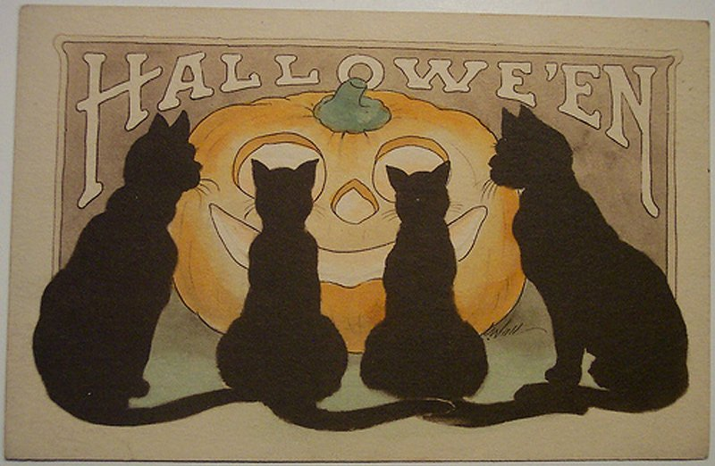
Keep the lights on this night, because you never know what may be lurking in the dark. Halloween greetings!

Slide 13
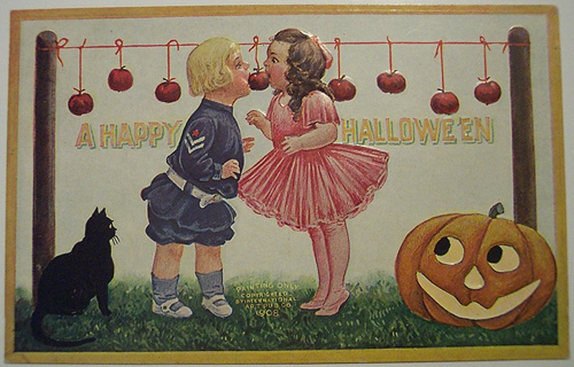
I'm dying to have a great Halloween with you!

Slide 14
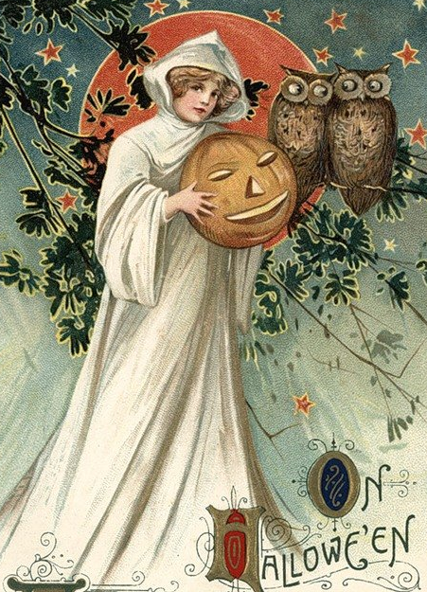
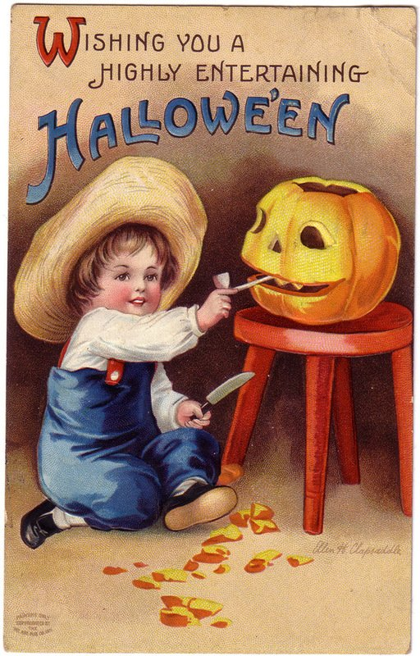
Don't be yourself!
It's Halloween!

Slide 15
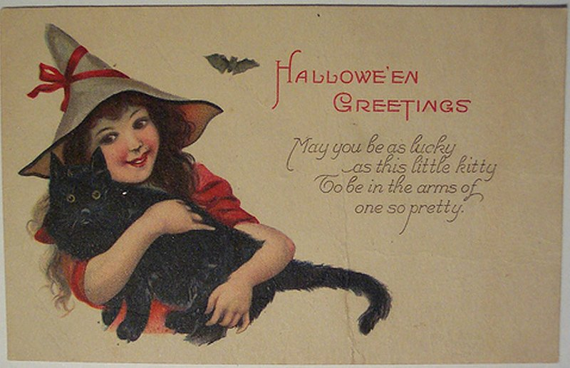
You're the cutest pumpkin in the patch!
Have a scary good time!

Slide 16
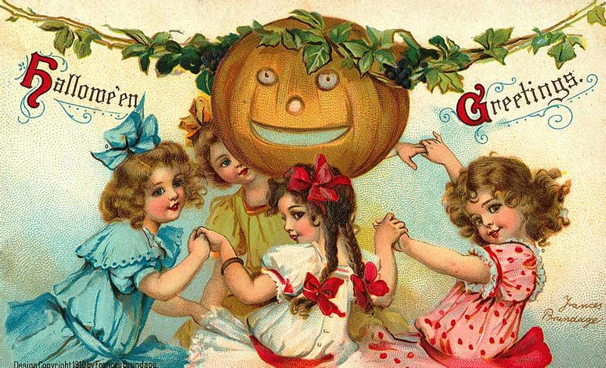
Have a spooky time on Halloween. Don't get too scared though. Happy Halloween

Slide 17
Lets carve out pumpkins on Halloween and enjoy the thrills of the frightful night. Have a happy Halloween!

Slide 18
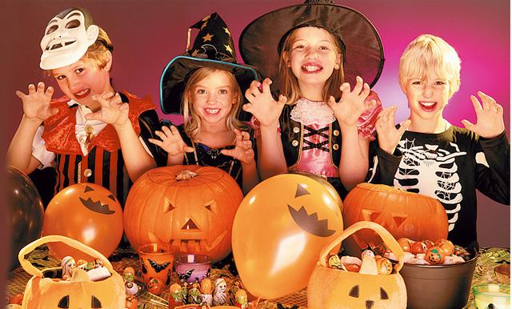
Be prepared to be possessed by demons. Be prepared to be spooked by Jack-o'-lantern.
Get set for goblins, witches, skeletons and monsters to follow your path. Get ready to be have the most frightful night of your life. Happy Halloween to you!

Slide 19
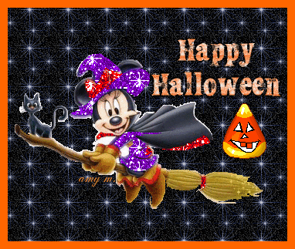
Sending you good wishes for a Happy Halloween. Have fun hanging with the gang!
The End

Slide 20
Sources
http://congratulationsto.com/various/halloween_wishes.php
http://musiclove.hubpages.com/hub/Halloween-Card-Messages-What-to-Write-in-a-Halloween-Card
http://img0.liveinternet.ru/images/attach/c/0/117/673/117673866_large_325.jpg
http://mylitta.ru/uploads/posts/2013-11/1383370163_halloween-01.jpg
http://mylitta.ru/uploads/posts/2013-11/1383370174_halloween-06.jpg
http://mylitta.ru/uploads/posts/2013-11/1383370150_halloween-09.jpg
http://mylitta.ru/uploads/posts/2013-11/1383370102_halloween-10.jpg
http://mylitta.ru/uploads/posts/2013-11/1383370145_halloween-11.jpg
http://mylitta.ru/uploads/posts/2013-11/1383370119_halloween-12.jpg
http://mylitta.ru/uploads/posts/2013-11/1383370141_halloween-13.jpg
http://mylitta.ru/uploads/posts/2013-11/1383370121_halloween-15.jpg
http://mylitta.ru/uploads/posts/2013-11/1383370190_halloween-16.jpg
http://mylitta.ru/uploads/posts/2013-11/1383370120_halloween-18.jpg
http://mylitta.ru/uploads/posts/2013-11/1383370191_halloween-19.jpg
http://mylitta.ru/uploads/posts/2013-11/1383370175_halloween-20.jpg
http://mylitta.ru/uploads/posts/2013-11/1383370144_halloween-28.jpg
http://mylitta.ru/uploads/posts/2013-11/1383370187_halloween-31.jpg
http://mylitta.ru/uploads/posts/2013-11/1383370124_halloween-34.jpg
http://img0.liveinternet.ru/images/attach/c/0/117/676/117676004_5230261_hel46.jpg
http://www.animashka.info/_ph/87/2/301376261.gif?1414746470
http://img1.liveinternet.ru/images/attach/c/0/117/691/117691071_1a__72_.jpg
http://img0.liveinternet.ru/images/attach/c/0/117/691/117691160_1a__68_.jpg

