Slide 1
What are you thankful for?
Интерактивная
викторина
по чтению
для 8-11 классов
Автор:
Ольга Михайловна Степанова
учитель английского языка
МБОУ «Цивильская СОШ№2»
города Цивильск
Чувашской Республики
2014

Slide 2
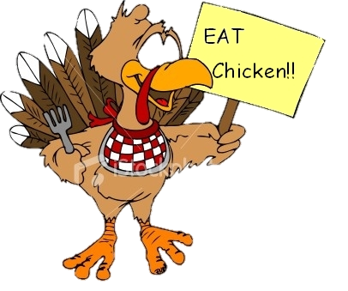
Thank you, God for this food so yummy;
Thank you for a happy tummy!
Thank you, Lord, for this special treat;
We'll keep Your blessings in mind, as we eat.
Thanks for food and thanks for _____________ ;
Thanks to our Lord in heaven above.
love |  | dove |  | above |  | glove

Slide 3
For each new morning with its light, For rest and shelter of the _______, For health and food, For love and friends, For everything Thy goodness sends.
bright |  | sight |  | night |  | white

Slide 4
Thanks for winter snow capes so serene, Harvest fields of gold and green,
Thanks for stars that twinkle high above And all the people that I love.
clean |  | teen |  | queen |  | green

Slide 5
Thank you God for all that grows,
Thank you for the sky's rainbows,
Thank you for the stars that shine,
Thank you for these friends of mine,
Thank you for the moon and sun,
Thank you God for all you've done!
fun |  | sun |  | gun |  | son

Slide 6
God is great and God is good,
And we thank God for our food;
By God's hand we must be fed,
Give us Lord, our daily bread.
Amen.
thread |  | bread |  | head |  | bed

Slide 7
We thank you, Lord,
for happy hearts,
for rain and sunny __________;
we thank you for the food we eat,
and that we are together.
Bender Family
feather |  | weather |  | heather |  | leather

Slide 8
For food, for friends, for happiness
we give our thanks to Thee, And pray that other families
may be as blessed as we.
For all we eat, for all we_________ ,
for all the good things everywhere, Father in Heaven we thank Thee.
wear |  | care |  | share |  | bear

Slide 9
Thank you God for blue skies over me, Green grass under me, Good friends beside me. Thank you God for good food in front of me And _____________ all over the world.
keys |  | geese |  | niece |  | peace

Slide 10
Thank you, Lord, for each new day you give to me, For earth and sky and sand and sea, For rainbows after springtime showers, Autumn leaves and summer flowers, For Beauty shining all around, Lilac scent and robin _____________ ,
round |  | bound |  | sound |  | pound

Slide 11
Bless the food upon the dishes as you blessed the loaves and fishes. As the sugar hides in the ___________ , let me hide myself in Thee.
Amen
tea |  | bee |  | sea |  | key

Slide 12
Be thankful for home
Be thankful for food
Be thankful for birds that fly
Be thankful for sleep
Be thankful for flowers
Be thankful for clouds in the _______ .
eye |  | pie |  | sky |  | spy

Slide 13
I'm glad that I was good today
As good as I was able
I'm glad to be inside this house
And sitting at this _____________
.
cable |  | table |  | fable |  | stable

Slide 14
I'm glad that it's Thanksgiving Day
And all the world is merry
And I'm glad I have a fork
And that the pie is _________ .
merry |  | ferry |  | cherry |  | carry

Slide 17
Sources
http://www.poemsource.com/thanksgiving-prayers.html
http://www.prayer-and-prayers.info/thanksgiving-prayers/childs-thanksgiving-prayer.htm
http://www.night.net/thanksgiving/g-family.html-ssi#deargod
http://www.lords-prayer-words.com/prayers_before/thanksgiving_prayer_to_god.html
http://www.teachingfirst.net/Poems/Thanksgiving.html
http://imperiumcrossfit.com/wp-content/uploads/2013/11/Thanksgiving.jpg
http://www.imagesbuddy.com/images/18/2013/03/give-thanks-today-always-happy-thanksgiving-glitter.gif
http://media-cache-ak0.pinimg.com/236x/5c/dd/d9/5cddd9d370f6cc94925ae91ef16a09b5.jpg
http://www.graphics99.com/wp-content/uploads/2012/07/happy-thanksgiving-turkey-picture.gif
http://www.commentnation.com/comments/happy_thanksgiving_glitter_text.gif

