Slide 1
Reading
about Animals
Interactive Quiz
Интерактивная викторина для 4-7 классов
Автор:
Ольга Михайловна Степанова
учитель английского языка
МБОУ «Цивильская СОШ №2»
Красноармейского района
Чувашской Республики
2014

Slide 2
Likes so much
To toss his mane.
Eats green grass and macaroni.
Who is it?
It is a … .
Pony

Slide 3
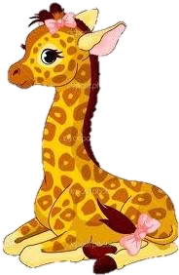
A lot of spots.
A long, long neck
A funny scarf.
It ‘s a …
Giraffe

Slide 4
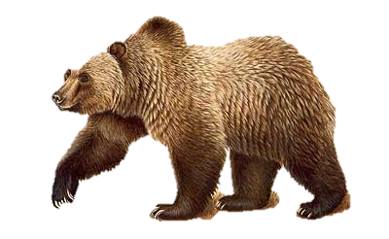
I live in the woods.
I’m very big and furry.
I like to eat fish
and berry.
I found a pear
I am a …
Bear

Slide 5
Green and long
With many teeth.
Beautiful smile -
It`s a … !
Crocodile

Slide 6
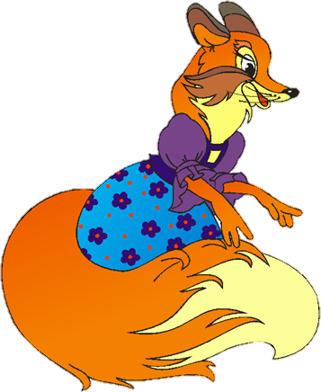
As red as fire,
With a fuzzy tale.
He likes long walks.
It is … !
Fox

Slide 7
A very long nose.
It grows and grows.
Не is huge and likes fun.
It is an … !
Elephant

Slide 8
So colorful and bright,
Is fond of talking much.
Likes eating carrot
It is a … !
Parrot

Slide 9
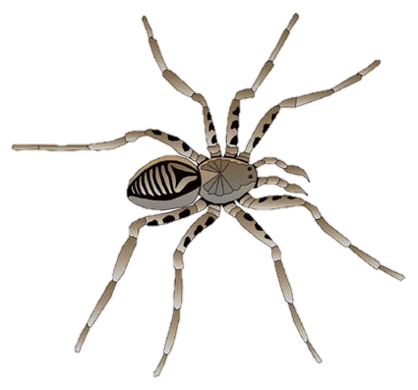
I am small and shy.
I have eight legs.
Webs are my beds.
I am a good rider
I am a…
Spider

Slide 10
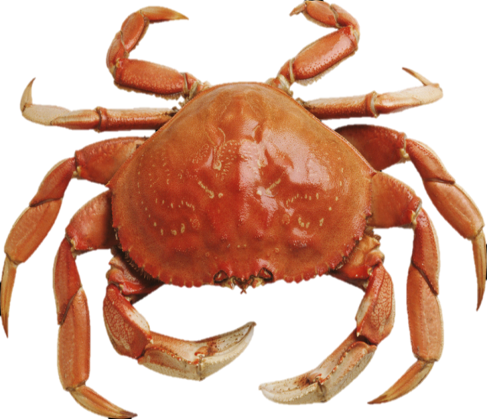
Lives in seas and rivers..
His hands are like two
pincers.
As round as a cab.
Who is it?
It is a … !
Crab

Slide 11
The End

Slide 12
Sources
http://www.angla.su/publ/zagadki_na_anglijskom_jazyke_s_perevodom_i_otvetami/zagadki/zagadki_dlja_malyshej_i_shkolnikov_na_anglijskom_jazyke_s_perevodom_i_otvetami/41-1-0-302
http://www.youloveit.ru/uploads/gallery/main/443/my_little_ponyes_rarity48.png
http://mamaschool.ru/wp-content/uploads/2012/09/2012-09-15_210657.jpg
http://volkam.zapoved.ru/photos/2685/2086/be19/2028/66be/dbcc/caab/93c6/large.jpg
http://deti-online.com/images/skazki-chukovskogo--krokodil.jpg
http://900igr.net/datai/skazki-i-igry/Kolobok-2.files/0008-016-Katitsja-kolobok-katitsja-a-navstrechu-emu-lisa.png
http://cs213.vk.me/u35011108/a_e67a016a.jpg
http://www.коллаж.net/frameforphoto/1/232foto42.png
http://www.zooclub.ru/attach/15000/15462.jpg
http://img0.joyreactor.cc/pics/post/story-%D0%B2%D0%B5%D1%81%D0%B5%D0%BB%D1%8B%D0%B9-%D0%BF%D0%BE%D0%BF%D1%83%D0%B3%D0%B0%D0%B9-%D0%BF%D0%B5%D1%81%D0%BE%D1%87%D0%BD%D0%B8%D1%86%D0%B0-584743.jpeg
http://static.wixstatic.com/media/3f6036_cc555c1fbb8842ecaf4d032bff5c59e1.png

