Slide 1
Professions
Интерактивное
упражнение
«Угадай профессию»
для 4-7 классов
Автор:
Ольга Михайловна Степанова
учитель английского языка
МБОУ «Цивильская СОШ №2»
города Цивильск
Чувашской Республики
2014

Slide 2
A person
treats the sick animals
is a …
vet

Slide 3
A person
who builds houses
is a …
builder

Slide 4
A person
who works in a library
is a …
librarian

Slide 5
A person
who drives a car
is a … .
driver

Slide 6
A person
who sells goods in a shop
is a … .
shop assistent

Slide 7
A person
whose job is to stop a fire is a … .
fireman

Slide 8
A person
who helps people
with laws
is a … .
lawyer

Slide 9
A person
who protects businessmen, politicians is a … .
bodyguard

Slide 10
A person
who treats the sick people in a hospital
is a … .
doctor

Slide 11
A person
who takes care of the children or old people
is a … .
nurse

Slide 12
A person who grows vegetables
is a … .
farmer

Slide 13
A person
who plans and designs buildings
is an … .
architect

Slide 14
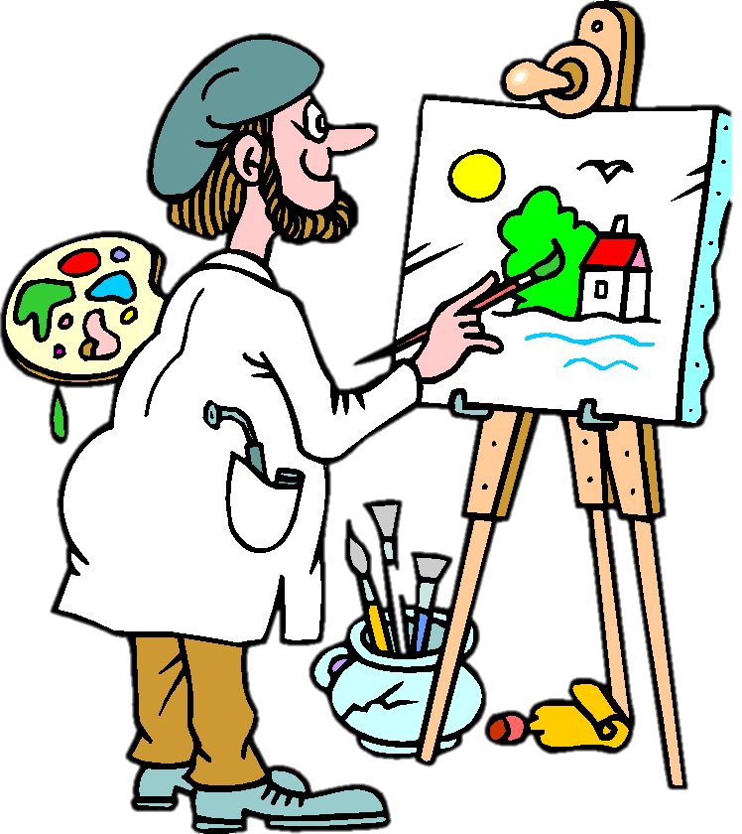
A person
who paints pictures
is an … .
artist

Slide 15
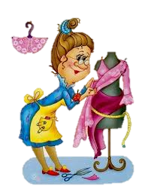
A person who sews or repairs clothes
Is a … .
tailor

Slide 16
A person who operates an airplane
is a … .
pilot

Slide 17
A person
who delivers letters and newspapers
is a … .
postman

Slide 18
A person
who cuts or styles hair
is a … .
hairdresser

Slide 19
A person
who teaches children at school
is a
teacher

Slide 20
The End

Slide 21
Sources
http://demosfen-plus.ucoz.ru/prezentacii/doktor.jpg
http://st.stranamam.ru/data/cache/2013nov/17/17/10108205_42836thumb500.jpg
http://justa-nn.ru/image/exkursii-nn/povar.jpg
http://dliadetei.ru/public/2/20110817/131355971404159093_normal.jpg
http://goodimg.ru/img/professii-v-kartinkah4.jpg
http://shgpi.edu.ru/biblioteka/blog/wp-content/uploads/2014/05/professii_13.jpg
http://900igr.net/datai/chelovek/Professii-01.files/0010-009-Professii-01.png
https://encrypted-tbn3.gstatic.com/images?q=tbn:ANd9GcRmokMUQnD1GfuXxs2p0SM7vkLHifo7TXJQZmEnunIvsRBZDaYC
http://www.prozagadki.ru/uploads/posts/2010-06/1276960823_1.jpg
http://900igr.net/datai/chelovek/Professii-5.files/0009-009-Arkhitektor.png
http://900igr.net/datai/chelovek/Professii-5.files/0013-014-Pilot.png

