Slide 1
Презентация к уроку английского языка в 10 классе
МАОУ СОШ № 67 с УИОП города Екатеринбурга
Тема урока: «Music. Where words fail…»
УМК М.З.Биболетова и др. «Enjoy English»
Автор: Птухин Александр
Учитель: Ваторопина Е.В.
2014 г.

Slide 2
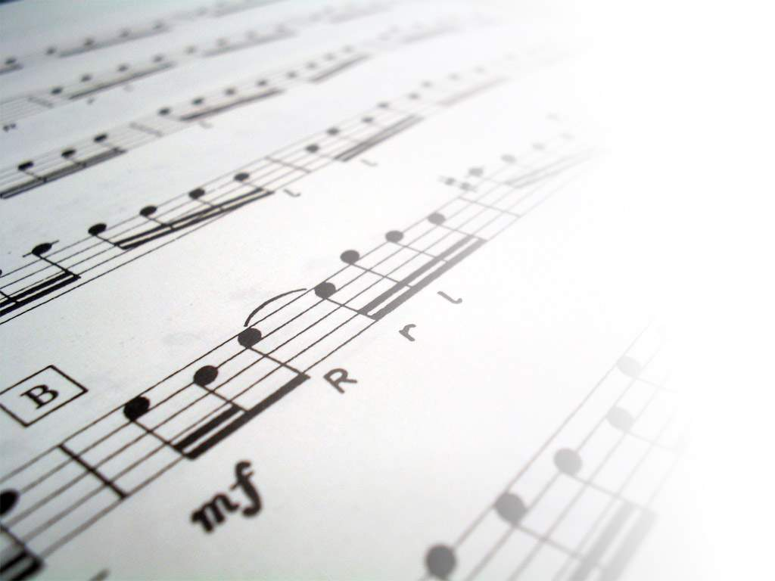
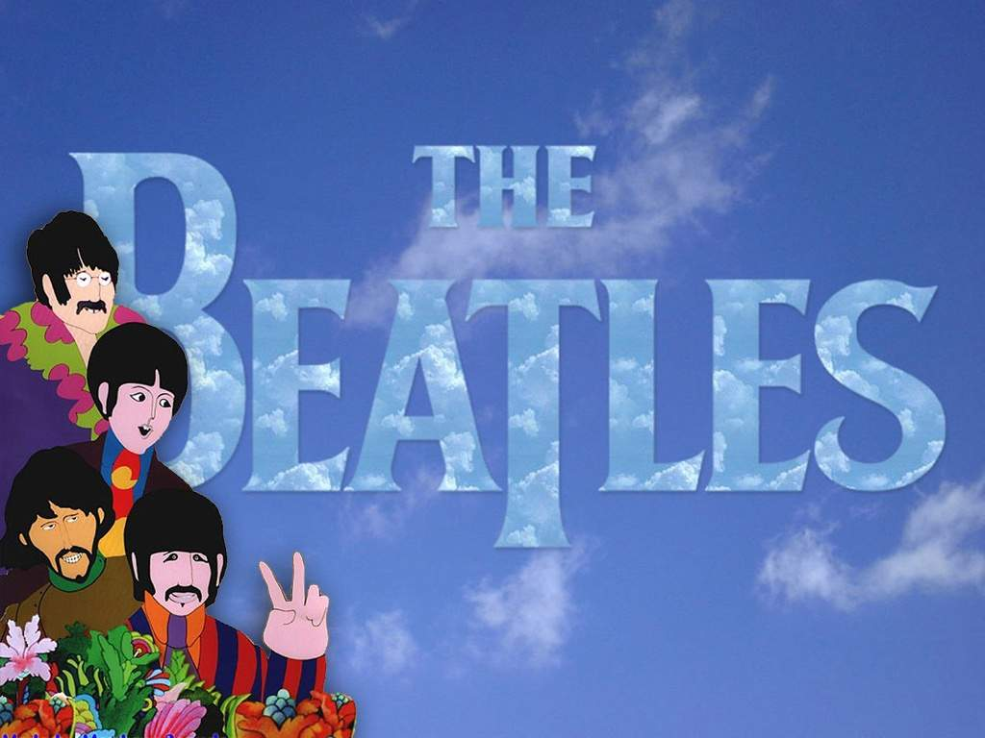

Slide 3
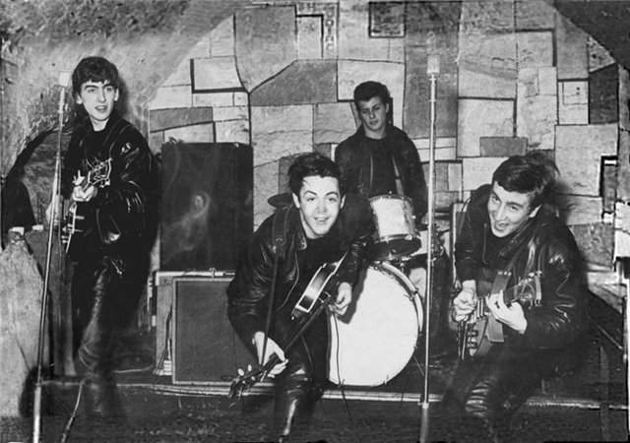
Some may say that they are four young long-haired hooligans singing primitive rock’n’roll tunes. The others may put them in the same rank with the greatest composers, such as Mozart, Beethoven and Bach…

Slide 4
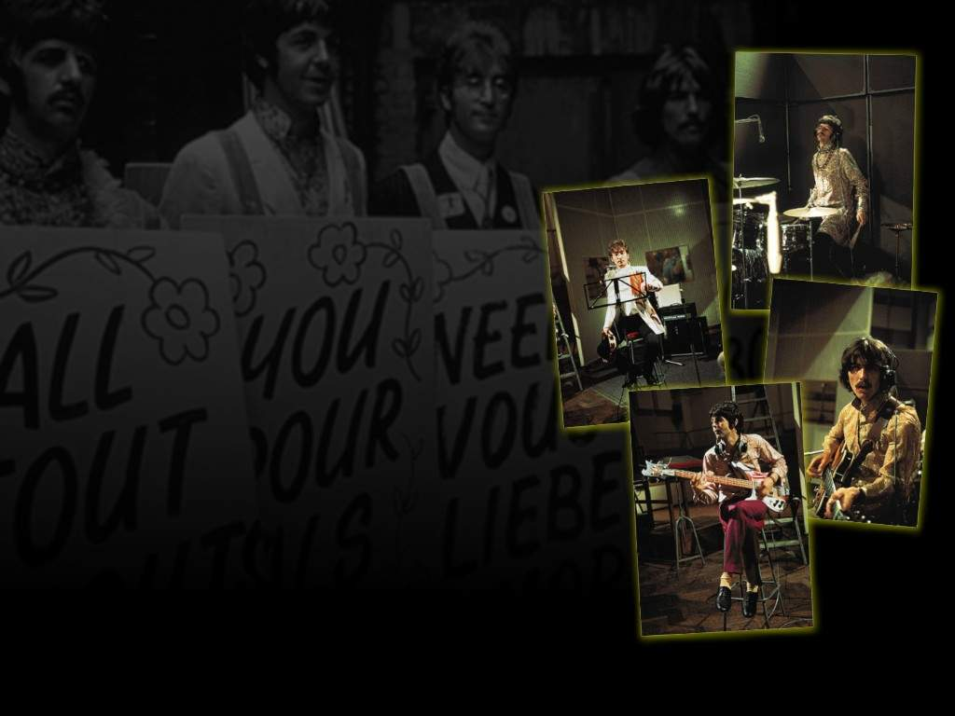
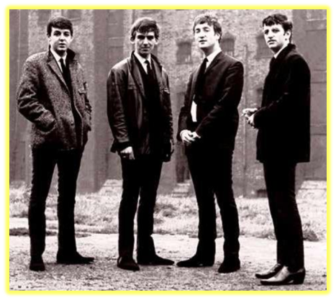
They are four boys from Liverpool, who decided to play and sing together.

Slide 5
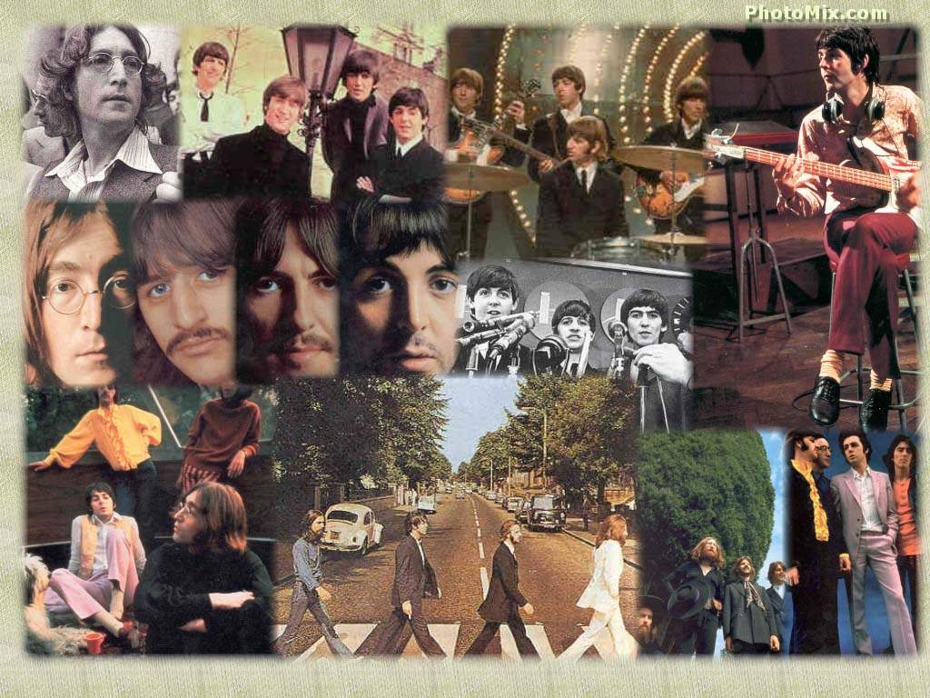
15 years of joint life and work, several concerts at the greatest TV-studios, concert-halls and stadiums of the World, some more than 200 songs and… …and the super-popularity which doesn’t fade away after so many years…

Slide 6
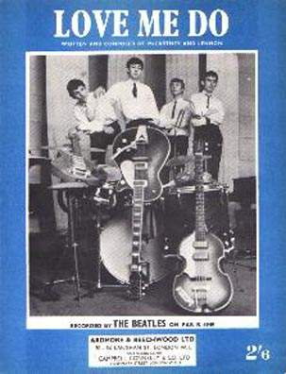
First album’s
In September, 1962, the band's first single, "Love Me Do" was released, eventually reaching #17 in the UK.

Slide 7
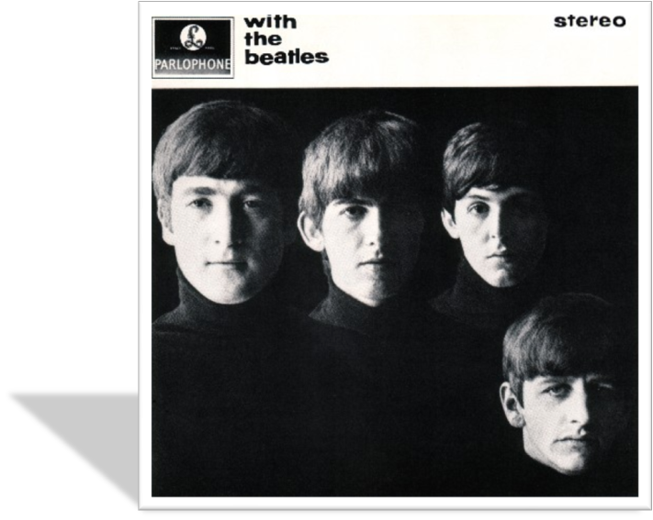
Their second album, With The Beatles became only the second album ever to sell a million copies in the UK

Slide 8
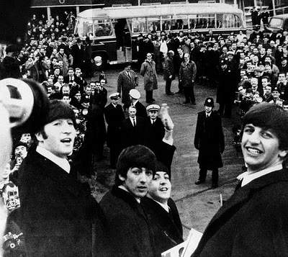
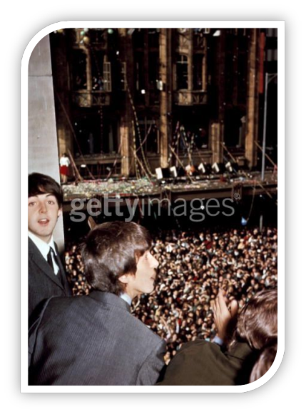
In New Zealand and Australia their arrival was greeted by a crowd estimated at more than 300,000.

Slide 9
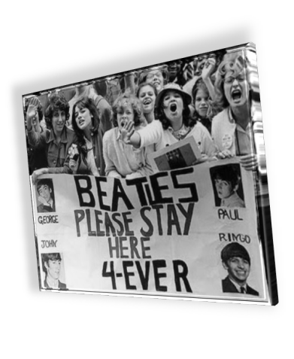
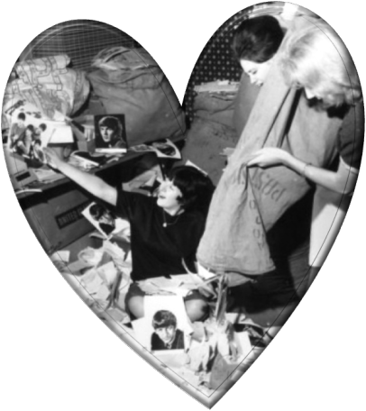
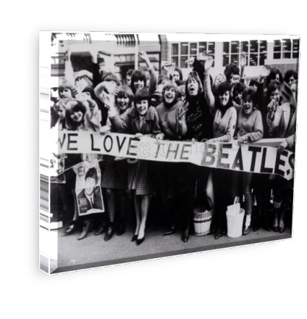
Beatlemania

Slide 10
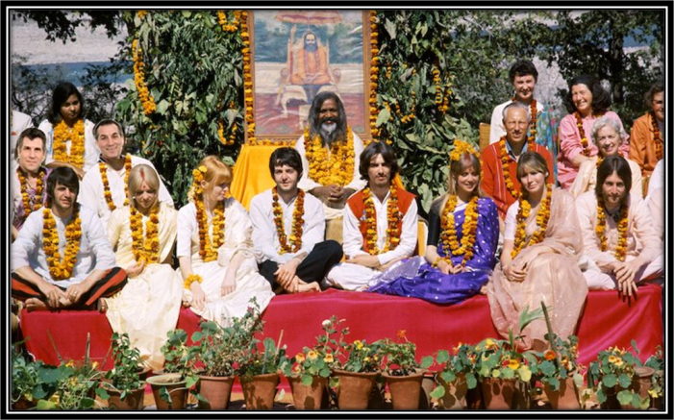
The band spent the first part of 1968 in India, studying transcendental meditation under the tutelage of Maharishi Mahesh Yogi. When they returned, they announced the creation of their own label, Apple Records, and went to work on the double album, called The White Album which was released in November 1968.

Slide 11
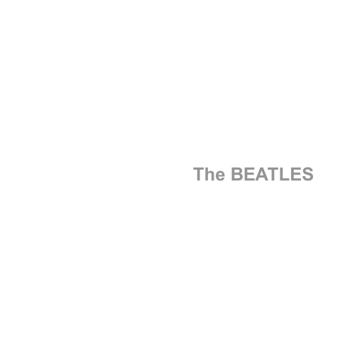
The double album, called The White Album which was released in November 1968.

Slide 12
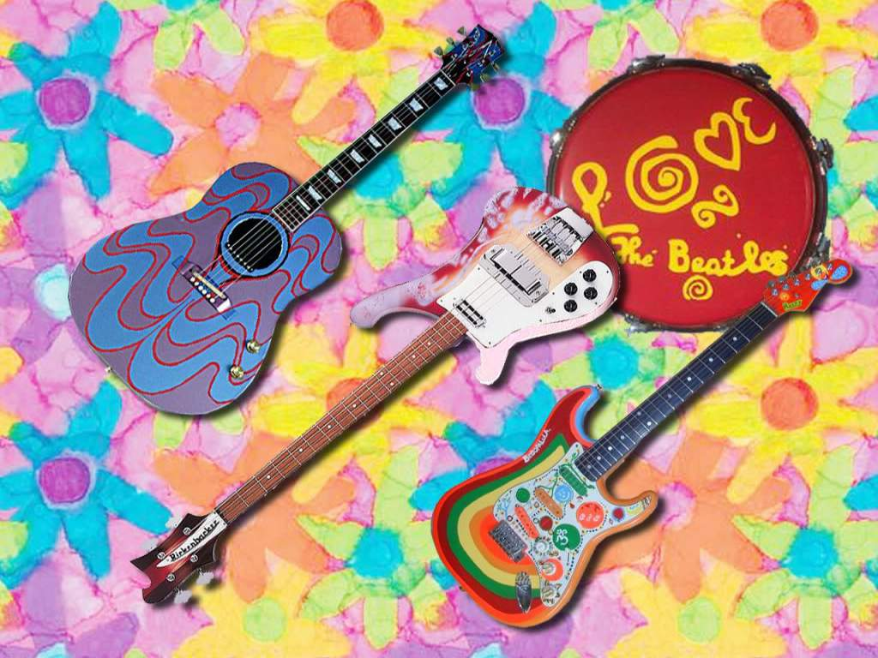
This band, their great music means a lot for Many people all over the world love Beatles. YOU can say with sure that they are still existing because their music will never die!

Slide 13
List of awards and nominations
received by The Beatles
In 1965, Queen Elizabeth II appointed the four Beatles Members of the Order of the British Empire (MBE).The film Let It Be (1970) won the 1971 Academy Award for Best Original Song Score. The Beatles have received 7 Grammy Awards and 15 Ivor Novello Awards. They have been awarded 6 Diamond albums, as well as 24 Multi-Platinum albums, 39 Platinum albums and 45 Gold albums in the United States, while in the UK they have 4 Multi-Platinum albums, 4 Platinum albums, 8 Gold albums and 1 Silver album. The group were inducted into the Rock and Roll Hall of Fame in 1988. In 2008, Billboard magazine released a list of the all-time most successful Hot 100 artists to celebrate the US singles chart's fiftieth anniversary — The Beatles ranked number one. As of 2012, they hold the record for most number one hits on the Hot 100 chart with 20. In 2009, the Recording Industry Association of America certified that the group have sold more albums in the US than any other artist. They have had more number one albums, 15, on the UK charts and held down the top spot longer, 174 weeks, than any other musical act. They were collectively included in Time magazine's compilation of the 20th century's 100 most influential people. The Beatles are the best-selling band in history, with estimated sales of over one billion units.

Slide 14
Список используемых источников
https://ru.wikipedia.org/wiki/The_Beatles
http://oldrockandroll.ru/the-beatles
https://ru.wikipedia.org/wiki/%C4%E6%E5%EA%F1%EE%ED,_%CC%E0%E9%EA

