Slide 1
Презентация по английскому языку
для 4 класса общеобразовательных школ
«Достопримечательности
Санкт – Петербурга»
Шайдурова Валентина Федоровна
учитель английского языка
ГБОУ «Школа №106»
Санкт-Петербург
2015

Slide 2
Saint-Petersburg
Содержание презентации
1. Достопримечательности Санкт-Петербурга – рассказ
2. Викторина по материалам презентации
1

Slide 3
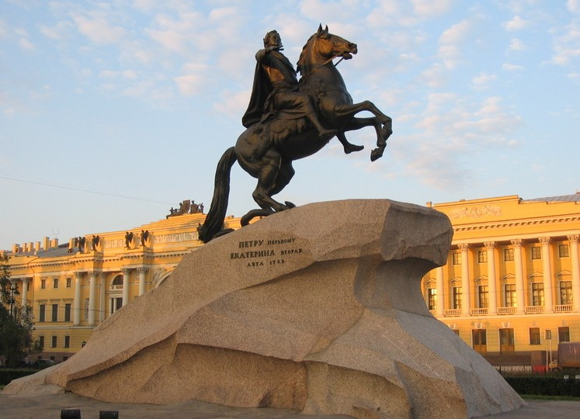
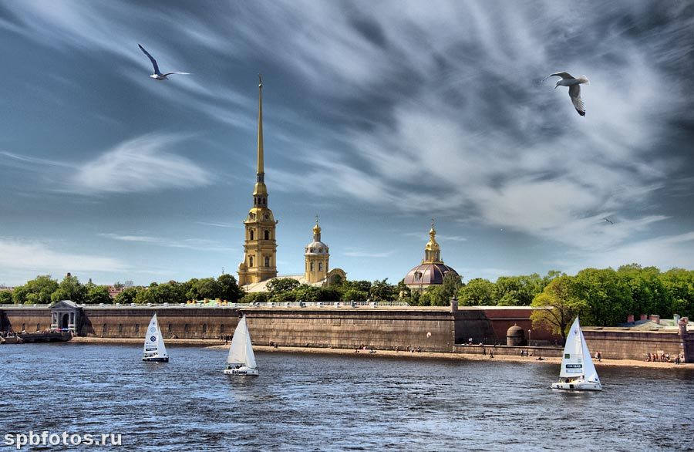
Saint-Petersburg
1
1

Slide 4
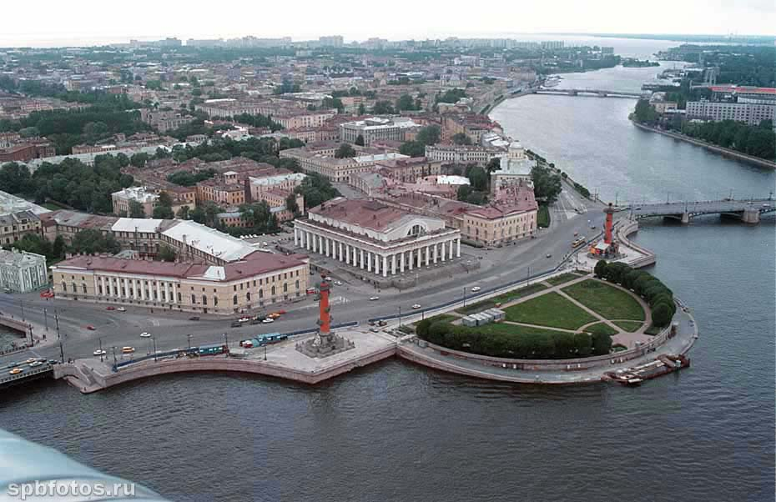
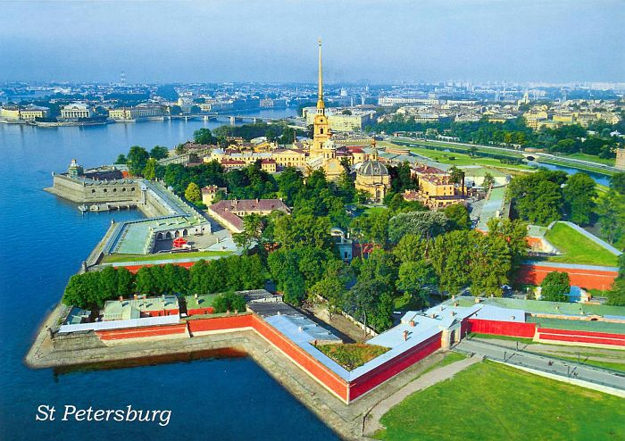
S-Petersburg was founded on May 27, 1703 by Peter the Great.
It is a big and beautiful city.
4

Slide 5
The Peter-and-Paul Fortress is the first site of S-Petersburg (1703).
5

Slide 6
.
It was build to protect the city from the Swedes.
Later it was a political prison.
All Russian tsars were buried there.
6

Slide 7
“The Bronze Horseman”. The monument to Peter the Great. (Sc. Falconet, 1782)
7

Slide 8
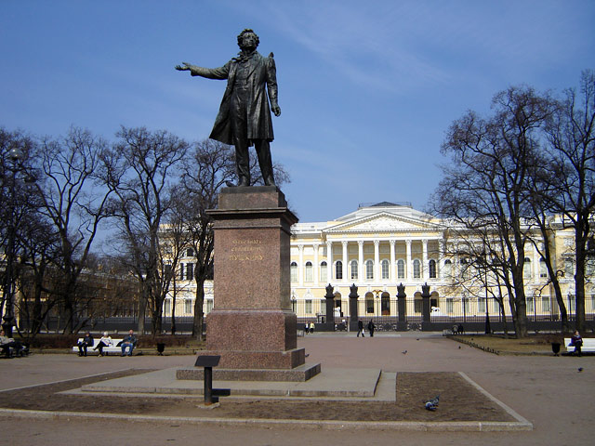
This is the monument to Pushkin.
You can see it in front of the Russian Museum
(sc. M. Anikushin, 1957).
8

Slide 9
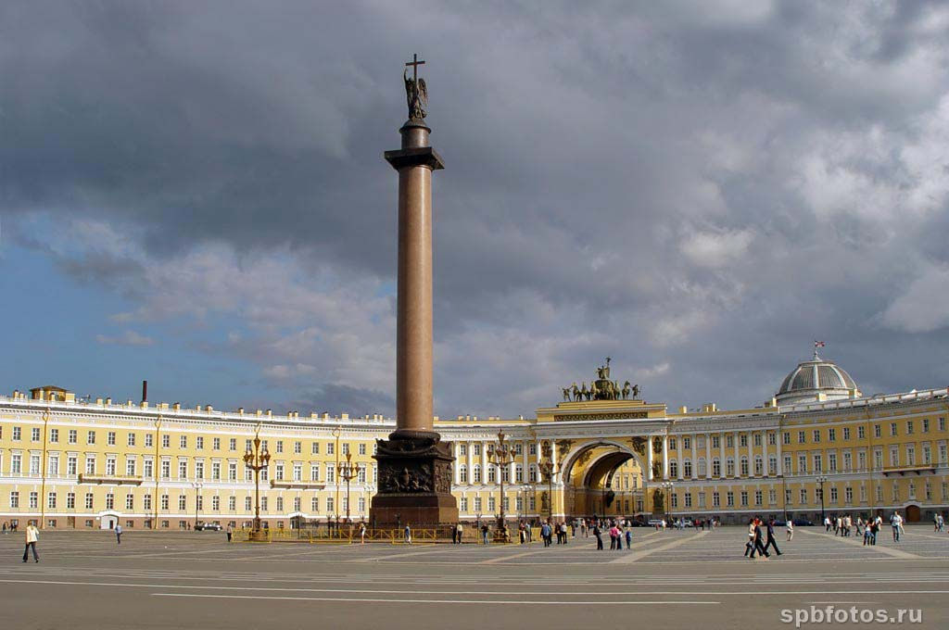
Palace Square is the main & the most beautiful square in the city
9

Slide 10
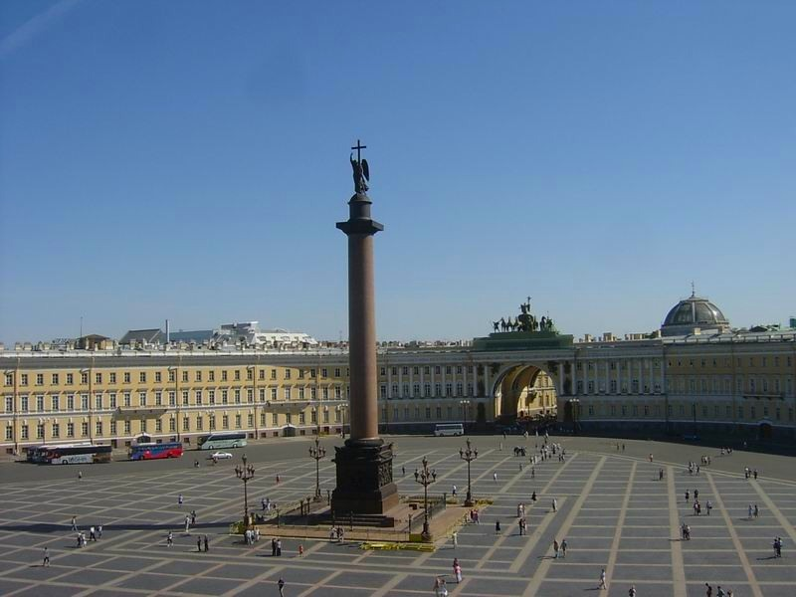
In the centre you can see the Triumphal Alexander column .
It was built in 1837 in honour of the victory of Russia
in the Patriotic War of 1812.
10

Slide 11
St. Isaac’s Cathedral is largest one in the city. It was designed by Montferrand in 1818-1858
11

Slide 12
The Kazansky Cathedral was designed by Voronikhin in 1801-1811
12

Slide 13
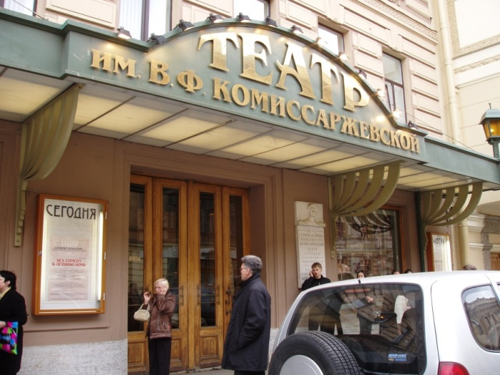
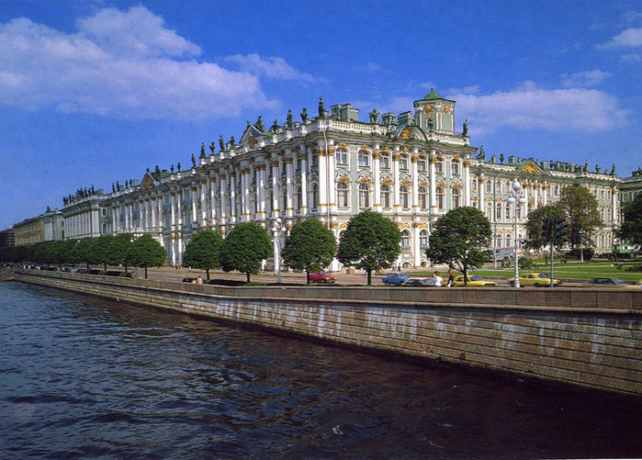
There are a lot of theatres, cinemas and museums in our city.
13

Slide 14
This is the Winter Palace. (Rastrelli, 1754-1762)
The Winter Palace was a residence of the Russian tsars
Today the rooms of
Winter Palace house
the collections of the
State Hermitage.
14

Slide 15
This is one of the halls of the Hermitage
15

Slide 16
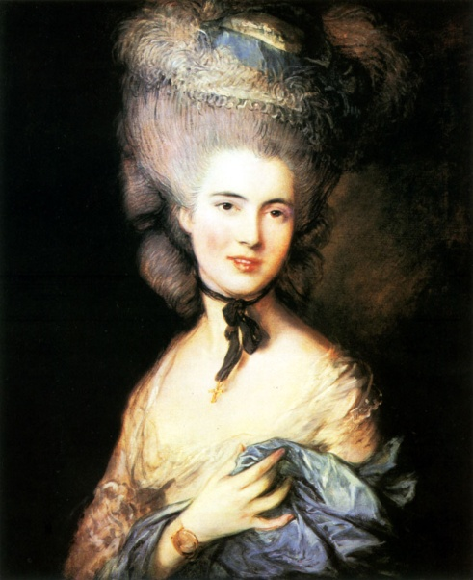
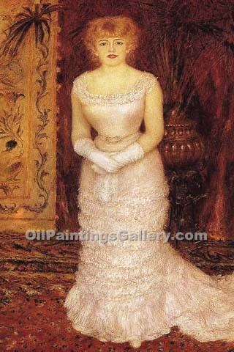
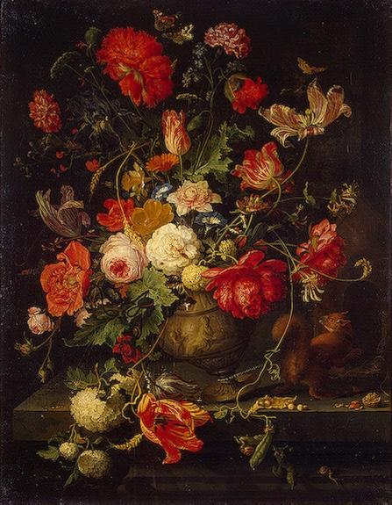
There are a lot of beautiful and amazing paintings of foreign artists.
16

Slide 17
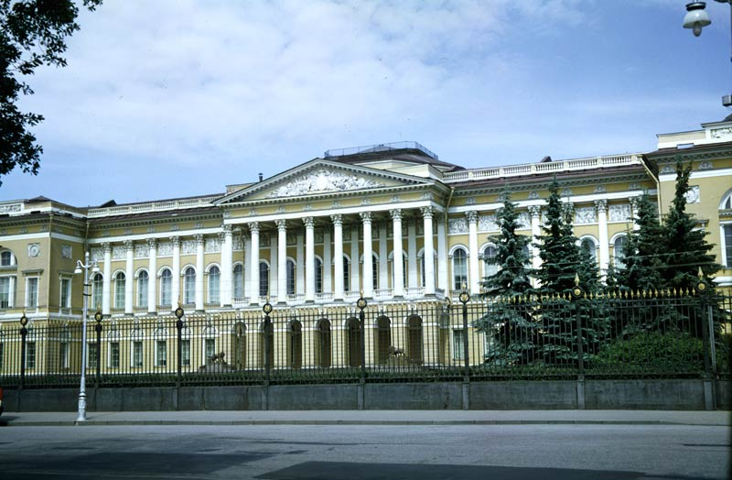
This is the Russian Museum.
17

Slide 18
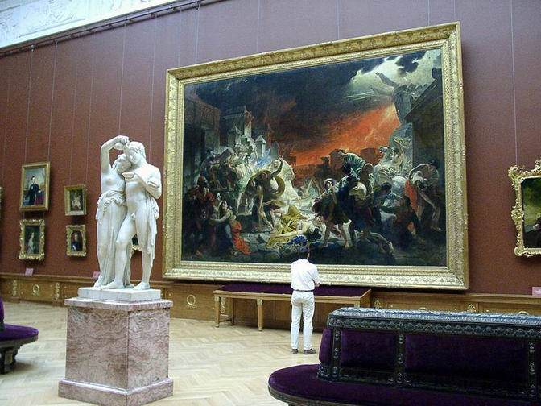
There are a lot of paintings of Russian artists.
18

Slide 19
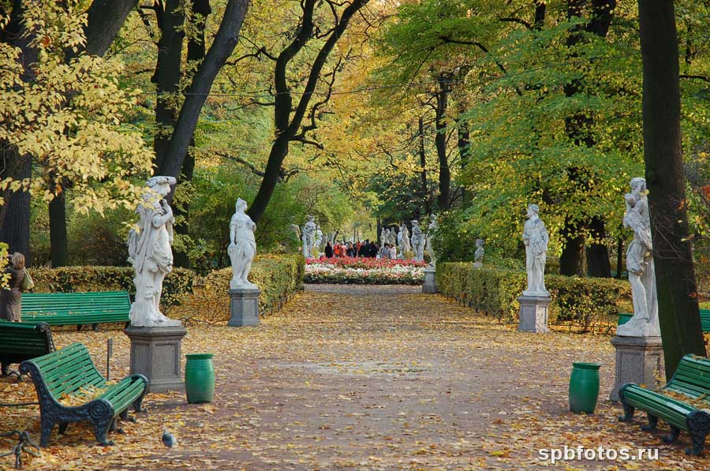
There are many gardens and parks in the city. The Summer Gardens are marvelous.
They were laid out in 1704
& decorated by numerous marble sculptures.
19

Slide 20
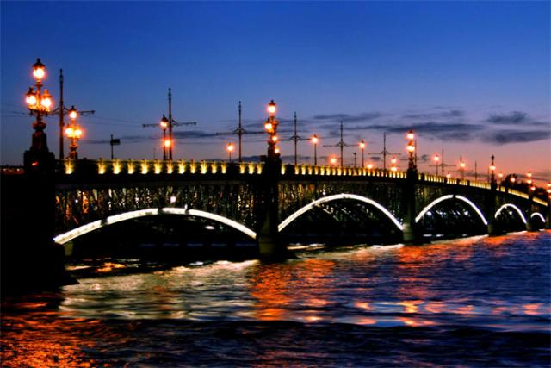
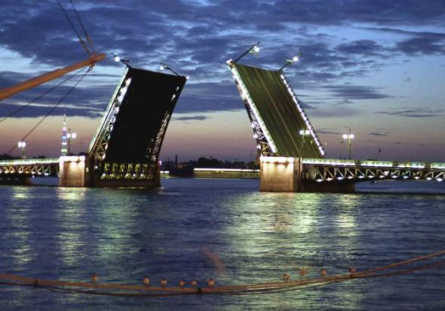
There are 93 rivers, 20 canals, more than 100 lakes in Saint-Petersburg
There are about 400 bridges over the river Neva
20

Slide 21
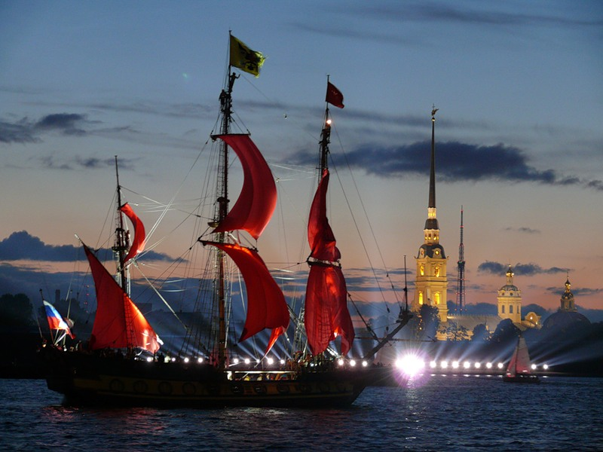
Saint-Petersburg is famous for its “White Nights”
21

Slide 22
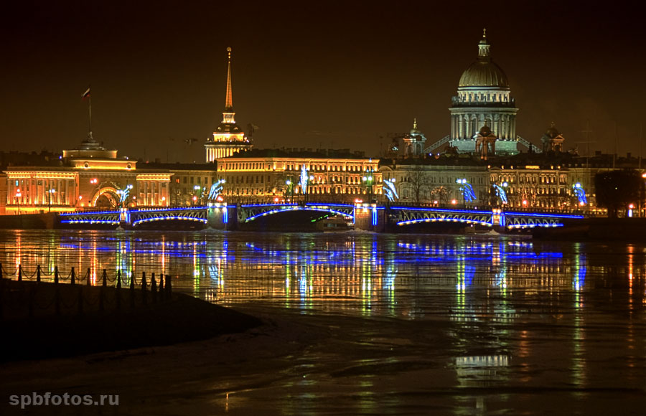
I like Saint-Petersburg.
Do you like our city?
22

Slide 23
The quiz
????????????
??????????????????????
??????????????????????????????
?????????????????????????????????????
????????????????????????????????????????????
?????????????????????????????????????????????????
?????????????????????????????????????????????????????
???????????????????????????????????????????????????????
????????????????????????????????????????????????????????
23

Slide 24
Name the monument, please!
1-Monument to Peter I
2- Monument to Pushkin
3- Monument to Lenin
What is the building?
1- the Hermitage
2- the Russian Museum
3- theatre
24

Slide 25
2- Monument to Pushkin
2- the Russian Museum
25

Slide 26
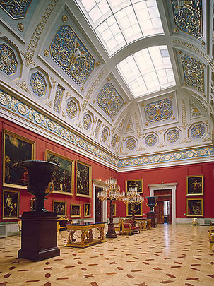
Name the museum!
1- the Russian Museum
2- the Hermitage
26

Slide 27
The Hermitage
27

Slide 28
Name the square, please!
The Palace Square
28

Slide 29
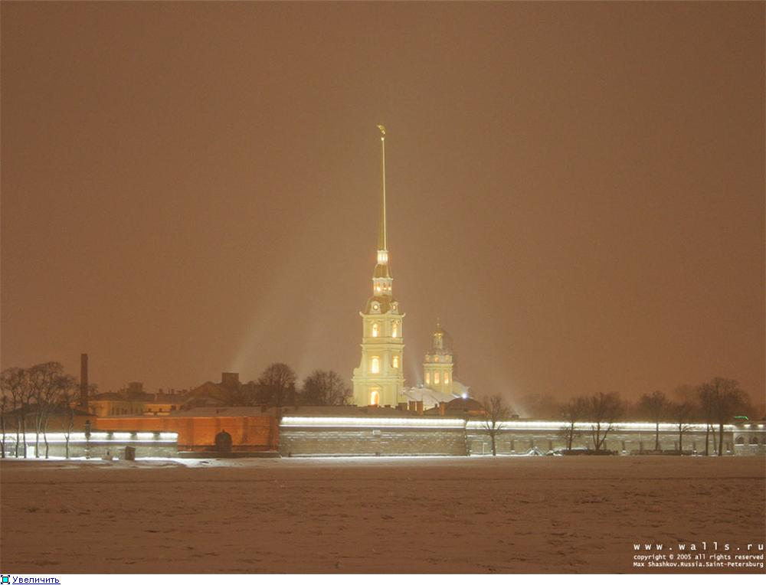
Please, name the fortress!
The Peter and Paul Fortress
29

Slide 30
Name the park, please!
The Summer Gardens
30

Slide 31
Name the palace and the museum!
- The Winter Palace
- The Hermitage
31

Slide 32
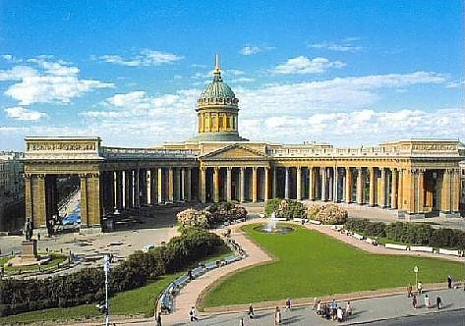
Please, name the cathedral!
Kazan Cathedral
32

Slide 33
Name the monument, please!
Monument to Peter the Great
33

Slide 34
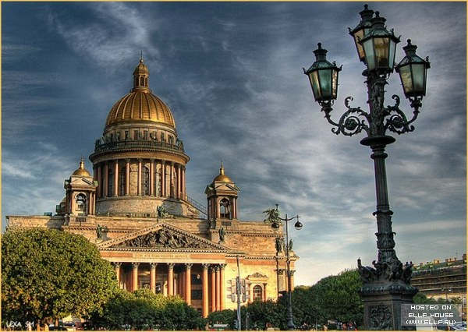
Name the cathedral, please!
St. Isaac’s Cathedral
35

Slide 35
How many bridges are there in the city?
About 400 bridges

Slide 36
Please, name the museum!
The Russian Museum
36

Slide 37
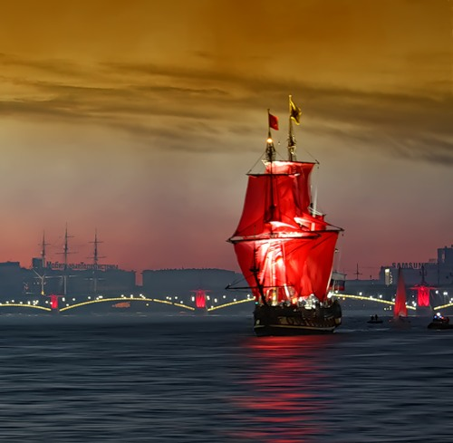
WELL DONE! THANK YOU!
37

