Slide 1
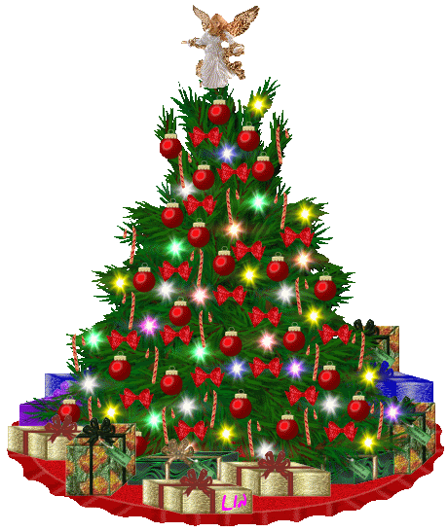
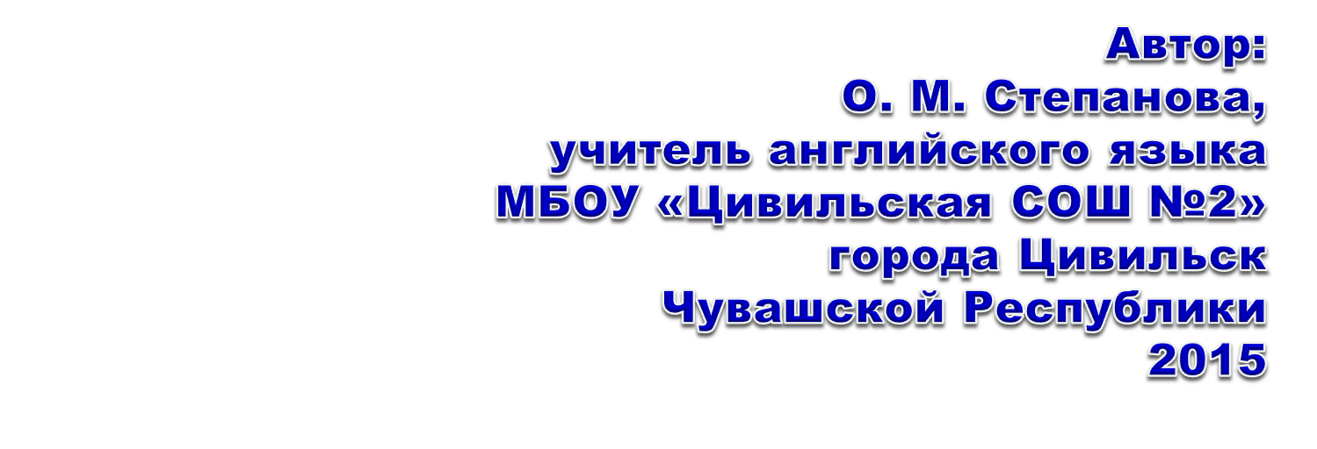
Karen Hahn Nativity
and her Inspirational Angels
Sculpture Gallery
The Heart of Christmas

Slide 2
Нежная Рождественская керамика
от
Karen Hahn

Slide 3
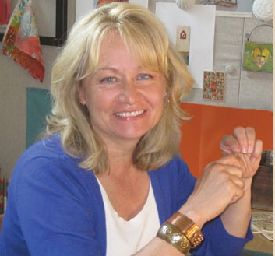
Karen Hahn : Designed with tradition
in mind, Karen's design feature timeless symbols and sentiments of the season
that
will be heirlooms for
a new generation.
My desire was that the collections would convey inspirational messages that reflect connections to family, faith, home and the foundations of life. The Heart of Christmas collection is my gift to the traditions of a classic Christmas when tables were set with Grandma’s china and the mantles were covered with as many pine boughs as possible.

Slide 4
Enjoy
Karen Hahn’s Christmas Nativity
Smooth, polished bone finish with gorgeous crystal accents. Foundations angels are brimming with insight and inspiration. Foundations© angels offer comforting reflections on family, faith and home with handwritten messages and gentle styles.

Slide 5
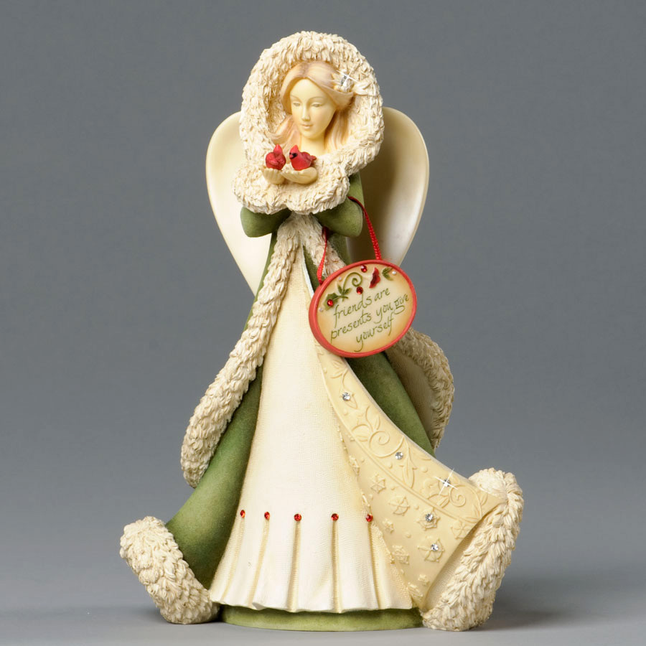
May this Christmas end the present year on a cheerful note
and make way
for a fresh and
bright New Year.

Slide 6
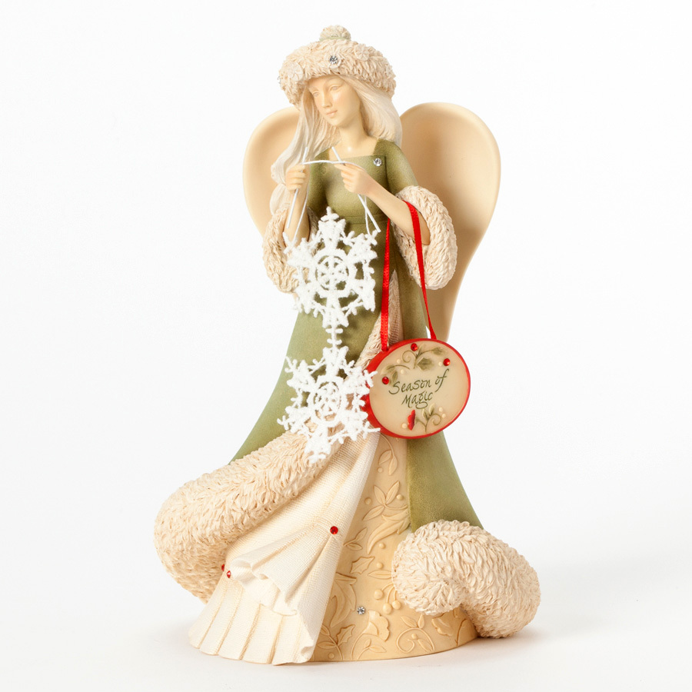
May this Christmas end the present year on a cheerful note
and make way
for a fresh and
bright New Year.

Slide 7
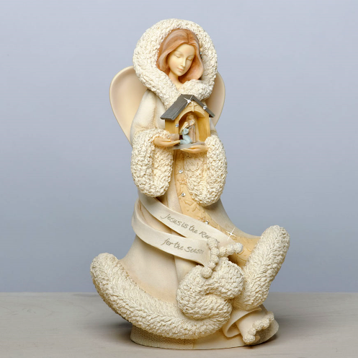
May the good times
and treasures of the present
become the golden memories of tomorrow.

Slide 8
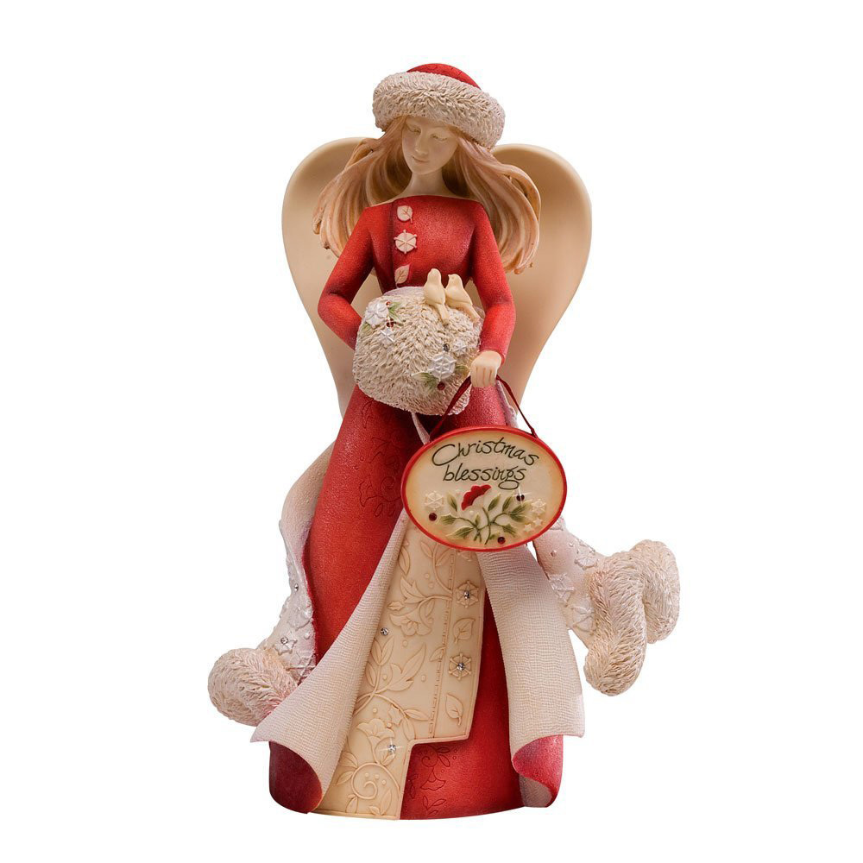
May
your Christmas sparkle with moments of
love, laughter and goodwill.
Merry
Christmas!

Slide 9
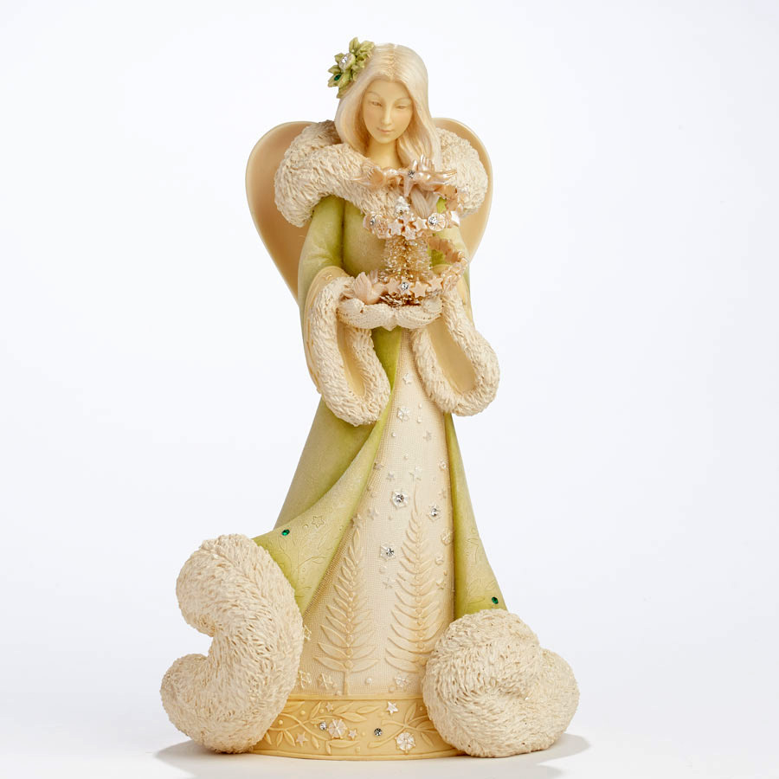
May
the joy
and festivities continue to radiate in
your lives,
long
after Christmas is
gone.

Slide 10
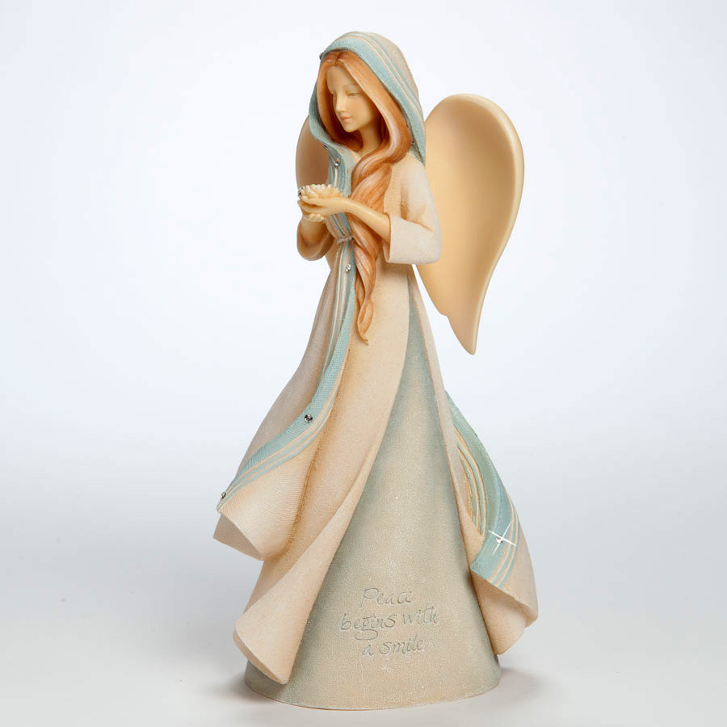
A wish
for
peace
and happiness
at Christmas and throughout the
New
Year.

Slide 11
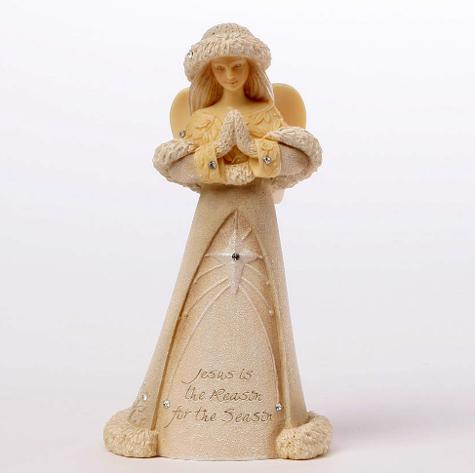
May
the Christmas season
fill your home
with joy,
your
heart
with love
and your life with laughter.

Slide 12
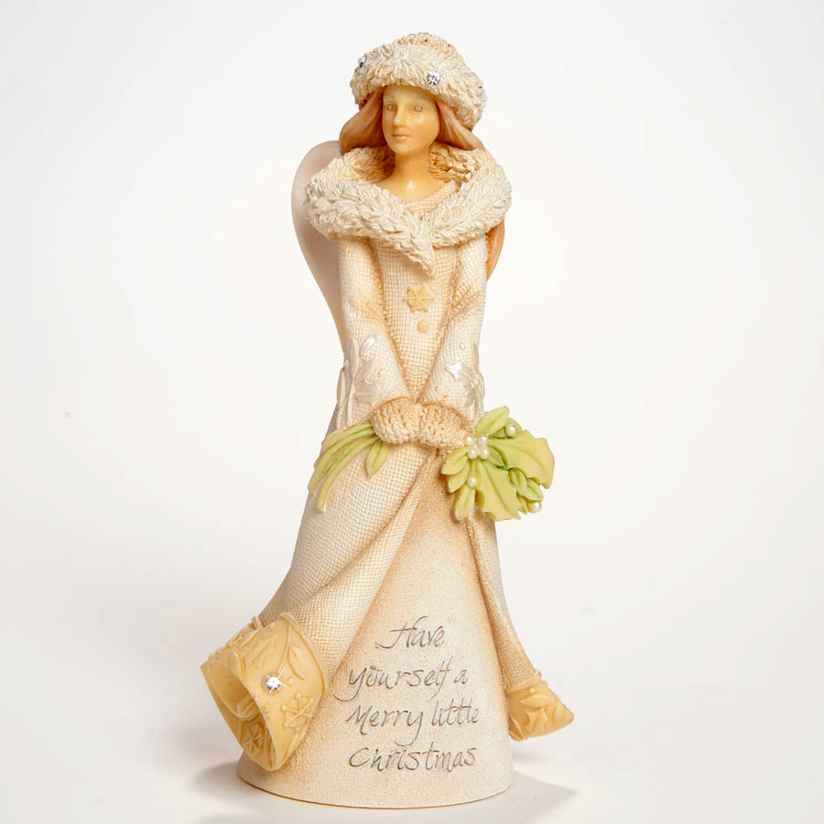
May
the peace and blessings
of Christmas be yours
And may the coming year
be filled with happiness.

Slide 13
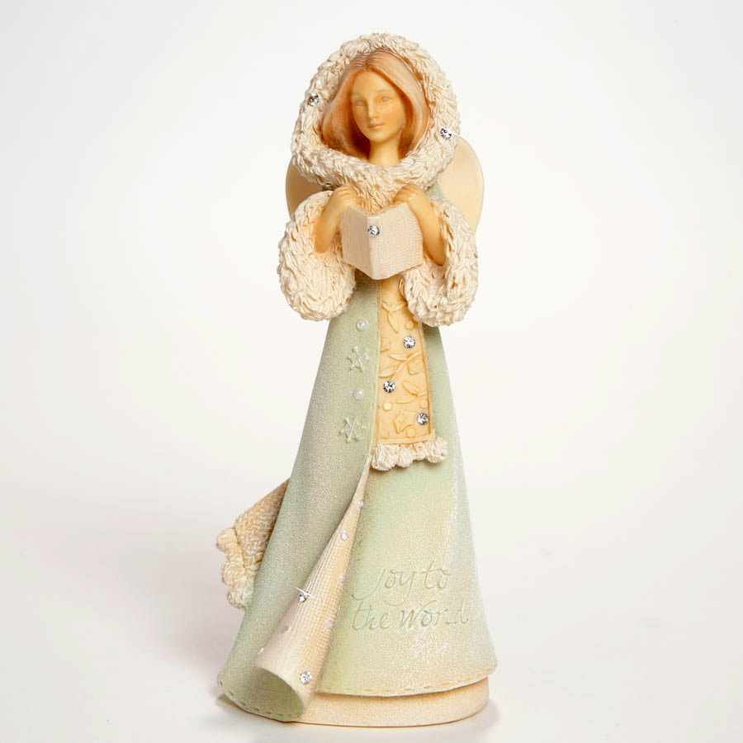
The gift of love.
The gift of peace.
The gift of happiness.
May
all
these
be
yours
at Christmas.

Slide 14
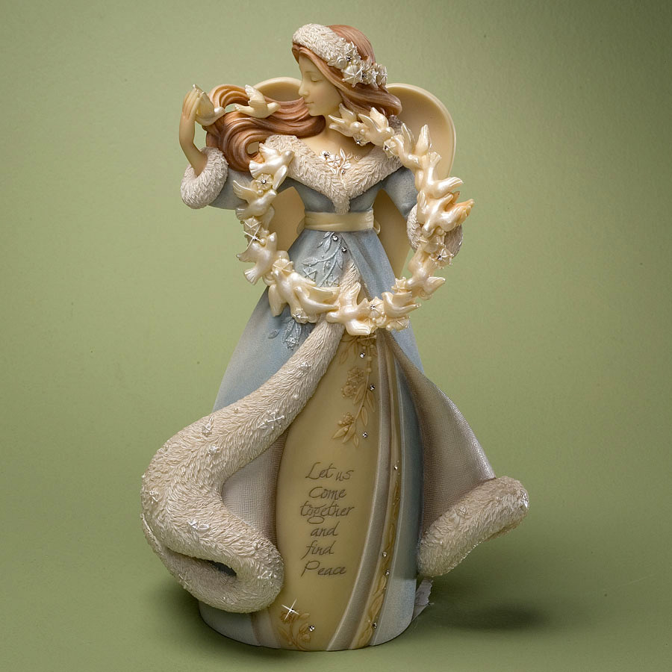
Wishing you
Merry Christmas
and
a most prosperous and healthy New
Year.

Slide 15
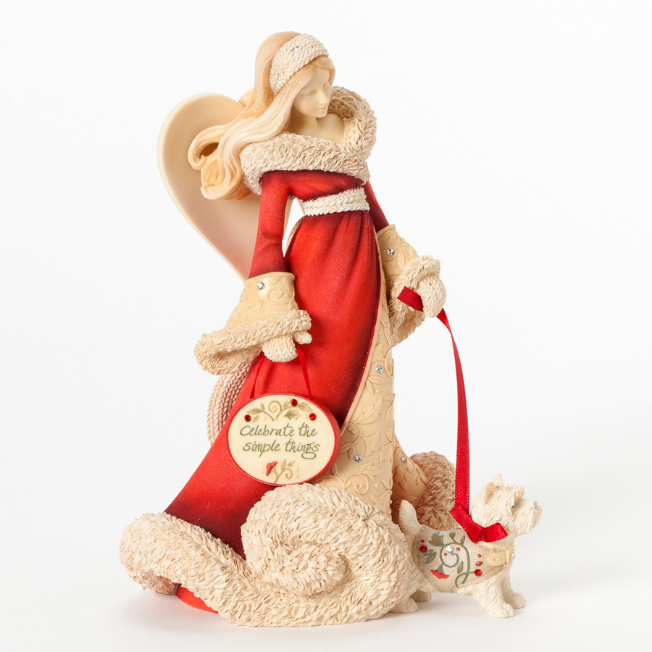
Peace
On
Earth
and
best wishes
throughout the
New
Year. Merry Christmas!

Slide 16
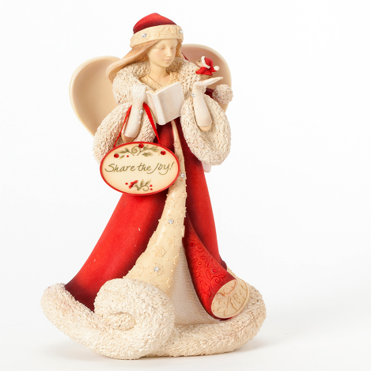
Whatever is beautiful.
Whatever is meaningful.
Whatever brings you happiness.
May it be yours at Christmas
and throughout the coming year.

Slide 17
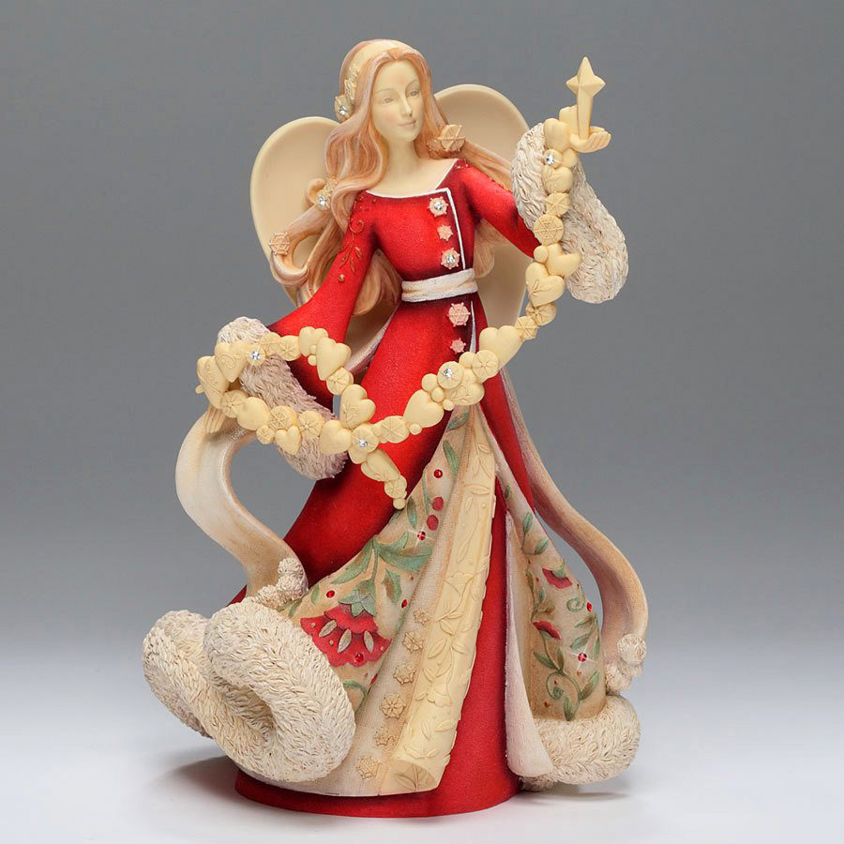
A silent night,
a star above,
a blessed gift
of
hope
and love.
A blessed Christmas to you!

Slide 18
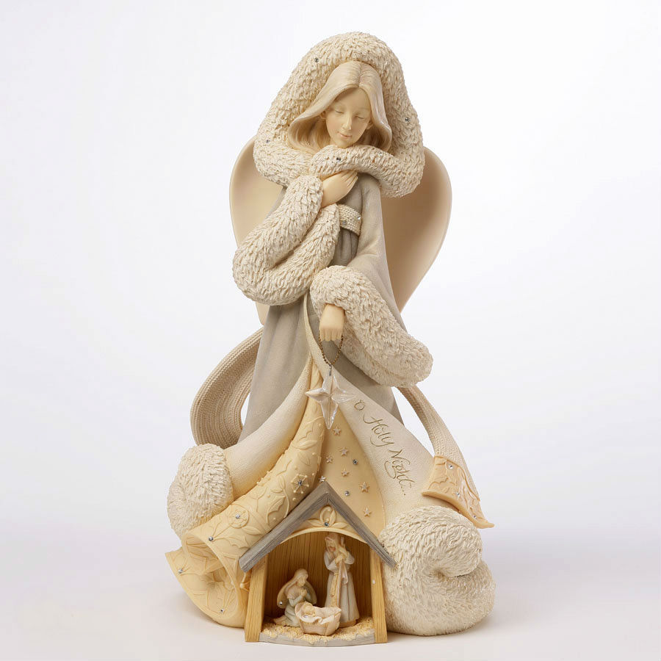
May
all
the sweet magic
of Christmas conspire to
gladden your heart
and fill every desire.

Slide 19
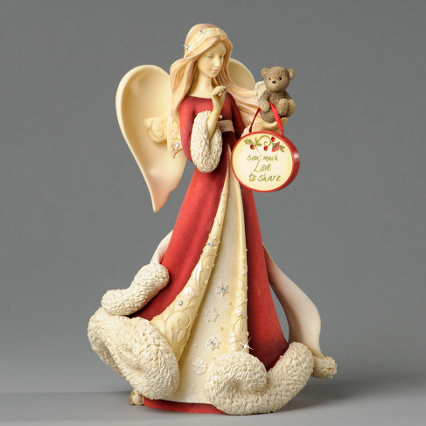
May God
fill
your life
with love, joy and peace
this Holiday Season
and throughout the New Year.

Slide 20
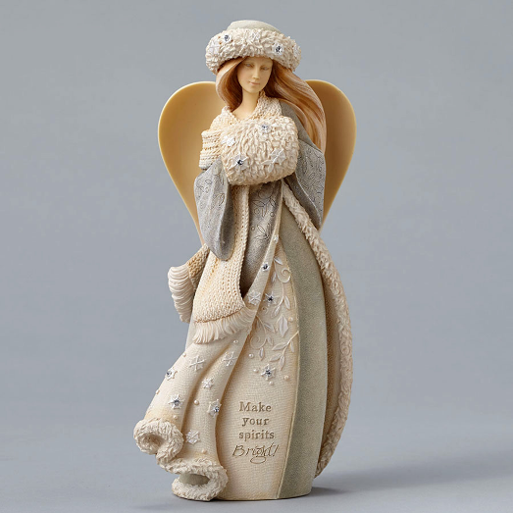
May the sadness and gloom in your life be replaced with never ending happiness and cheer!

Slide 21
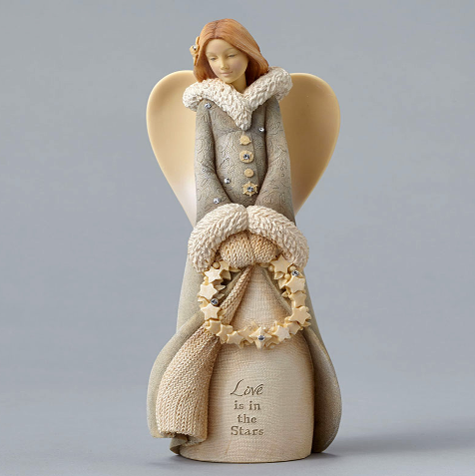
Wishing you the
Gladness of Christmas,
which is Hope,
the Spirit of Christmas,
which is Peace,
the Essence of Christmas,
which is Love.

Slide 22
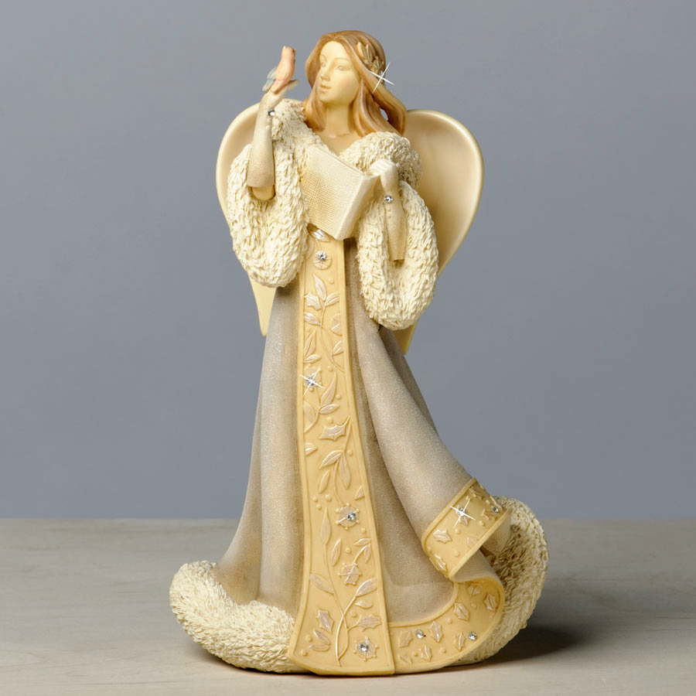
Especially for
you
my personal Christmas wish
good
luck
and
health
throughout the
year.

Slide 23
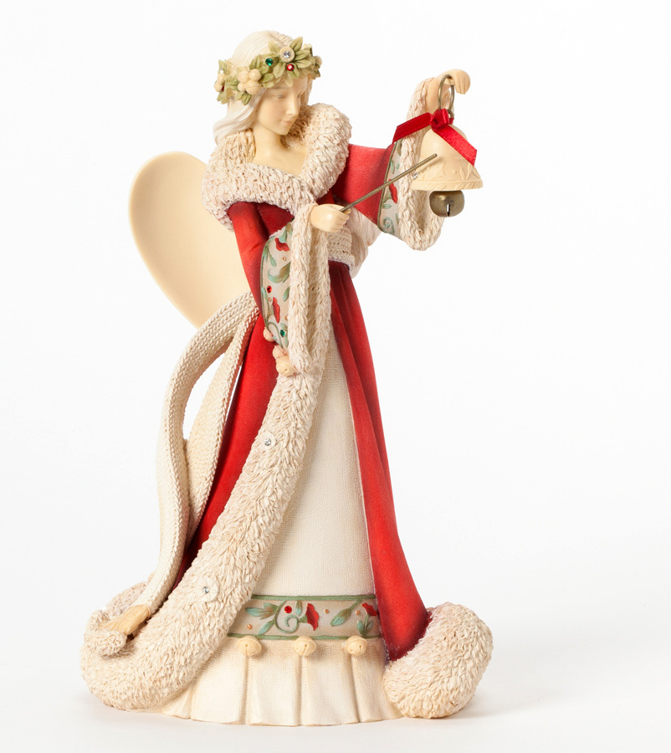
May
God bless you and your family
on this very special day. Merry Christmasa Happy New Year!

Slide 24
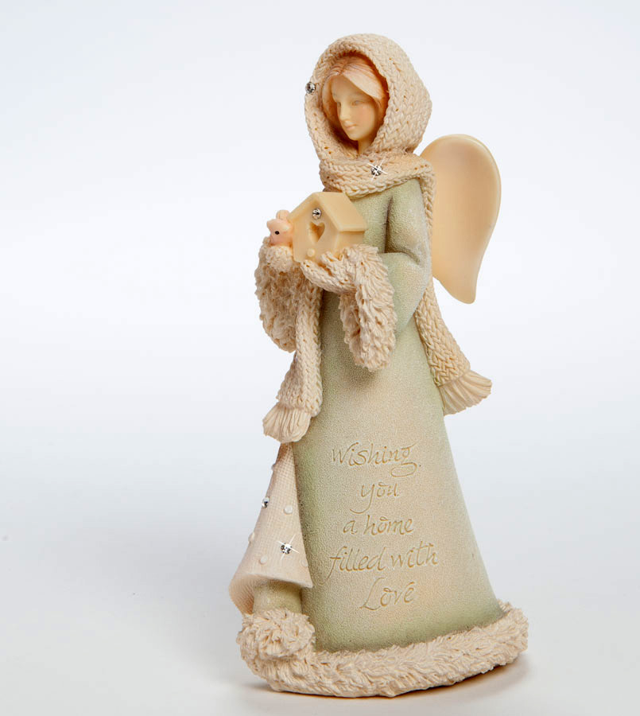
May
the light of love
shine
upon you, and may your life be filled
with blessings in this Christmas season.

Slide 25
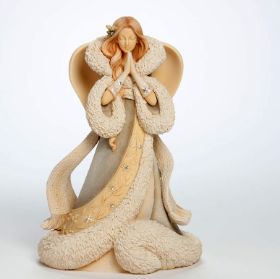
A little smile,
a word of cheer,
a bit of love from someone near. A little gift from one held dear, best wishes for the coming year.

Slide 26
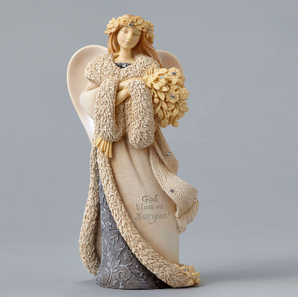
May this Christmas bring joy and love to your heart and soul, and
may you start the New Year on a beautiful note.

Slide 27
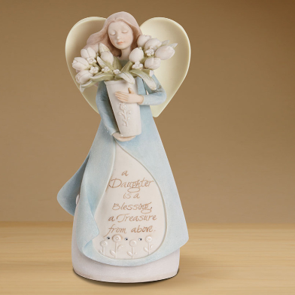
May
all
the sweet magic of Christmas conspire
to gladden your
hearts and fill
every desire.
Merry Christmas!

Slide 28
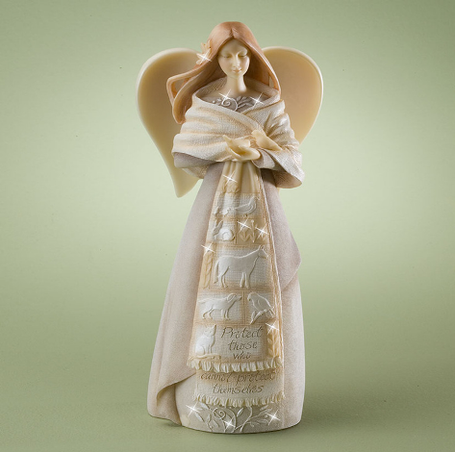
Sending you warm
hugs,
loving kisses
and
earnest wishes
for
the wonderful occasion
of Christmas.

Slide 29
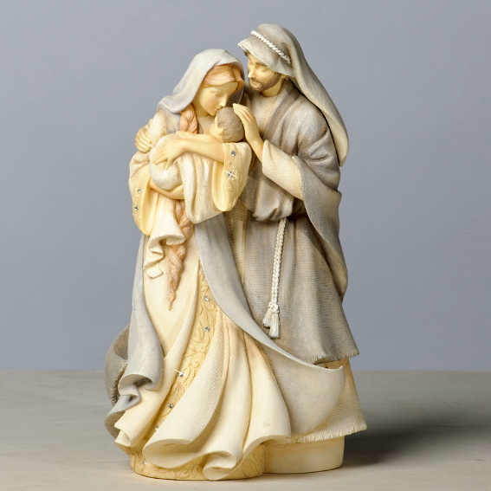
God bless you !

Slide 30
Thank you
for
visiting
Karen Hahn
Sculpture
Gallery

Slide 31
Sources
http://www.liveinternet.ru/users/oksana_mueller/post348932441/
http://www.wishesquotes.com/christmas/christmas-wishes
https://www.pinterest.com/lynnkatie90/the-wonder-of-karen-hahn/
http://www.amerheritage.com/salespages/artisan/karenhahnangels/karenangels1.htm
http://www.thefind.com/gifts/info-karen-hahn-angels

