Slide 1
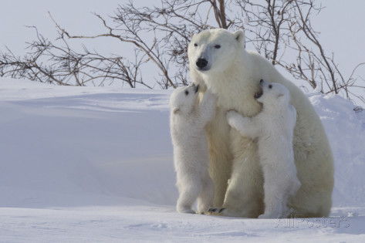
David Jenkins’
Polar Bears
Of Canada
Фотогалерея-викторина
для 7-11 классов
Автор:
О.М. Степанова
Учитель английского языка МБОУ «Цивильская СОШ №2»
города Цивильск
Чувашской Республики
2015

Slide 2
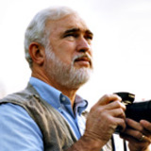
Dave Jenkins, a photographer since 1969, specializes in photography of people and architecture.
Known for his strong sense of design and special feeling for beautiful light, his assignments have taken him to 28 countries and around much of the United States. He and his wife Louise, a Nurse Practitioner, live on a small farm in the Northwest Georgia mountains.
42-летний ирландский фотограф Дэвид Дженкинс (David Jenkins) попытался показать мягкую сторону огромных полярных хищников. Эта коллекция фотографий, сделанных в течение 10 лет в Канаде, рассказывает о связи белых медведей и их детенышей, когда они впервые выходят из своей берлоги.

Slide 3
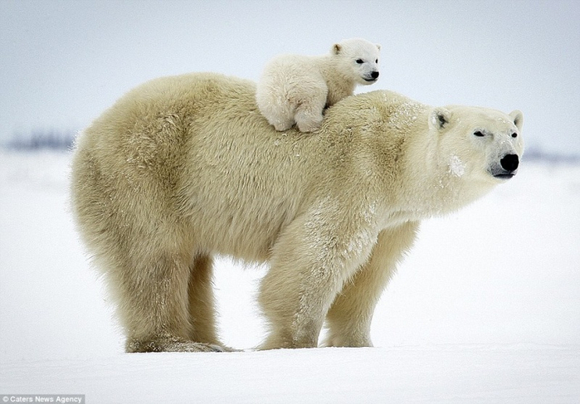
This little bear has a soft
fur suit,
This little bear acts very cute,
This little bear is bold and cross,
This little bear rests his head
on moss,
This little bear likes bacon
and honey,
But he can't buy them.
He has no ________ .
money

Slide 4
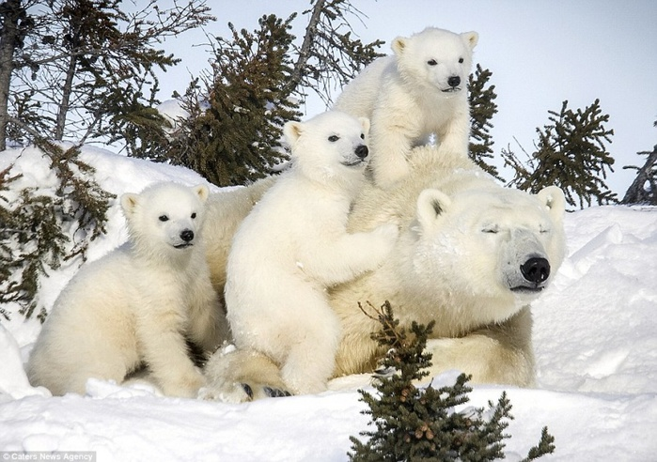
The polar bear lives in Alaska,
He never gets cold in a storm,
He swims in cold icy water,
His heavy coat keeps him __________
warm

Slide 5
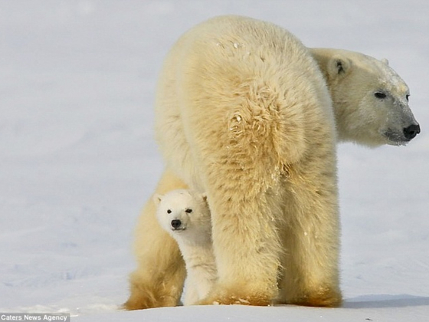
I'm a little polar bear
soft and white.
I catch a tasty fish
and take a big bite.
When the day is over
I know what is right.
I lay down my sleepy head
and say
"Good _______
night

Slide 6
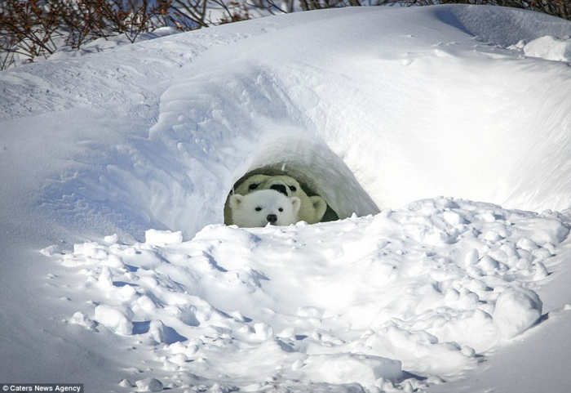
Waa! Waa! Waa!
Cried Baby Bear.
"I've got chickenpox in my hair,
On my nose and everywhere!"
Waa! Waa! Waa!
Cried ________ Bear.
Baby

Slide 7
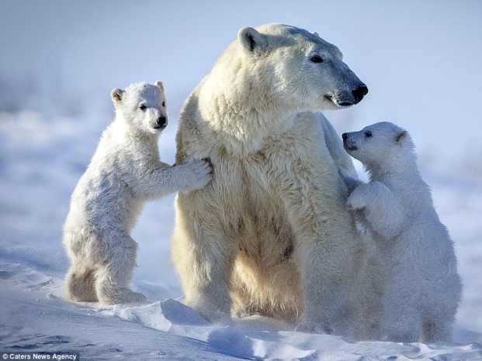
Little Polar Bear
White as the snow
Sat on the ice
Near
the cold
water's flow.
I am hungry,
he said
and made a wish
Then stuck in his paw
And pulled out a _______
fish

Slide 8
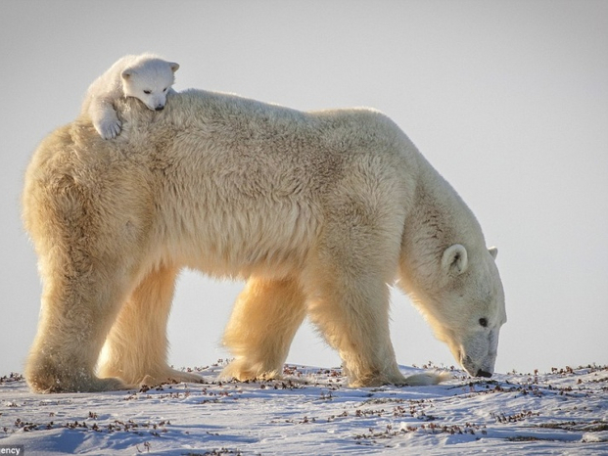
This little bear
Has a heart that’s true
And is filled with hugs
Especially for you.
If you ever need a little hug,
Find this little bear
And he’ll give you a _________
hug

Slide 9
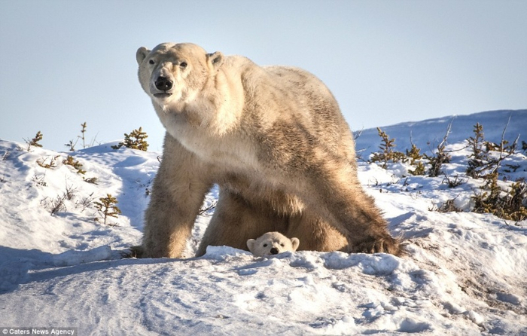
Now it's time for sleeping,
The bears go in their caves.
Keeping warm and cozy,
Time for lazy days.
When the snow is gone,
And the sun comes out to play,
The bears will wake up from their sleep,
And then go on their _____ .
way

Slide 10
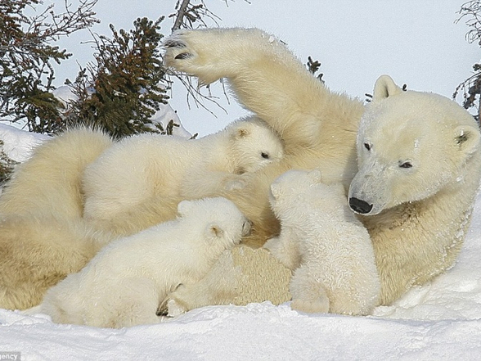
A polar bear felt quite alone
in the arctic circle zone.
So he looked up at the sun and
With his shadow he started having _______!
fun

Slide 11
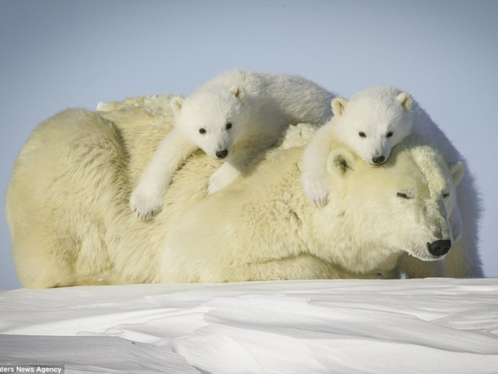
That sunny day
so the bear and his shadow
played all day in snow deep
until the bear decided
to go home and _______ .
sleep

Slide 12
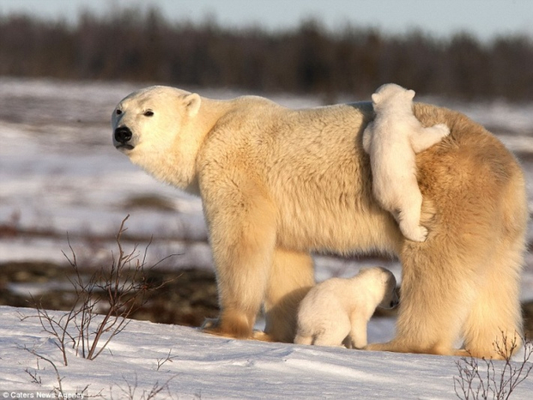
Polar bears live in the snow
Icy lands
of Arctic
shores.
They
Sleep,
They eat,
They hunt,
They play
For lives as long as 12,000 days.
That’s about 32 in years.
They get to prey and have no ________.
fears

Slide 13
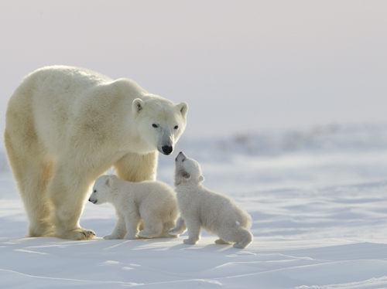
Thick white fur
Helps body heat
Keep Polar bears warm
In their climate
Though temperatures fall
Less than minus 58
They can still hunt and
_______ and mate
play

Slide 14
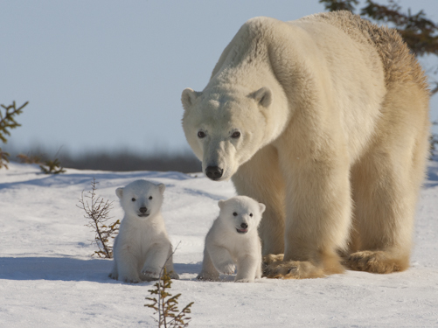
Grandpa Bear's Lullaby
The night is long
But fur is deep.
You will be warm
In winter sleep.
The food is gone
But dreams are sweet
And they will be
Your winter meat.
The cave is dark
But dreams are bright
And they will serve
As winter ________.
light

Slide 15
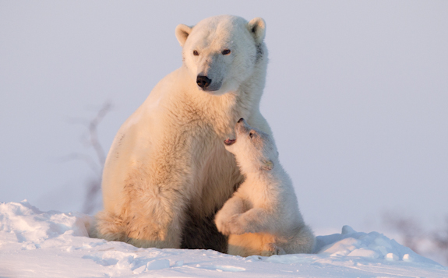
Bears like honey
That comes
from bees.
Bears like to nap
Under shady trees.
Bears can be
cuddly,
Or big and mean.
My little Teddy Bear
Is the cutest
I've seen.
He's at my side
When I'm happy or blue,
Here's to my Teddy Bear--
"I _______ you!"
love

Slide 16
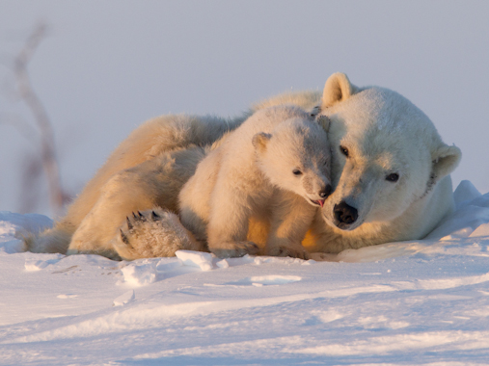
There's a Polar Bear
In our Frigidaire--
He likes it
'cause it's cold in there.
With his seat
in the meat
And his face in the fish
And his big hairy paws
In the buttery dish,
He's nibbling the noodles,
And munching the rice,
He's slurping the soda,
He's licking the ice.
And he lets out a roar
If you open the _______ .
door

Slide 17
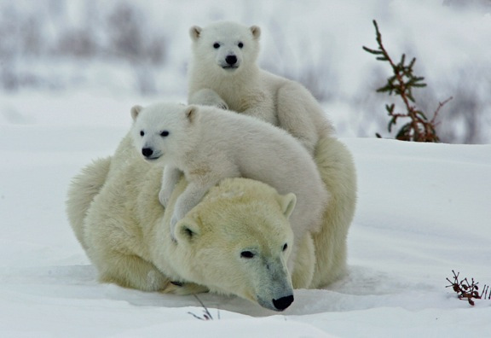
Enjoy
a Polar
Bear
Cub
Film!
http://www.youtube.com/watch?v=3rJO0o2NR6U

Slide 18
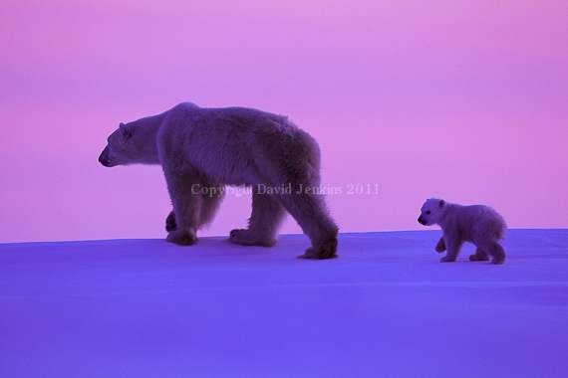
Thank you
for being with David Jenkins’
Polar Bears

Slide 19
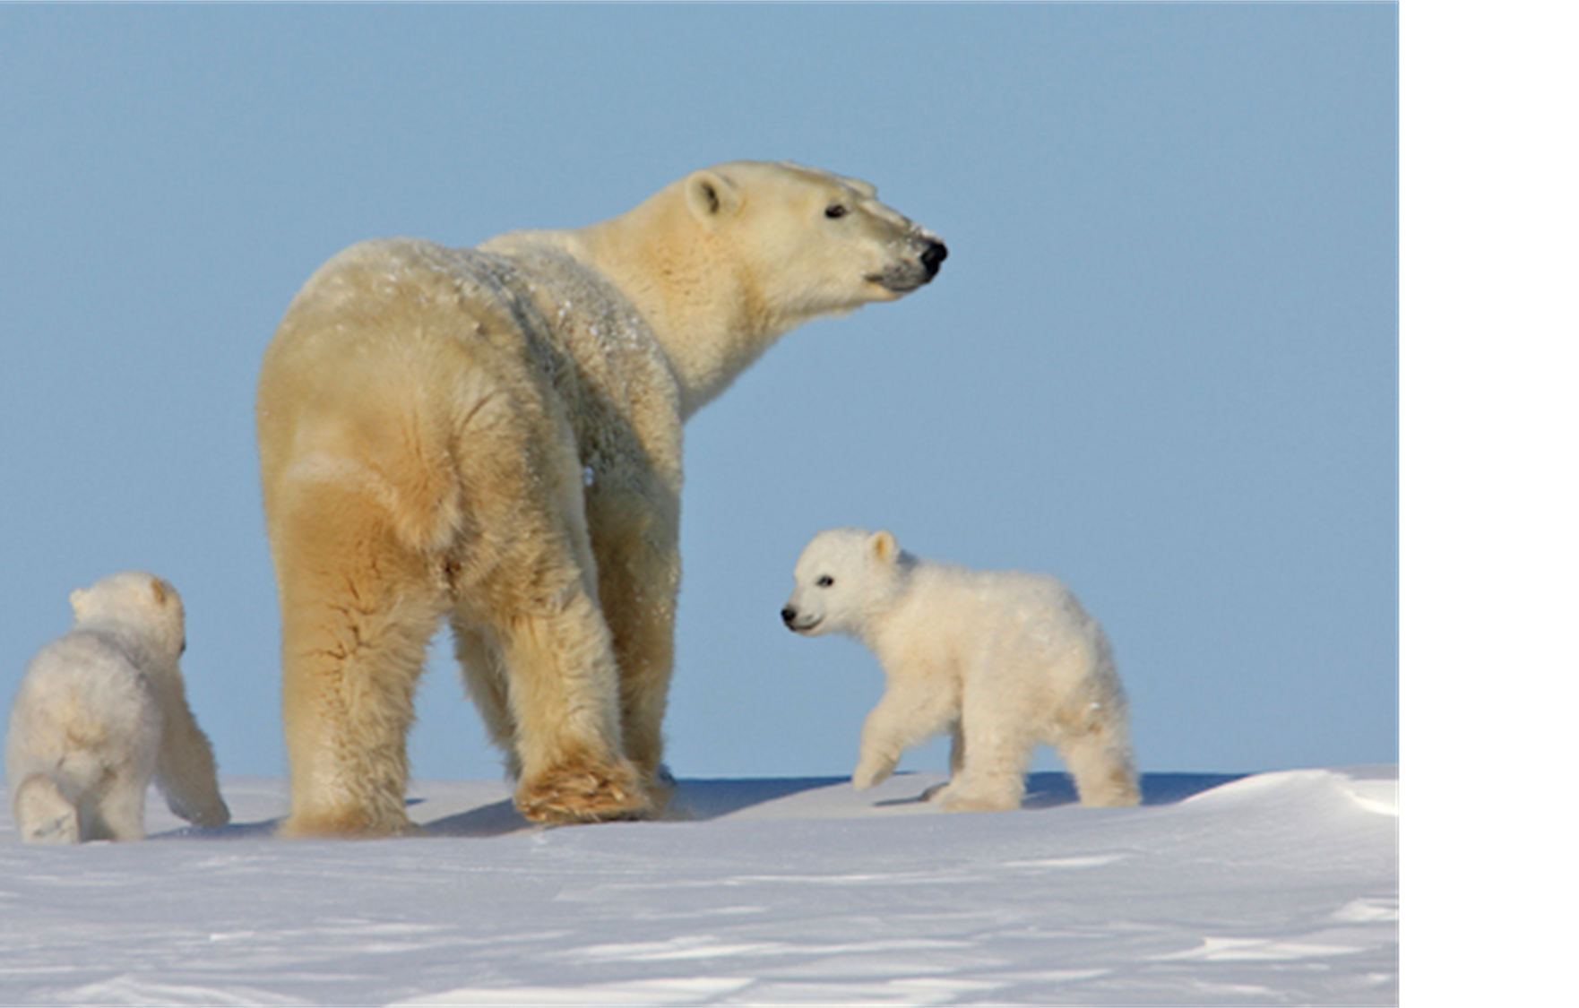
Sources
http://www.123learncurriculum.com/assets/docs/Bears_Everywhere_-_Songs_Poems_and_Fingerplays.91163926.pdf
http://www.lucylearns.com/polar-bear-poem.html
http://bearybearscl.tripod.com/poemsongs.htm
http://www.alphabet-soup.net/dir5/bearsong.html
http://www.canteach.ca/elementary/songspoems19.html
http://allpoetry.com/Bear-In-There
http://trackerbaz.com/gallery/bears/polar-bears/
http://www.blurb.com/user/DaveJenkins
http://loveopium.ru/zhivotnye-2/belye-medvedi-3.html

