Slide 1
Презентация по английскому языку
Предлоги места
Оборот there is /are
Шайдурова Валентина Федоровна
Учитель английского языка
ГБОУ «Школа №106»
Санкт-Петербург
2015

Slide 2
Содержание
Список предлогов
2. Упражнения для практики использования предлогов в речи

Slide 4
on the - на
in the - в
under the – под
next to the – рядом
under the – под
above the – над
behind the – за
around the - вокруг
in the middle of the - в середине
opposite the - напротив

Slide 5
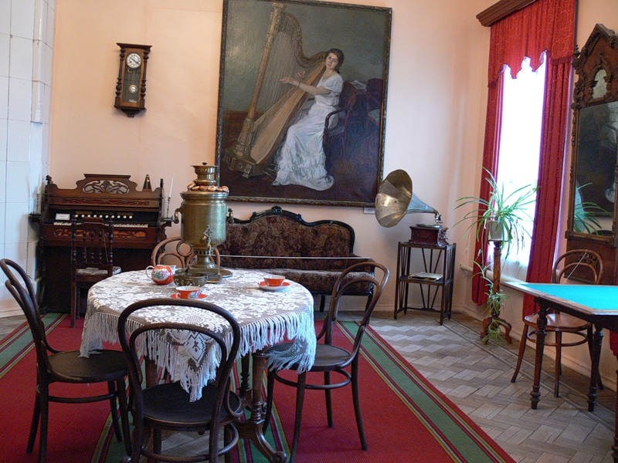
e
a picture
There is a picture on the wall.

Slide 6
a clock
There is a clock above the wall.

Slide 7
a sofa
There is a sofa
between a piano and a window.

Slide 8
a piano
There is a piano next to the door/sofa.

Slide 9
a chair
There is a chair next to the piano.

Slide 10
a table
There is a table
in the middle of the room.

Slide 11
3 chairs
There are 3 chairs around the table.

Slide 12
some cups of tea
There are some cups of tea on the table.

Slide 13
a carpet
There is a carpet on the floor.

Slide 14
Good work!
Thank you!

Slide 15
Sources
http://2berega.spb.ru/club/language/file2/809038/-

