Slide 1
Презентация по английскому языку
«Который час?»
What time is it?
4 класс
Глава 5, УМК М.Биболетова
Шайдурова Валентина Федоровна
учитель английского языка
ГБОУ «Школа №106»
Санкт-Петербург
2015

Slide 2
Содержание
Введение фраз «Который час?»
2.Тренировочные упражнения

Slide 3
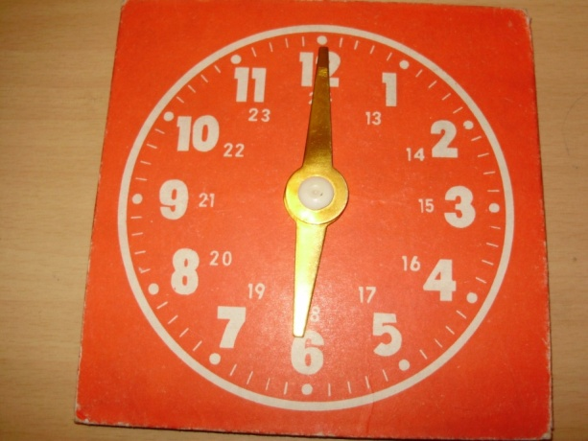
What time is it?
It’s 6 o’clock.

Slide 4
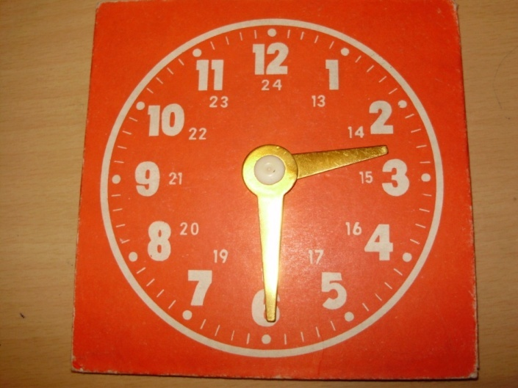
What time is it?
It’s half past two.

Slide 5
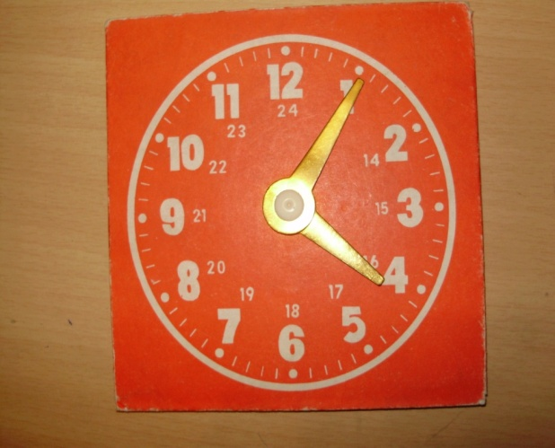
What time is it?
It’s twenty past one.

Slide 6
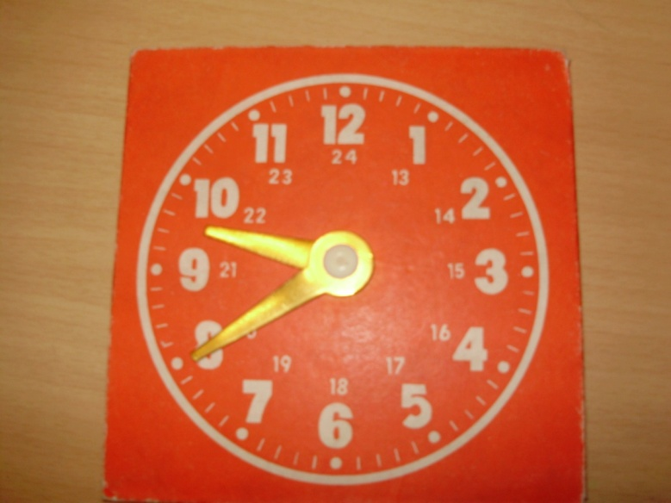
What time is it?
It’s twenty to ten.

Slide 7
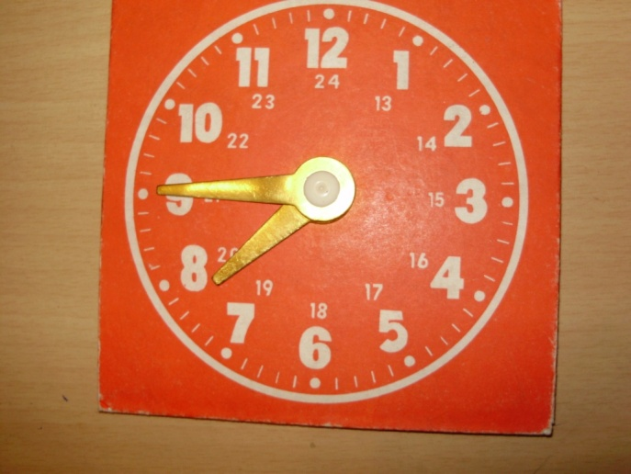
What time is it?
It’s a quarter to eight.

Slide 8
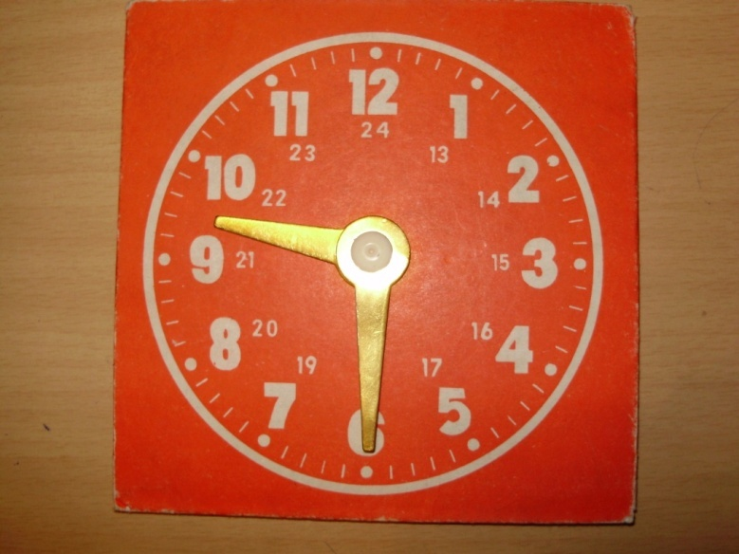
Can you tell me the time, please?
Sure! It’s half past nine.

Slide 9
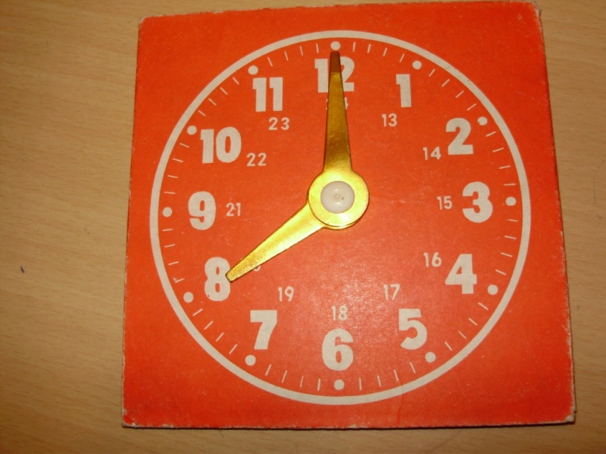
What time is it?
It’s 8 o’clock.

Slide 10
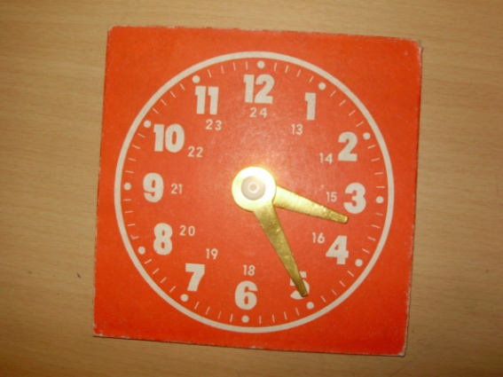
What time is it?
It’s twenty five past three.

Slide 11
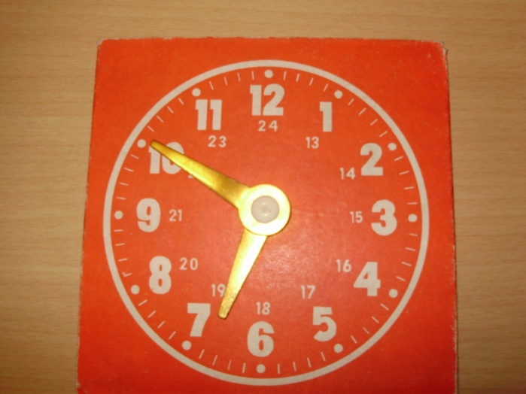
What time is it?
It’s ten to seven.

Slide 12
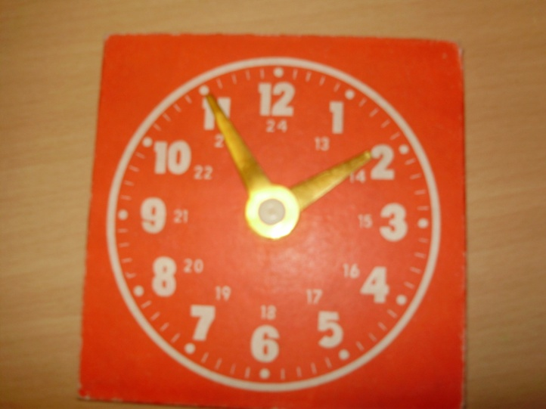
What time is it?
It’s five to two.

Slide 13
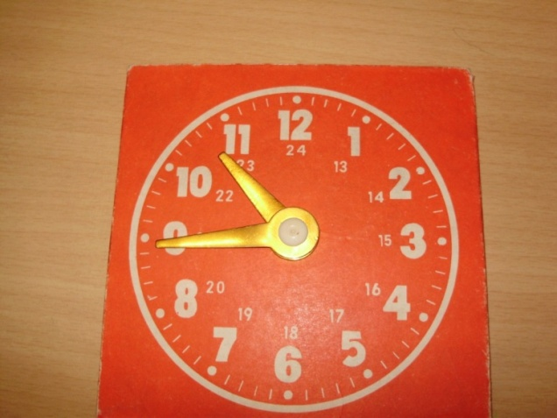
What time is it?
It’s a quarter to eleven.

Slide 14
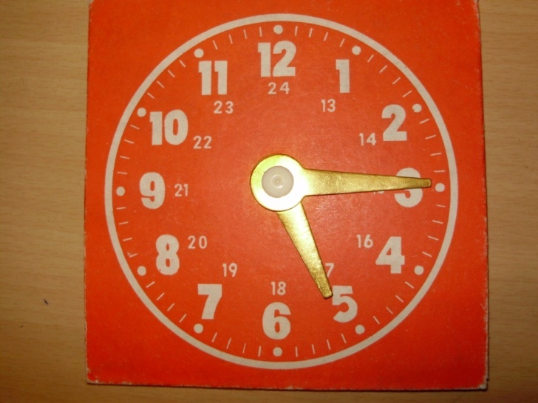
Can you tell me the time, please?
Sure! It’s a quarter past five.

Slide 15
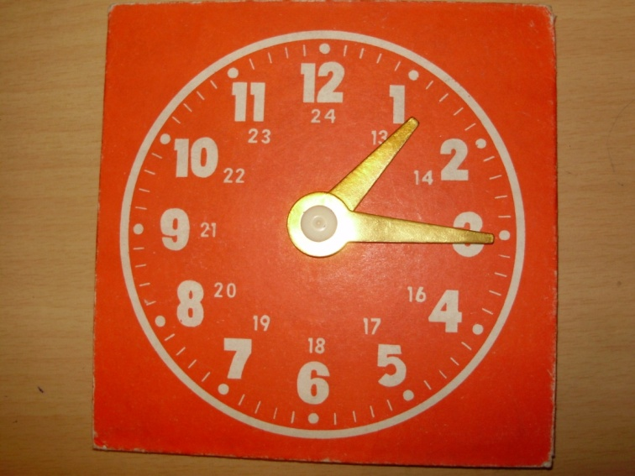
Can you tell me the time, please?
Sure! It’s a quarter past one.

Slide 16
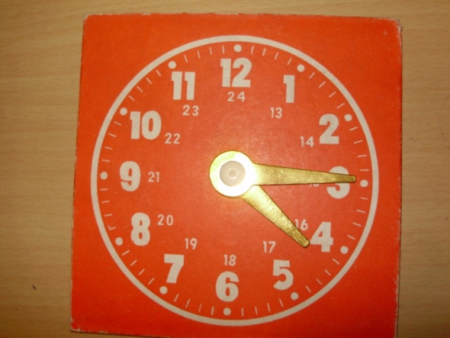
Can you tell me the time, please?
Sure! It’s a quarter past four.

Slide 17
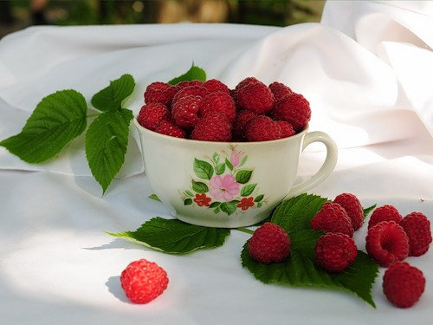
Good work!
Thank you!

