Slide 1
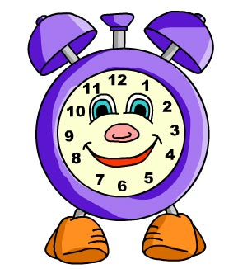
Презентация по английскому языку
Мой режим дня
My Day
4 класс
Глава 5, УМК М.З.Биболетовой
Шайдурова В.Ф.
учитель английского языка
ГБОУ «Школа №106»
Санкт-Петербург
2015

Slide 2
Сontent
Morning
2. Afternoon
3. Evening, night
.

Slide 3
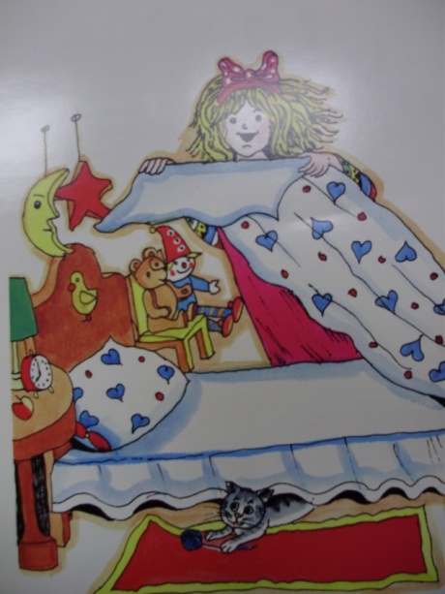
- When do you usually get up?
- I usually get up at 8 am.

Slide 4
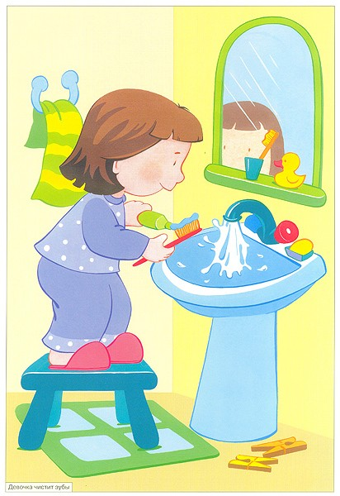
- What do you do then?
- I wash my face and hands.

Slide 5
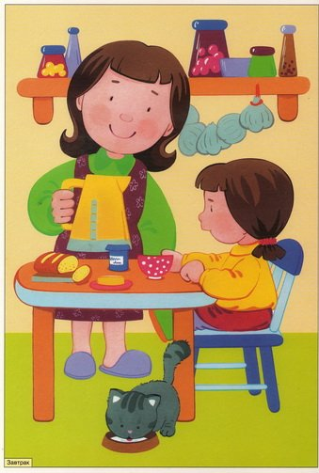
What do you usually do at 8.15 am?
I usually have breakfast at 8.15 am.

Slide 6
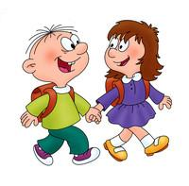
What do you usually do at 8.30 am?
I usually go to school at 8.30 am.

Slide 7
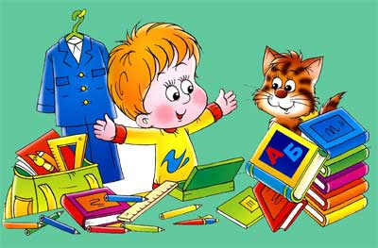
What do you usually do at 2.00 pm?
I usually come home from school at 2.00 pm.

Slide 8
What do you usually do at 10.30 am?
I usually have lunch at 10.30 am.

Slide 9
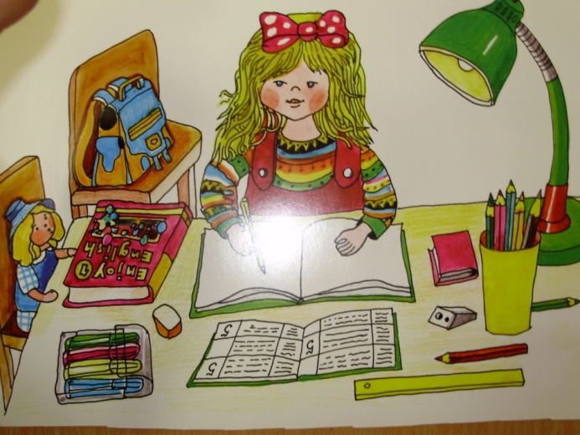
What do you usually do at 4.10 pm?
At 4.10 pm I usually do my homework.

Slide 10
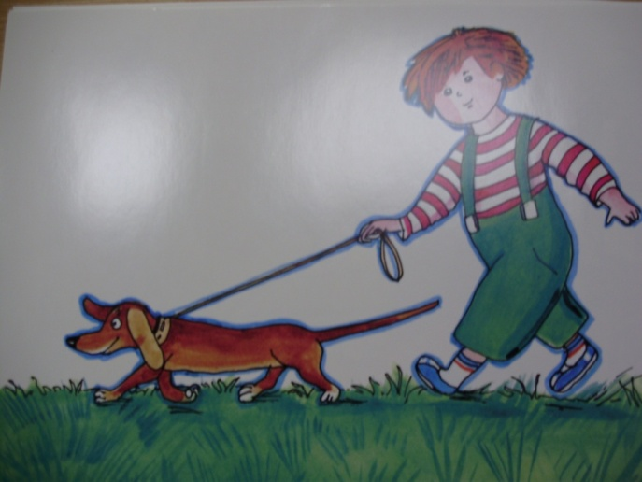
What do you usually do at 5.30 pm?
I usually go for a walk at 5. 30 pm.

Slide 11
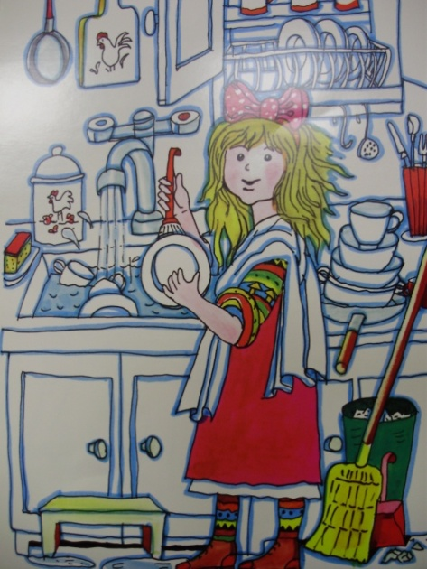
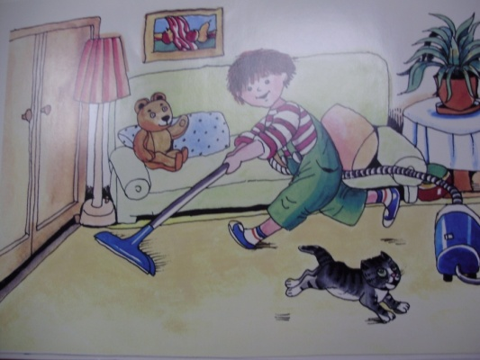
- What do you usually do at 6.15 pm?
- I usually help my Mum about the house at 6.15 pm.

Slide 12
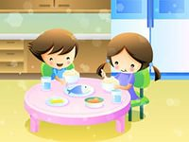
- What do you usually do at 7.10 pm?
- I usually have supper at 7.10 pm.

Slide 13
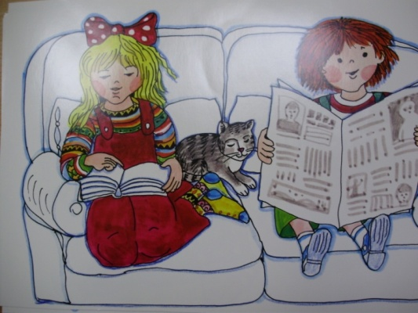
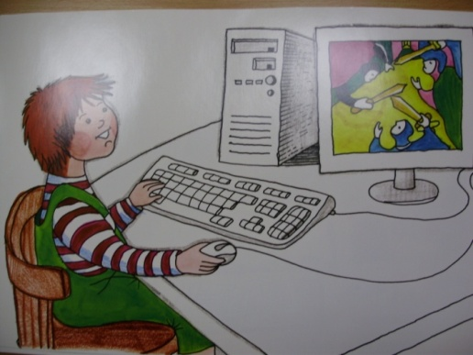
What do you usually do in the evening?
I usually read book or play computer games.

Slide 14
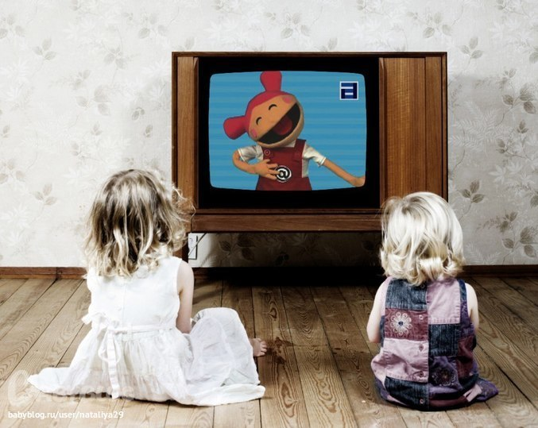
What do you usually do at 8.45 pm?
I usually watch TV at 8.45 pm.

Slide 15
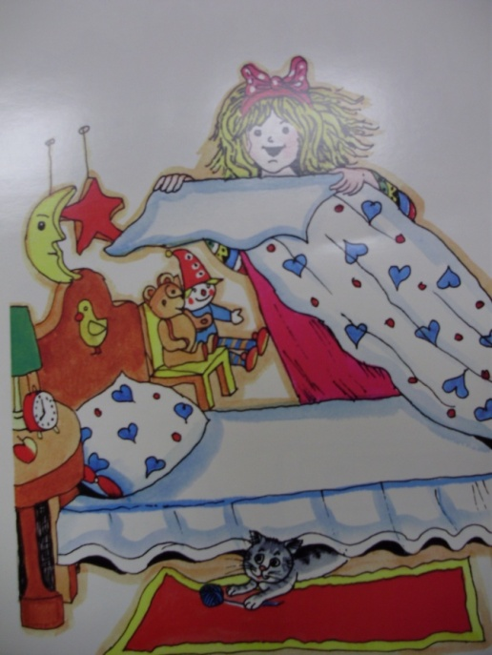
What do you usually do at 10.00 pm?
I usually go to bed at 10.00 pm.

Slide 16
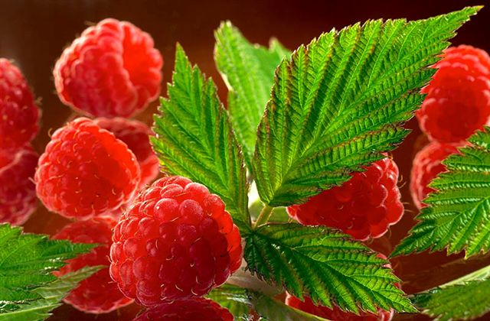
Good work!
Thank you!

Slide 17
http://yandex.ru/images

