Slide 1
Презентация по английскому языку
Настоящее простое время
Present Simple
(утвердительные предложения)
3 класс
Урок 6, УМК М.З. Биболетова
Шайдурова Валентина Федоровна
Учитель английского языка
ГБОУ «Школа №106»
Санкт-Петербург
2015

Slide 2
Remember!
I
You like to V
We
They
V

Slide 3
Remember!
He
She
It
likes to
V

Slide 4
I ride a bike
You like to live on a farm
We skate in the park
They sing at home
run in the park
Make up sentences, please

Slide 5
Make up sentences, please
He ride a bike
She likes to live on a farm
It skate in the park
sing at home
run in the park

Slide 6
Make up sentences, please
I
You ride a bike
He live on a farm
She like to skate in the park
It likes to sing at home
We run in the park
They

Slide 7
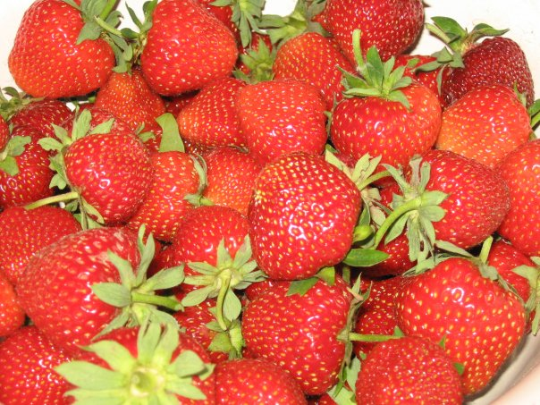
Good Work!
Thank you!

