Slide 1
Презентация по английскому языку
Введение лексики по теме
«Овощи и фрукты»
3 класс
Урок 7 Умк М.З. Биболетова
Шайдурова Валентина Федоровна
Учитель английского языка
ГБОУ «Школа №106»
Санкт-Петербург
2015

Slide 2
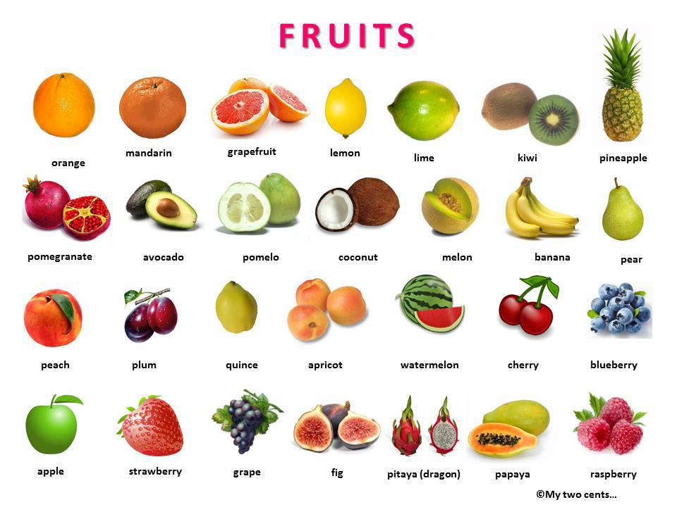
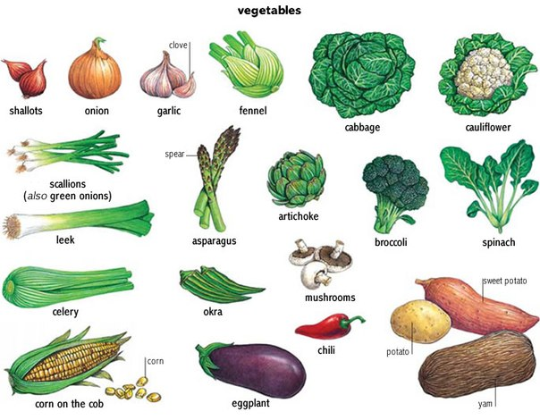
Content
Vegetables
2. Fruits
3. Berries

Slide 3
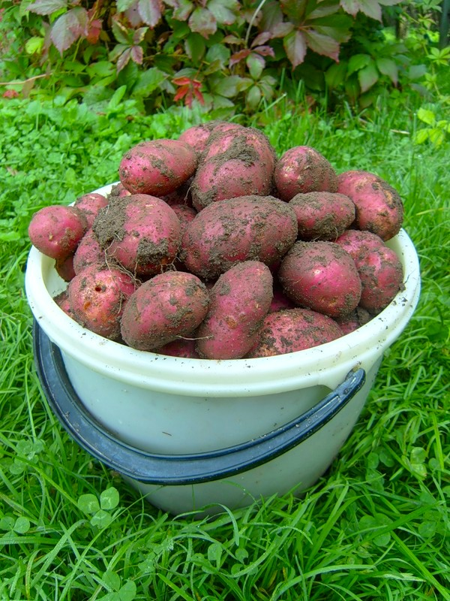
a potato
a lot of potatoes

Slide 4
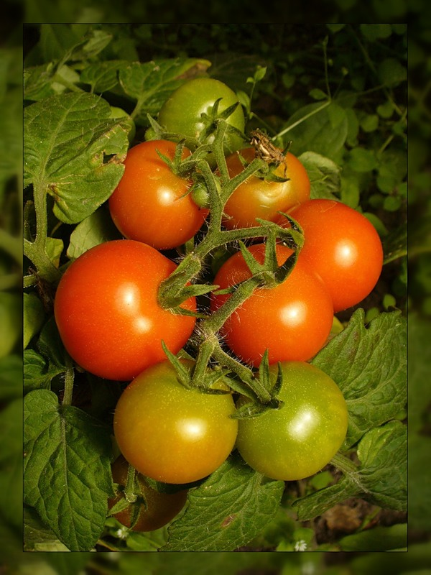
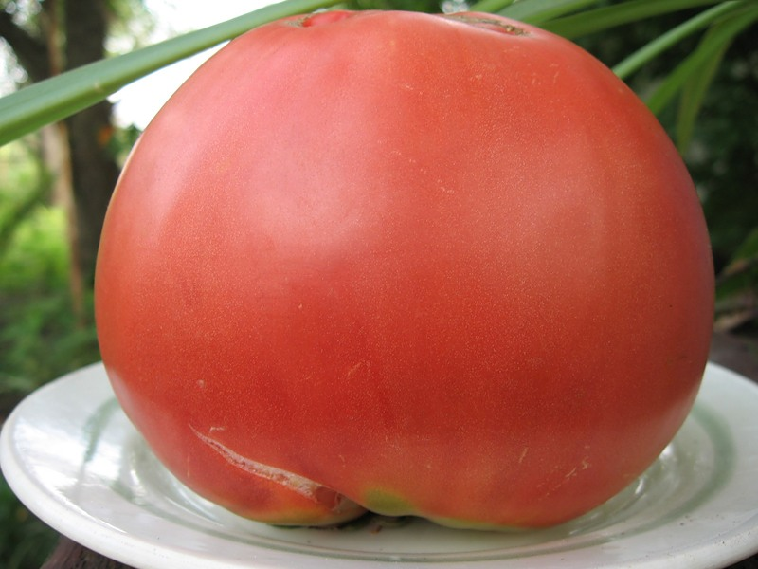
a tomato
many tomatoes

Slide 5
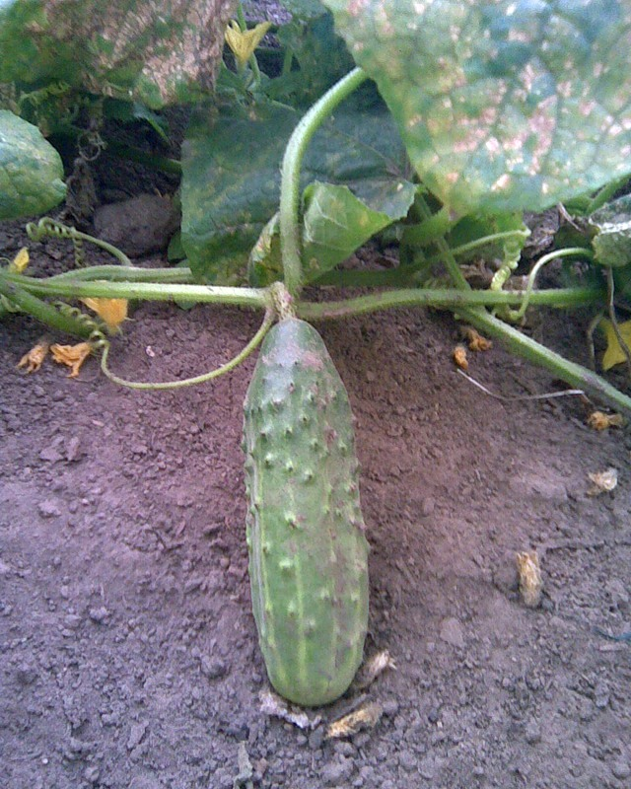
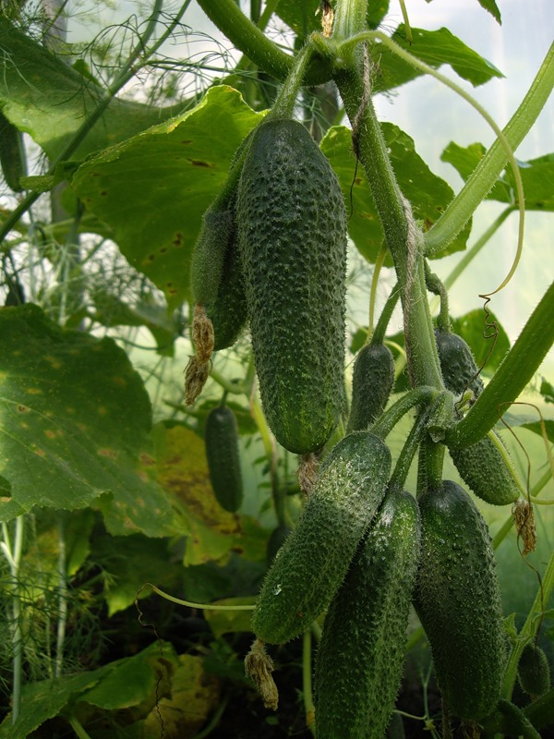
a cucumber many cucumbers

Slide 6
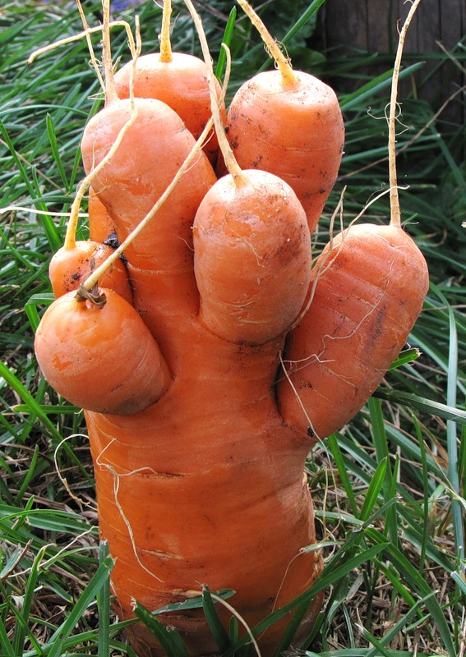
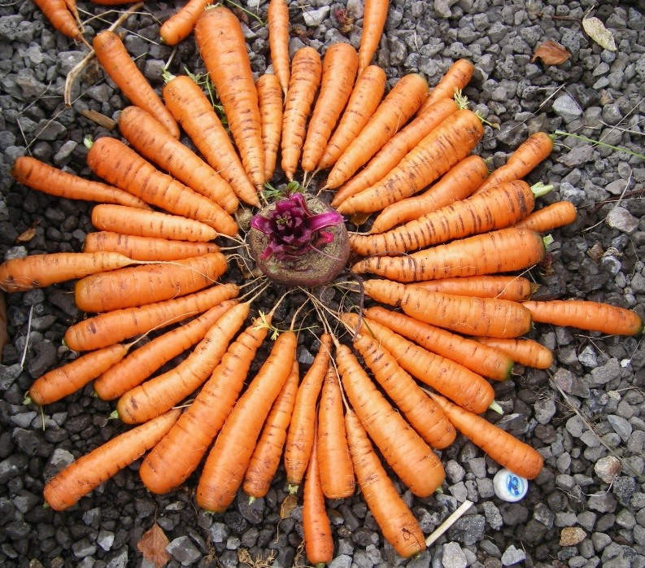
a carrot
a lot of carrots

Slide 7
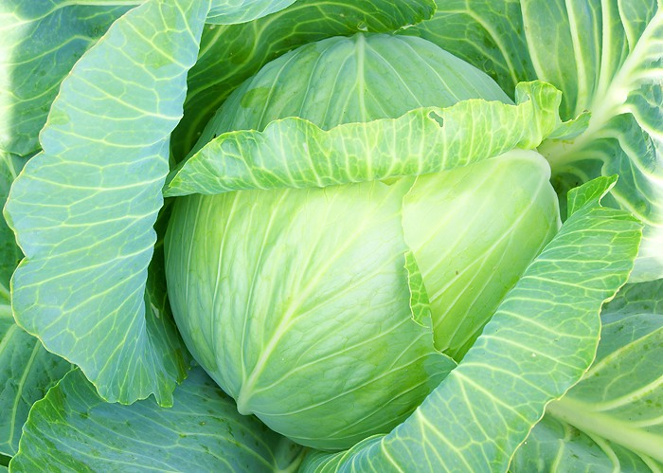
cabbage

Slide 8
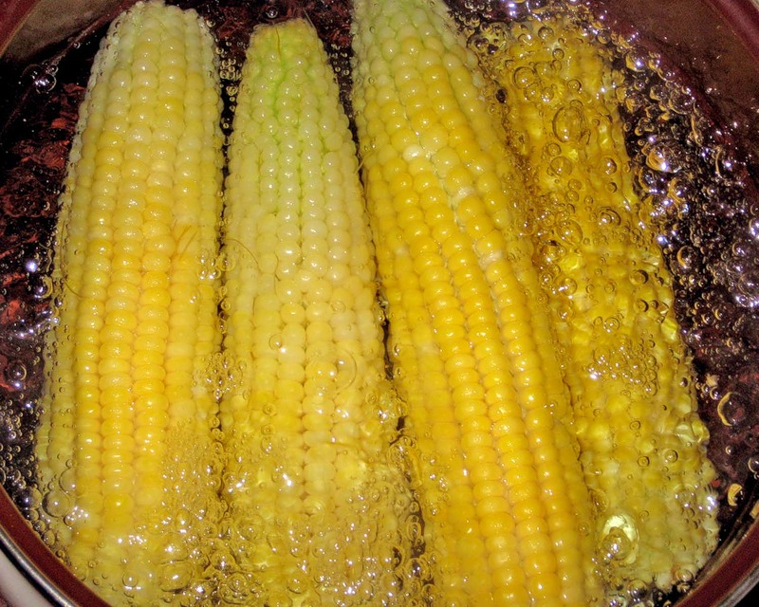
corn

Slide 9
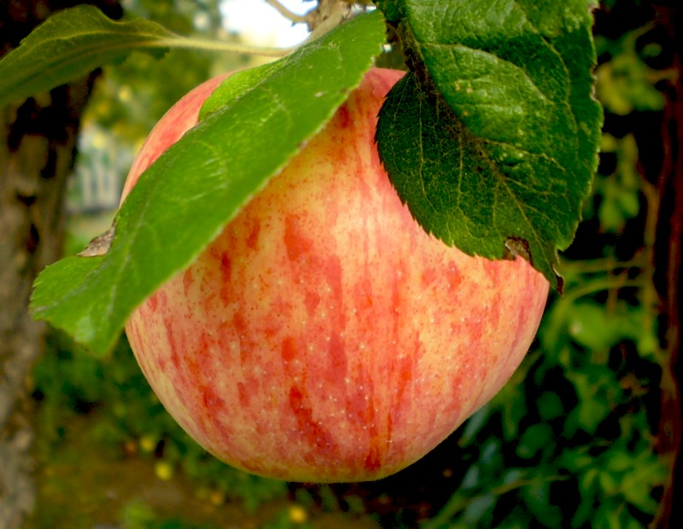
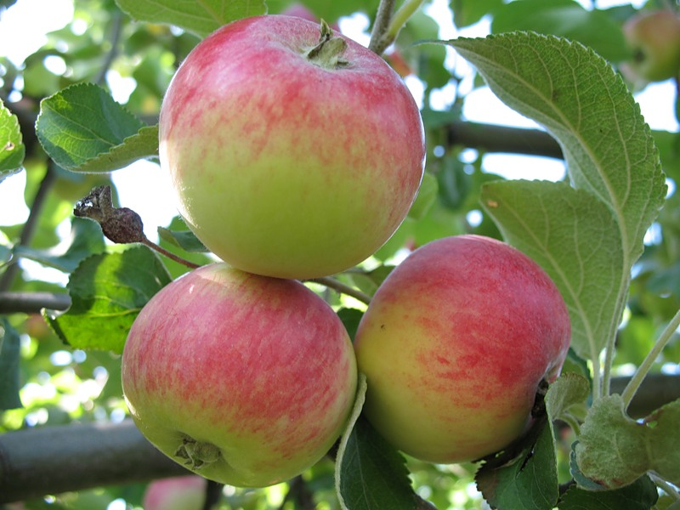
an apple
three apples

Slide 10
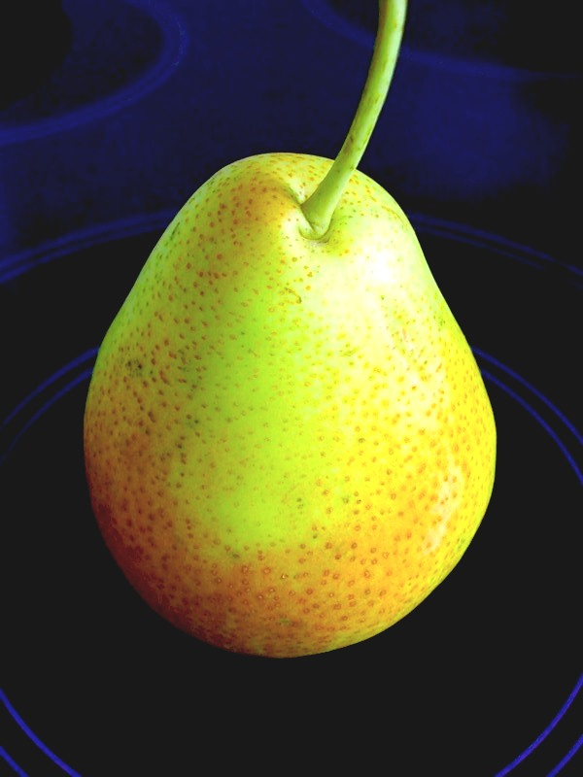
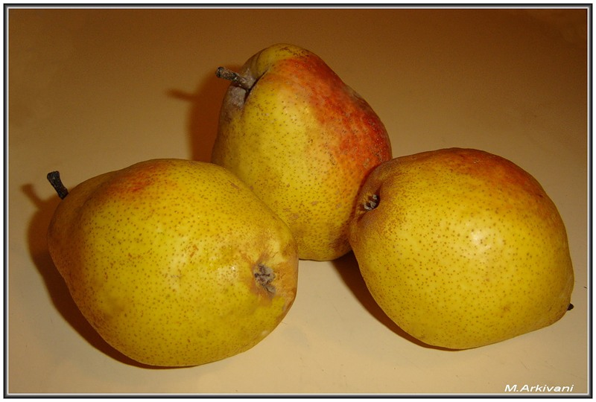
a pear
three pears

Slide 11
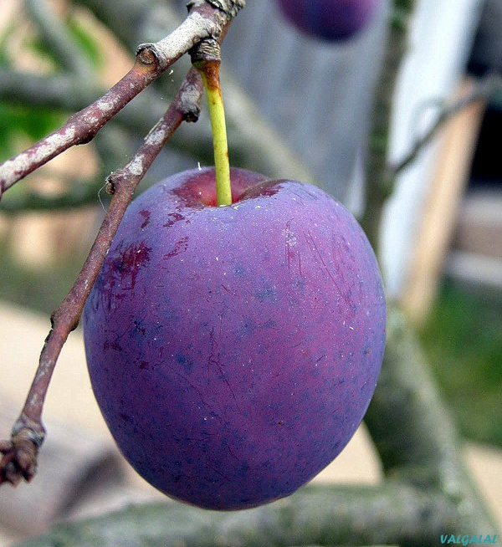
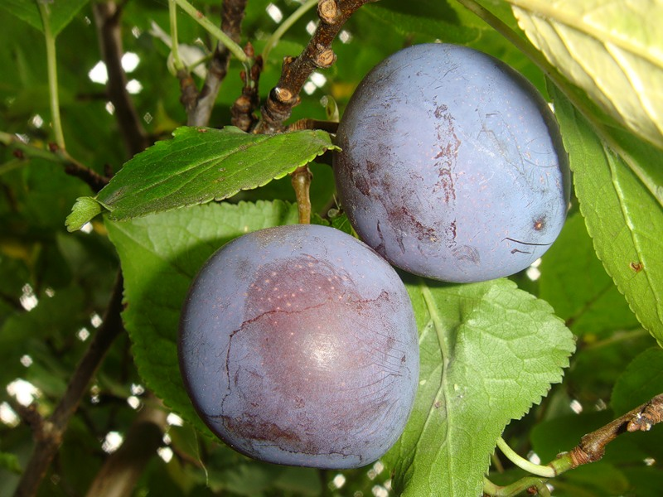
a plump
two plumps

Slide 12
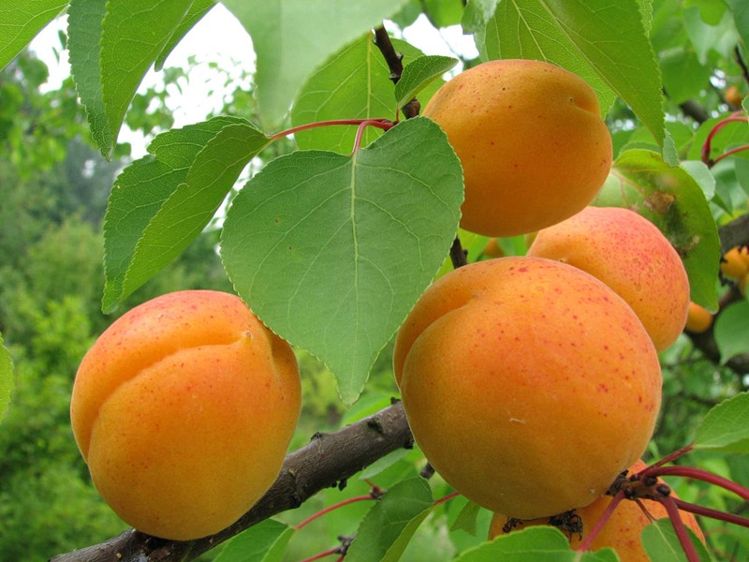
four apricots

Slide 13
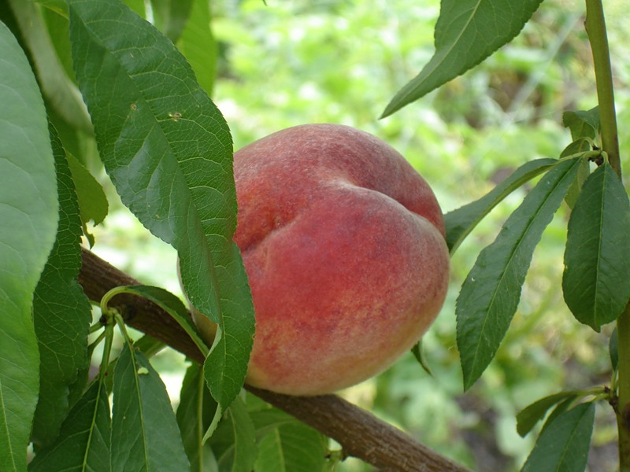
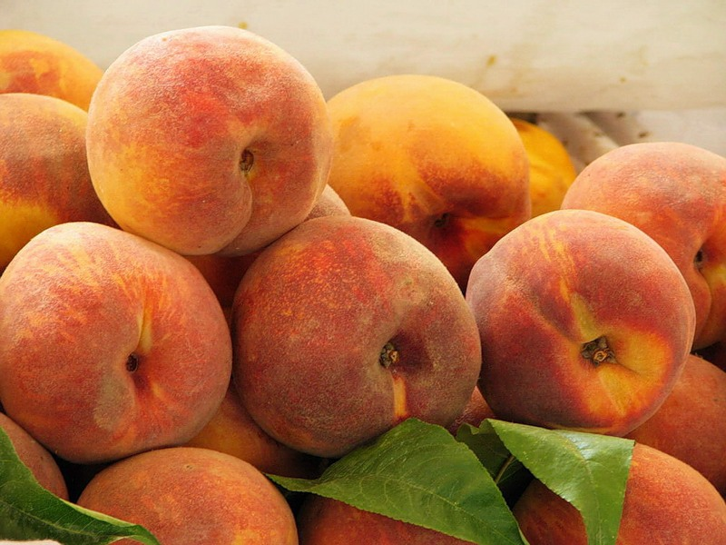
a peach
a lot of peaches

Slide 14
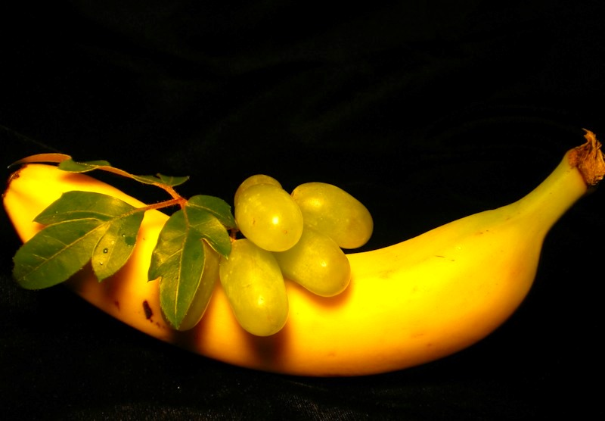
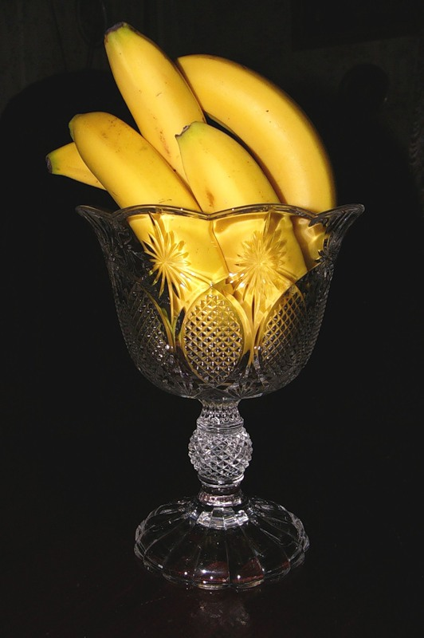
a banana
some bananas

Slide 15
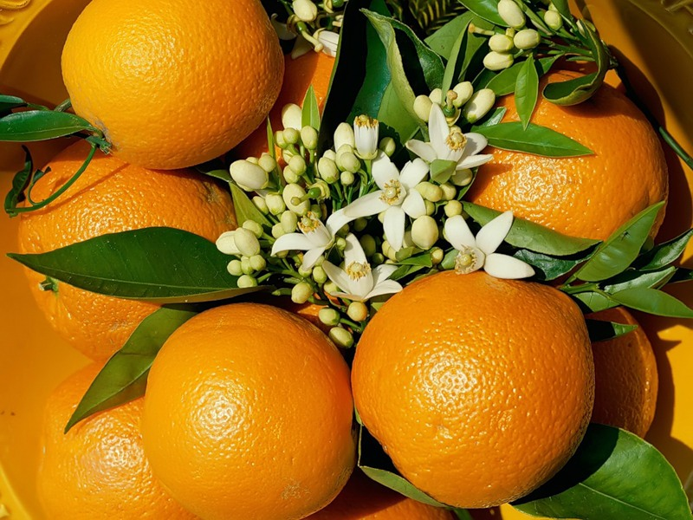
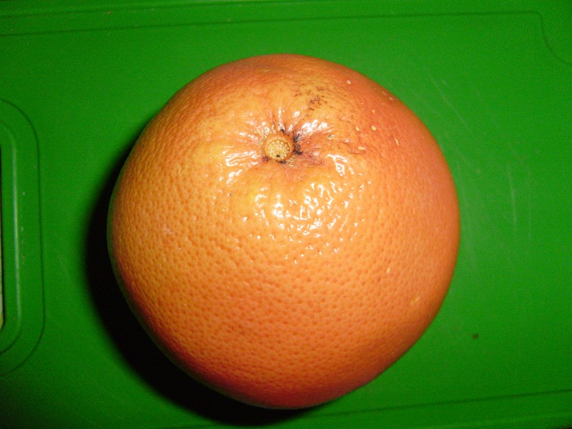
an orange
many oranges

Slide 16
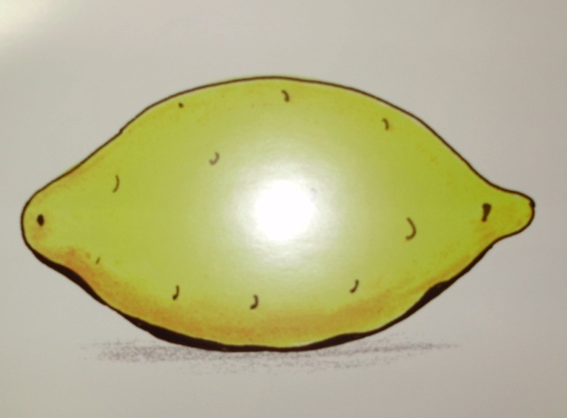
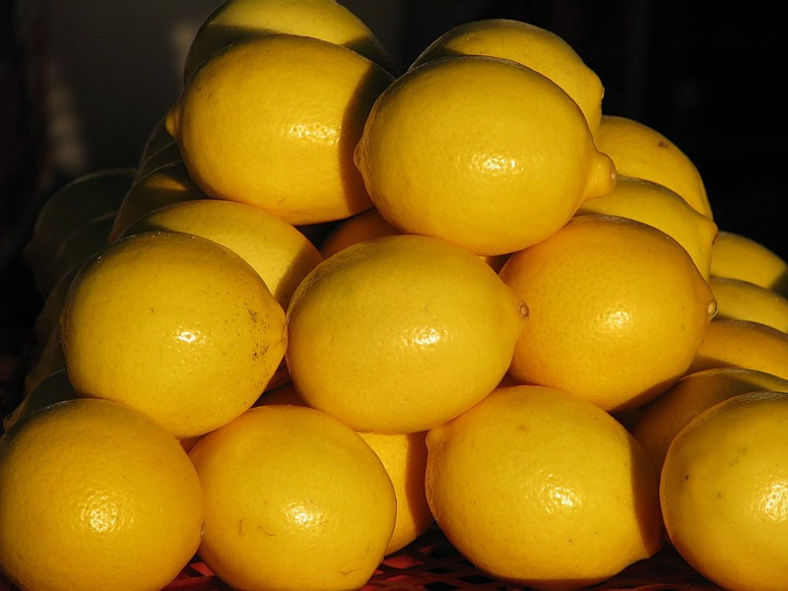
a lemon
a lot of lemons

Slide 17
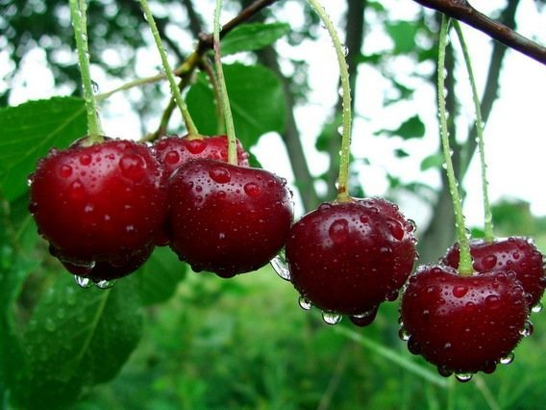
some cherries

Slide 18
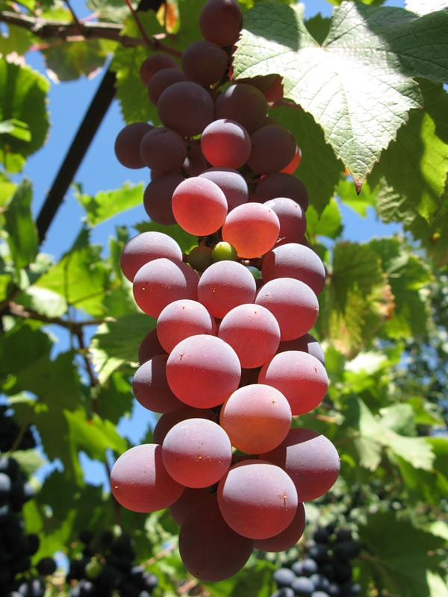
some grapes

Slide 19
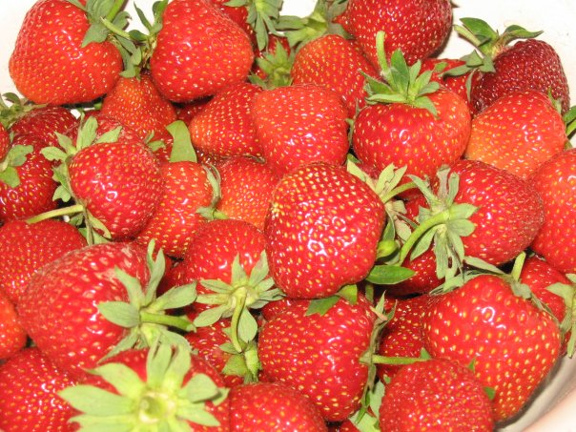
strawberries

Slide 20
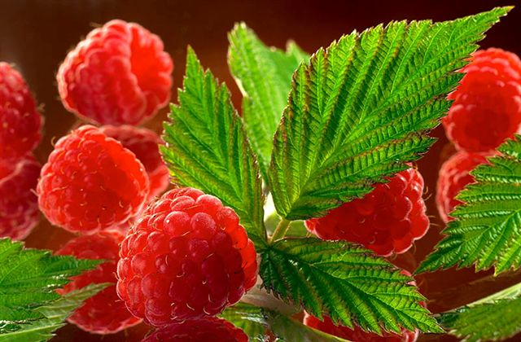
raspberries

Slide 21
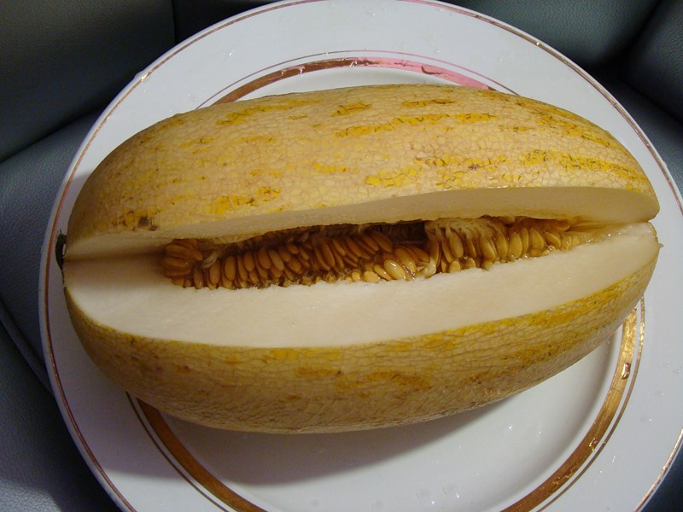
a melon

Slide 22
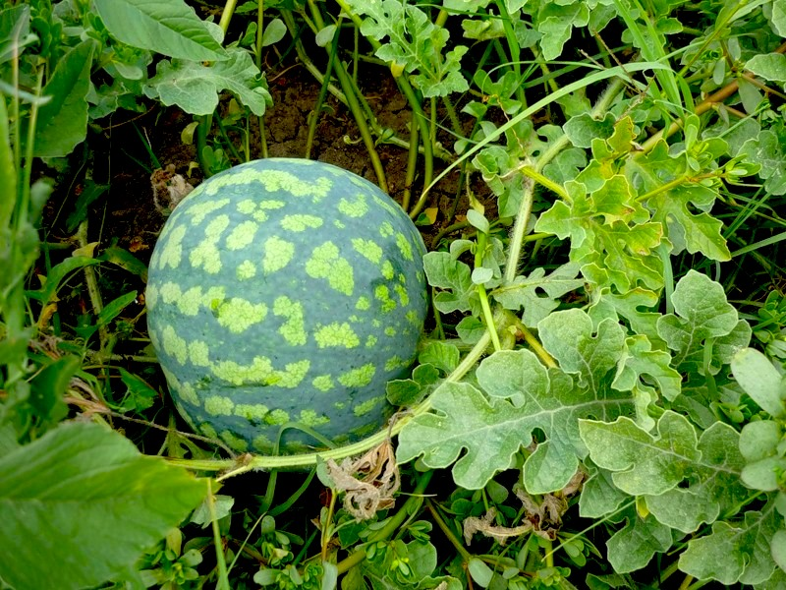
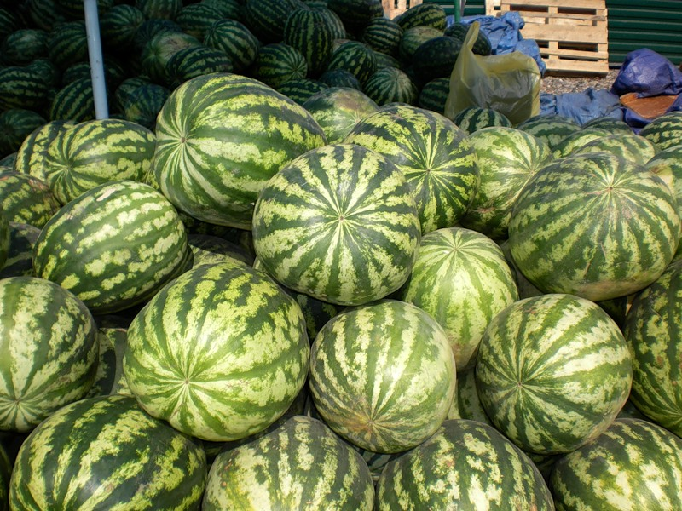
water-melons
a water-melon

Slide 23
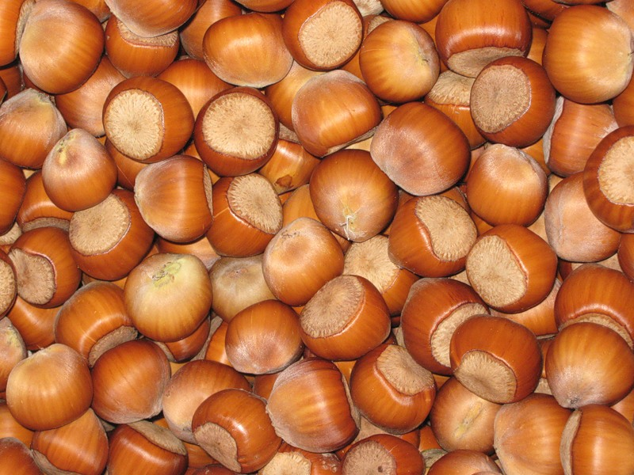
nuts

Slide 24
Tomatoes, carrots, cabbage, nuts, potatoes, corn, apples,
water-melon, apricots, peaches, plumps

Slide 25
Name the fruits!

Slide 26
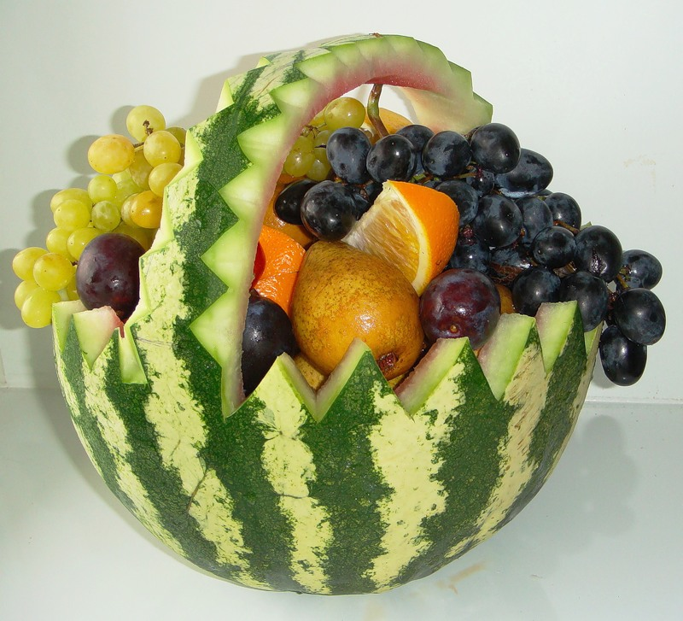
Name the fruits!

Slide 27
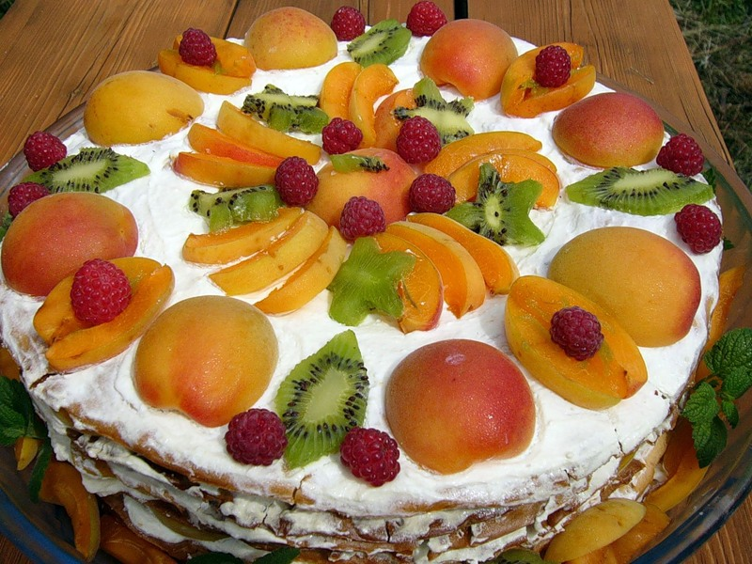
Good Work!
Thank you!

