Slide 1
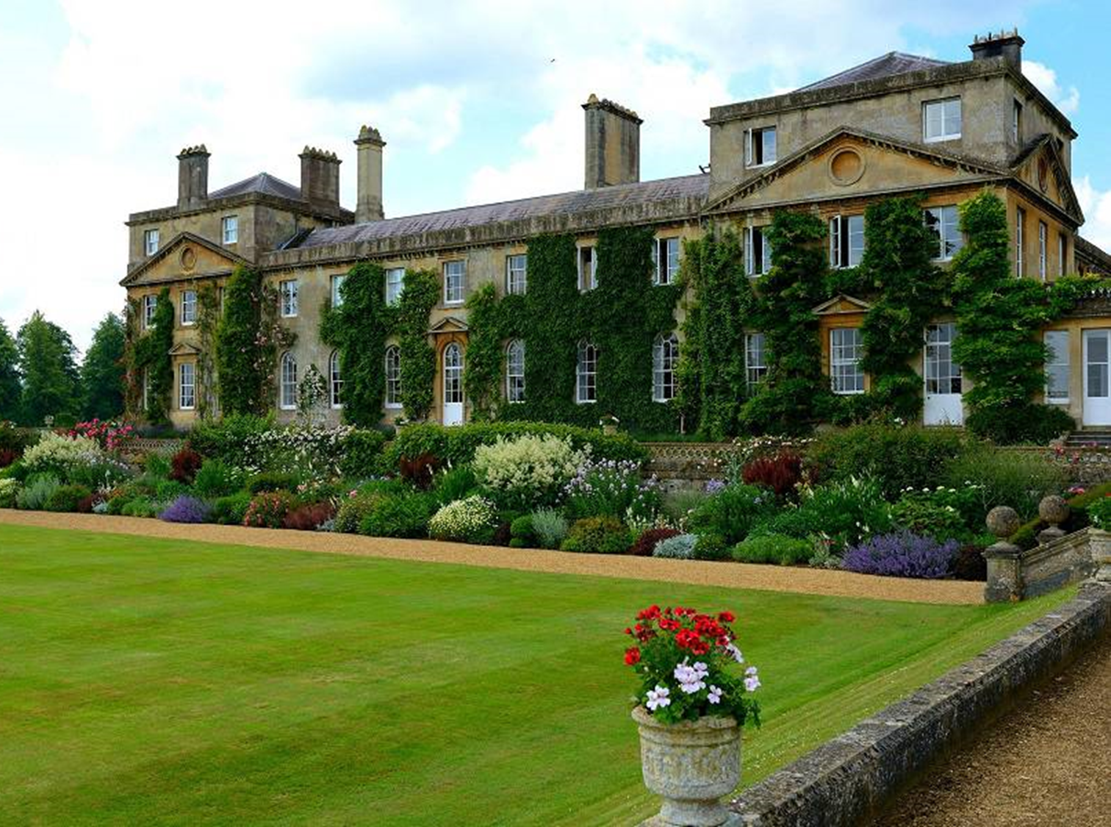
Welcome to Bowood!
Виртуальная экскурсия
для7-11 классов
Автор:
О.М. Степанова
Учитель английского языка МБОУ «Цивильская СОШ №2»
города Цивильск
Чувашской Республики
2015

Slide 2
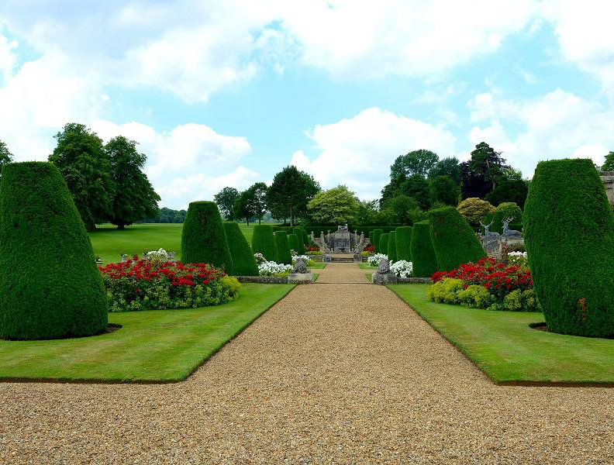
Always dreamt of a garden that's inviting, inspiring and relaxing?
To make it a reality, visit Bowood!

Slide 3
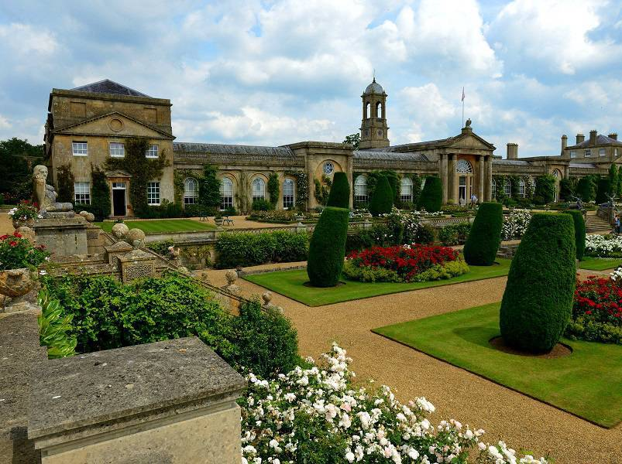
Set in the heart of the beautiful Wiltshire countryside is the Bowood Estate.

Slide 4
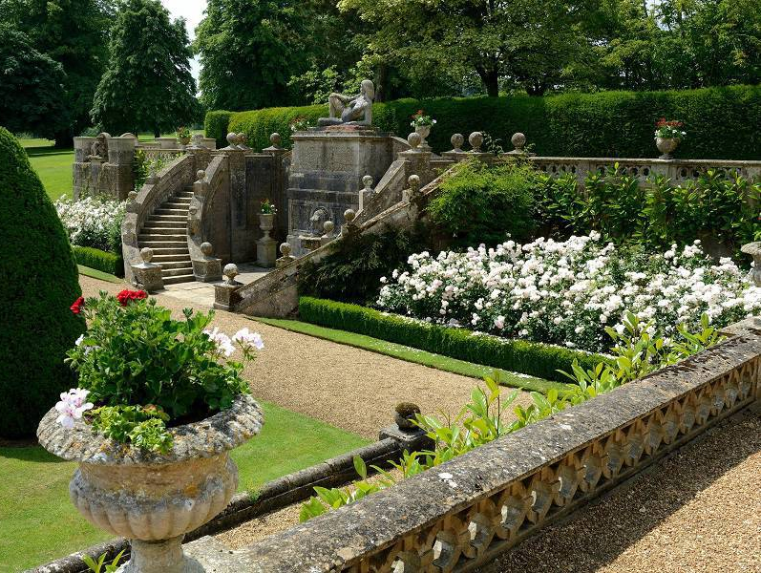
As with nearby Longleat, the grounds at Bowood were designed and sculpted by Lancelot 'Capability' Brown, the famous 18th Century landscape gardener.

Slide 5
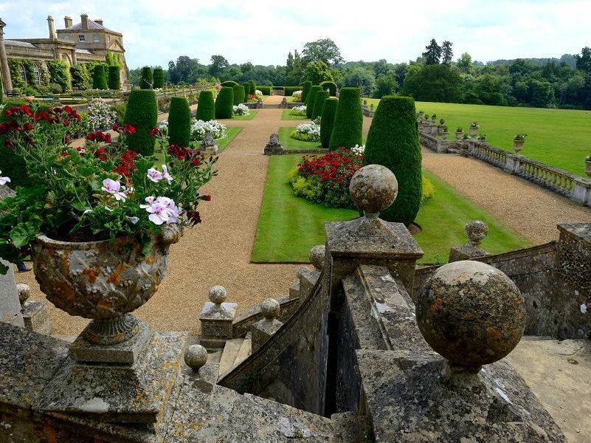
Set in 100 acres of beautiful parkland,
Bowood House & Gardens in Wiltshire, is a great day out for all the family.

Slide 6
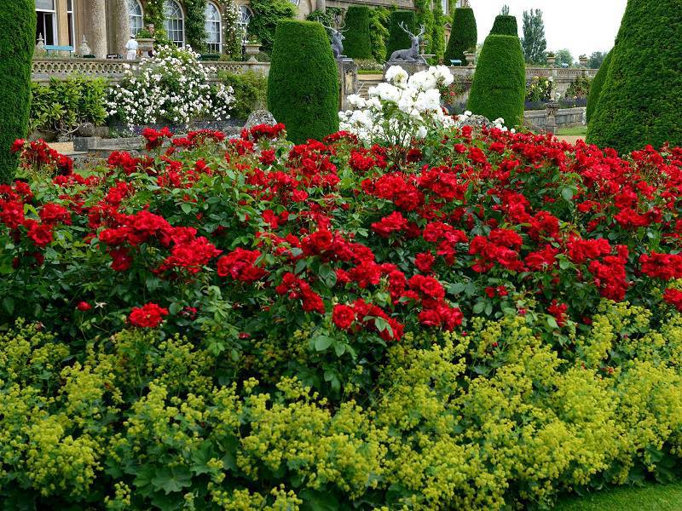
Welcome to Bowood House & Gardens, home of the Marquis and Maarchioness Lansdowne. Bowood offers a fantastic day out in Wiltshire for all the family. Famous for one of the UK’s most extensive Adventure Playgrounds, children are guaranteed the time of their lives. Younger children will enjoy meeting friendly farm animals at Tractor Ted’s Little Farm and undercover fun in the Soft Play Area.

Slide 7
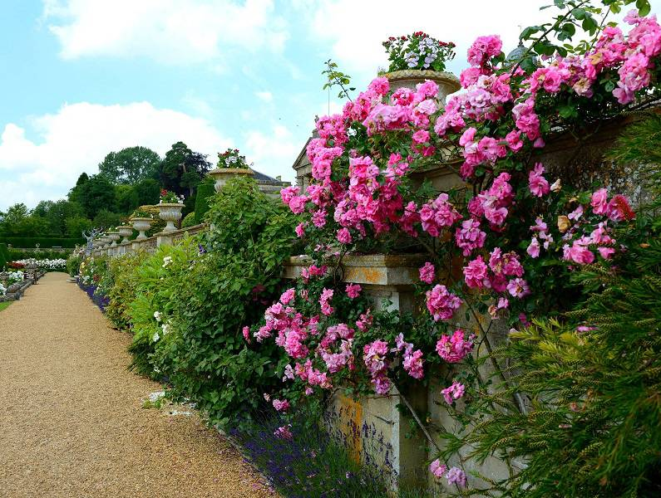
Hidden away, deep within the rolling, unspoiled countryside of Wiltshire lies the Bowood Estate.

Slide 8
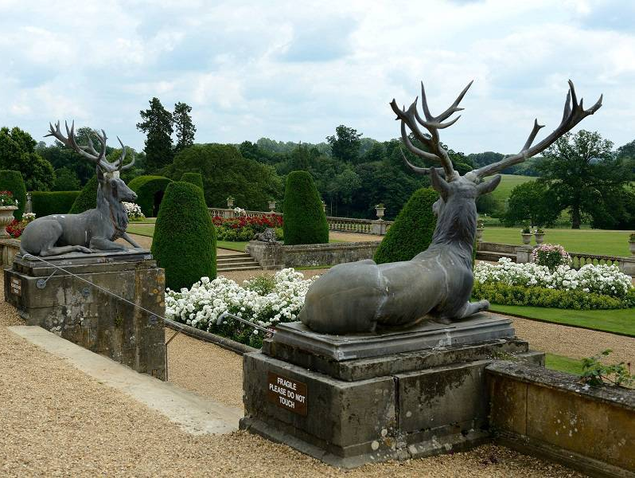
The whole family can relax in 100 acres of beautiful parkland, designed by ‘Capability’ Brown, offering a lake, arboretum, pinetum and cascade.
Perfect for walks and exploring.

Slide 9
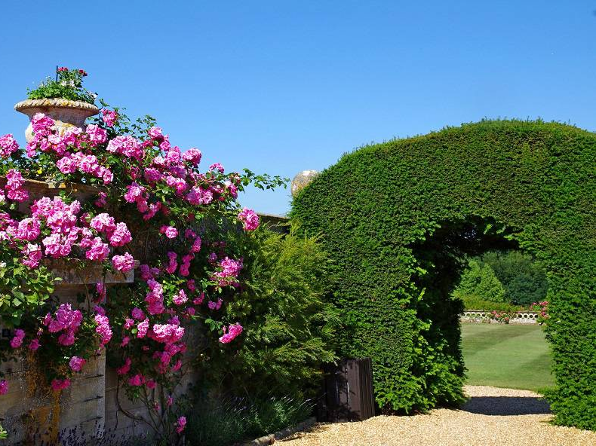
For those wishing to escape into an oasis of outstanding natural beauty, the “Capability” Brown grounds, designed in 1762, offer a soothing retreat from the modern world boasting an extensive arboretum and pinetum, including 11 champion trees with a further 700 trees identified and labelled within the grounds and are the gardens to visit in Wiltshire.

Slide 10
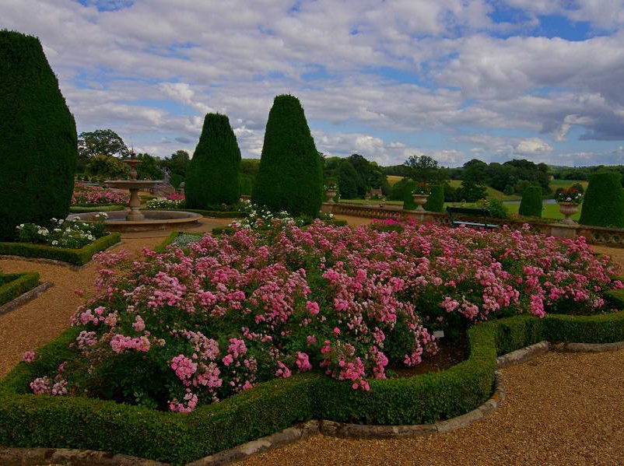
Imagine immaculate lawns , stretching through the arboretum and down towards the majestic lake. Spectacular flowers adorning the terraces and in the long borders surrounding Bowood House.

Slide 11
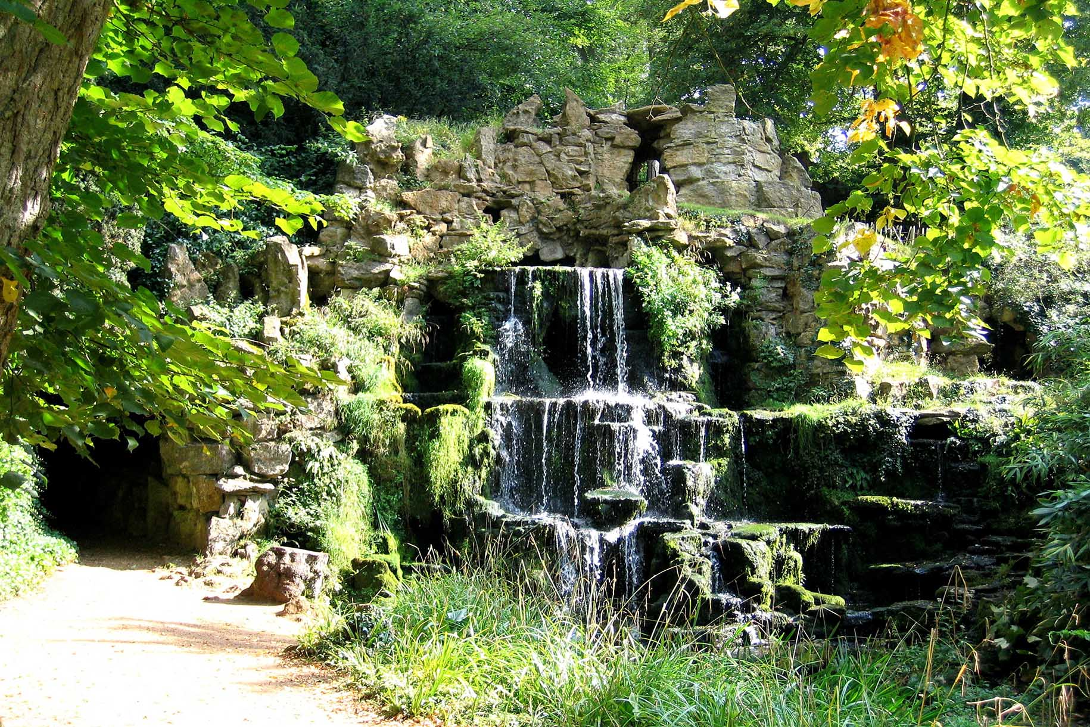
Central to the design of the park is Brown’s great lake, almost a mile long, winding sinuously like an enormous river. The outflow is channelled through a series of aqueducts which feed Hamilton’s Cascade, constructed fifteen years after the completion of the park.
A stunning torrent of white water falls 30ft over an outcrop of rocks which never ceases to amaze old and young alike. Set at the head of the small promontory is the Doric temple.

Slide 12
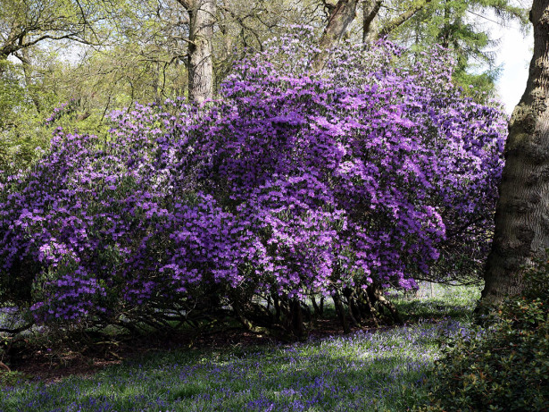
Bowood Gardens in Wiltshire is home to a wide variety of speciality gardens, making for the perfect day out in Wiltshire for horticultural lovers. A special treat includes scheduled monthly Exclusive Tours of the Private Walled Gardens.

Slide 13
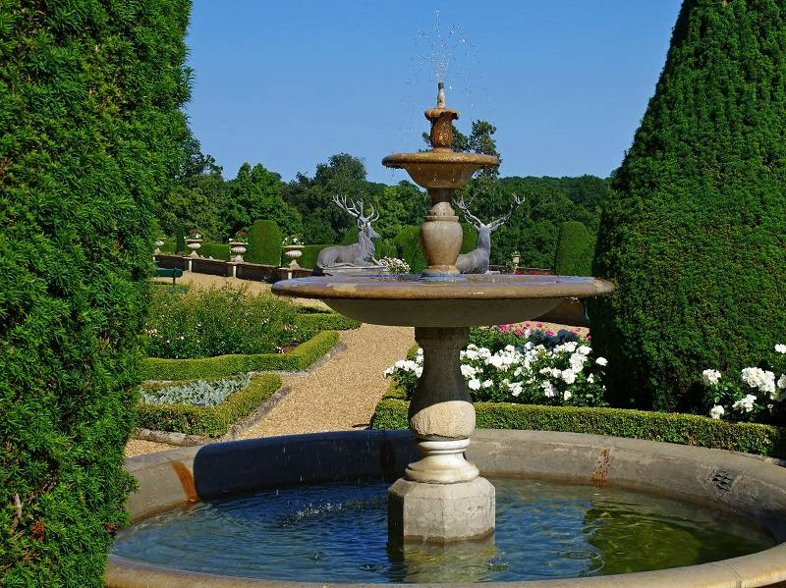
The Bowood Gardens are one of the special glories of Bowood and an ideal day out in Wiltshire, encompassing almost every period of English garden design from the early Georgian period onwards.
Enjoy a hot tea and coffee at The Temple Gate Coffee Shop after soaking up all the Estate’s history.

Slide 14
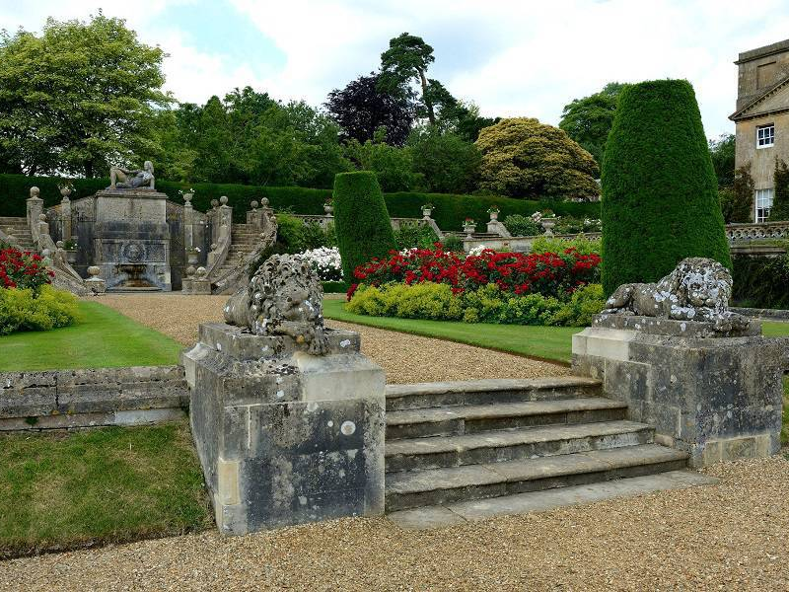
Bowood’s magnificent stately home stands within one of ‘Capability’ Brown’s most beautiful parks, with gently sloping lawns stretching down to the lake and distant views to the chalk downlands.
Delights within the park include the Cascade, Doric Temple, Terrace Gardens, Rhododendrons Walks and for children, the fantastic Adventure Playground.

Slide 15
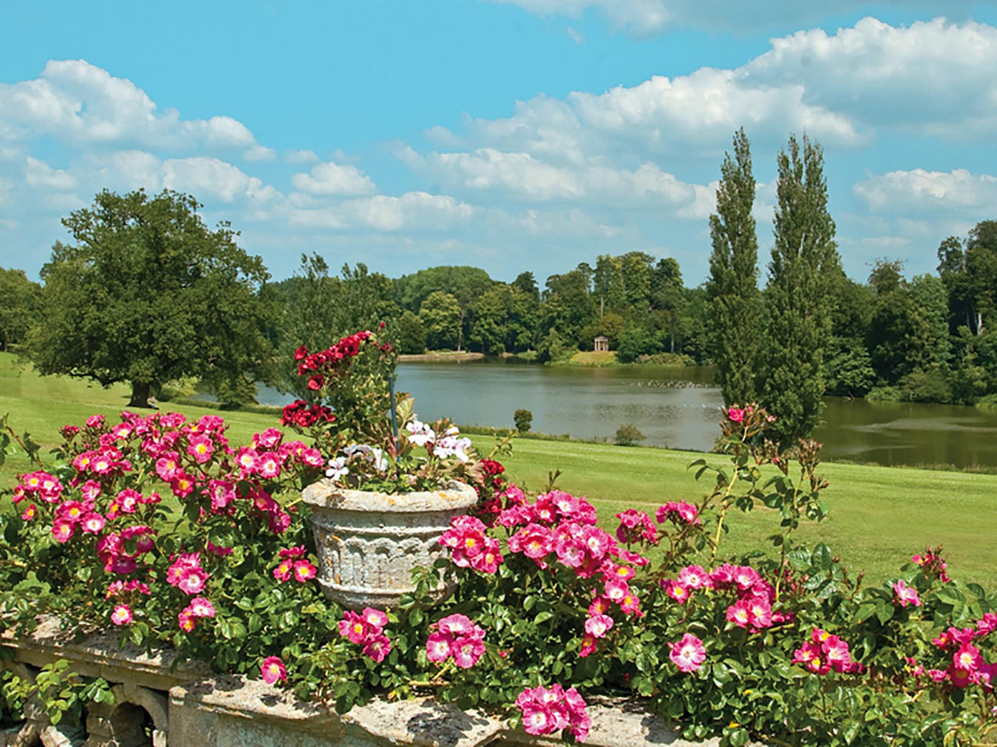
Near the lake is another testament to Capability Brown's work, the romantic Cascade Waterfall which has been used a filming location for a number of TV productions including Robin of Sherwood.

Slide 16
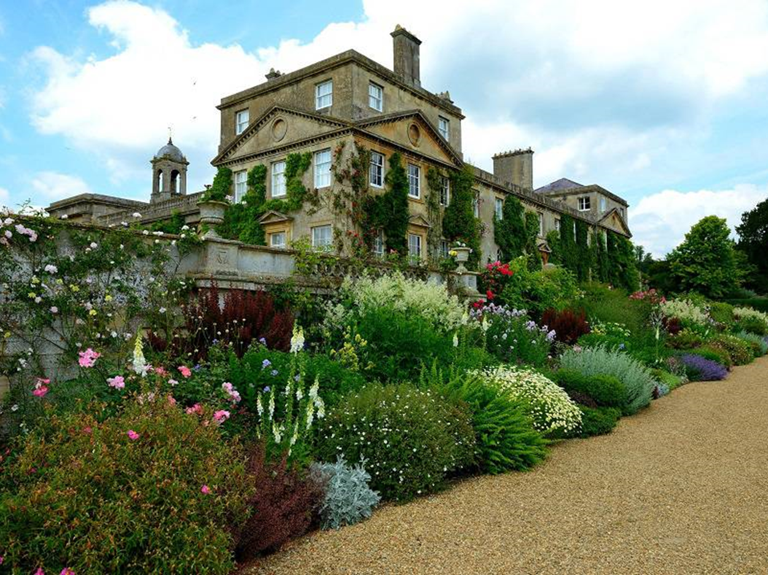
Between late April and early June you can visit the Rhododendron Walks.
Situated in a 60 acre garden on a separate part of the estate, this woodland garden of azalaeas and rhododendrons is considered to be one of the most beautiful gardens of its type in the country.

Slide 17
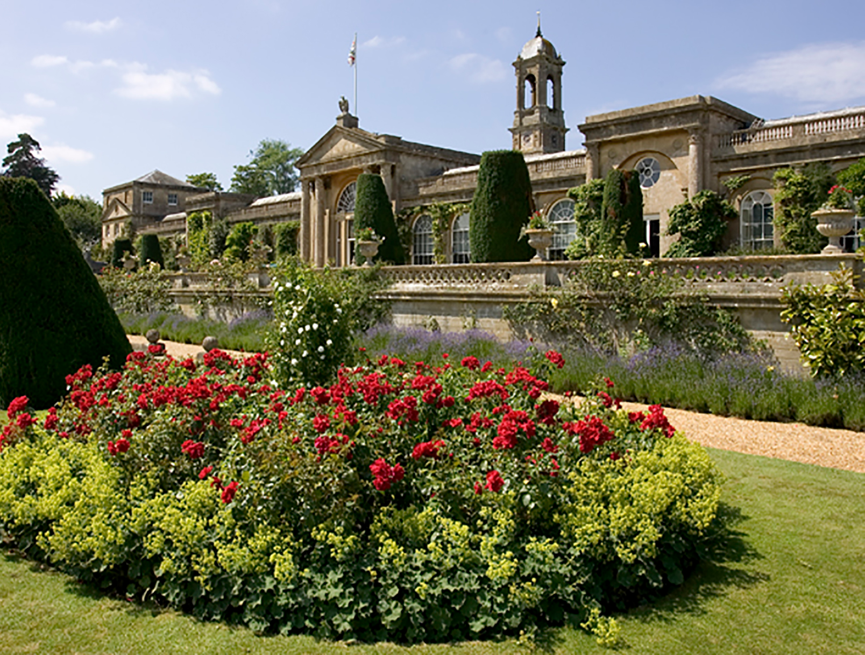
There is also plenty to keep the attention of children at Bowood. The estate boasts one of the best adventure playgrounds in the country.
Find a life-size pirate ship complete with rigging and a crows nest as well as a 'space dive' which features giant slides, chutes, trampolines and high-level rope walks.

Slide 18
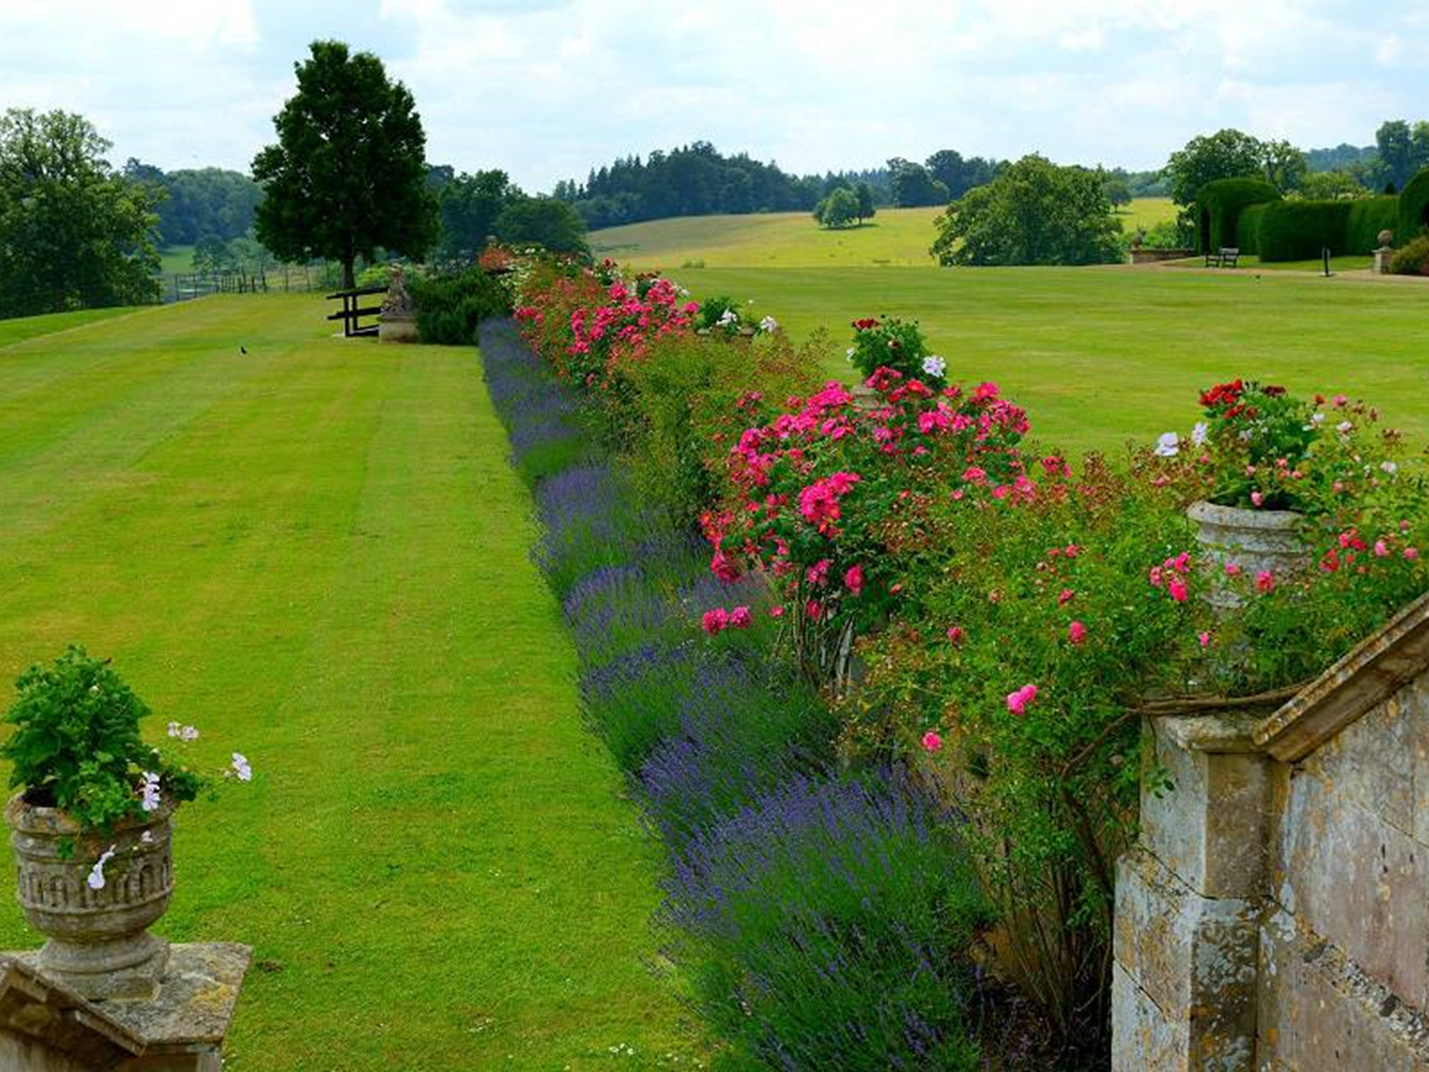
This is the place for those wishing to escape into an oasis of outstanding natural beauty

Slide 19
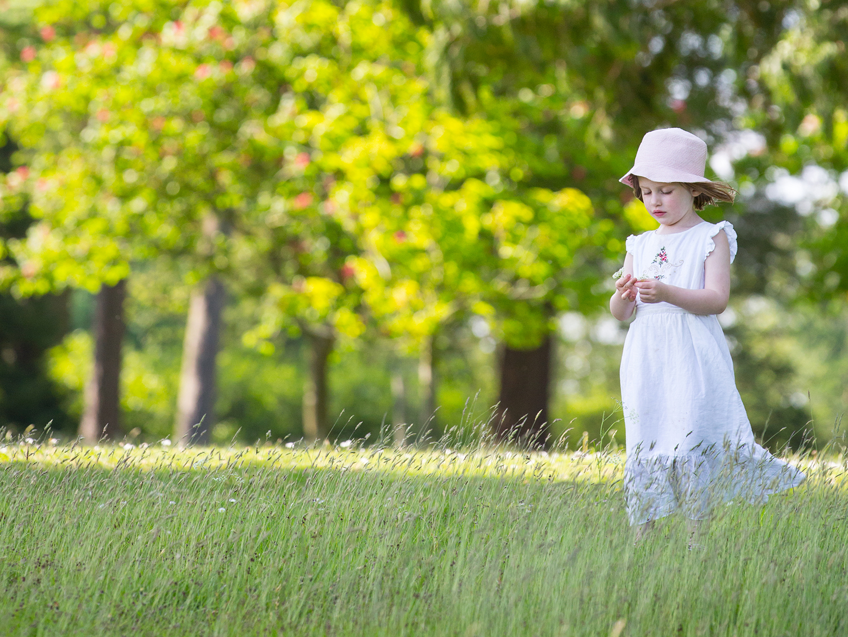
Thank you
for visiting Bowood!

Slide 20
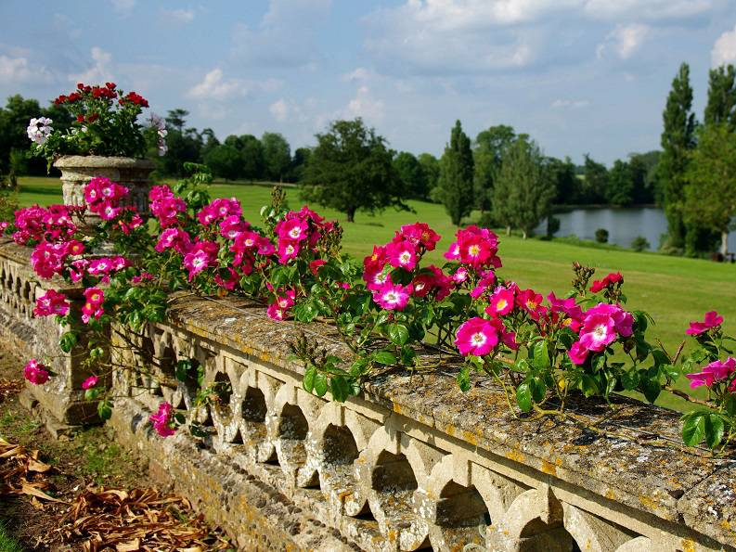
Resources
http://goddees.livejournal.com/43890.html
http://www.bowood.org/bowood-gardens/gardens-and-grounds/
http://www.bbc.co.uk/wiltshire/entertainment/days_out/bowood.shtml
http://www.bowood.org/bowood-house/great-days-wiltshire/
http://www.bowood.org/bowood-gardens/

