Slide 1
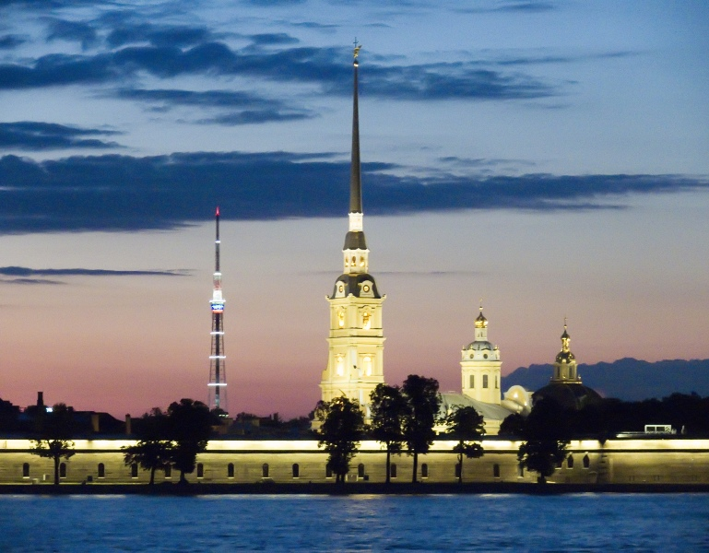
White Nights Festivals
in Saint-Petersburg
Sergei Ivanov, 4M

Slide 2
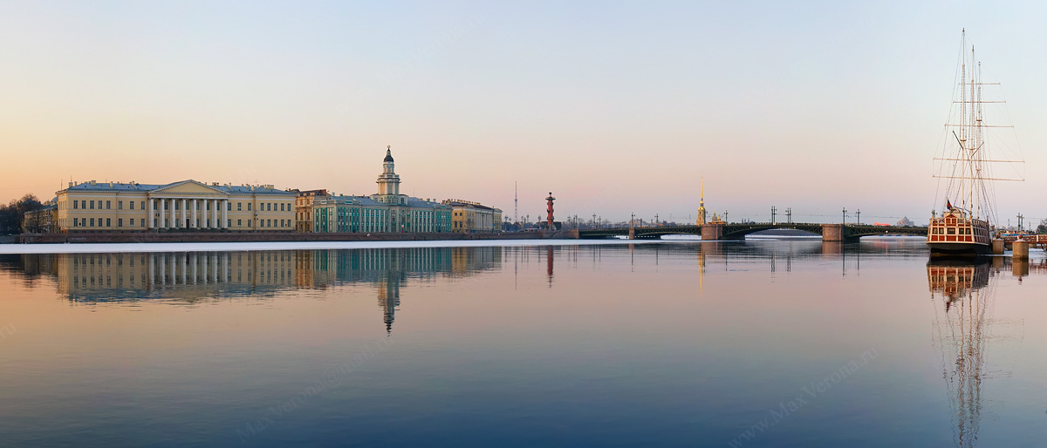
Saint- Petersburg is famous for its legendary white nights.

Slide 3
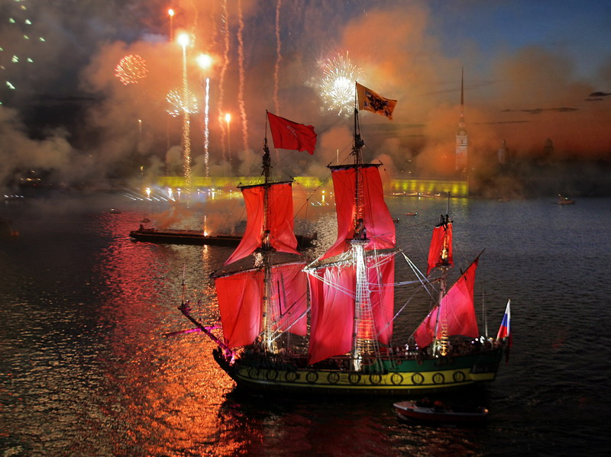
It has also been a tradition for graduates of all kinds
to celebrate their graduation in June.

Slide 4
Different festivals take place at this time.

Slide 5
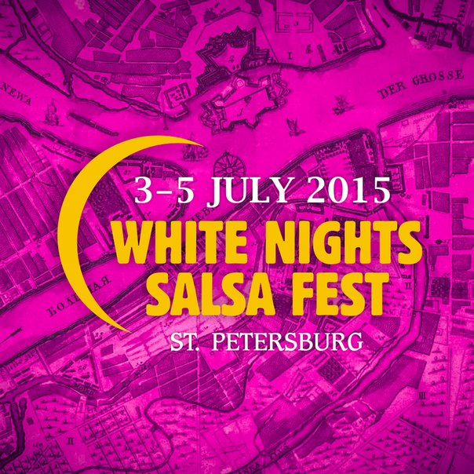

Slide 6
Stars of the White Nights
.

Slide 7
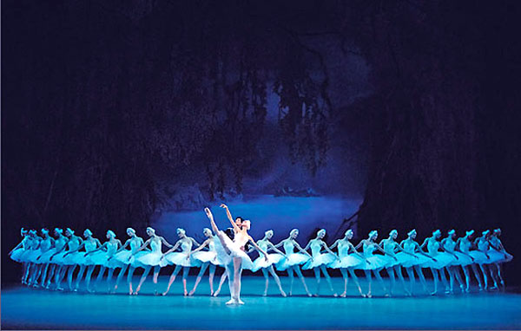
Ballet “ The Swan Lake”

Slide 8
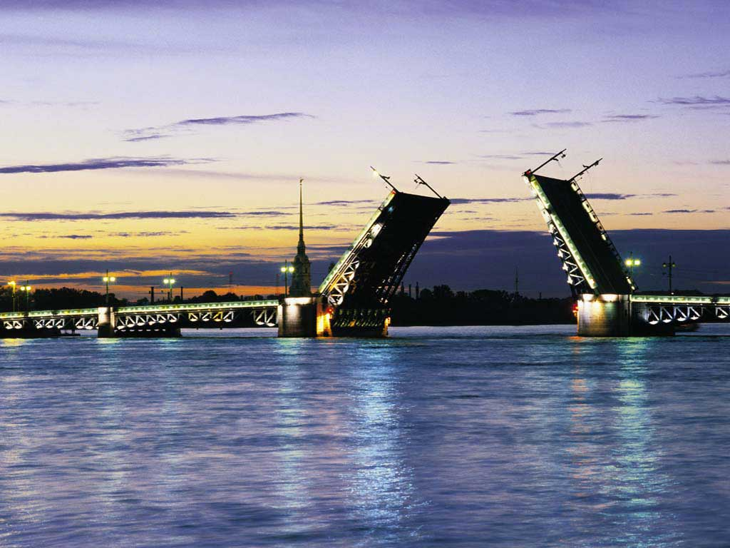
White Nights Festival is the most creative and romantic event
In Saint-Petersburg

Slide 9
Internet Resourses
Wikipedia White Night festivals.

