Slide 1
Alabama
Interactive Quiz
for 8-11 Forms
Автор:
Ольга Михайловна Степанова
учитель английского языка
МБОУ «Цивильская СОШ №2»
города Цивильск
Чувашской Республики
2015

Slide 2
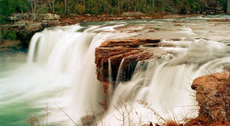
Welcome to Alabama!
How well do you think you know Alabama state? This quiz will help you to know some facts about one of the beautiful states of the USA!

Slide 3
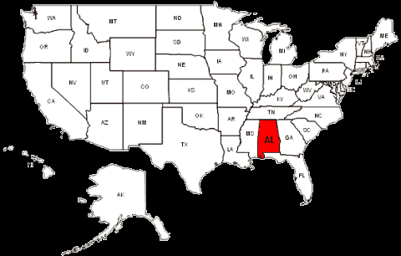
Ready? Steady? Go!

Slide 4
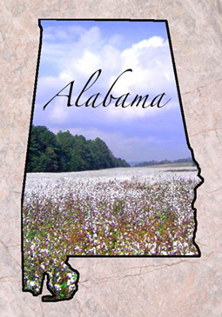
Alabama State Nicknames are Yellowhammer State, Heart of Dixie, … State cotton, linen, silk
Cotton

Slide 5
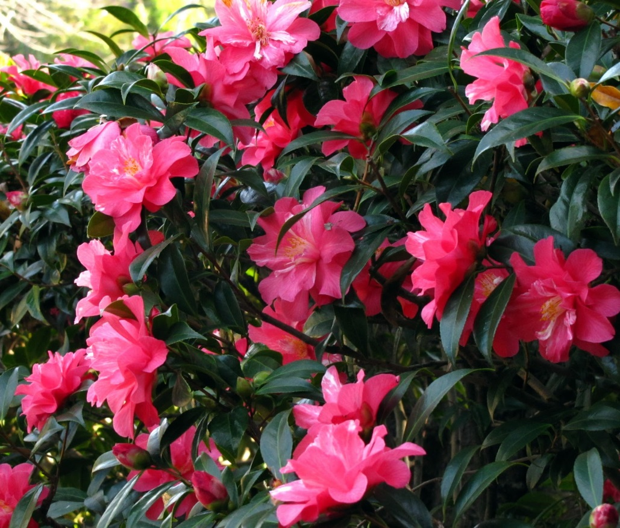
The State Flower is a … . rose, dandelion, camellia
Camellia

Slide 6
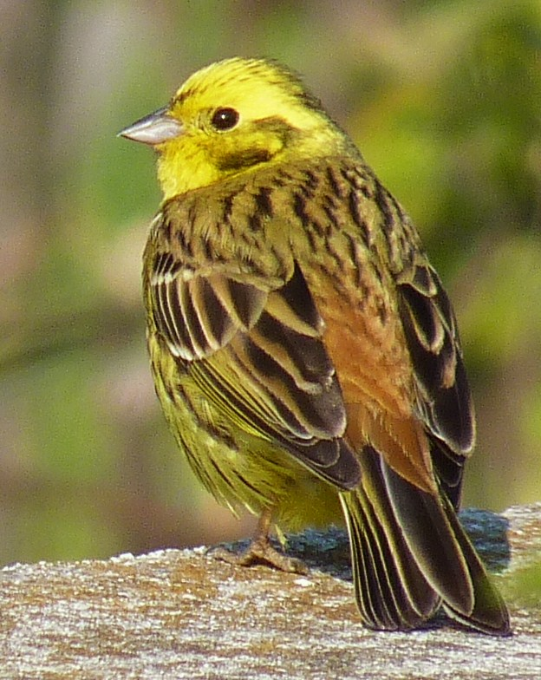
The State Bird is a … . woodpecker, eagle, yellowhammer
Yellowhammer

Slide 7
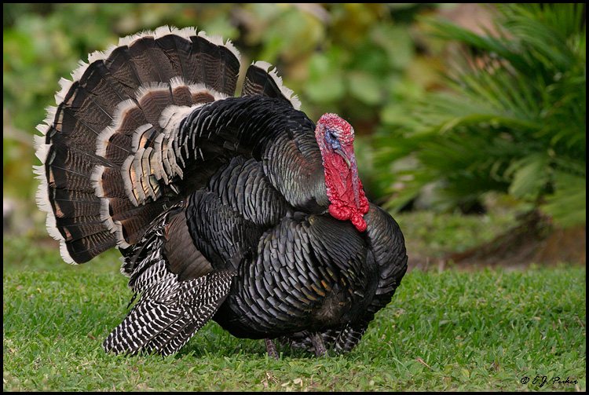
The State Game Bird is a Wild … .
turkey, hen, duck
Turkey

Slide 8
The State Insect is a Monarch … .
ladybird, butterfly, fly
Butterfly

Slide 9
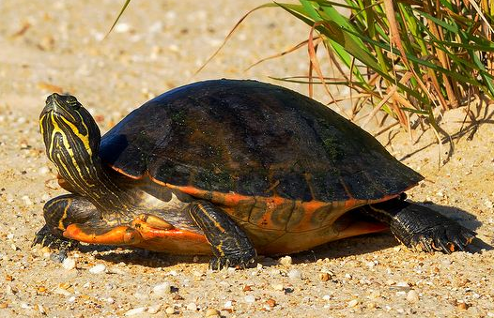
The State Reptile is an Alabama Red-bellied … . lizard, turtle, alligator
Turtle

Slide 10
The State Rock is … . granite, chalk, marble
Marble

Slide 11
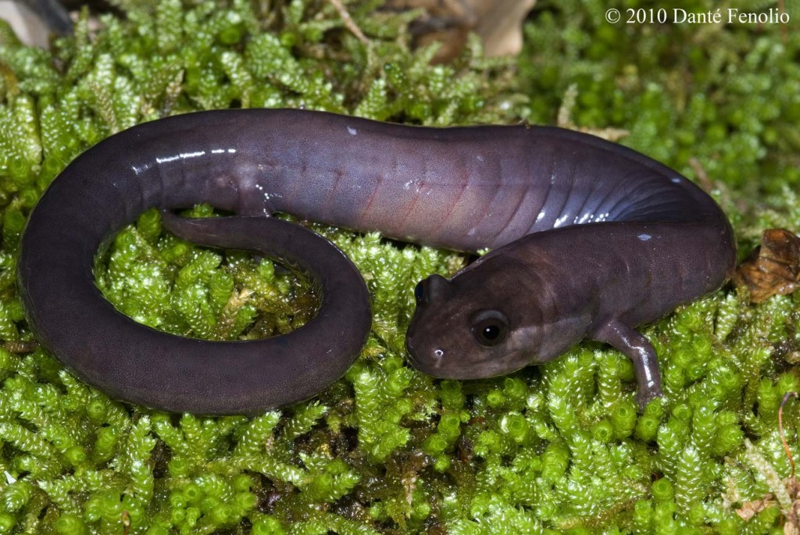
The State Amphibian is a Red Hills … .
newt, salamander, frog
salamander

Slide 12
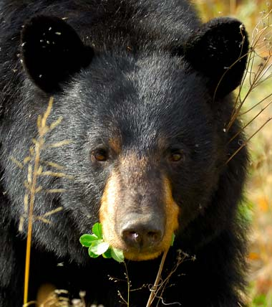
Alabama designated the black … as official state mammal in 1996. puma, jaguar, bear
bear

Slide 13
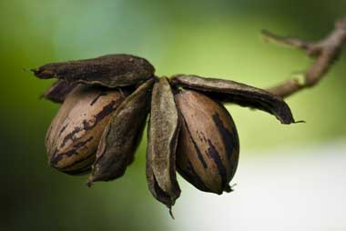
Alabama made the …the state nut in 1982. Astronauts took these nuts to the moon on two Apollo space missions.
acorn, hazel, pecan
pecan

Slide 14
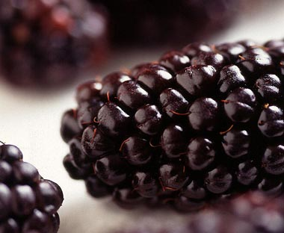
Alabama designated … as the official state fruit symbol in 2004.
gooseberry, blackberry, strawberry
blackberry

Slide 15
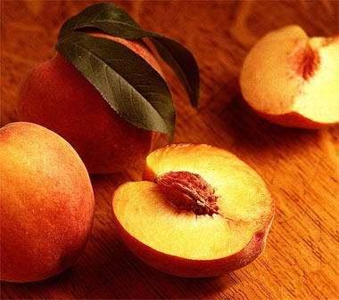
The … was designated the official state tree fruit of Alabama in 2006
peach, pear, apple
peach

Slide 16
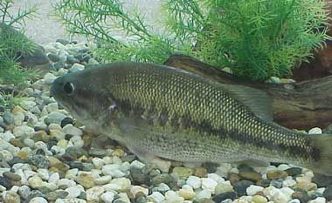
The largemouth … was designated the official state freshwater fish of Alabama in 1975
salmon,
bass,
karp
bass

Slide 17
Great Job!
Alabama Now Welcomes You!

Slide 18
The End

Slide 19
Sources
http://awesomeamerica.com/alabama/
http://www.statesymbolsusa.org/Alabama/State-Symbols-Alabama.html
http://www.infoplease.com/us-states/alabama.html

