Slide 1
Arkansas
Interactive Quiz
for 8-11 Forms
Автор:
Ольга Михайловна Степанова
учитель английского языка
МБОУ «Цивильская СОШ №2»
города Цивильск
Чувашской Республики
2015

Slide 2
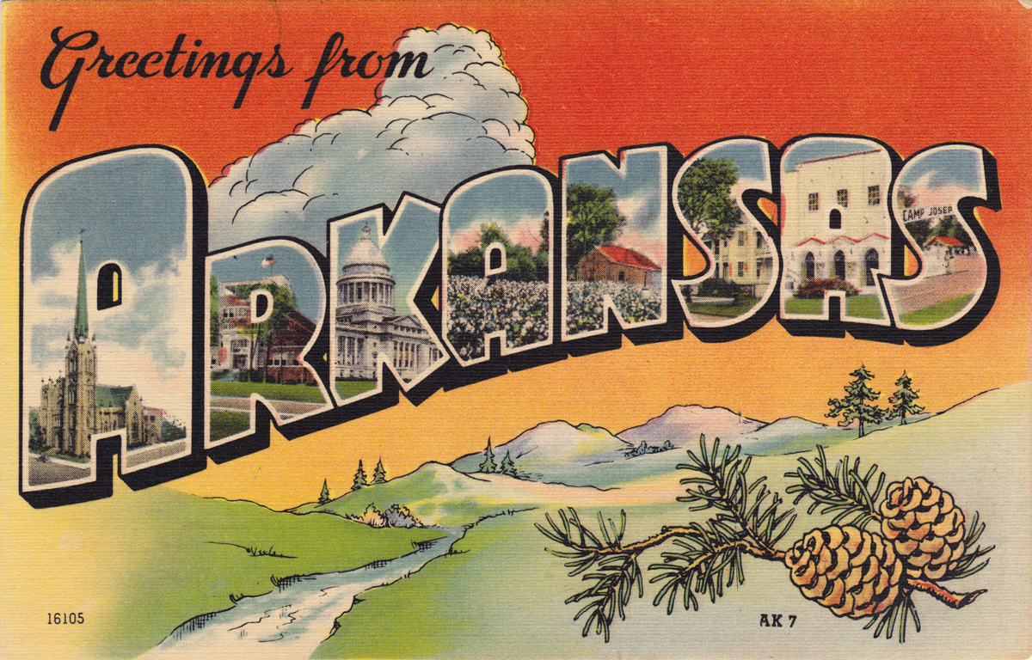
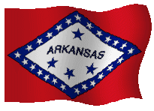
How well do you think you know Arkansas state? This quiz will help you to know some facts about one of the beautiful states of the USA!

Slide 3
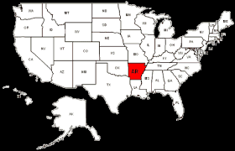
Ready? Steady? Go!

Slide 4
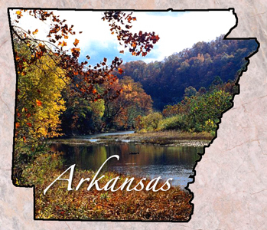
Arkansas is famous for its natural scenic beauty, clear lakes and streams, and abundant wildlife. That is why the nickname for Arkansas is The … State
Natural , Wild,
Beautiful
Natural

Slide 5
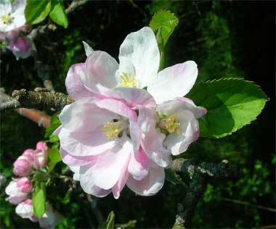
The State Flower is an … .
apple blossom, aster, azalea
Apple blossom

Slide 6
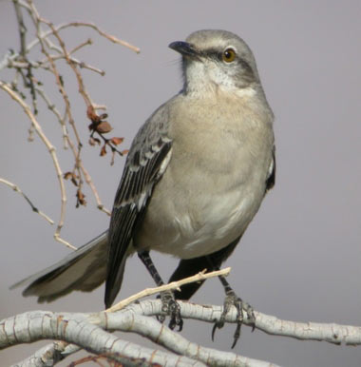
The … was recognized as the official state bird of Arkansas in 1929 and it has extraordinary vocal abilities and can sing up to 200 songs, including the songs of other birds, insect and amphibian sounds
swallow
mockingbird
parrot
mockingbird

Slide 7
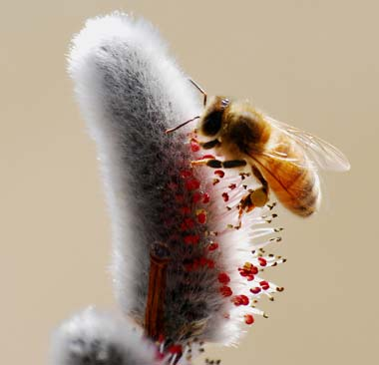
The … was designated the official state insect of Arkansas in 1973. This insect is recognized as an official state symbol in seventeen states, because honeybees play such an important role in agriculture.
ant, wasp, honeybee
honeybee

Slide 8
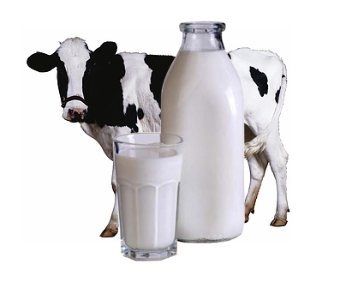
… was recognized as the official state beverage of Arkansas in 1985.
tea, coffee, milk
Milk

Slide 9
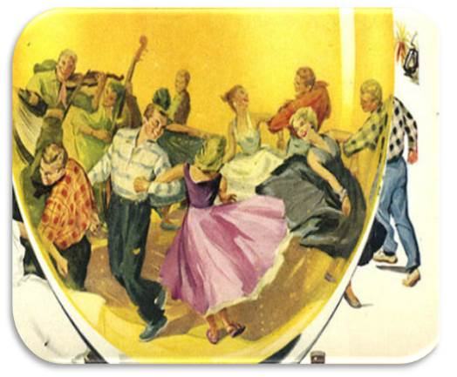
Arkansas designated the … dance as the official state American Folk Dance in 1991.
cha-cha, cancan, square
square

Slide 10
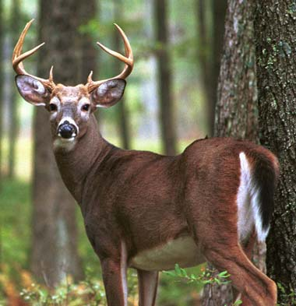
The animal of incredible beauty and power, the official bird of Arkansas that is white-tailed … is able to run up to 40 miles per hour, jump 9 foot fences, and swim 13 miles per hour.
lama, deer, rabbit
deer

Slide 11
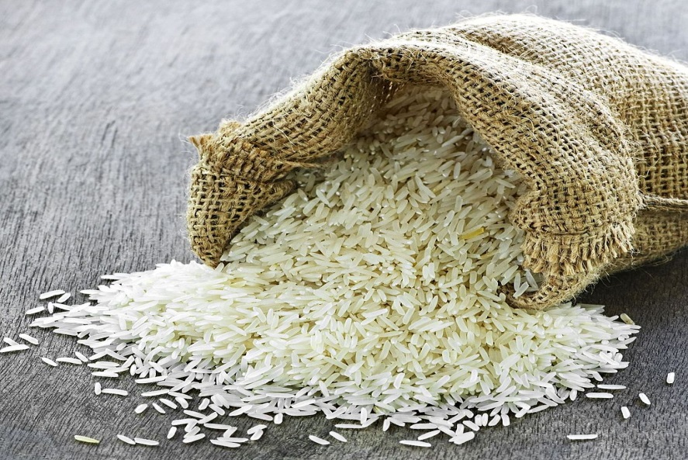
This grain is the leading agricultural crop of the state and it was designated the official state grain of Arkansas. It is fact that Arkansas is called "America's … Capital.“
corn, rye, rice
Rice

Slide 12
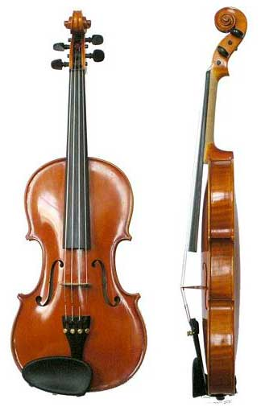
Arkansas designated the … as the official state musical instrument in 1985.
violin, fiddle, guitar
fiddle

Slide 13
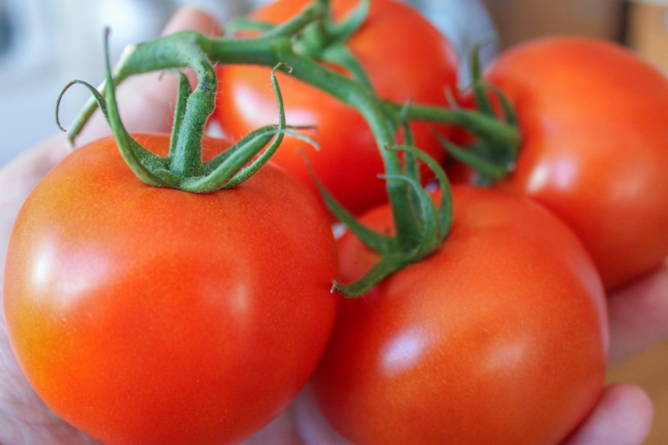
Arkansas designated the South Arkansas Vine Ripe Pink … as the official state fruit and vegetable in 1987.
cherry, apricot, tomato
tomato

Slide 14
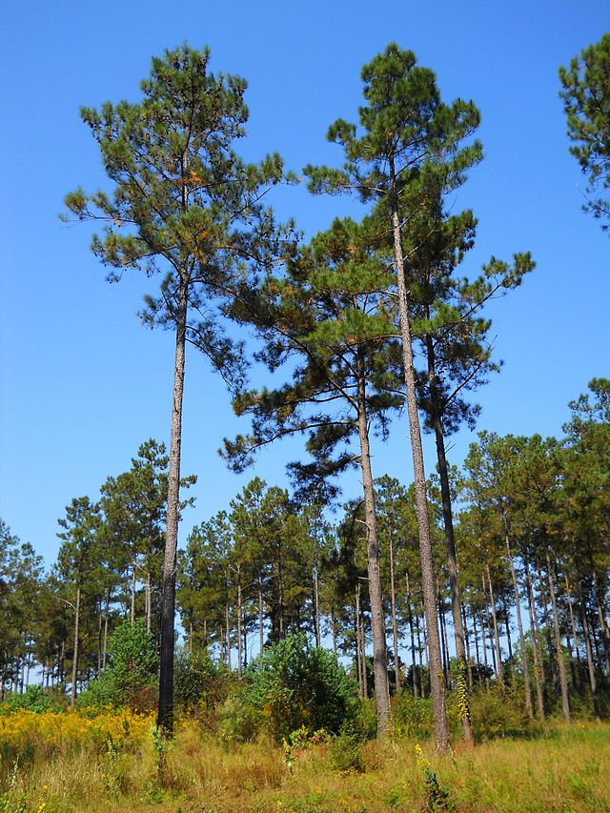
Arkansas designated the … tree as the official state tree in 1939.
fur
oak
pine
pine

Slide 15
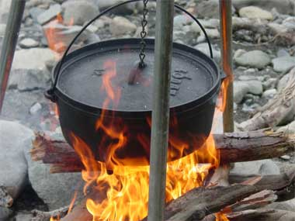
The … was designated the state cooking vessel of Arkansas in 2001.
pot, pan, Dutch oven
The Dutch oven

Slide 16
Great Job!
Arkansas Now Welcomes You!

Slide 17
The End

Slide 18
Sources
http://www.statesymbolsusa.org/Arkansas/Arkansas-State-Symbols.html
http://en.wikipedia.org/wiki/List_of_Arkansas_state_symbols

